Slide 1

  Introduction to AI
Prepared by:
Misganaw Aguate
Msc. In Computer Engineering
Email: ethiomisgie@gmail.com
Website1 : https://www.ethioptec.com
Website2 : https://info.ethioptec.com
Website3 : https://project.ethioptec.com
YouTube: Ethiop computing

Slide 2

Introduction to AI
What is Artificial Intelligence (AI)
composed of two words Artificial (man-made) and Intelligence (thinking power)
Intelligence is an intangible part of our brain which is a combination of Reasoning, learning, problem-solving, perception, language understanding, etc.
AI is the branch of computer science by which we can create intelligent machines which can behave like a human, think like humans, and able to make decisions.
It exists when a machine can have human-based skills such as learning, reasoning, and solving problems.
Intelligence is composed of: Reasoning, Learning, Problem Solving, Perception, Linguistic Intelligence

Slide 3
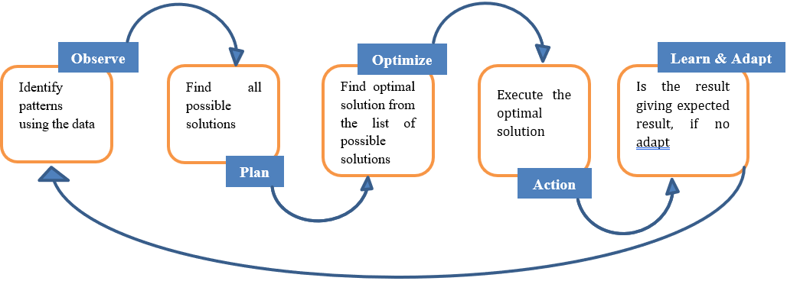
Introduction to AI
We have different sensory organs such as eyes, ears, noses, tongues, and skin to perceive our environment and organs such as hands, legs, and mouths are the effectors that enable us to take action within our environment based on the perception. AI also have these functionalities.

Slide 4
Introduction to AI
AI system is composed of an agent and its environment. An agent (e.g., human or robot) is anything that can perceive its environment through sensors and acts upon that environment through effectors
examples of AI include
autonomous vehicles (such as drones and self-driving cars), medical diagnosis, creating art (such as poetry), proving mathematical theorems, playing games (such as Chess or Go), search engines (such as Google search), online assistants (such as Siri), image recognition in photographs, spam filtering, prediction of judicial decisions and targeting online advertisements

Slide 5
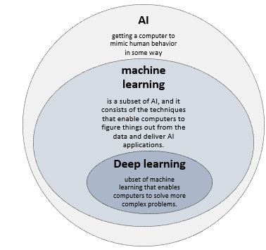
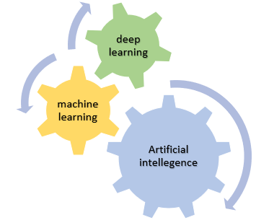
Introduction to AI
Artificial Intelligence (AI), Machine Learning (ML) and Deep Learning (DL)

Slide 6
Introduction to AI
Need for Artificial Intelligence
To create expert systems that exhibit intelligent behavior with the capability to learn, demonstrate, explain and advice its users.
Helping machines find solutions to complex problems like humans do and applying them as algorithms in a computer-friendly manner.

Slide 7
Introduction to AI
Goals of Artificial Intelligence
1. Replicate human intelligence
2. Solve Knowledge-intensive tasks
3. An intelligent connection of perception and action
4. Building a machine which can perform tasks that requires human intelligence such as:
  ✓ Proving a theorem
  ✓ Playing chess
  ✓ Plan some surgical operation
  ✓ Driving a car in traffic
5. Creating some system which can exhibit intelligent behavior, learn new things by itself, demonstrate, explain, and can advise to its user.

Slide 8
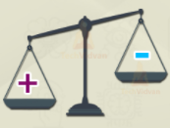
Introduction to AI
Advantages and disadvantages of AI
Advantages
High Accuracy with fewer errors
Doesn’t get tired
High-Speed
High reliability
Reduce human risk
Help in decision making
Useful as a public utility like application in medical industry
Rational decision maker
Dis advantages
  Incurs high cost
  Can't think out of the box
  No feelings and emotions
  Increase dependence on machines
  Leads to un employment
  Lack in creativity

Slide 9
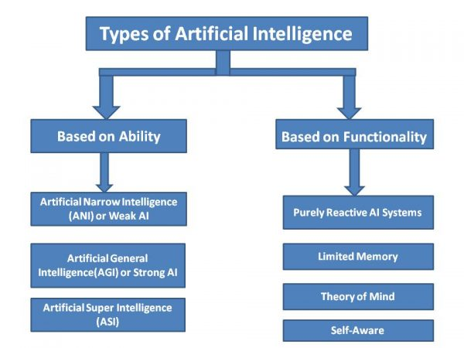
Introduction to AI
Types of AI

Slide 10
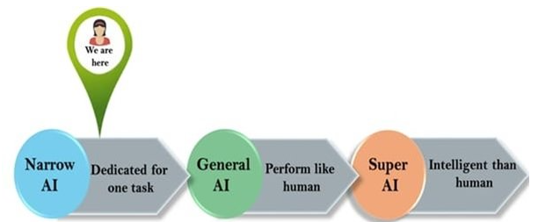
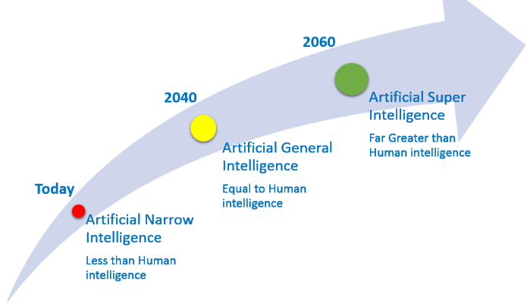
Introduction to AI
Based on ability/capability
But No one technology is intelligent than human
characteristics of strong AI include capability include the ability to think, to reason solve the puzzle, make judgments, plan, learn, and communicate on its own.
Super AI is still a hypothetical concept of Artificial Intelligence

Slide 11
Introduction to AI
Based on the functionality
Reactive Basic types of AI Has no memory i.e. do not store memories or past experiences for future actions Only focus on current scenarios and react on it as per possible best action. | Limited memory Uses memory to learn and improve its responses store past experiences or some data for a short period of time.
Theory of mind Understand the needs of human emotions, people, beliefs, and be able to interact socially like humans. This type of AI machines is still not developed | Self aware Has human like intelligence and self awareness the future of Artificial Intelligence. ➢ These machines will be smarter than the hum

Slide 12
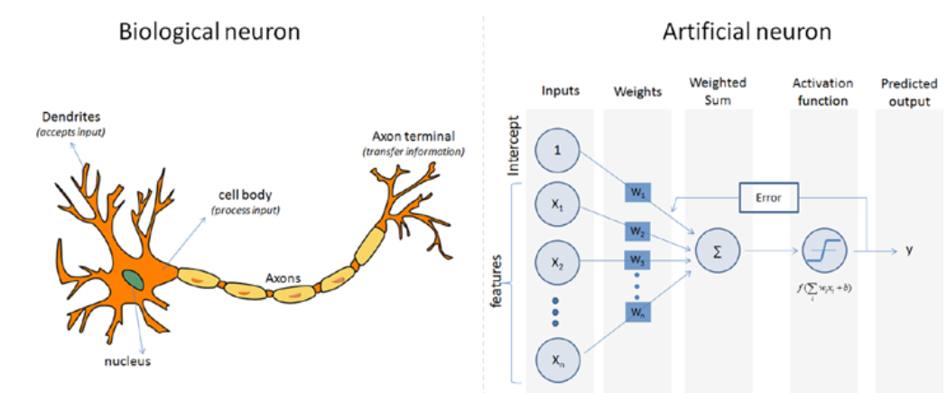
Introduction to AI
Perceptron – Single Artificial Neuron
Inspired by the biological neurons, that is the basic building block of the artificial neural network.
They are not only named after their biological counterparts but also modeled after the behavior of the neurons in our brain.

Slide 13
Introduction to AI
Biological neurons have
dendrites to receive signals
a cell body to process them and
an axon/axon terminal to transfer signals out to other neurons.
Similarly, an artificial neuron has
multiple input channels to accept training samples represented as a vector
a processing stage where the weights(w) are adjusted such that the output error
(actual vs. predicted) is minimized.
Then the result is fed into an activation function to produce output

Slide 14
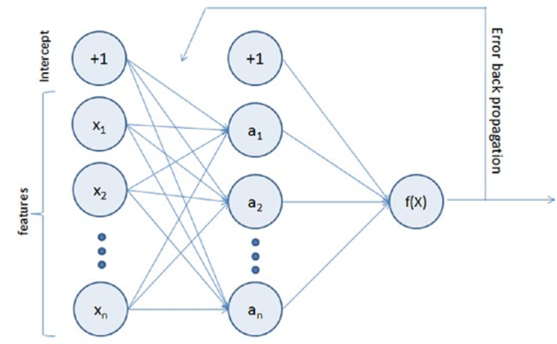
Introduction to AI
Multilayer Perceptron (Feedforward Neural Network)
it is a composition of multiple perceptron connected in different ways and operating on distinctive activation functions to enable improved learning mechanisms.
The training sample propagates forward through the network
The output error is back propagated and the error is minimized using the gradient descent method, which will calculate a loss function for all the weights in the network.

Slide 15

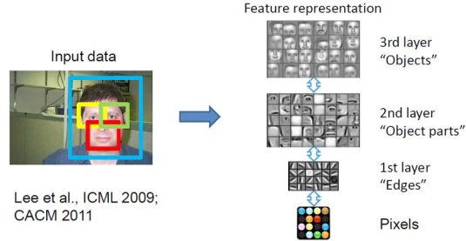
Introduction to AI
An example
A face recognition case using the multi-layered perceptron approach is shown next
Multiple layers take this image as input and finally, a classifier definition is created and stored.

Slide 16
Introduction to AI
How does a human being think?
Intelligence or the cognitive process is composed of three main stages:
➢ Observe and input the information or data in the brain.
➢ Interpret and evaluate the input that is received from the surrounding environment.
➢ Make decisions as a reaction towards what you received as input and interpreted and evaluated.

Slide 17
Introduction to AI
Mapping human thinking to artificial intelligence components
AI is the science of simulating human thinking, it is possible to map the human thinking stages to the layers or components of AI systems.
Steg 1: humans acquire information from their surrounding environments through human senses, such as sight, hearing, smell, taste, and touch, through human organs, such as eyes, ears, and other sensing organs, for example, the hands.
this stage is represented by the sensing layer, which perceives information from the surrounding environment. This information is specific to the AI application.

Slide 18
Introduction to AI
Steg 2: The second stage is related to interpreting and evaluating the input data. In AI, this stage is represented by the interpretation layer, that is, reasoning and thinking about the gathered input that is acquired by the sensing layer.
Steg 3: is related to taking action or making decisions. After evaluating the input data, the interacting layer performs the necessary tasks. Robotic movement control and speech generation are examples of functions that are implemented in the interacting layer

Slide 19
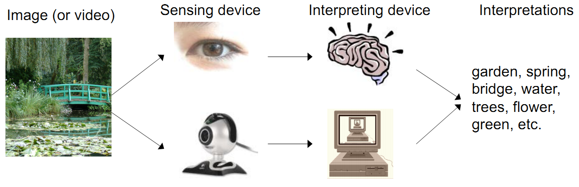
Introduction to AI
Mapping human thinking to artificial intelligence components

Slide 20
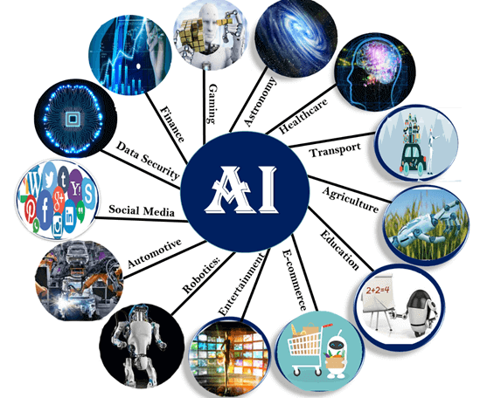
Introduction to AI
Applications of AI

Slide 21
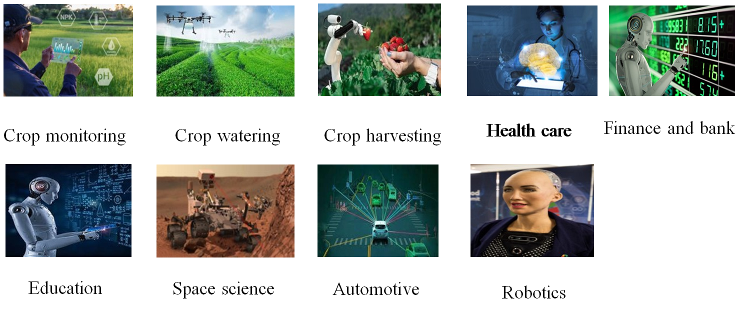
Introduction to AI
Applications of AI

Slide 22
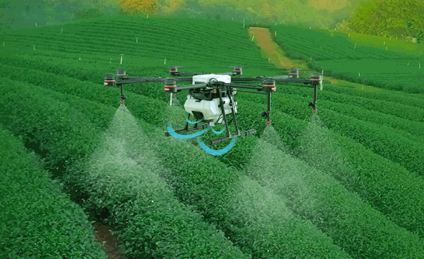
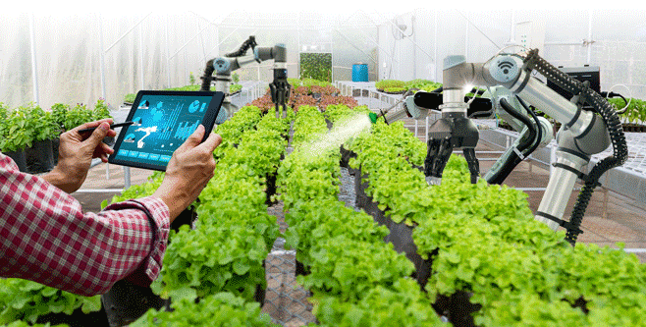
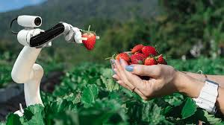
Introduction to AI
Application of AI in Agriculture
Crop watering
Pesticides

Slide 23
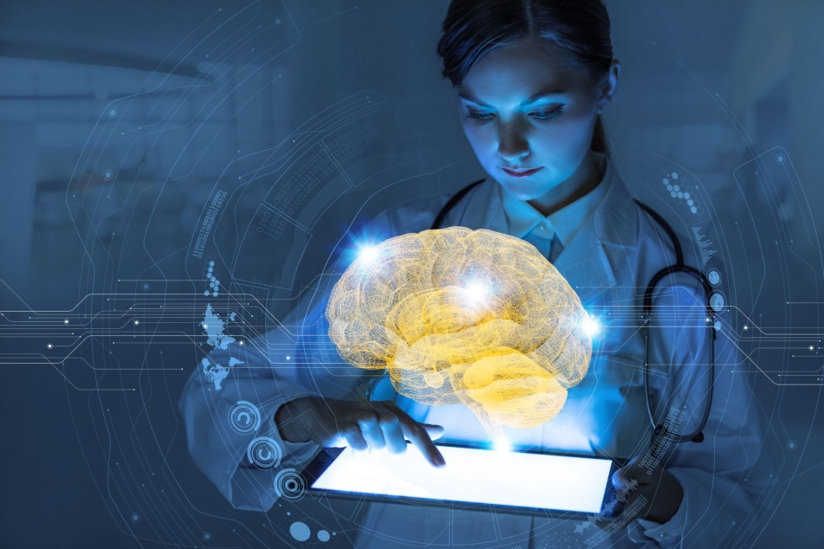
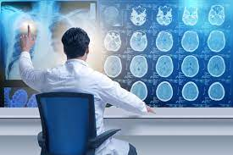
Introduction to AI
AI in Health care
In medical science specially disease diagnostic process related to
internal
parts of the human body such as
Heart case
Diabetes
Blood pressure
Pneumonia
Diseases related to brain,
Hepatitis
Censer, and a lot of diseases can be identified by AI

Slide 24
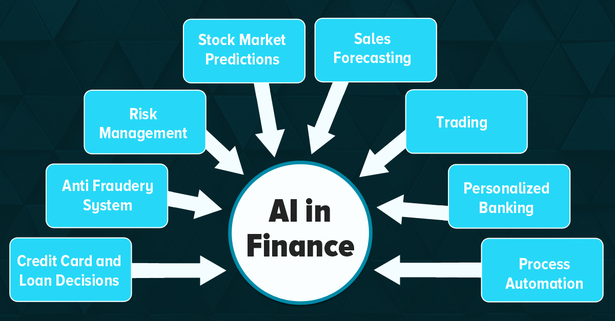
Introduction to AI
AI in Finance and Banking

Slide 25
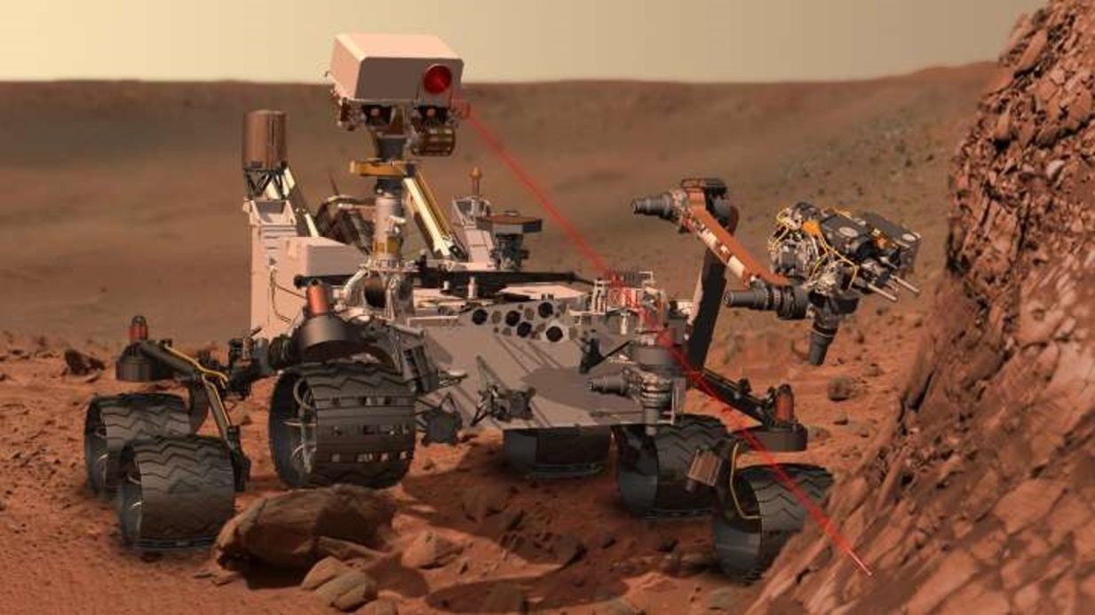
Introduction to AI
AI in Astronomy and Space Science
To identify rock type and minerals present in different planets
To identify different star constellation
Generally to discover what is new present outside of our world

Slide 26
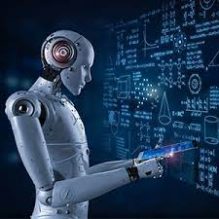
Introduction to AI
AI in Education
Grading System Automation
Adaptation of educational software for students need
Student can get additional tutor from AI robot
It could change the role of teachers
AI can make trial and error learning less intermediating
Data pored by AI change how schools find, teach, and support students

Slide 27
Introduction to AI
AI in Education
Grading System Automation
Adaptation of educational software for students need
Student can get additional tutor from AI robot
It could change the role of teachers
AI can make trial and error learning less intermediating
Data pored by AI change how schools find, teach, and support students

Slide 28
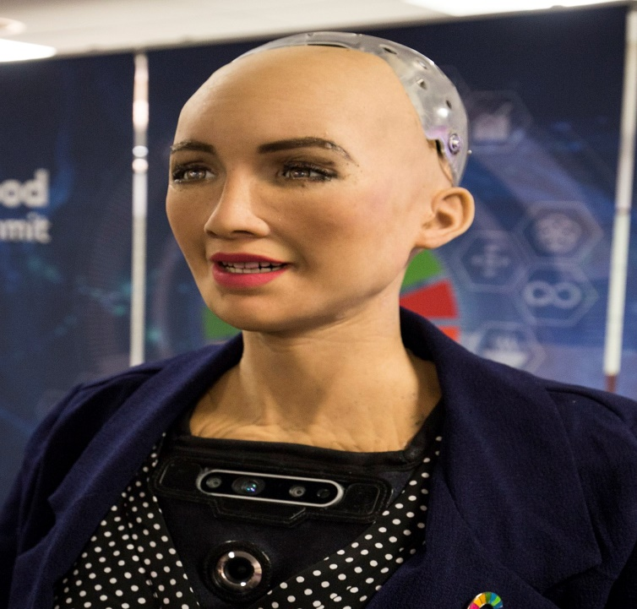
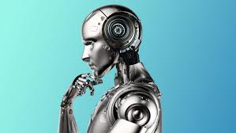
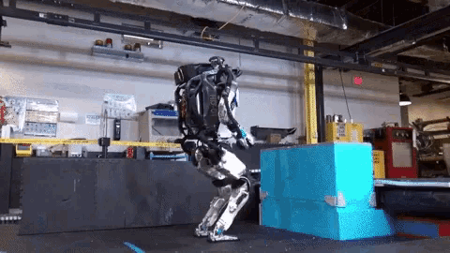
Introduction to AI
AI in Robotics
AI make the robot think deeply hear and feel
AI make the robot to talk and act as human being
AI make the robot think deeply hear and feel

Slide 29
Introduction to AI
Sub fields of AI
✓ Neural Networks – e.g. brain modelling, time series prediction, classification
✓ Evolutionary Computation – e.g. genetic algorithms, genetic programming
✓ Computer Vision – e.g. object recognition, image understanding
✓ Robotics – e.g. intelligent control, autonomous exploration
✓ Expert Systems – e.g. decision support systems, teaching systems
✓ Speech Processing– e.g. speech recognition and production
✓ Natural Language Processing – e.g. machine translation
✓ Planning – e.g. scheduling, game playing
✓ Machine Learning – e.g. decision tree learning, version space learning

Slide 30
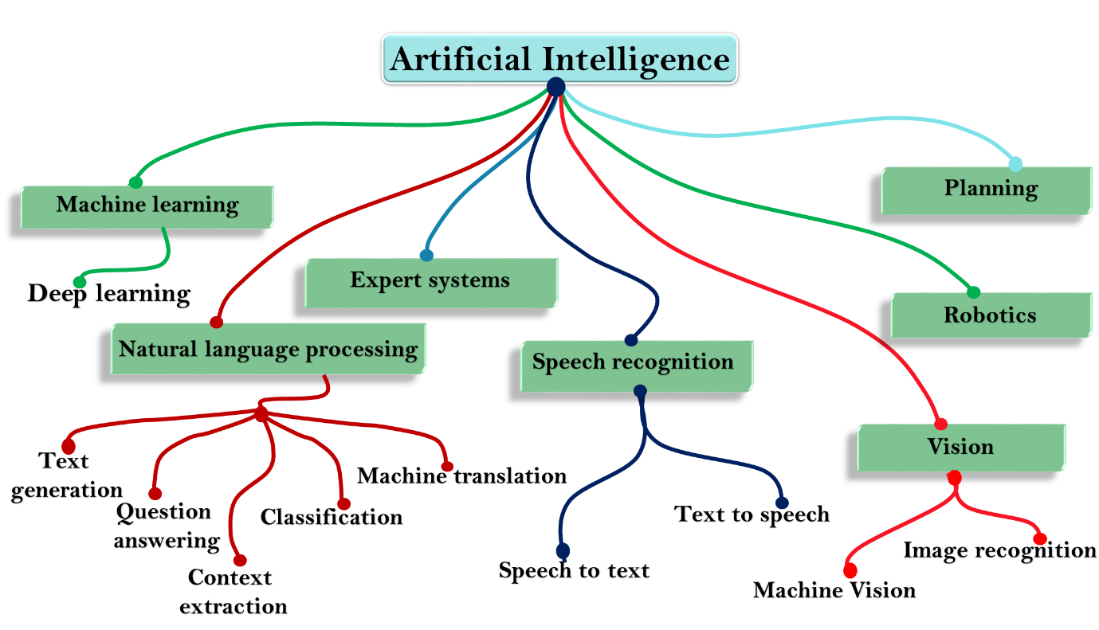
Introduction to AI
Sub fields of AI

Slide 31
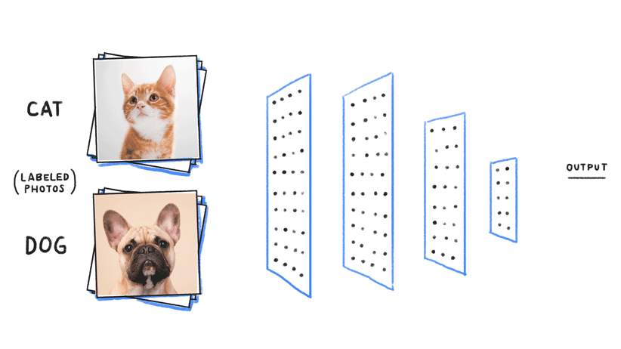
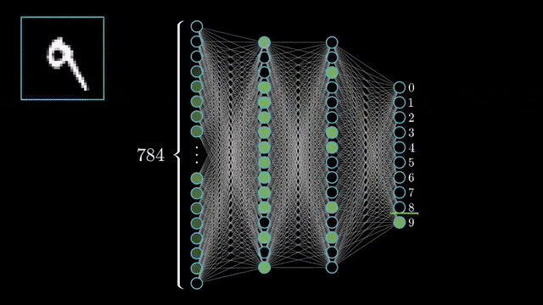
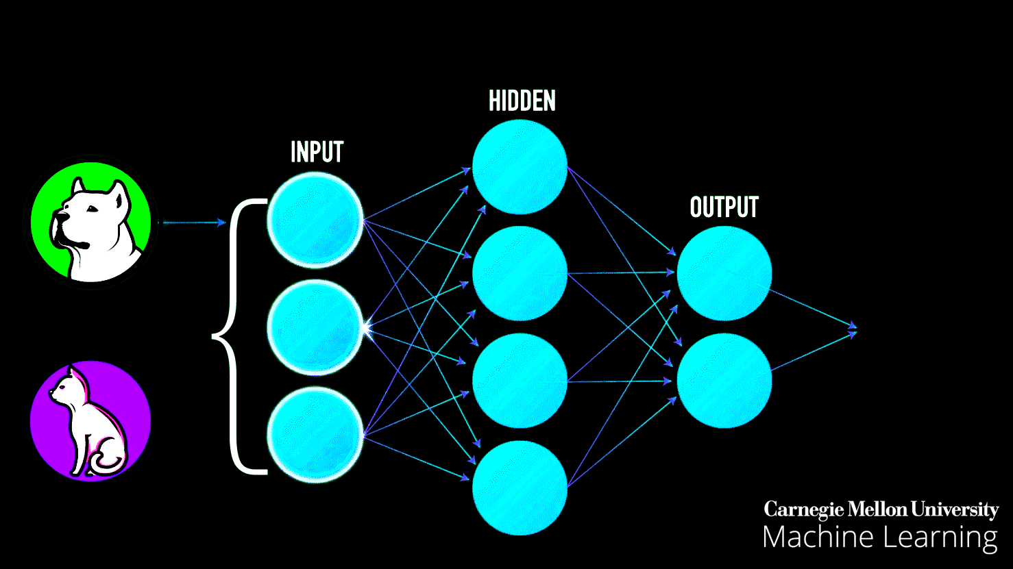
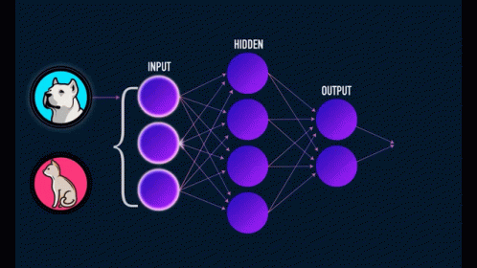
What is Artificial Intelligence (AI)
Machine learning and deep learning Using ANN

Slide 32
  Introduction to Python programming to be covered by Laboratory exercises

Slide 33
Introduction to AI
Write the application of AI in astronomy with its brief explanation and tangible examples. It should be least 3 pages
Write the application of AI in health care with its brief explanation and tangible examples.
Write the application of AI in transportation with its brief explanation and tangible examples. It should be least 3 pages
Write the application of AI in astronomy with its brief explanation and tangible examples. It should be least 3 pages
Write the application of AI in education with its brief explanation and tangible examples. It should be least 3 pages
Write the application of AI in agriculture with its brief explanation and tangible examples. It should be least 3 pages
Write the application of AI in robotics with its brief explanation and tangible examples. It should be least 3 pages
Write the application of AI in automotive with its brief explanation and tangible examples. It should be least 3 pages
Write the application of AI in social media with its brief explanation and tangible examples. It should be least 3 pages
Write the application of AI in space science with its brief explanation and tangible examples. It should be least 3 pages
Write the application of AI in NLP (Natural Language Processing) with its brief explanation and tangible examples. It should be least 3 pages
Write the application of AI in Data security with its brief explanation and tangible examples. It should be least 3 pages

