Slide 1

  Introduction to Machine Learning
Prepared by:
Misganaw Aguate
Msc. In Computer Engineering
Email: ethiomisgie@gmail.com

Slide 2

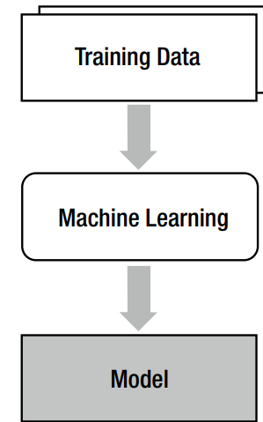
Introduction to Machine Learning
In short, Machine Learning is a modeling technique that involves data.
Machine Learning is a technique that figures out the “model” out of “data.”
Here, the data literally means information such as documents, audio, images, etc.
The “model” is the final product of Machine Learning

Slide 3
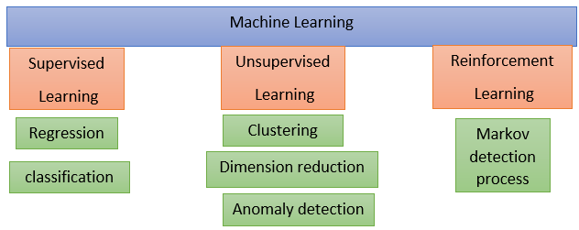
Introduction to Machine Learning

Slide 4
Introduction to Machine Learning
Supervised learning
Supervised learning is very similar to the process in which a human learns things. Consider that humans obtain new knowledge as we solve exercise problems.
Select an exercise problem. Apply current knowledge to solve the problem. Compare the answer with the solution.
If the answer is wrong, modify current knowledge.
Repeat Steps 1 and 2 for all the exercise problems.

Slide 5
Introduction to Machine Learning
When we apply an analogy between this example and the Machine Learning process
the exercise problems and solutions correspond to the training data
the knowledge corresponds to the model.
In supervised learning, each training dataset should consist of input and correct output pairs. The correct output is what the model is supposed to produce for the given input.
{input, correct output }
Stage 1: Feature extraction
Stage 2: Training (model building)
Stage 3: Testing or validation
Stage 4: prediction
Building supervised learning machine learning models has four stages:

Slide 6


Introduction to Machine Learning
How Developer use Supervised Learning?
The image includes tree, house, green-land, cloud, and sky. But this image is tagged (labeled) with only house, tree, and cloud. Because the we needs to classify only with these target labels. Then the supervised model predicts the image as only house, tree, and cloud. It cannot classify as both tree, house, green-land, cloud, and sky because even though green-land and sky are parts of the image features, it is not tagged (labeled) with the image features.

Slide 7
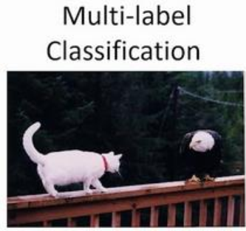
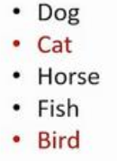
Introduction to Machine Learning
This implies that during supervised learning image features are used only as identity for the target label. That means we can tag (map) the target labels with identity image in multi label classification even though that labels are not present inside the image. The following figure also illustrates Supervised Learning.
You see this image; this is classified as both cat and bird. But there is also trees, wood frame, and electric wire in the image. In supervised learning the machine only understands the tagged (mapped) label with the image feature

Slide 8
Introduction to Machine Learning
The model uses the image features as identity of tagged label. If we label the above image only with trees, wood frame, and electric wire, it classifies as these target label. Even though there is cat and bird feature, the model can not understand this feature because the image is tagged (labeled) only with trees, wood frame, and electric wire.

Slide 9
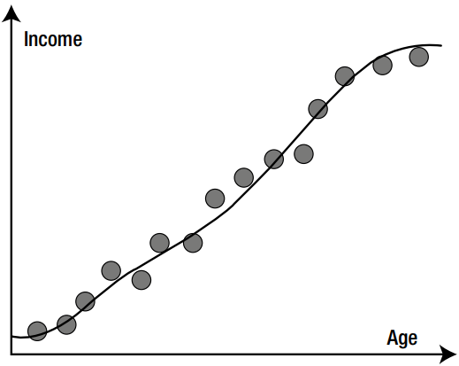
Introduction to Machine Learning
Broadly, there are two types commonly used as supervised learning algorithms. Thus are regression and classification
Regression
The output to be predicted is a continuous number in relevance with a given input dataset.
The regression does not determine the class. Instead, it estimates a value. As an example, if you have datasets of age and income and want to find the model that estimates income by age, it becomes a regression problem.

Slide 10
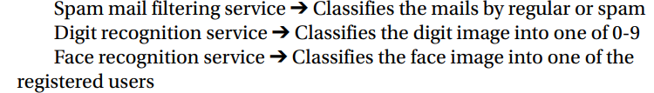
Introduction to Machine Learning
Classification
The classification problem focuses on literally finding the classes to which the data belongs. Some examples may help.
The output to be predicted is the actual or the probability of an event/class and the number of classes to be predicted can be two or more.

Slide 11
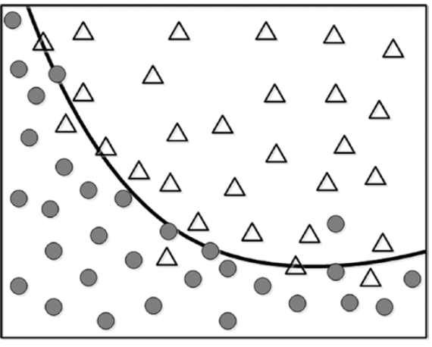
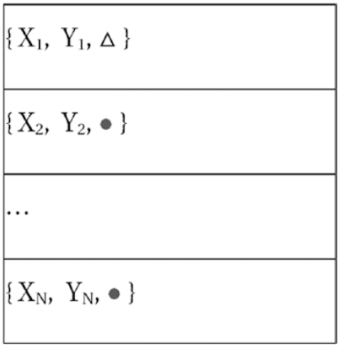
Introduction to Machine Learning
In this case, the training data of N sets of the element will look like Figure

Slide 12
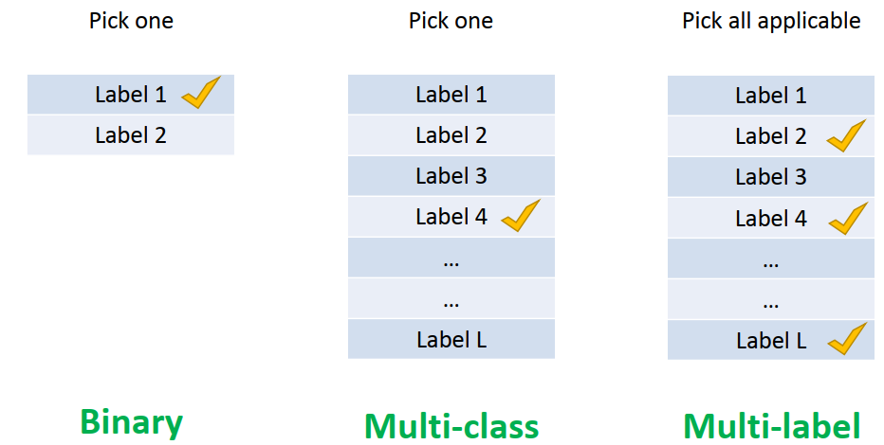
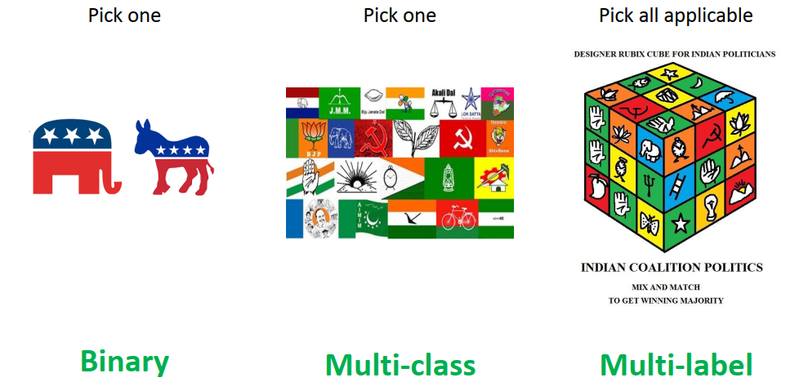
Introduction to Machine Learning
There are three main classes in classification task.

Slide 13
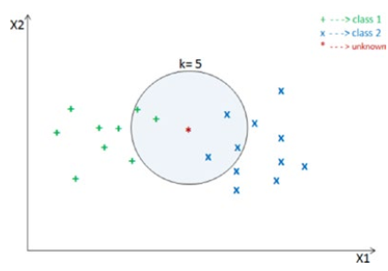
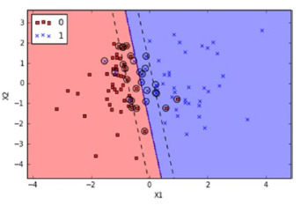
Introduction to Machine Learning
Supervised learning algorisms
Decision tree
Support Vector Machine (SVM)
k Nearest Neighbors (kNN)
k Nearest Neighbors (kNN)
Support Vector Machine (SVM)

Slide 14
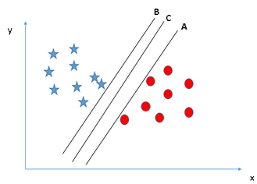
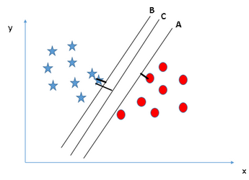
Introduction to Machine Learning
Supervised learning algorisms
Here, maximizing the distances between nearest data point (either class) and hyper-plane will help us to decide the right hyper-plane. This distance is called as Margin. Let’s look at the below snapshot:
Decision tree
Support Vector Machine (SVM)
k Nearest Neighbors (kNN)
Support Vector Machine (SVM)
Above, you can see that the margin for hyper-plane C is high as compared to both A and B. Hence, we name the right hyper-plane as C. Another lightning reason for selecting the hyper-plane with higher margin is robustness. If we select a hyper-plane having low margin then there is high chance of miss-classification.

Slide 15
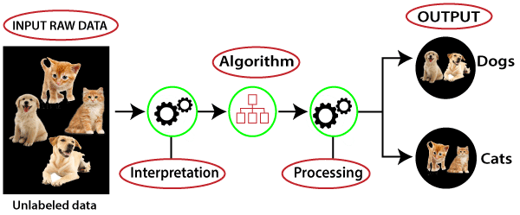
Introduction to Machine Learning
Unsupervised Learning
There are situations where the desired output class/event is unknown for historical data. The objective in such cases would be to study the patterns in the input dataset to get better understanding and identify similar patterns that can be grouped into specific classes or events
This concept is similar to a student who just sorts out the problems by construction and attribute and doesn’t learn how to solve them because there are no known correct outputs.

Slide 16
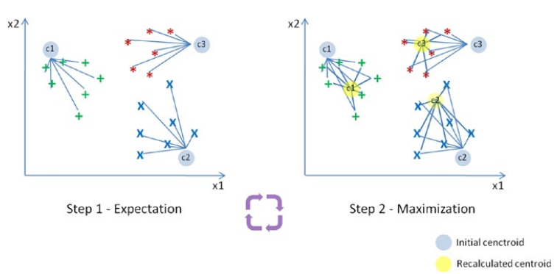
Introduction to Machine Learning
The basic type of unsupervised learning is:
Clustering
Dimension reduction
Anomaly detection
Clustering
The goal here is to divide the input dataset into logical groups of related items. Some examples are grouping similar news articles, grouping similar customers based on their profile, etc. the popular algorithm for clustering is K-means. Suppose we have ‘n’ data points that we need to cluster into k (c1, c2, c3) groups.

Slide 17
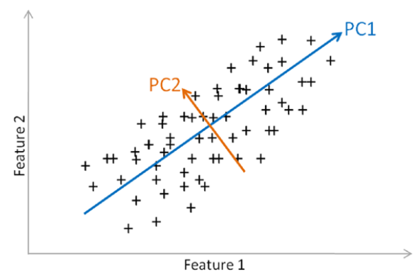
Introduction to Machine Learning
Dimension Reduction
Here the goal is to simplify a large input dataset by mapping them to a lower dimensional space. For example, carrying analysis on a large dimension dataset is very computationally intensive, so to simplify you may want to find the key variables that hold a significant percentage (say 95%) of information and only use them for analysis.
The common algorithm for dimension reduction technique is Principal Component Analysis (PCA)

Slide 18
Introduction to Machine Learning
Anomaly Detection
It is also commonly known as outlier detection
It is the identification of items, events or observations which do not conform to an expected pattern or behavior in comparison with other items in a given dataset. It has applicability in a variety of domains, such as machine or system health monitoring, event detection, fraud/intrusion detection etc. In the recent days, anomaly detection has seen a big area of interest in the word of Internet of Things (IoT) to enable detection of abnormal behavior in a given context.

Slide 19
Introduction to Machine Learning
Reinforcement training
The combustion of supervised and unsupervised learning
Data Analysis packages
There are four key packages that are most widely used for data analysis.
NumPy
Matplotlib
Pandas

Slide 20
Introduction to Machine Learning
NumPy
NumPy is the core library for scientific computing in Python. It provides a high-performance multidimensional array object, and tools for working with these arrays.
A NumPy array is a collection of similar data type values, and is indexed by a tuple of nonnegative numbers. The rank of the array is the number of dimensions, and the shape of an array is a tuple of numbers giving the size of the array along each dimension.

Slide 21
Introduction to Machine Learning
Pandas
Pandas are an open-source Python package providing fast, flexible, and expressive data structures designed to make working with “relational” or “labeled” data both easy and intuitive.
Data Structures Pandas introduces two new data structures to Python – Series and Data Frame, both of which are built on top of NumPy.
Series
This is a one-dimensional object similar to column in a spreadsheet or SQL table. By default each item will be assigned an index label from 0 to N.

Slide 22
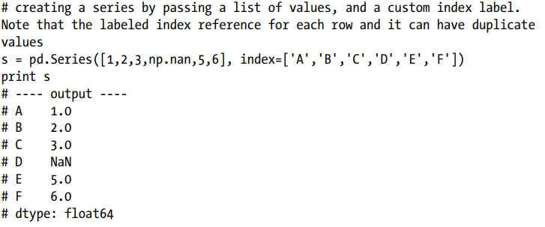
Introduction to Machine Learning
Data Frame
It is a two-dimensional object similar to a spreadsheet or an SQL table. This is the most commonly used pandas object.

Slide 23
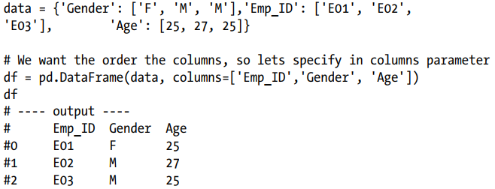
Introduction to Machine Learning
Basic Statistics Summary
Pandas has some built-in functions to help us to get better understanding of data using basic statistical summary methods.
describe ()- will returns the quick stats such as count, mean, std (standard deviation), min, first quartile, median, third quartile, max on each column of the data frame

Slide 24
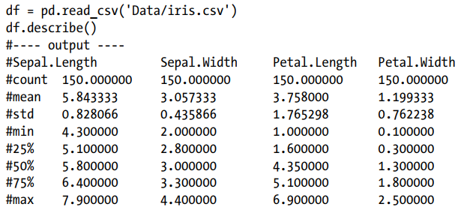
Introduction to Machine Learning

Slide 25
Introduction to Machine Learning
Matplotlib
Matplotlib is a numerical mathematics extension NumPy and a great package to view or present data in a pictorial or graphical format. It enables analysts and decision makers to see analytics presented visually, so they can grasp difficult concepts or identify new patterns.
Using Global Functions
Let’s look at some of the most commonly used charts.
plt.bar – creates a bar chart
plt.scatter – makes a scatter plot
plt.boxplot – makes a box and whisker plot
plt.hist – makes a histogram
plt.plot – creates a line plot

Slide 26
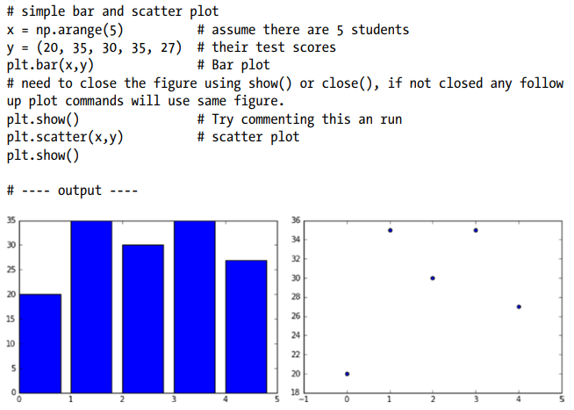
Introduction to Machine Learning

Slide 27
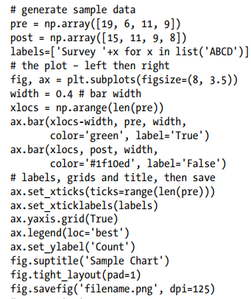
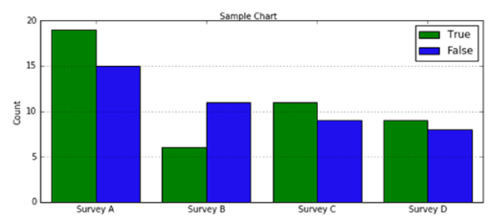
Introduction to Machine Learning

Slide 28
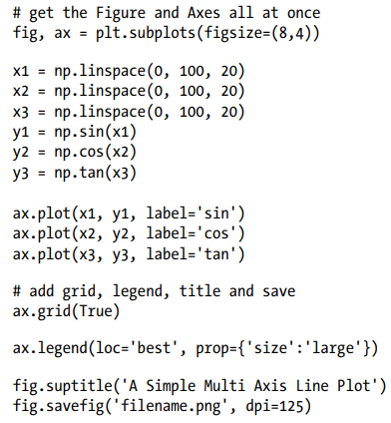
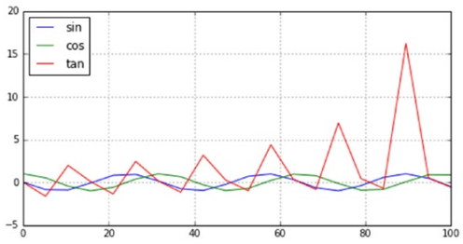
Introduction to Machine Learning

