Slide 1

Introduction to Deep Learning
Prepared by:
Misganaw Aguate
Msc. In Computer Engineering
Email: ethiomisgie@gmail.com

Slide 2

Introduction to Deep Learning
What we can do with deep learning
The three primary research areas of Deep Learning are usually said to be
Image recognition
Speech recognition, and
Natural language processing.
Deep Learning is a result of many small technical improvements of machine learning.
The reason that the neural network with deeper layers yielded poorer performance was that the network was not properly trained.

Slide 3
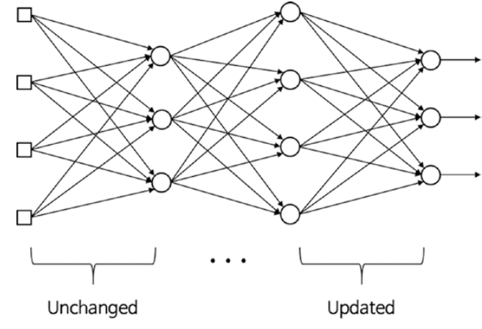
Introduction to Deep Learning
The backpropagation algorithm solves the following three primary difficulties in the training process of the deep neural network (machine learning):
Vanishing gradient
Overfitting
Computational load
The representative solution to the vanishing gradient is the use of the Rectified Linear Unit (ReLU) function as the activation function.
The vanishing gradient in the training process occurs when the output error is more likely to fail to reach the farther nodes.

Slide 4
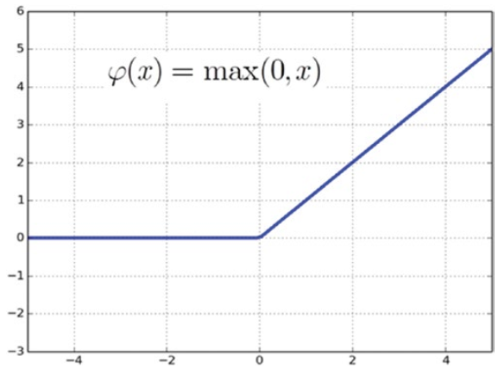
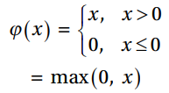
Introduction to Deep Learning
The ReLU function is defined as follows:
Overfitting The reason that the deep neural network is especially vulnerable to overfitting is that the model becomes more complicated as it includes more hidden layers, and hence more weight.
The most representative solution is the dropout, which trains only some of the randomly selected nodes rather than the entire network.
Using dropout Some nodes are randomly selected at a certain percentage and their outputs are set to be zero to deactivate the nodes.

Slide 5
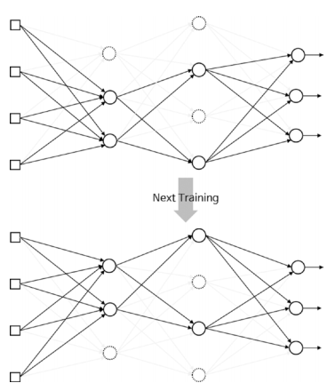
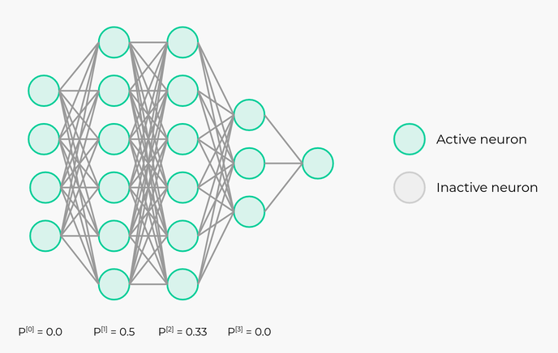
Introduction to Deep Learning
The dropout effectively prevents overfitting as it continuously alters the nodes and weights in the training process.
The adequate percentages of the dropout are approximately 50% and 25% for hidden and input layers, respectively.

Slide 6
Introduction to Deep Learning
Computational Load
The last challenge is the time required to complete the training. The number of weights increases geometrically with the number of hidden layers, thus requiring more training data. This ultimately requires more calculations to be made. The more computations the neural network performs, the longer the training takes. This problem is a serious concern in the practical development of the neural network. If a deep neural network requires a month to train, it can only be modified 20 times a year.
This trouble has been relieved to a considerable extent by the introduction of high-performance hardware, such as GPU, and algorithms, such as batch normalization.

Slide 7
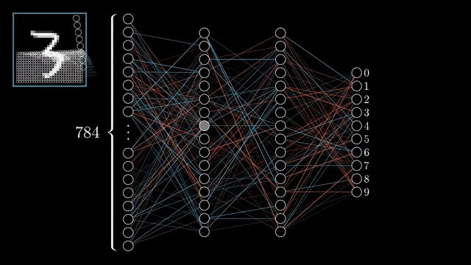
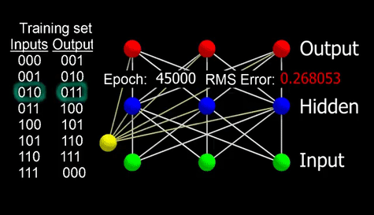
Introduction to Deep Learning
Backpropagation
The only algorithm to optimize the error and adjust the wight of each neuron in each hidden layer is called back propagation.

Slide 8
Introduction to Deep Learning
Basic Python Library for Deep learning
Sckit-Learn
TensorFlow
Keras
Panadas
PyTorch
OpenCV

Slide 9
Introduction to Deep Learning
Why use the backpropagation algorithm?
Neural Network is trained using 2 passes:
forward and
backward.
At the end of the forward pass, the network error is calculated, and should be as small as possible.
If the current error is high, the network didn’t learn properly from the data. It means the current set of weights isn’t accurate enough to reduce the network error and make accurate predictions. As a result, we should update network weights to reduce the network error.
The backpropagation algorithm is one of the algorithms responsible for updating network weights with the objective of reducing the network error.

Slide 10
Introduction to Deep Learning
Convolutional Neural Network (CNN)
Convolution network architecture comprises a fixed set of layers designated for specialized functions. The most critical layers are as follows
Convolutional layer (CONV)
Pooling layer (POOL)
Full-connected (FC) layer

Slide 11
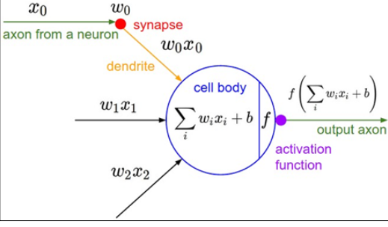
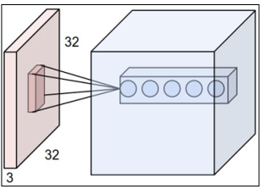
Introduction to Deep Learning
Convolutional layer (CONV)
This layer is responsible for holding the neurons in a three-dimensional format and is therefore responsible for a three-dimensional output. The left side figure is an example of an input volume with the dimensions 32 x 32 x 3. As shown, each neuron is connected to a particular input region. Along the depth, there can be many neurons; we can see five neurons in the example.

Slide 12
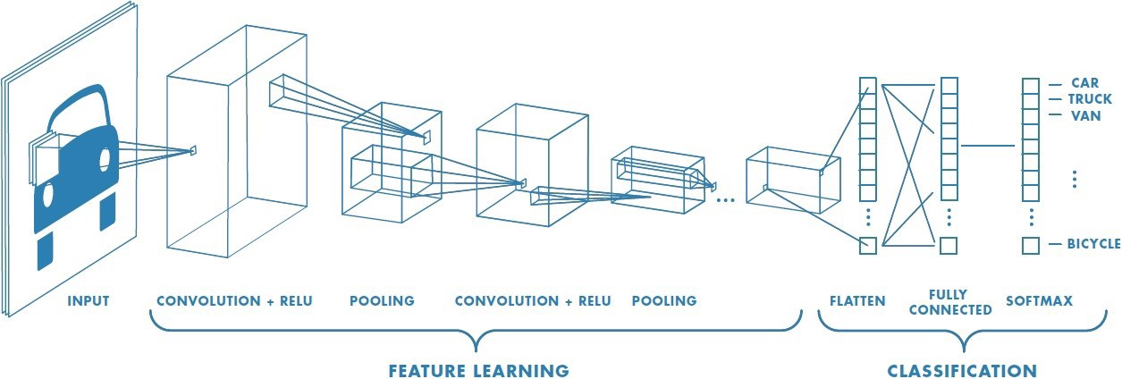
Introduction to Deep Learning
Convolutional layer (CONV)
CNN basically has two main parts such as feature extraction (learning) layer and Classification layer as follows

Slide 13
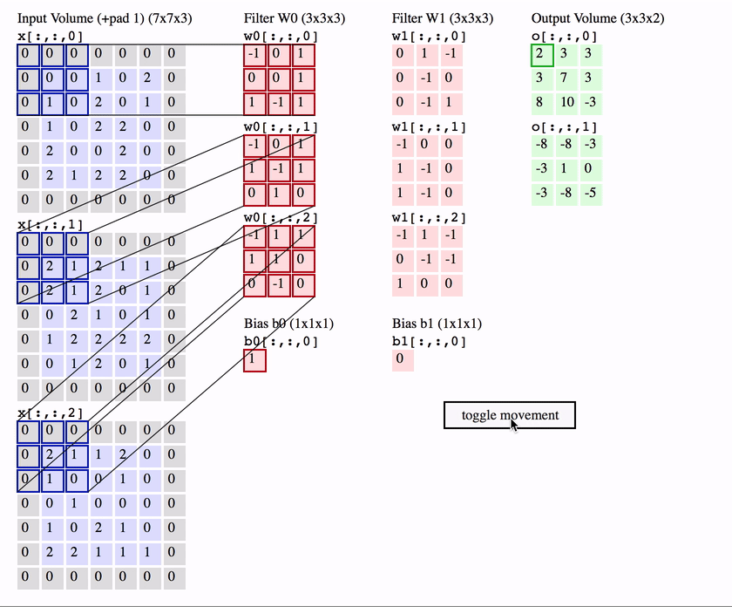
Introduction to Deep Learning
Convolution
The term convolution refers to the mathematical combination of two functions to produce a third function. It merges two sets of information. In the case of a CNN, the convolution is performed on the input data with the use of a filter or kernel (these terms are used interchangeably) to then produce a feature map.

Slide 14
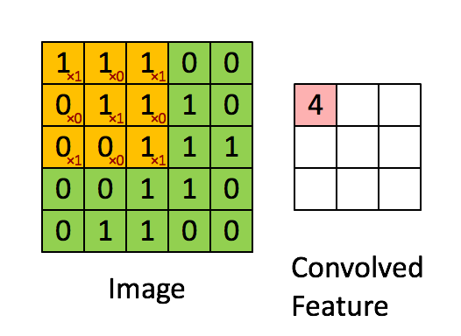
Introduction to Deep Learning
Convolution
The term convolution refers to the mathematical combination of two functions to produce a third function. It merges two sets of information. In the case of a CNN, the convolution is performed on the input data with the use of a filter or kernel (these terms are used interchangeably) to then produce a feature map.

Slide 15
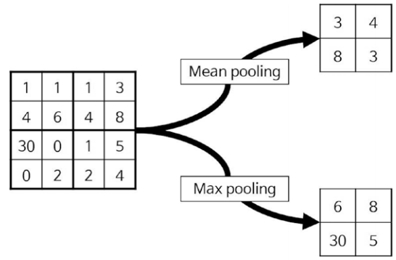
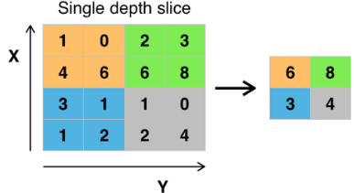
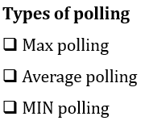
Introduction to Deep Learning
Pooling layer (POOL)
The pooling layer is responsible for reducing the chances of over-fitting by reducing the spatial size of the input volume. The reduction of the spatial size implies reducing the number of parameters or the amount of computations in the network.

Slide 16
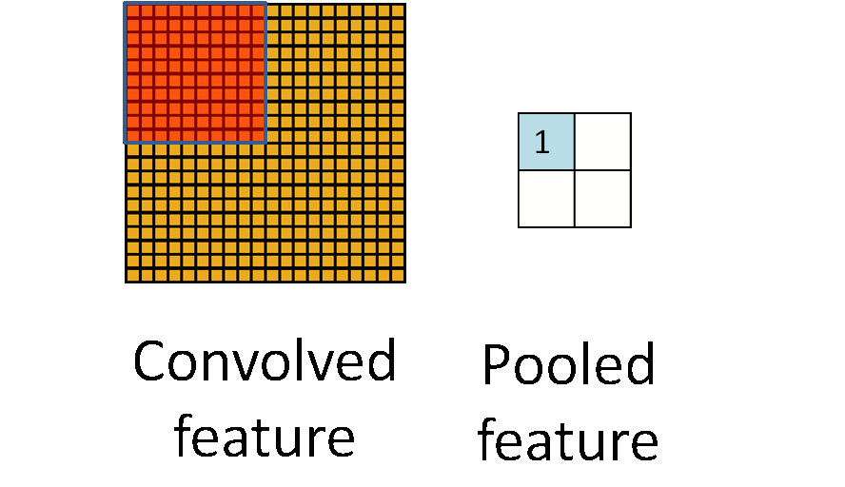
Introduction to Deep Learning

Slide 17
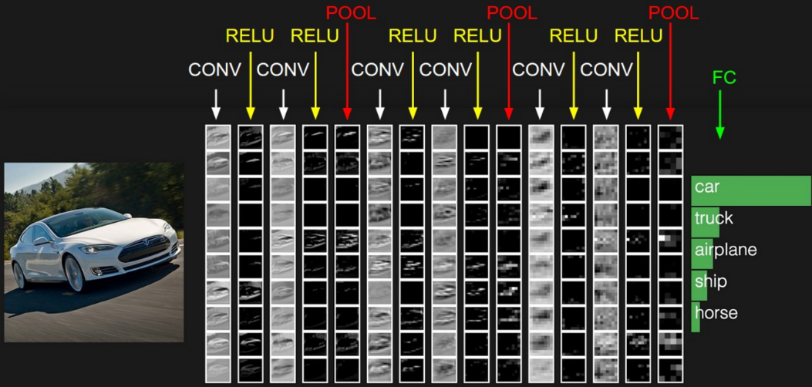
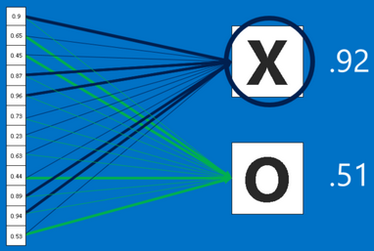
Introduction to Deep Learning
Fully connected layer
The fully connected layer will compute the class score, and the resulted dimension will be a single vector 1x1x10 (if there is 10 class scores). This layer is a regular neural network layer that takes input from the previous layer and computes the class scores and outputs the 1-D array of size equal to the number of classes.

Slide 18
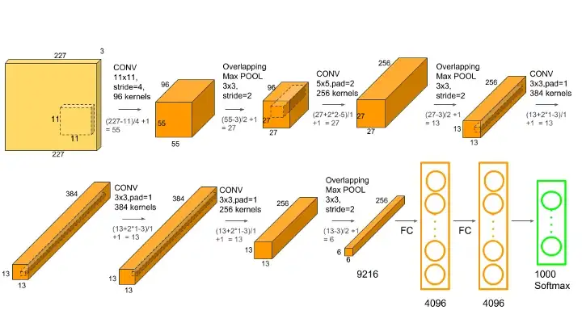
Introduction to Deep Learning
CNN Parameter Calculation

Slide 19
Introduction to Deep Learning
Parameters in general are weights that are learnt during training. They are weight matrices that contribute to model’s predictive power, changed during back-propagation process.
The first input layer has no parameters. You know why.
Parameters in the second CONV1(filter shape =5*5, stride=1) layer is: ((width of filter*height of filter*number of filters in the previous layer+1)*number of filters) = (((5*5*3)+1)*8) = 608.
The third POOL1 layer has no parameters. You know why.
Parameters in the fourth CONV2(filter shape =5*5, stride=1) layer is: ((width of filter * height of filter * number of filters in the previous layer+1) * number of filters) = (((5*5*8)+1)*16) = 3216.
The fifth POOL2 layer has no parameters. You know why.
Parameters in the Sixth FC3 layer is((current layer c*previous layer p)+1*c) = 120*400+1*120= 48120.
Parameters in the Seventh FC4 layer is: ((current layer c*previous layer p)+1*c) = 84*120+1* 84 = 10164.
The Eighth Softmax layer has ((current layer c*previous layer p)+1*c) parameters = 10*84+1*10 = 850.

Slide 20
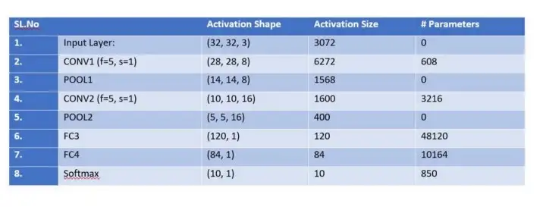
Introduction to Deep Learning

Slide 21
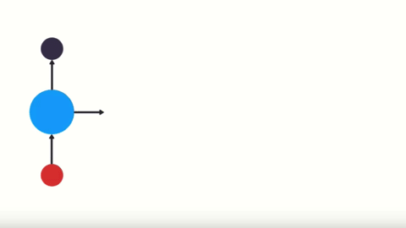
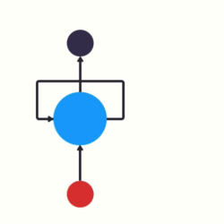
Introduction to Deep Learning
Recurrent Neural Network
An RNN has a looping mechanism that acts as a highway to allow information to flow from one step to the next.
RNN’s are good at processing sequence data for predictions. But how??

Slide 22
Introduction to Deep Learning
Well, they do that by having a concept we may call sequential memory. To get a good intuition behind what sequential memory means…
You may take alphabet in your mind.
That was pretty easy right. If you were taught this specific sequence, it should come quickly to you. Now try saying the alphabet backward.
this is much harder. Unless you’ve practiced this specific sequence before, you’ll likely have a hard time.
first, you’ll struggle with the first few letters, but then after your brain picks up the pattern, the rest will come naturally.
Sequential memory is a mechanism that makes it easier for your brain to recognize sequence patterns.

Slide 23

Introduction to Deep Learning
Let’s say we want to build a chatbot. They’re pretty popular nowadays. Let’s say the chatbot can classify intentions from the users inputted text.
To tackle this problem. First, we are going to encode the sequence of text using an RNN. Then, we are going to feed the RNN output into a feed-forward neural network which will classify the intents.
so a user types in… what time is it?. To start, we break up the sentence into individual words. RNN’s work sequentially so we feed it one word at a time.

Slide 24
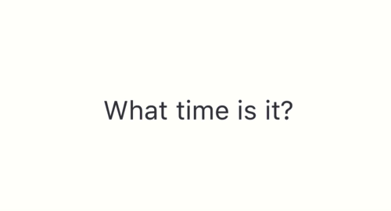
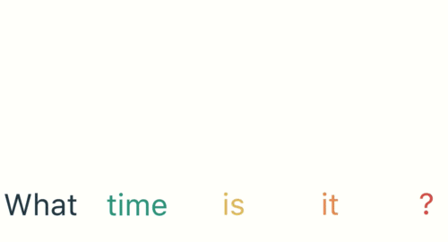
Introduction to Deep Learning
The first step is to feed “What” into the RNN. The RNN encodes “What” and produces an output
For the next step, we feed the word “time” and the hidden state from the previous step. The RNN now has information on both the word “What” and “time.”

Slide 25
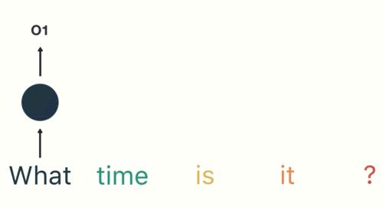
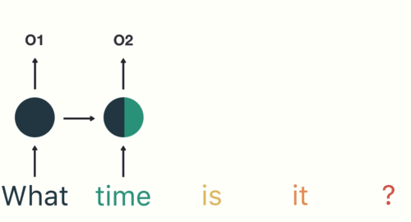
Introduction to Deep Learning
We repeat this process, until the final step. You can see by the final step the RNN has encoded information from all the words in previous steps.
Since the final output was created from the rest of the sequence, we should be able to take the final output and pass it to the feed-forward layer to classify an intent.

Slide 26
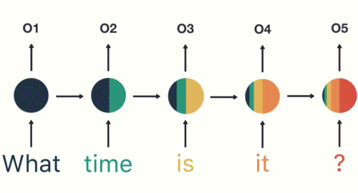

Introduction to Deep Learning
Vanishing Gradient
You may have noticed the odd distribution of colors in the hidden states. That is to illustrate an issue with RNN’s known as short-term memory.
Short-term memory is caused by the infamous vanishing gradient problem, which is also prevalent in other neural network architectures.

Slide 27
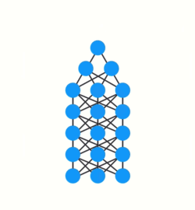
Introduction to Deep Learning
Training a neural network has three major steps.
First, it does a forward pass and makes a prediction.
Second, it compares the prediction to the ground truth using a loss function. The loss function outputs an error value which is an estimate of how poorly the network is performing.
Last, it uses that error value to do back propagation which calculates the gradients for each node in the network.
The gradient is the value used to adjust the networks internal weights, allowing the network to learn.
The bigger the gradient, the bigger the adjustments and vice versa.
Here is where the problem lies. When doing back propagation, each node in a layer calculates it’s gradient with respect to the effects of the gradients
So if the adjustments to the layers before it is small, then adjustments to the current layer will be even smaller.

Slide 28
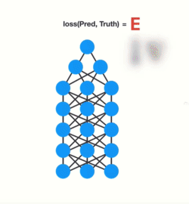
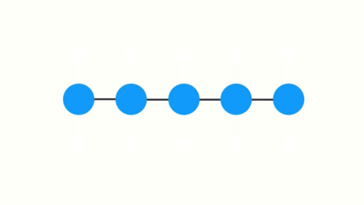
Introduction to Deep Learning
That causes gradients to exponentially shrink as it back propagates down. The earlier layers fail to do any learning as the internal weights are barely being adjusted due to extremely small gradients. And that’s the vanishing gradient problem.
To train a recurrent neural network, you use an application of back-propagation. The gradient values will exponentially shrink as it propagates through each time step.
Again, the gradient is used to make adjustments in the neural networks weights thus allowing it to learn. Small gradients mean small adjustments. That causes the early layers not to learn.

Slide 29
Introduction to Deep Learning
Recurrent Neural Networks suffer from short-term memory.
If a sequence is long enough, they’ll have a hard time carrying information from earlier time steps to later ones.
So if you are trying to process a paragraph of text to do predictions, RNN’s may leave out important information from the beginning.
Because of vanishing gradients, the RNN doesn’t learn the long-range dependencies across time steps.
That means there is a possibility that the word “what” and “time” are not considered when trying to predict the user’s intention.
The network then has to make the best guess with “is it?”.
So not being able to learn on earlier time steps causes the network to have a short-term memory.

Slide 30
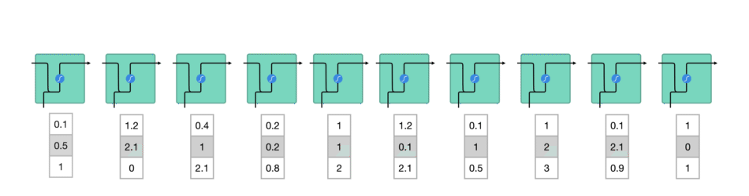
Introduction to Deep Learning
An RNN works like this; First words get transformed into machine-readable vectors. Then the RNN processes the sequence of vectors one by one.
While processing, it passes the previous hidden state to the next step of the sequence. The hidden state acts as the neural networks memory. It holds information on previous data the network has seen before.

Slide 31
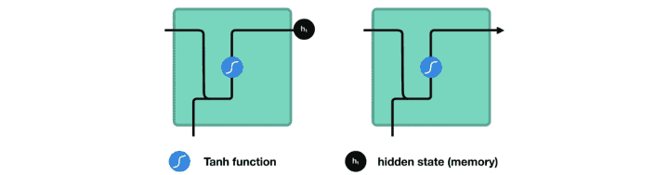
Introduction to Deep Learning
Let’s look at a cell of the RNN to see how you would calculate the hidden state. First, the input and previous hidden state are combined to form a vector. That vector now has information on the current input and previous inputs. The vector goes through the tanh activation, and the output is the new hidden state, or the memory of the network.

Slide 32
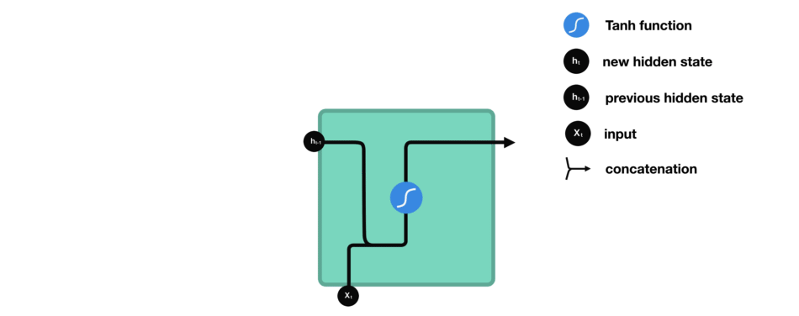
Introduction to Deep Learning

Slide 33
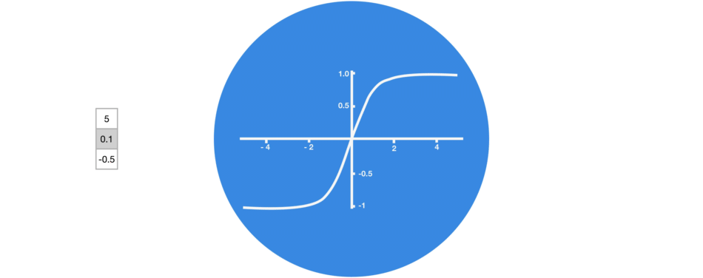
Introduction to Deep Learning
Tanh activation
The tanh activation is used to help regulate the values flowing through the network. The tanh function squishes values to always be between -1 and 1.

Slide 34
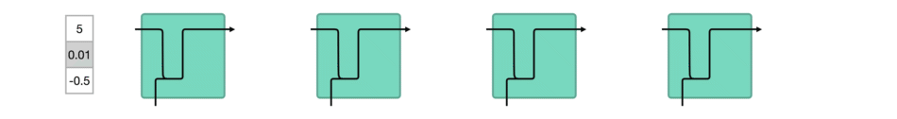
Introduction to Deep Learning
When vectors are flowing through a neural network, it undergoes many transformations due to various math operations. So imagine a value that continues to be multiplied by let’s say 3. You can see how some values can explode and become astronomical, causing other values to seem insignificant.
A tanh function ensures that the values stay between -1 and 1, thus regulating the output of the neural network. In the next slide, You can see how the same values from above remain between the boundaries allowed by the tanh function.

Slide 35
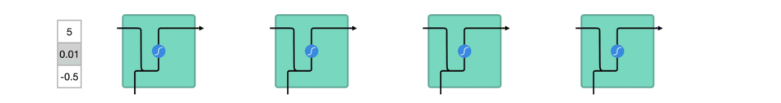
Introduction to Deep Learning
So that’s an RNN. It has very few operations internally but works pretty well given the right circumstances (like short sequences). RNN’s uses a lot less computational resources than it’s evolved variants, LSTM’s and GRU’s.
Recurrent Neural Networks suffer from short-term memory. Hence, the optimum, solution is adding LSTM or GRU

Slide 36
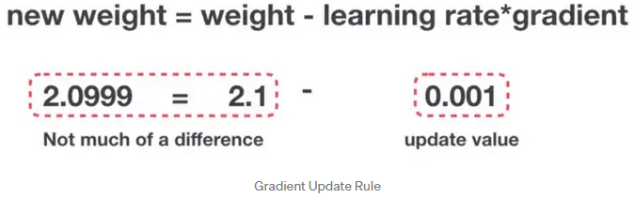
Introduction to Deep Learning
So in recurrent neural networks, layers that get a small gradient update stops learning. Those are usually the earlier layers. So because these layers don’t learn, RNN’s can forget what it seen in longer sequences, thus having a short-term memory.

Slide 37
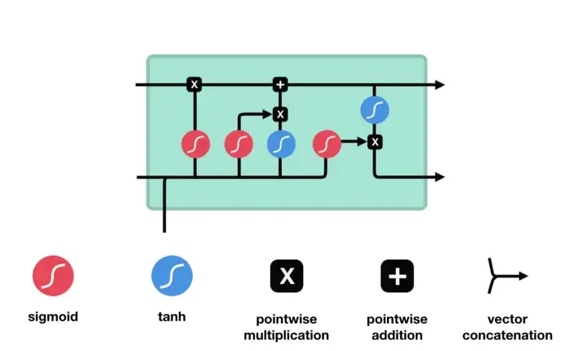
Introduction to Deep Learning
LSTM
An LSTM has a similar control flow as a recurrent neural network. It processes data passing on information as it propagates forward. The differences are the operations within the LSTM’s cells.

Slide 38
Introduction to Deep Learning
Core Concept of LSTM
The core concept of LSTM’s are the cell state, and it’s various gates.
The cell state act as a transport highway that transfers relative information all the way down the sequence chain.
Information from the earlier time steps can make it’s way to later time steps, reducing the effects of short-term memory.
As the cell state goes on its journey, information get’s added or removed to the cell state via gates.
The gates are different neural networks that decide which information is allowed on the cell state. The gates can learn what information is relevant to keep or forget during training.

Slide 39
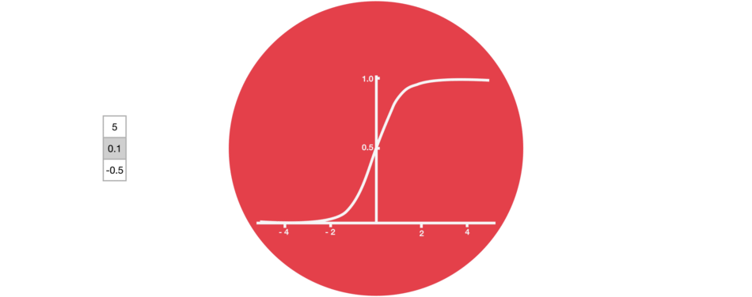
Introduction to Deep Learning
Sigmoid
Gates contains sigmoid activations. A sigmoid activation is similar to the tanh activation. Instead of squishing values between -1 and 1, it squishes values between 0 and 1. That is helpful to update or forget data because any number getting multiplied by 0 is 0, causing values to disappears or be “forgotten.” Any number multiplied by 1 is the same value therefore that value stay’s the same or is “kept.” The network can learn which data is not important therefore can be forgotten or which data is important to keep.

Slide 40
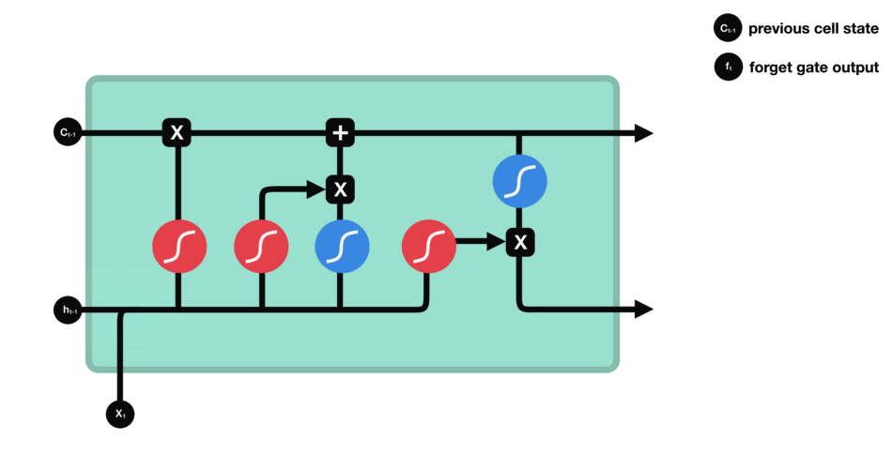
Introduction to Deep Learning
we have three different gates that regulate information flow in an LSTM cell.
Forget gate
This gate decides what information should be thrown away or kept. Information from the previous hidden state and information from the current input is passed through the sigmoid function.

Slide 41
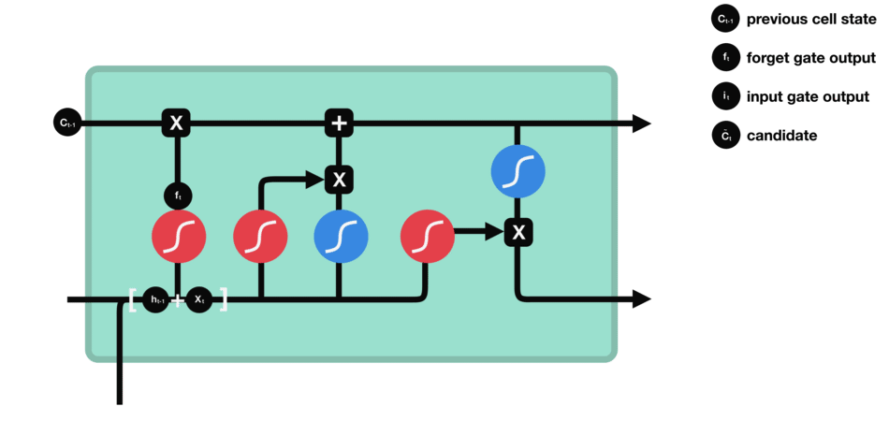
Introduction to Deep Learning
Input Gate
To update the cell state, we have the input gate. First, we pass the previous hidden state and current input into a sigmoid function. That decides which values will be updated by transforming the values to be between 0 and 1.
You also pass the hidden state and current input into the tanh function to squish values between -1 and 1 to help regulate the network. Then you multiply the tanh output with the sigmoid output. The sigmoid output will decide which information is important to keep from the tanh output.

Slide 42
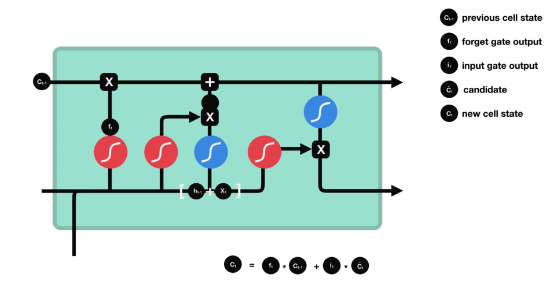
Introduction to Deep Learning
Cell State
Now we should have enough information to calculate the cell state. First, the cell state gets pointwise multiplied by the forget vector. This has a possibility of dropping values in the cell state if it gets multiplied by values near 0.
Then we take the output from the input gate and do a pointwise addition which updates the cell state to new values that the neural network finds relevant. That gives us our new cell state.

Slide 43
Introduction to Deep Learning
Output Gate
The output gate decides what the next hidden state should be. Remember that the hidden state contains information on previous inputs. The hidden state is also used for predictions. First, we pass the previous hidden state and the current input into a sigmoid function.
Then we pass the newly modified cell state to the tanh function. We multiply the tanh output with the sigmoid output to decide what information the hidden state should carry. The output is the hidden state. The new cell state and the new hidden stat is then carried over to the next time step.

Slide 44
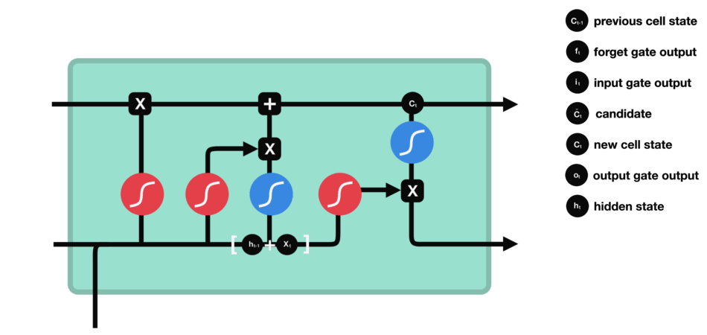
Introduction to Deep Learning

Slide 45
Introduction to Deep Learning
Transfer Learning
Based on our past experience, we humans can learn a new skill easily.
We are more efficient in learning, particularly if the task in hand is similar to what we have done in the past
for example, learning a new programming language for a computer professional or driving a new type of vehicle for a seasoned driver is relatively easy based on our past experience.
Transfer learning is an area in machine learning that aims to utilize the knowledge gained while solving one problem to solve a different but related problem.

Slide 46
Introduction to Deep Learning
With transfer learning, instead of starting the learning process from scratch, you start from patterns that have been learned when solving a different problem.
This way you leverage previous learnings and avoid starting from scratch.
In computer vision, transfer learning is usually expressed through the use of pre-trained models.
A pre-trained model is a model that was trained on a large benchmark dataset to solve a problem similar to the one that we want to solve.
Accordingly, due to the computational cost of training such models, it is common practice to import and use models from published literature (e.g. VGG, Inception, MobileNet).

Slide 47
Introduction to Deep Learning
Transfer learning process
From a practical perspective, the entire transfer learning process can be summarized as follows:
Select a pre-trained model. From the wide range of pre-trained models, you pick one that looks suitable for your problem. For example, if you’re using Keras, you immediately have access to a set of models, such as VGG, InceptionV3, Mobile Net and ResNet5
Classify your problem according to the Size-Similarity Matrix. In the following figure you have ‘The Matrix’ that controls your choices. This matrix classifies your computer vision problem considering the size of your dataset and its similarity to the dataset in which your pre-trained model was trained.

Slide 48
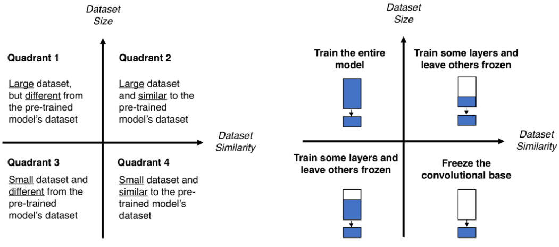
Introduction to Deep Learning
3. Fine-tune your model. Here you can use the Size-Similarity Matrix to guide your choice and then refer to the three options we mentioned before about repurposing a pre-trained model.

