Slide 1

Emerging Technology
Ethiop Tech - ኢትዮጵ ቴክ
www.ethioptec.com
www.academics.ethioptec.com
YouTube: ethioptech
Email: ethiomisgie@gmail.com

Slide 2
Chapter 1: Introduction to Emerging Technologies
Objective
After completing this chapter, the students will be able to:
Identify the technological advances that made the industrial revolution possible
Analyze the changing conditions created by the industrial revolution in both Europe and the united states
Understand the causes of the Industrial Revoነlution in Great Britain, continental Europe, and the United States.
Describe the technological innovations that spurred industrialization
Understand concepts relating to the design of human-computer interfaces in ways making computer-based systems comprehensive, friendly and usable.

Slide 3
What is emerging technology?
Emerging technology describe a new technology,
It may also refer to the continuing development of existing technology; it can have slightly different meanings when used in different areas, such as media, business, science, or education.
The term commonly refers to technologies that are currently developing, or that are expected to be available within the next five to ten years
Examples of currently available ET: AI, IoT, AR and VR, Cloud computing, block chain, Big Data , DevOpps Etc..

Slide 4
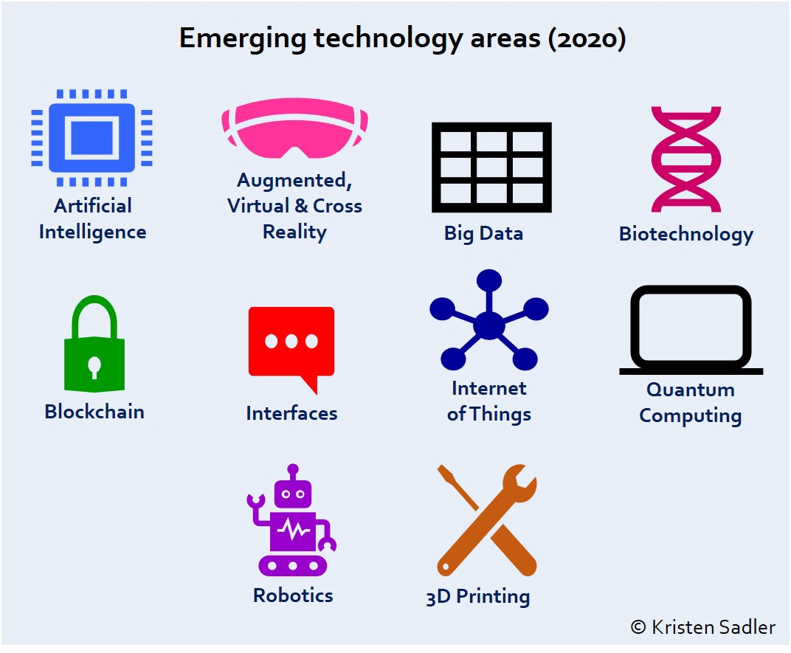
Emerging Technology arias

Slide 5
Introduction to the Industrial Revolution (IR) (late 1700s and early 1800s)
The IR was a period of major industrialization and innovation that took place
occurs when a society shifts from using tools to make products to use new sources of energy, such as coal, to power machines in factories.
The revolution started in England, with a series of innovations to make labor more efficient and productive.
IR was a time when the manufacturing of goods moved from small shops and homes to large factories. This shift brought about changes in culture as people moved from rural areas to big cities in order to work.

Slide 6
Con…
Generally, the following IR changed and transfer the world into modern society.
  • The steam engine,
  • The age of science and mass production, and
  • The rise of digital technology
  • Smart and autonomous systems fueled by data and machine learning.
The most important innovations of IR are:
Transportation: The Steam Engine, The Railroad, The Diesel Engine, The Airplane.
Communication.: The Telegraph, Phonograph, Telephone.
Industry: the cotton gin, the sewing machine, electric lights.

Slide 7
Historical Background (IR 1.0, IR 2.0, IR 3.0)
The industrial revolution began in Great Britain in the late 1770s before spreading to the rest of Europe. The first European countries to be industrialized after England were Belgium, France, and the German states. The final cause of the Industrial Revolution was the effects created by the Agricultural Revolution.
The four types of industries are:
• The primary industry involves getting raw materials e.g. mining, farming, and fishing.
• The secondary industry involves manufacturing e.g. making cars and steel.
• Tertiary industries provide a service e.g. teaching and nursing.
• The quaternary industry involves research and development industries e.g. IT.

Slide 8
Historical…con..
Industrial Revolution (IR 1.0) (1760s)
described as a transition to new manufacturing processes
going from hand production methods to machines, the increasing use of steam power , the development of machine tools and the rise of the factory system.
Industrial Revolution (IR 2.0) (1870s)
also known as the Technological Revolution,
included the development of methods for manufacturing interchangeable parts and widespread adoption of pre-existing technological systems such as telegraph and railroad networks.
This adoption allowed the vast movement of people and ideas, enhancing communication. Moreover, new technological systems were introduced, such as electrical power and telephone

Slide 9
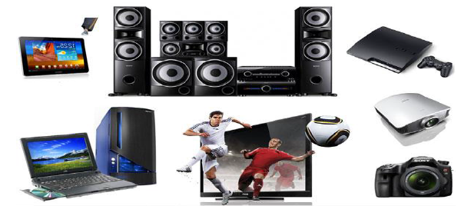
Historical…con..
Industrial Revolution (IR 3.0) began from the late 1950s
Also called “Digital Revolution”.
Introduced the transition from mechanical and analog electronic technology to digital electronics.
Introduces mass production and widespread use of digital logic circuits and its derived technologies such as the computer, handphones and Internet.
These technological innovations have arguably transformed traditional production and business techniques enabling people to communicate with another without the need of being physically present.

Slide 10
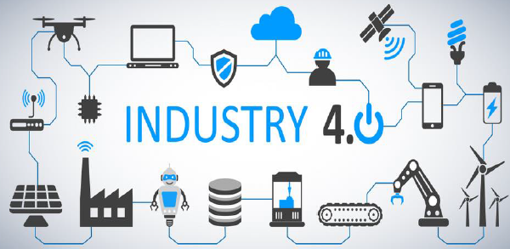
Historical…con..
Fourth Industrial Revolution (IR 4.0) Now
with advancements in various technologies such as
  Robotics
  Internet of Things
  additive manufacturing and autonomous vehicles
  AI
The technologies mentioned above are what you call – cyber-physical systems. A cyber-physical system is a mechanism that is controlled or monitored by computer-based algorithms, tightly integrated with the Internet and its users.
Example Computer Numerical Control (CNC) machines. These machines are operated by giving it instructions using a computer.

Slide 11
Role of Data for Emerging Technologies
Data is regarded as the new oil and strategic asset since we are living in the age of big data, and drives or even determines the future of science, technology, the economy, and possibly everything in our world today and tomorrow

Slide 12
Enabling devices and network (Programmable devices)
In the world of digital electronic systems, there are four basic kinds of devices:
Memory: devices store random information such as the contents of a spreadsheet or database.
Microprocessors: execute software instructions to perform a wide variety of tasks such as running a word processing program or video game
Logic: provide specific functions, including device-to-device interfacing, data communication, signal processing, data display, timing and control operations, and almost every other function a system must perform
networks : is a collection of computers, servers, mainframes, network devices, peripherals, or other devices connected to one another to allow the sharing of data. An excellent example of a network is the Internet, which connects millions of people all over the world

Slide 13
Human to Machine Interaction
HMI is the communication and interaction between a human and a machine via a user interface.
HCI (human-computer interaction) is the study of how people interact with computers and to what extent computers are or are not developed for successful interaction with human beings. As its name implies, HCI consists of three parts: the user, the computer itself, and the ways they work together.
How do users interact with computers?
The user interacts directly with hardware for the human input and output such as displays, e.g. through a graphical user interface. The user interacts with the computer over this software interface using the given input and output (I/O) hardware

Slide 14
Con…
How important is human-computer interaction?
To improve the interaction between users and computers by making computers more user-friendly and receptive to the user's needs.
Ease of deployment & operations and cost savings for smaller set-ups.
Reduce solution design time and integration complexity
Disciplines Contributing to Human-Computer Interaction (HCI)
Cognitive psychology: Limitations, information processing, performance prediction, cooperative working, and capabilities.
Computer science: Including graphics, technology, prototyping tools, user interface management systems.
Linguistics.
Engineering and design.
Artificial intelligence.
Human factors.

Slide 15
Recent emerging technologies
• 5G Networks
• Artificial Intelligence (AI)
• Autonomous Devices
• Blockchain
• Augmented Analytics
• Digital Twins
• Enhanced Edge Computing and
• Immersive Experiences in Smart Spaces

Slide 16

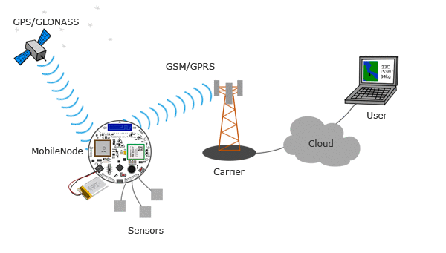
5G Network

Slide 17
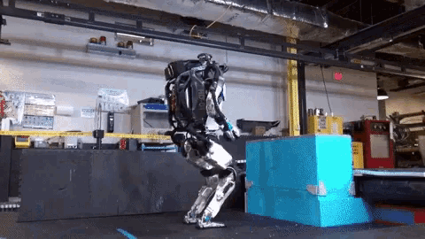
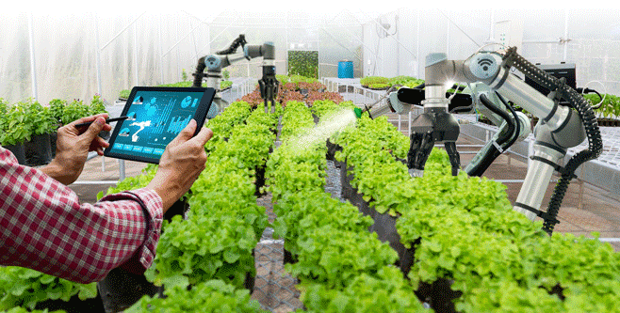
AI
AI in Agriculture and robotics

Slide 18
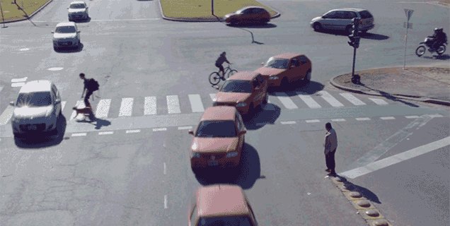
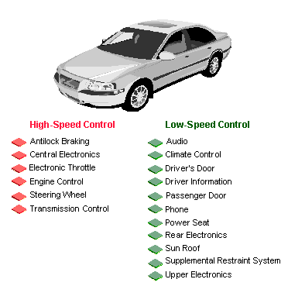
Autonomous device

Slide 19
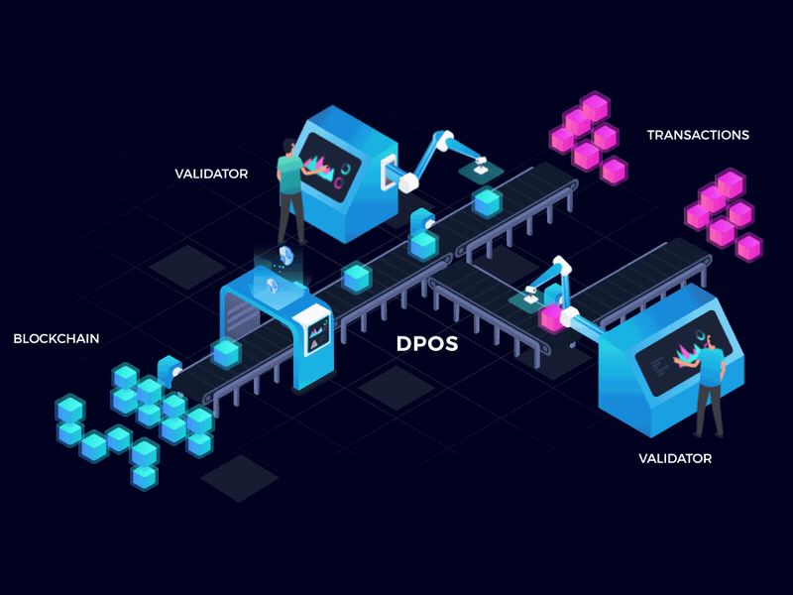

Block chain (hard security mechanism)
Delegated Proof of Stake (DPoS) is a popular evolution of the PoS concept, whereby users of the network vote and elect delegates to validate the next block.

Slide 20

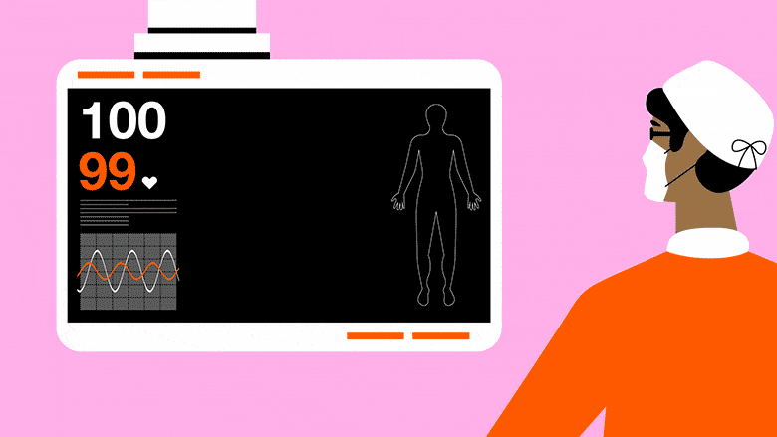
Augmented Analytics
Augmented analytics is the use of enabling technologies such as machine learning and AI to assist with data preparation, insight generation and insight explanation to augment how people explore and analyze data in analytics.

Slide 21
Chapter 2: Data Science
Objectives:
After completing this chapter, the students will be able to:
Describe what data science is and the role of data scientists.
Differentiate data and information.
Describe data processing life cycle
Understand different data types from diverse perspectives
Understand the basics of Big Data

Slide 22
Data Science
Data science is a multi-disciplinary field that uses
scientific methods
Processes
algorithms, and
systems
to extract knowledge and insights from
Structured
semi-structured and
unstructured data.

Slide 23
What are data and information?
Data can be defined as a representation of
Fact
concepts, or
instructions
In a formalized manner which should be suitable for
Communication
interpretation, or
processing, by human or electronic machines.
Data also can be described as
unprocessed facts and
figures.

Slide 24
What are data and information?
It is represented with the help of characters such as
alphabets (A-Z, a-z)
digits (0-9) or
special characters (+, -, /, *, <,>, =, etc.). ሀለመሰር
information is the processed data on which
decisions and
actions are happened.
information is meaningful and interpreted data; created from
Organized
structured, and
processed data in a particular context.

Slide 25
Data Processing Cycle
Data processing is the re-structuring or re-ordering of data by people or machines to increase their usefulness and add values for a particular purpose basic steps - input, processing, and output
Input − the input data is prepared in some convenient form for processing. The form will depend on the processing machine.

Slide 26
Data Processing ...con…
Processing − the input data is changed to produce data in a more useful form.
example, interest can be calculated on deposit to a bank, or a summary of sales for the month can be calculated from the sales orders
Output − the result of the proceeding processing step is collected. The particular form of the output data depends on the use of the data. For example, output data may be payroll for employees.

Slide 27
Data types and their representation
Data types can be described from diverse perspectives.
In computer science and computer programming, a data type is simply an attribute of data that tells the compiler or interpreter how the programmer intends to use the data.
Data types from Computer programming perspective
Common data types include:
  Integers(int)
  Booleans(bool)
  Characters(char)
  Floating-point numbers(float)
  Alphanumeric strings(string)

Slide 28
Con…
Data types from Data Analytics perspective
There are three common types of data types or structures: Structured, Semi-structured, and Unstructured data types

Slide 29
Con…
Structured data:
adheres to a pre-defined data model and is therefore straightforward to analyze.
Structured data conforms to a tabular format with a relationship between the different rows and columns.
Common examples of structured data are Excel files or SQL databases

Slide 30
Con…
Semi-structured:
a form of structured data that does not conform with the formal structure of data models associated with relational databases or other forms of data tables
but contains tags or other markers to separate semantic elements and enforce hierarchies of records and fields within the data
it is also known as a self-describing structure e.g. XML, JSON

Slide 31
Con…
Unstructured data
is information that either does not have a predefined data model or is not organized in a pre-defined manner.
Unstructured information is typically text-heavy but may contain data such as dates, numbers, and facts as well.
This results in irregularities and ambiguities
examples audio, video files or No-SQL databases.

Slide 32
Metadata – Data about Data
The last category of data type
the most important elements for Big Data analysis and big data solutions.
Metadata is data about data
It provides additional information about a specific set of data.
In a set of photographs, for example, metadata could describe when and where the photos were taken. The metadata then provides fields for dates and locations which, by themselves, can be considered structured data

Slide 33
Data value Chain
The Data Value Chain is introduced to describe the information flow within a big data system as a series of steps needed to generate value and useful insights from data

Slide 34
con...
Data Acquisition
the process of
Gathering
filtering, and
cleaning data before it is put in a data warehouse or any other storage solution on which data analysis can be carried out.
It is one of the major big data challenges in terms of infrastructure requirements

Slide 35
con...
Data Analysis
Making the raw data acquired amenable to use in decision-making as well as domain-specific usage (specify the data).
It may Involves
Exploring
transforming, and
modeling data to highlight relevant data, synthesize and extract useful hidden information with high potential from a business point of view

Slide 36
Con…
Data Curation
It is the active management of data over its life cycle to ensure it meets the necessary data quality requirements for its effective usage.
It can be categorized into different activities such as
content creation
selection,
Classification
Transformation
validation, and
preservation.
Data curation is performed by expert curators that are responsible for improving the accessibility and quality of data. Data curators (also known as scientific curators or data annotators) hold the responsibility of ensuring that data are trustworthy, discoverable, accessible, reusable and fit their purpose.

Slide 37
Con…
Data Curation
Data curation is performed by expert curators that are responsible for improving the accessibility and quality of data.
Data curators (also known as scientific curators or data annotators) hold the responsibility of ensuring that data are
Trustworthy
Discoverable
Accessible
reusable and
fit their purpose.

Slide 38
Data Storage
It is the persistence and management of data in a scalable way that satisfies the needs of applications that require fast access to the data. Relational Database Management Systems (RDBMS) have been the main solution to the storage paradigm. However, the ACID (Atomicity, Consistency, Isolation, and Durability) properties makes database transactions lack flexibility when data volumes and complexity grow.
Data Usage
It covers the data-driven business activities that need access to data, its analysis, and the tools needed to integrate the data analysis within the business activity.

Slide 39
Basic concepts of big data
Big data is a blanket term for the non-traditional strategies and technologies needed to
Gather
organize,
process, and
gather insights from large datasets
Big data is the term for a collection of data sets so large and complex that it becomes difficult to process using on-hand database management tools or traditional data processing applications

Slide 40
Con…
Big data is characterized by 3V and more:
Volume: large amounts of data Zeta bytes/Massive datasets
Velocity: Data is live streaming or in motion
Variety: data comes in many different forms from diverse sources
Veracity: can we trust the data? How accurate is it? etc.

Slide 41
Clustered Computing and Hadoop Ecosystem
Clustered Computing
Big data clustering software combines the resources of many smaller machines, seeking to provide a number of benefits
  Resource Pooling
  High Availability:
  Easy Scalability:

Slide 42
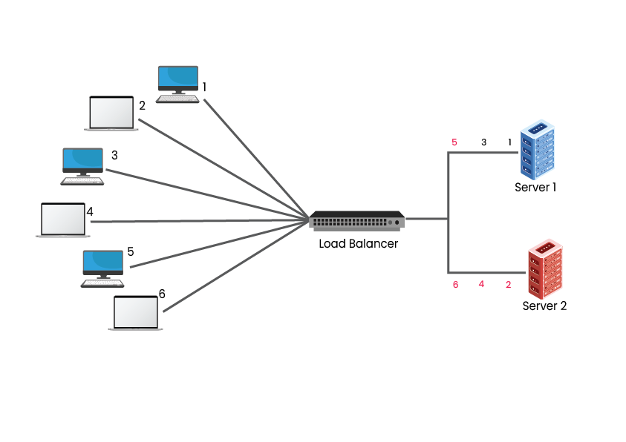
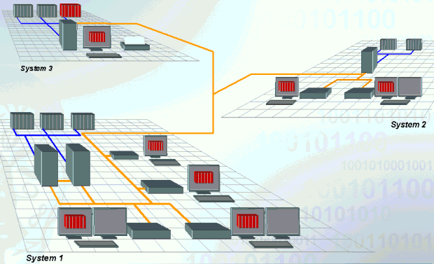
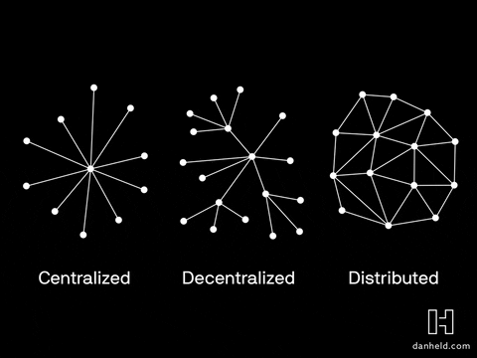
Clustered Computing

Slide 43
Con…
Hadoop and its Ecosystem
Hadoop is an open-source framework intended to make interaction with big data easier. It is a framework that allows for the distributed processing of large datasets across clusters of computers using simple programming models
four key characteristics of Hadoop are
Economical
Reliable
Scalable
Flexible

Slide 44
Big Data Life Cycle with Hadoop
Ingesting data into the system
Processing the data in storage
Computing and analyzing data
Visualizing the results

Slide 45
Chapter 3: Artificial Intelligence (AI)
Objectives
After completing this chapter, the students will be able to:
define artificial intelligence (AI) is.
Explain the types and approaches of AI.
Describe the applications of AI
List the factors that influenced the advancement of AI in recent years.
Understand the relationship between the human’s way of thinking and AI systems

Slide 46
What is Artificial Intelligence (AI)
composed of two words Artificial (man-made) and Intelligence (thinking power)
Intelligence is an intangible part of our brain which is a combination of
Reasoning
Learning
problem-solving
perception
language understanding, etc.

Slide 47
What is Artificial Intelligence (AI)
AI is the branch of computer science by which we can create intelligent machines which can
behave like a human
think like humans, and
able to make decisions.
It exists when a machine can have human-based skills such as
Learning
reasoning, and
solving problems.
Intelligence is composed of: Reasoning, Learning, Problem Solving, Perception, Linguistic Intelligence

Slide 48
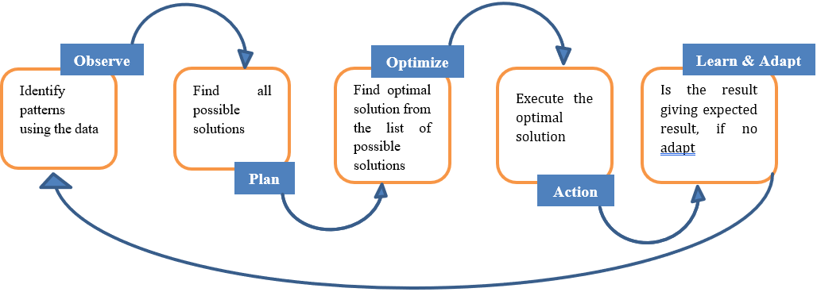
Introduction of AI
We have different sensory organs such as eyes, ears, noses, tongues, and skin to perceive our environment and organs such as hands, legs, and mouths are the effectors that enable us to take action within our environment based on the perception. AI also have these functionalities.

Slide 49
Con…
AI system is composed of an
agent and
its environment.
An agent (e.g., human or robot) is anything that can perceive its environment through sensors and acts upon that environment through effectors
examples of AI include

Slide 50
Con…
examples of AI include
autonomous vehicles (such as drones and self-driving cars)
medical diagnosis
creating art (such as poetry)
proving mathematical theorems
playing games (such as Chess or Go)
search engines (such as Google search)
online assistants (such as Siri)
image recognition in photographs, spam filtering, prediction of judicial decisions and targeting online advertisements

Slide 51
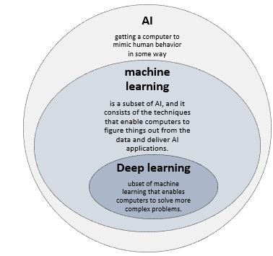
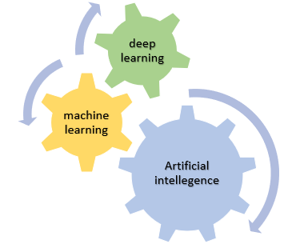
Artificial Intelligence (AI), Machine Learning (ML) and Deep Learning (DL)

Slide 52
Need for Artificial Intelligence
To create expert systems that exhibit intelligent behavior with the capability to learn, demonstrate, explain and advice its users.
Helping machines find solutions to complex problems like humans do and applying them as algorithms in a computer-friendly manner.

Slide 53
Goals of Artificial Intelligence
1. Replicate human intelligence
2. Solve Knowledge-intensive tasks
3. An intelligent connection of perception and action
4. Building a machine which can perform tasks that requires human intelligence such as:
  ✓ Proving a theorem
  ✓ Playing chess
  ✓ Plan some surgical operation
  ✓ Driving a car in traffic
5. Creating some system which can exhibit intelligent behavior, learn new things by itself, demonstrate, explain, and can advise to its user.

Slide 54
What Comprises to Artificial Intelligence?
Artificial Intelligence is multidisciplinary of

Slide 55
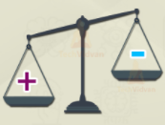
Advantages and disadvantages of AI
Advantages
High Accuracy with fewer errors
Doesn’t get tired
High-Speed
High reliability
Reduce human risk
Help in decision making
Useful as a public utility like application in medical industry
Rational decision maker
Dis advantages
  Incurs high cost
  Can't think out of the box
  No feelings and emotions
  Increase dependence on machines
  Leads to un employment
  Lack in creativity

Slide 57
Levels of AI
Stage 1 – Rule-Based Systems
Stage 3 – Context Awareness and Retention
Stage 3 – Domain-Specific Expertise
Stage 4 – Reasoning Machines
Stage 5 – Self Aware Systems / Artificial General Intelligence (AGI)
Stage 6 – Artificial Superintelligence (ASI)
Stage 7 – Singularity and Transcendence

Slide 58
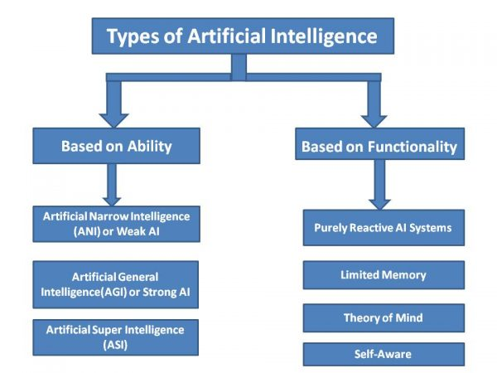
Types of AI

Slide 59
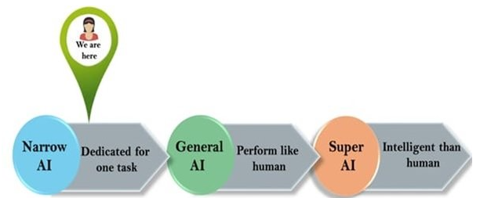
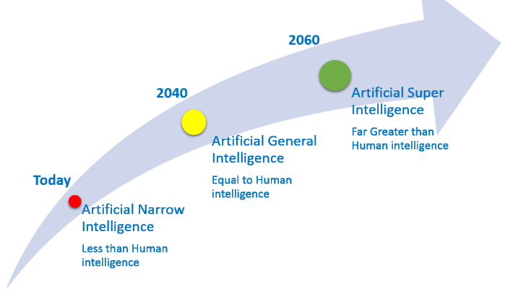
Based on ability/capability
But No one technology is intelligent than human
characteristics of strong AI include capability include the ability to think, to reason solve the puzzle, make judgments, plan, learn, and communicate on its own.
Super AI is still a hypothetical concept of Artificial Intelligence

Slide 60
Based on the functionality
Reactive Basic types of AI Has no memory i.e. do not store memories or past experiences for future actions Only focus on current scenarios and react on it as per possible best action. | Limited memory Uses memory to learn and improve its responses store past experiences or some data for a short period of time.
Theory of mind Understand the needs of human emotions, people, beliefs, and be able to interact socially like humans. This type of AI machines is still not developed | Self aware Has human like intelligence and self awareness the future of Artificial Intelligence. ➢ These machines will be smarter than the hum

Slide 61
How does a human being think?
Intelligence or the cognitive process is composed of three main stages:
➢ Observe and input the information or data in the brain.
➢ Interpret and evaluate the input that is received from the surrounding environment.
➢ Make decisions as a reaction towards what you received as input and interpreted and evaluated.

Slide 62
Mapping human thinking to artificial intelligence components
AI is the science of simulating human thinking, it is possible to map the human thinking stages to the layers or components of AI systems.
Steg 1: humans acquire information from their surrounding environments through human senses, such as sight, hearing, smell, taste, and touch, through human organs, such as eyes, ears, and other sensing organs, for example, the hands.
this stage is represented by the sensing layer, which perceives information from the surrounding environment. This information is specific to the AI application

Slide 63
Con…
Steg 2: The second stage is related to interpreting and evaluating the input data. In AI, this stage is represented by the interpretation layer, that is, reasoning and thinking about the gathered input that is acquired by the sensing layer.
Steg 3: is related to taking action or making decisions. After evaluating the input data, the interacting layer performs the necessary tasks. Robotic movement control and speech generation are examples of functions that are implemented in the interacting layer

Slide 64
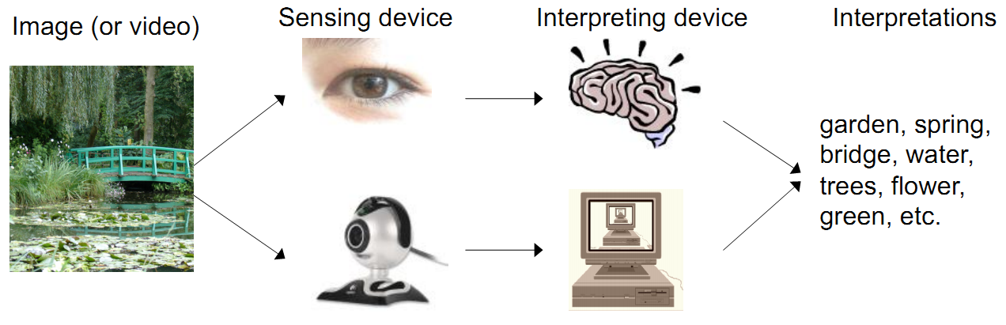
Mapping human thinking to artificial intelligence components

Slide 65
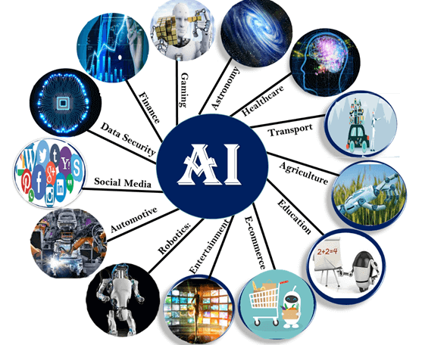
Applications of AI

Slide 66
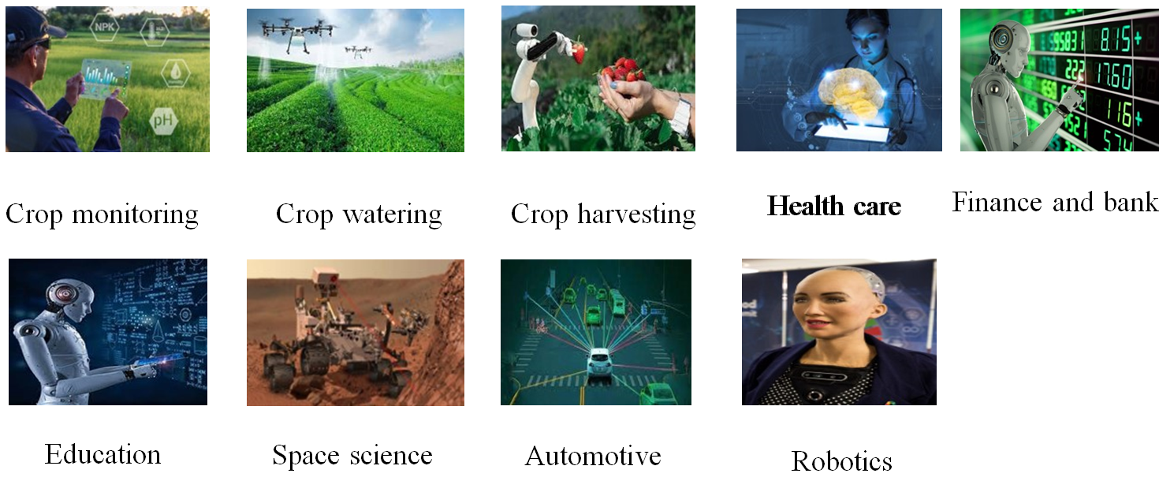
Applications of AI

Slide 67
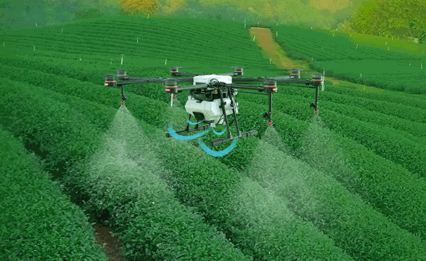
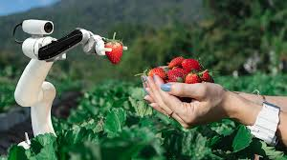
Application of AI in Agriculture
Crop watering
Pesticides
Harvesting

Slide 68
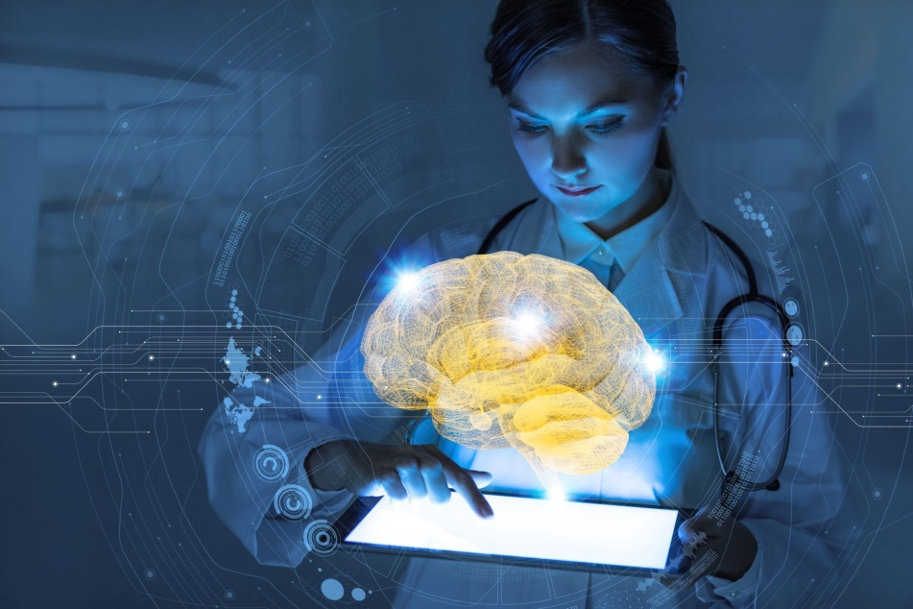
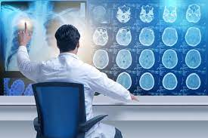
AI in Health care
In medical science specially disease diagnostic process related to
internal
parts of the human body such as
Heart case
Diabetes
Blood pressure
Pneumonia
Diseases related to brain,
Hepatitis
Censer, and a lot of diseases can be identified by AI

Slide 69
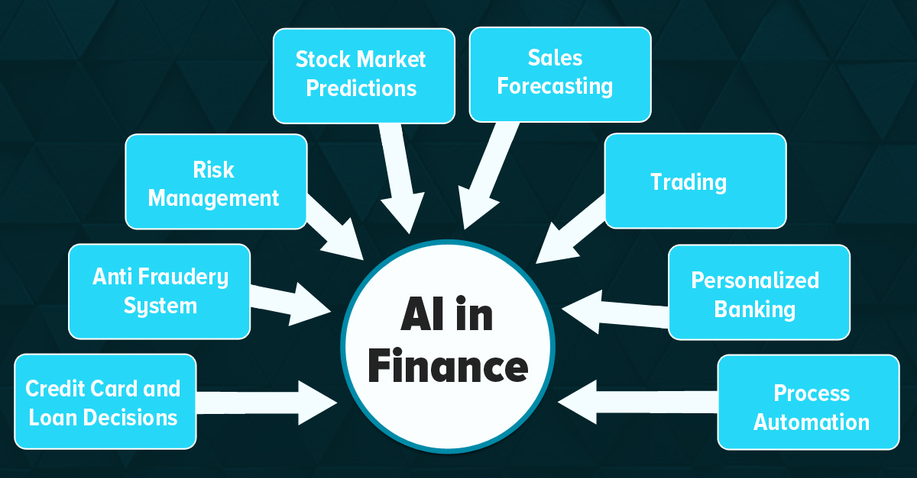
AI in Finance and Banking

Slide 70
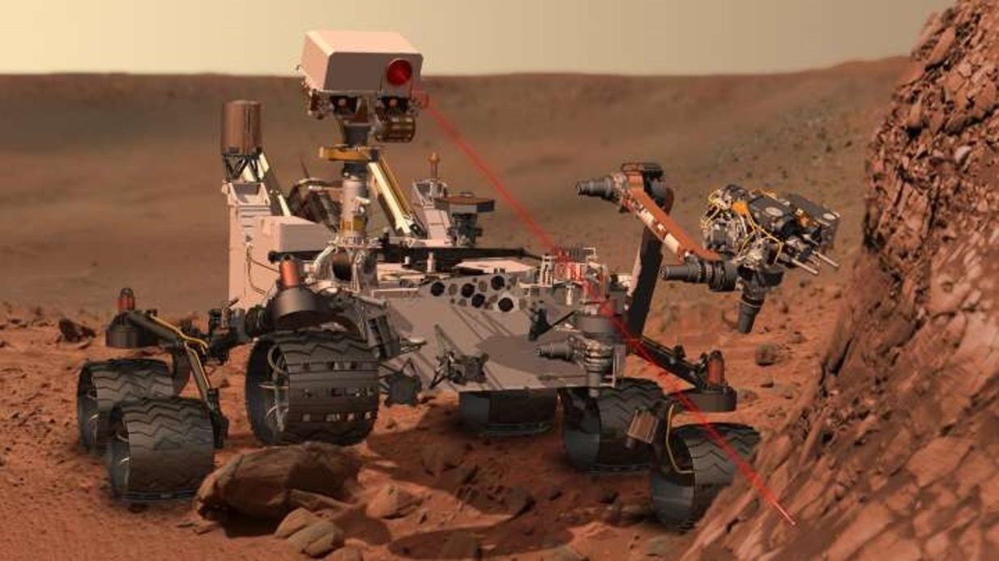
AI in Astronomy and Space Science
To identify rock type and minerals present in different planets
To identify different star constellation
Generally to discover what is new present outside of our world

Slide 71
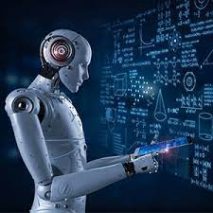
AI in Education
Grading System Automation
Adaptation of educational software for students need
Student can get additional tutor from AI robot
It could change the role of teachers
AI can make trial and error learning less intermediating
Data pored by AI change how schools find, teach, and support students

Slide 72
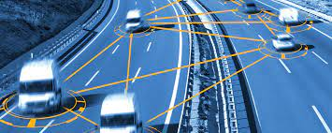
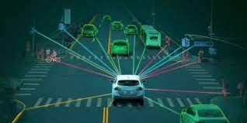
AI in Automotive
To select shortest path
To monitor drivers and vehicles from central controller
To find nearest gas station
To avoid vehicle crashing
To identify less traffic congestion
To automat vehicles with audition system

Slide 73
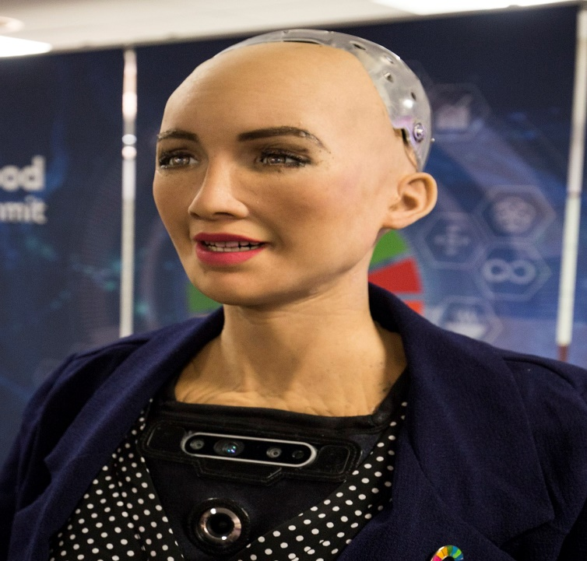
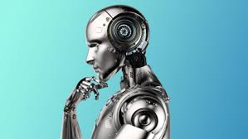
AI in Robotics
AI make the robot to talk and act as human being
AI make the robot think deeply hear and feel

Slide 74
Sub fields of AI
✓ Neural Networks – e.g. brain modelling, time series prediction, classification
✓ Evolutionary Computation – e.g. genetic algorithms, genetic programming
✓ Computer Vision – e.g. object recognition, image understanding
✓ Robotics – e.g. intelligent control, autonomous exploration
✓ Expert Systems – e.g. decision support systems, teaching systems
✓ Speech Processing– e.g. speech recognition and production
✓ Natural Language Processing – e.g. machine translation
✓ Planning – e.g. scheduling, game playing
✓ Machine Learning – e.g. decision tree learning, version space learning

Slide 75
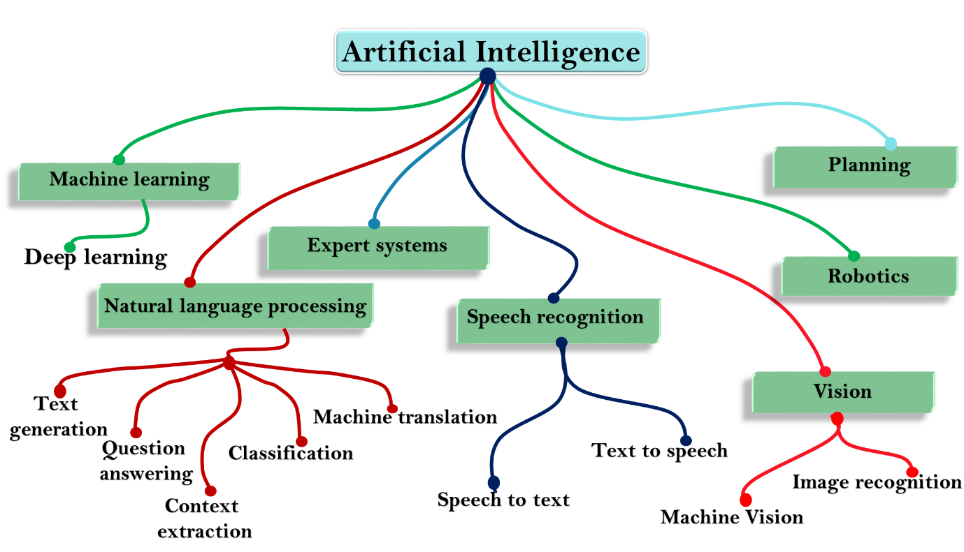
Sub fields of AI

Slide 76
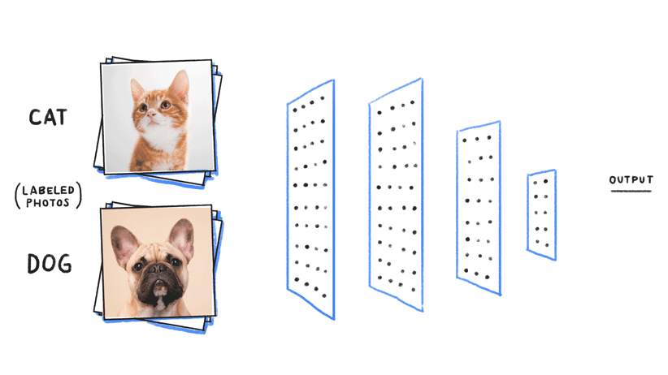
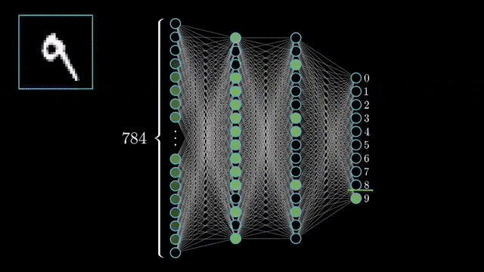
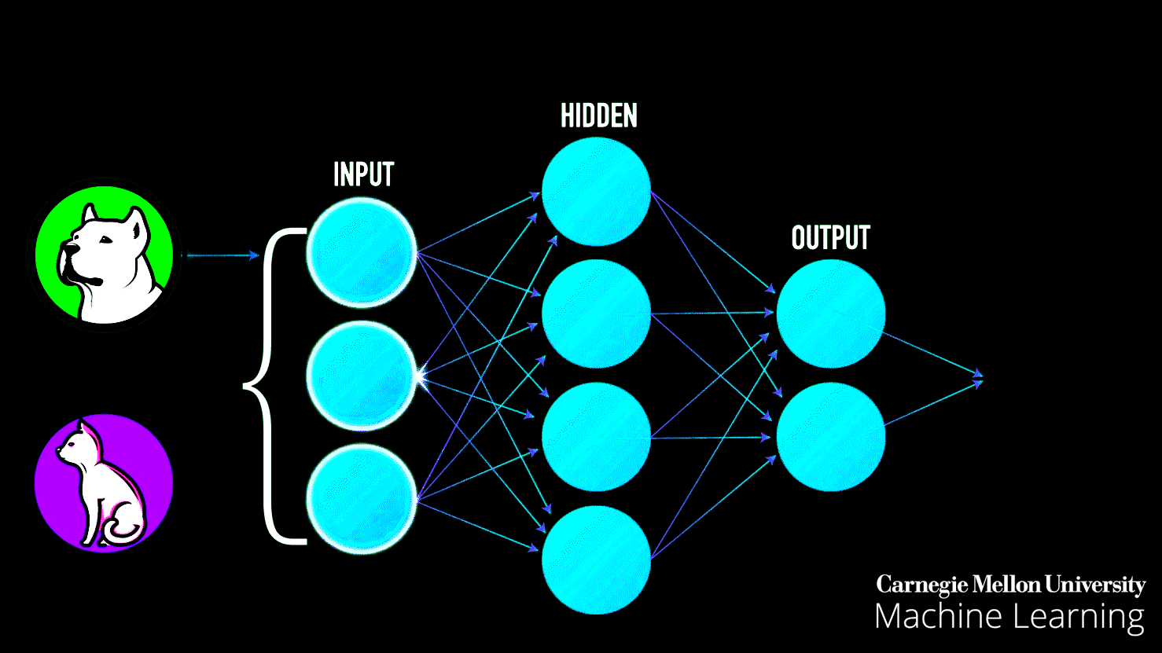
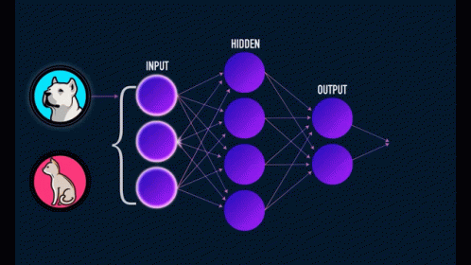
Machine learning and deep learning

Slide 77
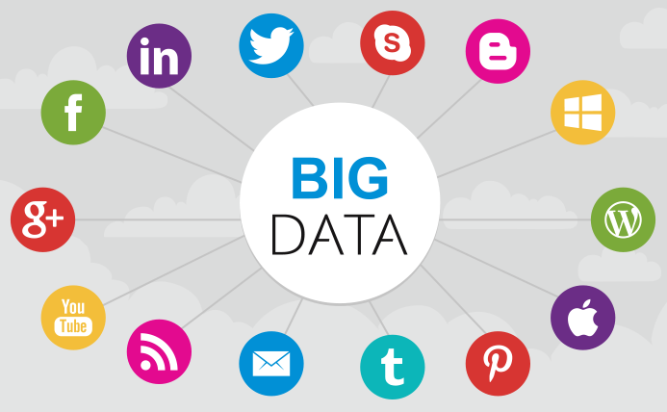
Influencers of artificial intelligence
Big data: huge amounts of data. Big data requires innovative forms of information processing to draw insights, automate processes, and help decision making Big data can be structured, semi-structured and unstructured formats

Slide 78
Con…
Advancements in computer processing speed and new chip architectures
Significant advancements in computer processing and memory speeds enable us to make sense of the information that is generated by big data more quickly
In recent years, big data and the ability to process a large amount of data at high speeds have enabled researchers and developers to access and work with massive sets of data

Slide 79
Con…
Cloud computing and application programming interfaces(APIs)
Cloud computing is a general term that describes the delivery of on-demand services, usually through the internet, on a pay-per-use basis
application programming interfaces (APIs) expose capabilities and services. APIs enable software components to communicate with each other easily
AI APIs are usually delivered on an open cloud-based platform on which developers can infuse AI capabilities into digital applications, products, and operations by using one or more of the available APIs.

Slide 80
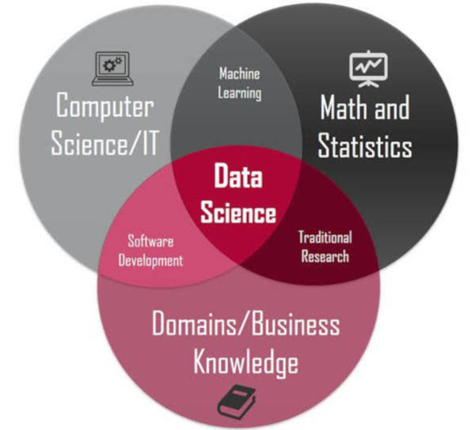
Con…
The emergence of data science
Data science has emerged in the last few years as a new profession that combines several disciplines, such as statistics, data analysis, machine learning, and others
The goal of data science is to extract knowledge or insights from data in various forms, either structured or unstructured, which is like data mining.

Slide 81
AI tools and platforms
AI tools help a machine to solve the most difficult problems in computer science and computer engineering:
✓ Search and optimization
✓ Logic
✓ Probabilistic methods for uncertain reasoning
✓ Classifiers and statistical learning methods
✓ Neural networks
✓ Control theory
✓ Languages

Slide 82
Con…
AI platforms are defined as some sort of hardware architecture or software framework (including application frameworks), that allows the software to run.
It involves the use of machines to perform the tasks that are performed by human beings
provide users a tool kit to build intelligent applications. These platforms combine intelligent, decision-making algorithms with data, which enables developers to create a business solution
AI platforms are frequently used by developers to create both the learning algorithm and intelligent application.

Slide 83
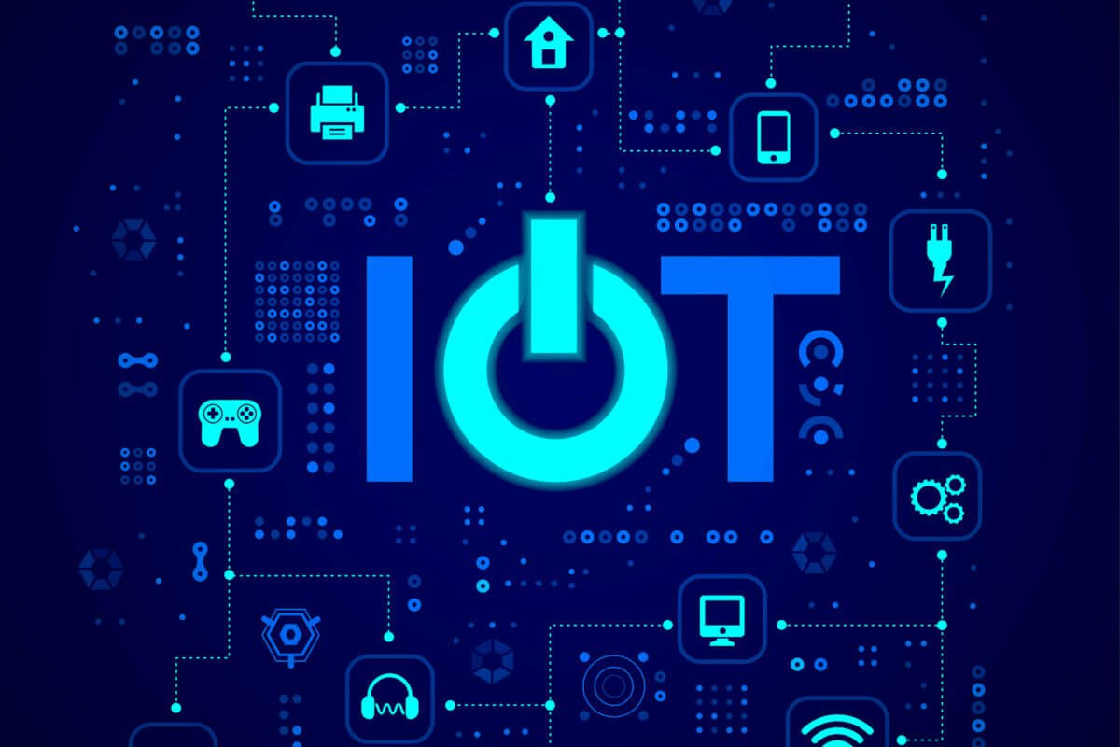
Chapter 4: Internet of Things (IoT)
Objectives
After accomplishing this chapter, Students will be able to:
➢ define IoT
➢ Describe the pros and cons of IoT
➢ Explain how IoT works
➢ Explain the architecture of IoT
➢ Describe IoT tools and platforms

Slide 84
What is IoT?
The Internet of Things (IoT) is the network of physical objects or "things" embedded with
Electronics
Software
sensors, and
network connectivity, which enables these objects to collect and exchange data.

Slide 85
What is IoT?
IoT= Services+ Data+ Networks + Sensors
IoT connects all things, so it is called “the Internet of Things”
Internet of Things (IoT) is a network of devices which can
Sense
accumulate and
transfer data over the internet without any human intervention.

Slide 86
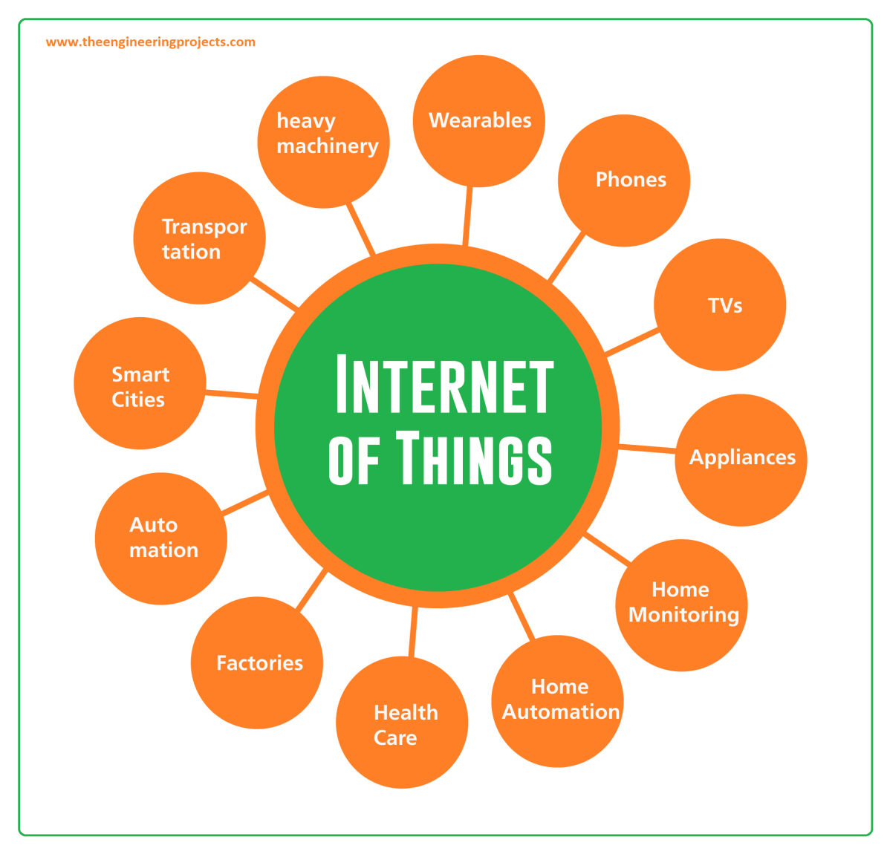
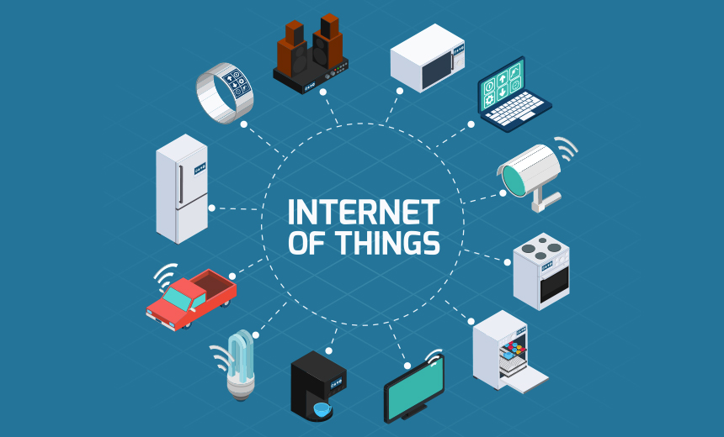
What is IOT

Slide 87
IoT consists of any device with an on/off switch connected to the Internet.
This includes almost anything you can think of, ranging from
cellphones
building maintenance
the jet engine of an airplane
medical devices
farm animal etc.

Slide 88
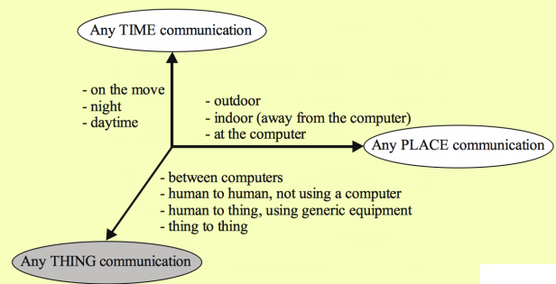

Slide 89
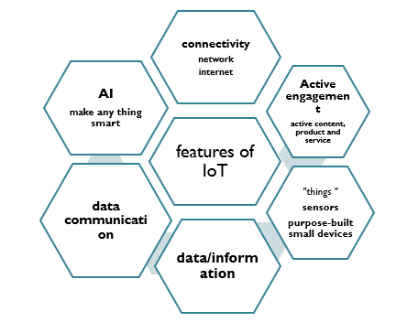
Features of IoT
The IoT consists of a gigantic (excess) network of internet-connected “things” and devices.
Example of IOT: Ring a doorbell that links to your smartphone

Slide 90
Application of IoT
Smart city
connected industry
connected building
Business, logistics
Media
environmental monitoring are among other domains etc.
Utilities - IoT sensors can be employed to monitor environmental conditions such as
Humidity
temperature, and
lighting.

Slide 91
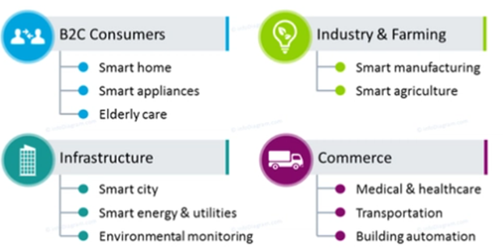
Application of IoT
IoT in Different Domains

Slide 92
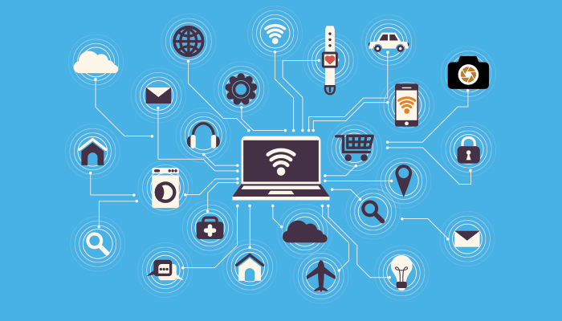
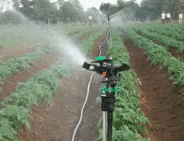
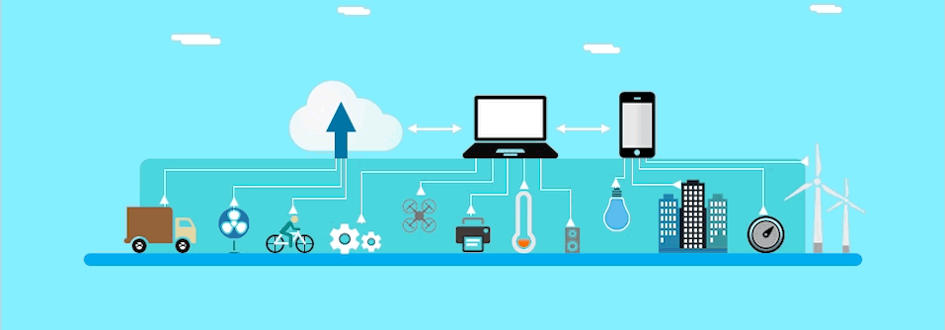
Applications of IOT

Slide 93
Advantages and disadvantages of IoT
Advantages | Disadvantages
Improved Customer Engagement | Loss of privacy and security
Technology Optimization | complexity
Reduce waste | Loss employment
Improved data collection | compatibility
Minimize human effort | Over dependency on technology
Better quality of life | Power (energy) constraints

Slide 94

Challenges of IoT
Security
Privacy
Complexity
Flexibility
compliance

Slide 95
How IoT works?
An IoT ecosystem consists of web-enabled smart devices that use embedded processors, sensors and communication hardware to collect, send and act on data they acquire from their environments using sensors, processors and communicated hard wares.
IoT devices share the sensor data they collect by connecting to an IoT gateway or another edge device where data is either sent to the cloud to be analyzed or analyzed locally.

Slide 96

Con…
The connectivity, networking and communication protocols used with these web-enabled devices largely depend on the specific IoT applications deployed.

Slide 97
Architecture of IoT
1. Sensing Layer :
identify any phenomena in the devices’ peripheral and obtain data from the real world
Sensors, actuators, devices are present in this Sensing layer. These Sensors or Actuators accepts data(physical/environmental parameters), processes data and emits data over network.

Slide 98
Con…
Sensors in IoT devices can be classified into three broad categories
Motion Sensors: Motion sensors measure the change in motion as well as the orientation of the devices. There are two types of motions one can observe in a device: linear and angular motions
Environmental Sensors: Sensors such as Light sensors, Pressure sensors, etc. are embedded in IoT devices to sense the change in environmental parameters in the device’s peripheral.
Position sensors: Position sensors of IoT devices deal with the physical position and location of the device. E.g. magnetic sensors and Global Positioning System (GPS) sensors

Slide 99



Components of IOT

Slide 100



Cont

Slide 101

Cont

Slide 102
Con…
2. Network Layer
The network layer acts as a communication channel to transfer data, collected in the sensing layer, to other connected devices by the technologies include Wi-Fi, Bluetooth, Zigbee, Z-Wave, LoRa, cellular network, etc.)
3. Data Processing Layer
Takes data collected in the sensing layer and analyses the data to make decisions based on the result
Saves the result of the previous analysis to improve the user experience.
This layer may share the result of data processing with other connected devices via the network layer.

Slide 103
Con…
Application Layer - implements and presents the results of the data processing layer to accomplish disparate applications of IoT devices.
APL is a user-centric layer that executes various tasks for the users. which include smart transportation, smart home, personal care, healthcare etc

Slide 104
Devices and Networks
Connected devices are talk to other related devices in an environment to automate home and industrial tasks, and to communicate usable sensor data to users, businesses and other interested parties
devices that connect wirelessly to a network and have the ability to transmit data.
devices can be categorized into three main groups: consumer, enterprise and industrial.
IoT network typically includes a number of devices with constrained resources (power, processing, memory, among others) and some of those devices may be massively deployed over large areas like smart cities, industrial plants, whereas others may be deployed in hard-to-reach areas like pipelines hazardous zones, or even in hostile environments like war zones.

Slide 105
Con….

Slide 106
IoT Based Smart Home
Smart Home initiative allows subscribers to remotely manage and monitor different home devices from anywhere via smartphones or over the web.
Home applications | Description
Remote Control Appliances | Switching on and off remotely appliances to avoid accidents and save energy
Weather | Displays outdoor weather conditions such as humidity, temperature, pressure, wind speed and rain levels
Smart Home Appliances | Refrigerators with LCD screen telling what’s inside food that’s about to expire, ingredients you need to buy, Washing machines allowing you to monitor the laundry remotely
Safety Monitoring | cameras, and home alarm systems making people feel safe in their daily life at home.
Intrusion Detection Systems | Detection of window and door openings and violations to prevent intruders
Energy and Water Use | Energy and water supply consumption monitoring

Slide 107

IoT Based Smart City
In cities, the development of smart grids, data analytics, and autonomous vehicles will provide an intelligent platform to deliver innovations in energy management, traffic management, and security, sharing the benefits of this technology throughout society . Include
Structural Health
Lightning
Safety
Transportation
Smart Parking
Waste Management

Slide 108

IoT Based Smart Farming
Green Houses: Control micro-climate conditions to maximize the production of fruits and vegetables
Compost: Control of humidity and temperature levels etc. to prevent fungus
• Animal Farming/Tracking: Location and identification of animals grazing.
• Offspring Care: Control of growing conditions of the offspring in animal farms to ensure its survival and health.
• Field Monitoring: including better control of fertilizing, electricity and watering.

Slide 109
Chapter 5: Augmented Reality (AR)
After Objectives:
accomplishing this chapter, Students will be able to:
➢ Explain augmented reality
➢ Explain the features of augmented reality
➢ Explain the difference between AR, VR, and MR
➢ Explain the architecture of augmented reality systems
➢ Describe the application areas of augmented reality

Slide 110


Chapter 5: Augmented Reality (AR)

Slide 111

Chapter 5: Augmented Reality (AR)

Slide 112
Overview of augmented reality
AR combine, or mix, the view of the real environment with additional, virtual content that is presented through computer graphics.
Its convincing effect is achieved by ensuring that the virtual content is aligned and registered with the real objects.

Slide 113
Virtual reality (VR), Augmented Reality (AR) vs Mixed reality (MR)
With constant development in computer vision and the exponential advancement of computer processing power, virtual reality (VR), augmented reality (AR), and mixed reality (MR) technology is becoming more and more prominent.

Slide 114
Virtual Reality (VR)
Also called a computer-simulated reality
Refers to computer technologies using reality headsets to generate realistic sounds, images and other sensations that replicate a real environment or create an imaginary world.

Slide 115
Augmented Reality (AR)
Augmented reality, users see and interact with the real world while digital content is added to it.
AR adds digital elements to a live view often by using the camera on a smartphone
Augmented Reality (AR) is a live, direct or indirect view of a physical, real-world environment whose elements are augmented (or supplemented) by computer-generated sensory input such as sound, video, graphics or GPS data

Slide 116
Mixed Reality (MR) or hybrid reality
The merging of real and virtual worlds to produce new environments and visualizations where physical and digital objects co-exist and interact in real-time.
Placing new imagery within a real space in such a way that the new imagery is able to interact, to an extent, with what is real in the physical world we know
The key characteristic of MR is that the synthetic content and the real-world content are able to react to each other in real-time.
In mixed reality, you interact with and manipulate both physical and virtual items and environments, using next-generation sensing and imaging technologies.
It provides the ability to have one foot (or hand) in the real world, and the other in an imaginary place

Slide 117
Comparison of the three
One of the most obvious differences among augmented reality, virtual reality, and mixed reality is the hardware requirements and also VR is content which is 100% digital and can be enjoyed in a fully immersive environment, AR overlays digital content on top of the real-world. and MR is a digital overlay that allows interactive virtual elements to integrate and interact with the real-world environment
On the other hand, virtual reality programs require specialized VR headsets, noise-canceling headphones, cameras to track room space and boundaries, and sometimes even motion capture technology
Mixed reality hardware is still emerging and hasn’t quite broken into the mainstream consumer market, most likely due to the price

Slide 118
The architecture of AR Systems
The first Augmented Reality Systems (ARS) were usually designed with a basis on three main blocks
  (1) Infrastructure Tracker Unit,
  (2) Processing Unit, and
  (3) Visual Unit
  Infrastructure Tracker Unit collecting data from the real world, sending them to the Processing Unit, which mixed the virtual content with the real content and sent the result to the Video Out module of the Visual Unit.

Slide 119
Con…
Head-Mounted Display (HMD)s are currently the dominant display technology in the AR field

Slide 120
Applications of AR Systems
AR In education
    Affordable learning materials
    Interactive lessons
    Higher engagement
    Higher retention
    Boost intellectual curiosity
Entertainment
    AR in games
    AR in music
    AR on TV
    AR in eSports
    AR in the theater
Military etc.
Medicine
    surgery
    education of future doctors;
    Diagnostics
    Describing symptoms
    Ultrasounds
    Diabetes management
    Navigation
    Generally
  Reduce the risks associated with minimally invasive surgery.
  Better informed decisions about the right treatment and illness prevention.
  Make procedures more tolerable.
  Better aftercare
  Medical training and education.
  • Assistance in medical procedures and routine tasks.

Slide 121
Chapter 6: ETHICS AND PROFESSIONALISM OF EMERGING TECHNOLOGIES
objectives
After accomplishing this chapter, Students will be able to:
➢ Distinguish the link between ethics and technology.
➢ Understand general, professional and leadership ethical questions.
➢ Explain what digital privacy is, its components and why it is important.
➢ Identify the threats and challenges we face in developing and utilizing emerging technologies.

Slide 122
Technology and ethics
The Internet boom has provided many benefits for society, allowing the creation of new tools and new ways for people to interact however, the Internet has not been without negative aspects. For example, it has created new concerns about privacy, and it has been hampered by spam and viruses
The Information Society should foster the use of emerging technologies in such a way as to maximize the benefits that they provide while minimizing the harms
establishing the proper legal or regulatory system to ensure that technology capable of abuse is not in fact abused and that the benefits of technology are shared among all.

Slide 123
Con…
Ethics is particularly important for the accountancy profession, with a code for professional ethics based on five basic principles –
Integrity
Objectivity
competence and due care
confidentiality, and
professional behavior. However, the emergence of new technologies raises some new challenges for the profession to address.

Slide 124
New ethical questions
The increasing use of
big data
algorithmic decision-making, and
artificial intelligence can enable more consistent, evidence-based and accurate judgments or decisions.
However, these strengths can potentially have a darker side too, throwing up questions around the ethical use of these fairly new technologies.

Slide 125
A central problem of the ethics of technology is that it tends to arrive too late. In many cases, ethical issues are only recognized when the technology is already on the market and problems arise during its widespread use
General ethical principles
  1. Contribute to society and to human well-being
  2. Avoid harm.
  3. Be honest and trustworthy.
  4. Be fair and take action not to discriminate
  5. Respect the work required to produce new ideas, inventions, creative works, and computing artifacts.
  6. Respect privacy.
  7. Honor confidentiality

Slide 126
Professional responsibilities.
1. Strive to achieve high quality in both the processes and products of professional work.
2. Maintain high standards of professional competence, conduct, and ethical practice.
3. Know and respect existing rules pertaining to professional work.
4. Accept and provide appropriate professional review.
5. Give comprehensive and thorough evaluations of computer systems and their impacts, including analysis of possible risks.

Slide 127
Con…
6. Perform work only in areas of competence.
7. Foster public awareness and understanding of computing, related technologies, and their consequences.
8. Access computing and communication resources only when authorized or when compelled by the public good.
9. Design and implement systems that are robustly and usably secure

Slide 128
Professional leadership principles
1. Ensure that the public good is the central concern during all professional computing work.
2. Articulate, encourage acceptance of and evaluate fulfillment of social responsibilities
3. Manage personnel and resources to enhance the quality of working life.
4. Articulate, apply, and support policies and processes
5. Create opportunities for members of the organization or group to grow as professionals.
6. Use care when modifying or retiring systems.
7. Recognize and take special care of systems that become integrated into the infrastructure of society.

Slide 129
Digital privacy
Digital Privacy is the protection of personally identifiable or business identifiable information that is collected from respondents through information collection activities or from other sources
three sub-related categories;
  information privacy
  communication privacy,
  individual privacy

Slide 130
Information privacy
Individuals should have the freedom, or right, to determine how their identifiable digital information is collected and used.
Communication privacy
individuals should have the freedom, or right, to securly communicate information digitally

Slide 131
In other word messages and communications will only be accessible to the sender's original intended recipient
However, communications can be intercepted or delivered to other recipients without the sender's knowledge.
Individual privacy:
Individuals have a right to exist freely on the internet or
They can choose what types of information they are exposed to, and
more importantly that unwanted information should not interrupt them.

Slide 132
digital privacy principles
Data Minimization: collect the minimal amount of information necessary from individuals and businesses
Transparency: information collected will not be used for any other purpose unless authorized or mandated by law.
Accuracy: information collected will be maintained in a sufficiently accurate, timely, and complete manner to ensure the need
Security: Adequate physical and IT security should be implemented

Slide 133
Accountability and trust
Understand and mitigate new risks will help to build confidence
legal and regulatory frameworks required
ET can provide improved accuracy, better quality and cost efficiencies for businesses in every sector
They can enhance trust in the organization’s operations and financial processes, which is crucial for sustainable success But this can produce a paradox: the very solutions that can be used to better manage risk, increase transparency and build confidence are often themselves the source of new risks, which may go unnoticed

Slide 134
Ethical and regulatory challenges
Related to security, we need to keep pace with ever-changing technology and be aware of the AI, IoT, Big Data, Machine Learning, etc.
We should have strong security for sensitive information both physical and cyber
Exercise:
What are the challenges related to AI, robotics, big data, IoT

Slide 135
Emerging technologies are making an impact include:
1. Counter-terrorism and law enforcement informatics via predictive analytics and AI.
2. Real-time horizon scanning and data mining for threats and information sharing
3. Automated cybersecurity and information assurance
4. Enhanced Surveillance (chemical and bio-detection sensors, cameras, drones, facial recognition, license plate readers)
5. Simulation and augmented reality technologies for training and modeling
6. Safety and security equipment (including bullet and bomb proof) made with lighter and stronger materials
7. Advanced forensics enabled by enhanced computing capabilities
8. Situational awareness capabilities via GPS for disaster response and crisis response scenarios
9. Biometrics: assured identity security screening solutions by bio-signature: (every aspect of your physiology can be used as a bio-signature. Measure unique heart/pulse rates, electrocardiogram sensor, blood oximetry, skin temperature)

Slide 136
Chapter seven: Other Emerging technologies
Nano Technology
Nanotechnology is science, engineering, and technology conducted at the nanoscale, which is about 1 to 100 nanometers.
Nanoscience and nanotechnology are the study and application of extremely small things and can be used across all the other science fields, such as chemistry, biology, physics, materials science, and engineering

Slide 137
Fundamental concepts in nanoscience and nanotechnology
It’s hard to imagine just how small nanotechnology is. One nanometer is a billionth of a meter or
10-9 of meters. Here are a few illustrative examples:
➢ There are 25,400,000 nanometers in an inch
➢ A sheet of newspaper is about 100,000 nanometers thick
➢ On a comparative scale, if a marble were a nanometer, then one meter would be the size of
the Earth

