Slide 1
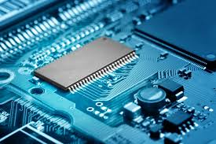
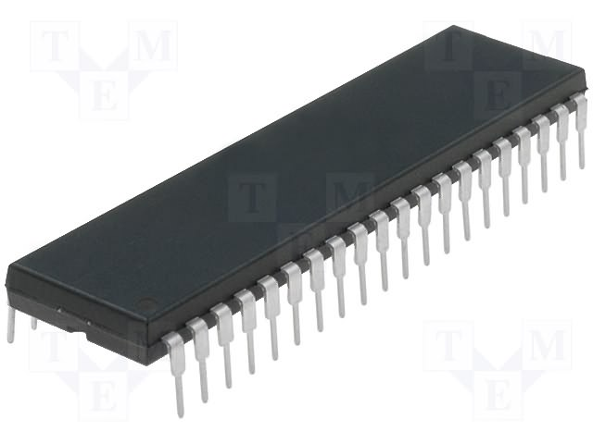
Department of Electrical and computer Engineering
College of Engineering and Technology
Jimma University
CHAPTER 2
MICROCONTROLLERS

Slide 2
Chapter objectives
To understand the internal architecture of a microcontroller (pic16f877a)
Understand the instruction set of this micro-controllers
To introduce the assembly programming for embedded application.

Slide 3
Lecture Objective
Why study the hardware (architecture) of a micro-controllers?
Why PIC?
Why pic16f877?

Slide 4
Computer architecture
Based on number of instruction set
  RISC VSS CISC architecture
Based on memory CPU organization
  Harvard VSS von Neumann

Slide 5
RISC architecture
(Reduced Instruction Set Computer)
  A large number of instruction(more than 170 instruction set in Intel family processors
    This makes them relatively costy, with large power requirements and more than 1 clock cycle per instruction (less speed)
Example: PIC, AVR
Advantage
  Small number of instruction to learn
  Small number of cycle per instruction (most PIC instruction set have one clock per instruction set)
Disadvantage
  Only basic operation is supported
    Complex operation is performed by the software programmer

Slide 6
CISC architectures
(Complex Instruction Set Computer)
A lot of instruction set
Complex computation are implemented in the instruction set (egg. multiplication)
Example
  8086 families(intel based processor)
  8051 microcontrollers
Advantage
  Easy of programming
  Large number of addressing modes
Disadvantage
  Low speed
  Difficult to study all instructions
  Lot of memory access (because of small number of registers)

Slide 7
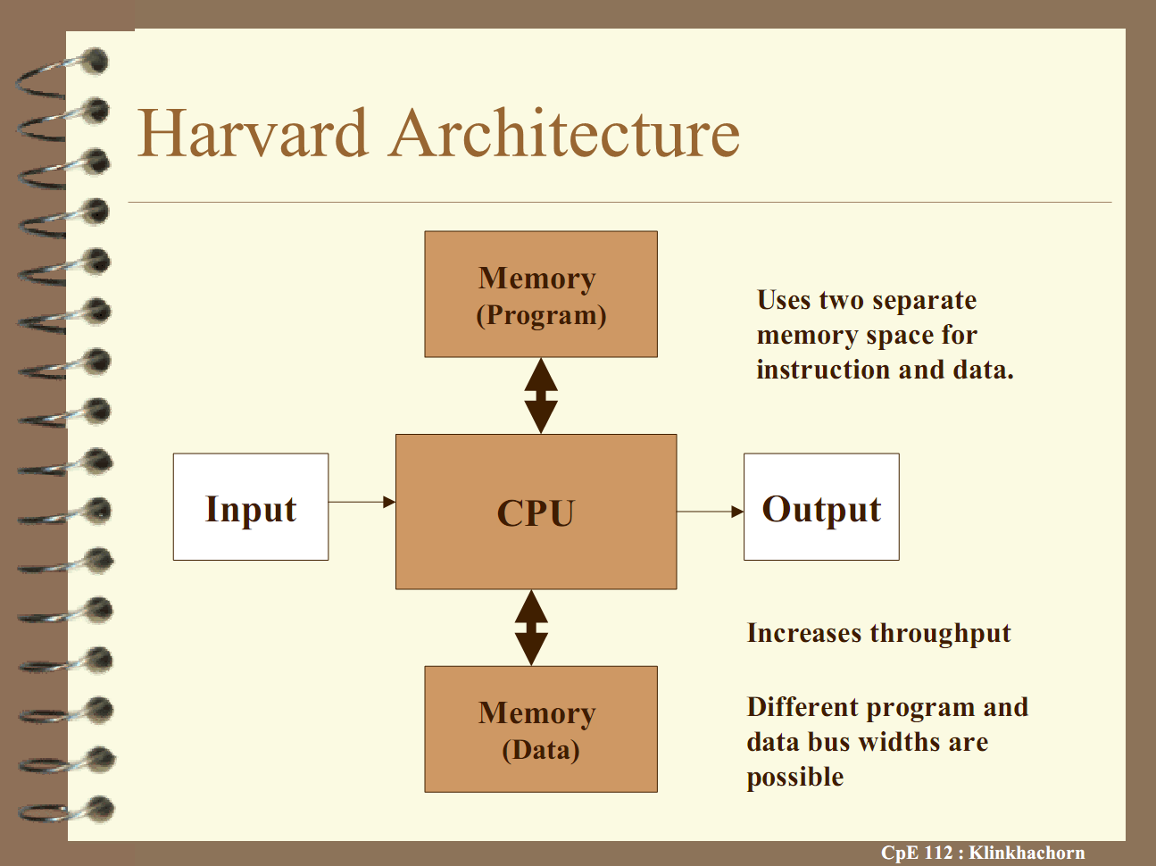
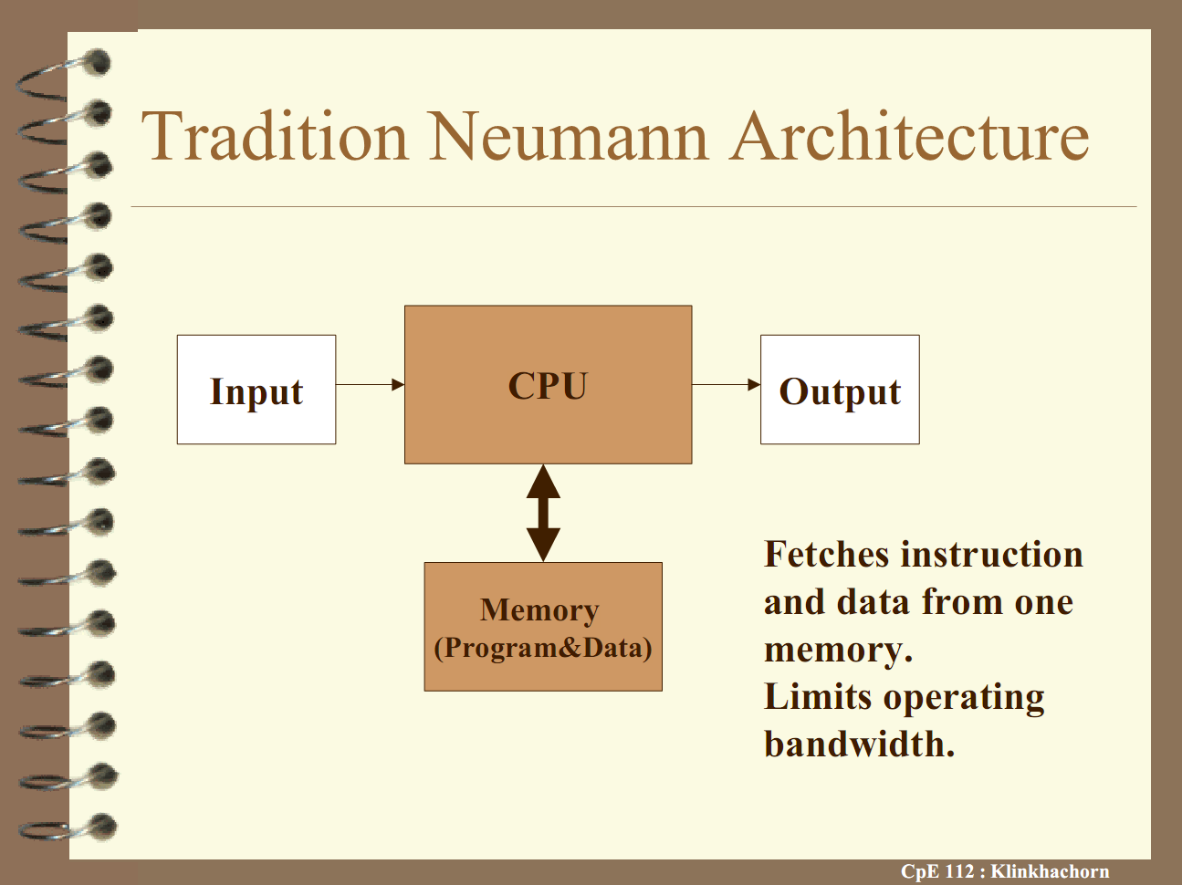
Harvard vss von Neumann architecture

Slide 8
Harvard architecture
Memory space for data and instruction is different (they don’t share the same space)
Both Data and instruction can be accessed at the same time (pipelining)
  This makes this processor relatively fast
A lot of registers for fast processing

Slide 9
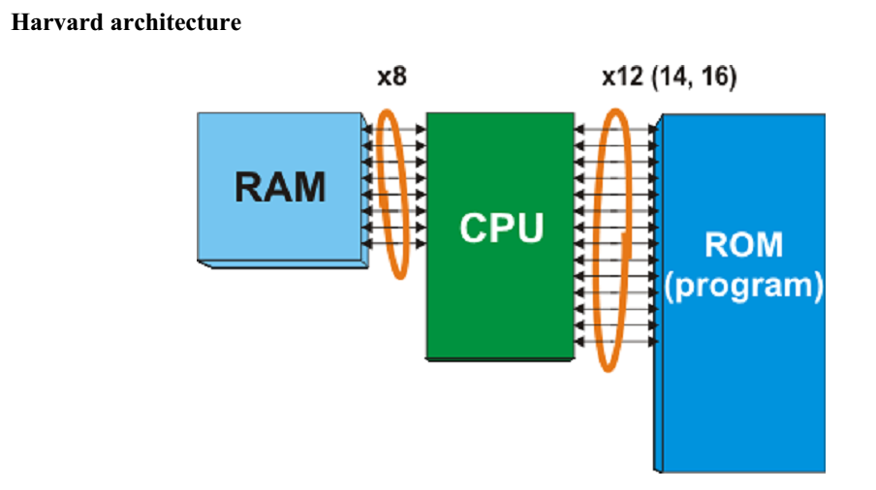
Harvard architecture in the pic case

Slide 10
Von Neumann architecture
  Instruction and data share the same memory space (cannot be accessed at the same time)
  Both data and instruction cannot be accessed at the same time
  Variable length of instruction length
  Variable instruction cycle
  Small number of registers

Slide 11
The difference between microcontroller and microprocessors
Number of instruction
Availability of peripherals
Power consumption
Cost
Speed
Amount of resource

Slide 12
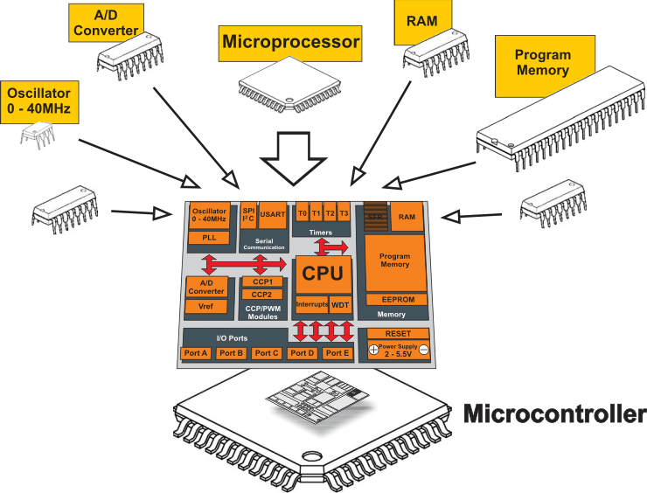
Microcontrollers

Slide 13
Example of microcontrollers
There are more than 140 microcontrollers and more than 40 companies that produce them
Some example includes
  8051 families
    Produced by more than 50 companies
  AVR microcontrollers
  ARM microcontrollers
  PIC microcontrollers
  Etc
In this course we will only see one of the PIC families (pic16f877(A))

Slide 14
Why PIC?
Popular in academic institution projects
Relatively accessible (widely available) in small quantities
Has high clock speed
Has a rich set of development tools
  IDE and compilers
    E.g. Mplab (free), MicroC, MicroC Pro, PIC C, CCS for PIC etc
  Hardware development tools
    Evaluation board and programmers, debuggers etc

Slide 15
Why PIC? Conti…
It has a Harvard architecture
  High speed (pipelining)
  One instruction in one instruction cycles
  Large number of registers (RAM)
It has a RISC architecture
  Only small number of instruction set to remember (35 instructions in the case of pic16f877(A) )
  Small addressing moods
Have a rich set of families for different applications
In circuit programming

Slide 16
Introduction to pic16f877a architecture
It is a RISC like feature
  Harvard architecture
  Instruction pipelining
  A lot of registers
  Single instruction cycle per instruction
  Only 35 instruction to learn

Slide 17
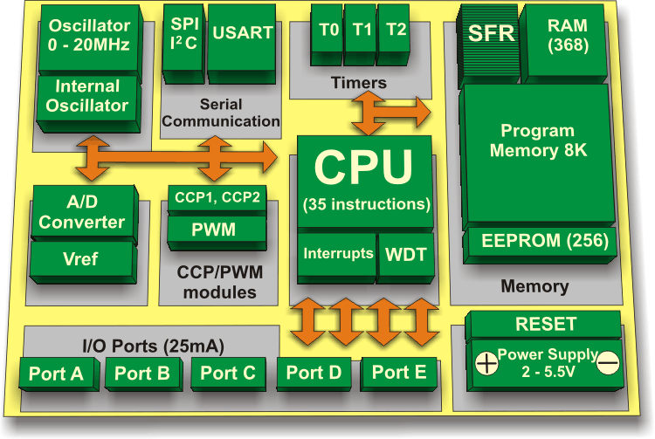
Architecture of pic16f877a

Slide 18
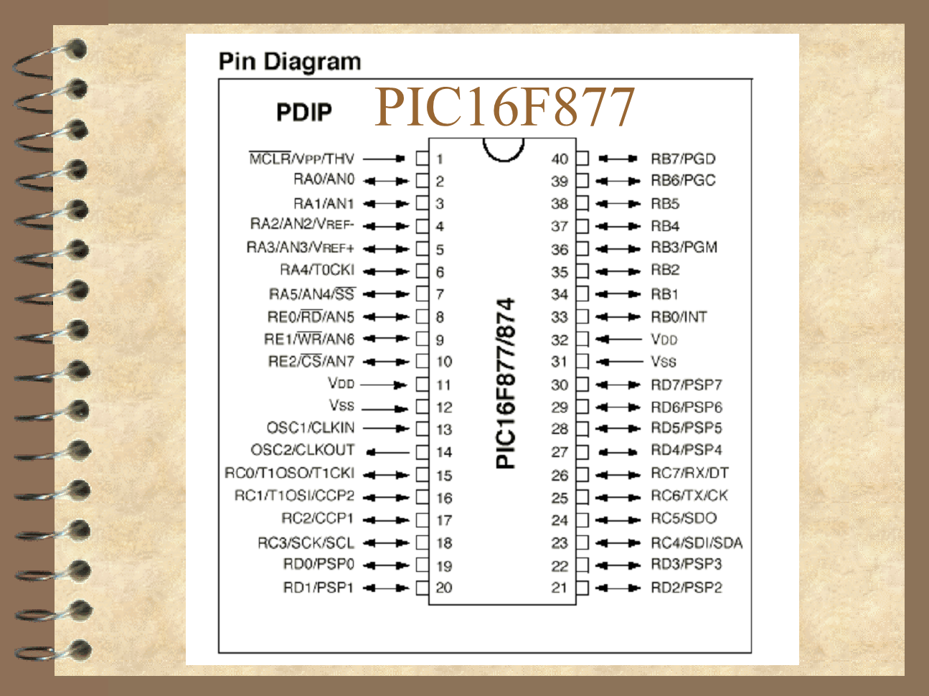

Slide 19
Architecture of pic16f877
CPU
I/O
Memory organization
  Program memory
  Data memory
Power supply
Peripherals
  Clock
  A/D converter
  Serial communication

Slide 20
CPU
It is a RISC architecture
  Harvard architecture
  Pipelining capability
Contains
  The ALU
  The control unit
Only 35 instruction to learn
Only one word instruction (LWI)

Slide 21
Peripherals
Clock
A/D and (D/A) converter
Timer
  Power on timer
  Watch dog timer
Pulse width modulator
Comparator
Serial communication

Slide 22
Power supply
Brown-out Reset (BOR)
  Circuitry which will force the device to the reset state if the (device) voltage falls below a specified voltage level. Some devices have an internal BOR circuit, while other devices would require an external circuit to be created.
Power-on Reset POR)
  Circuitry which determines if the device voltage rose from a powered down level (0V). If the device voltage is rising from ground, a device reset occurs and the PWRT is started.

Slide 23
Power supply
Sleep
  This is the low power mode of the device, where the device’s oscillator is disabled. This reduces the current the device consumes. Certain peripherals may be placed into modes where they continue to operate.

Slide 24
Timer
Oscillator Start-up Timer (OST)
  This timer counts 1024 crystal/resonator oscillator clock before releasing the internal reset signal.
Power-up Timer (PWRT)
  A timer which holds the internal reset signal low for a timed delay to allow the device voltage to reach the valid operating voltage range. Once the timer times out, the OST circuitry is enabled (for all crystal/resonator device oscillator modes).

Slide 25
Timer
Watchdog Timer (WDT)
  Used to increase the robustness of a design by recovering from software ﬂows that were not expected in the design of the product or other system related issues. The Watchdog Timer causes a reset if it is not cleared prior to overflow. The clock source for a PICmicro is an on-chip RC oscillator which enhances system reliability.

Slide 26
Memory architecture
Program memory(8kb)
  Flash technology
  4 page (2k each)
Data memory
  Special purpose register
    For I/O, timer, A/D, clock select etc
  General purpose register
  4 banks (128 b each)
DATA EEPROM
Three addressing mode
  Direct
  Indirect
  Literal

Slide 27
Input/output
5 input/output ports
  PortA
  PortB
  PortC
  PortD
  PortE

Slide 28
Summary of PIC16f877 Core features
High-performance RISC CPU
Only 35 single word instructions to learn
All single cycle instructions except for program branches which are two cycle
Operating speed: DC - 20 MHz clock input DC - 200 ns instruction cycle
Up to 8K x 14 bit of FLASH Program Memory
Up to 368 x 8 bit of Data Memory (RAM)
Up to 256 x 8 bytes of EEPROM data memory

Slide 29
PIC16f877 Core feature (conti…)
Interrupt capability (up to 14 sources)
Eight level deep hardware stack
Direct, indirect and relative addressing modes
Power-on Reset (POR)
Power-up Timer (PWRT) and Oscillator Start-up Timer (OST)
Watchdog Timer (WDT) with its own on-chip RC oscillator for reliable operation
Power saving SLEEP mode
Selectable oscillator options
Low-power, high-speed CMOS FLASH/EEPROM technology

Slide 30
PIC16f877 Core feature (conti…)
In-Circuit Serial Programming (ICSP) via two pins
Single 5V In-Circuit Serial Programming capability
In-Circuit Debugging via two pins
Processor read/write access to program memory
Wide operating voltage range: 2.0V to 5.5V
High Sink/Source Current: 25 mA
Commercial and Industrial temperature ranges

Slide 31
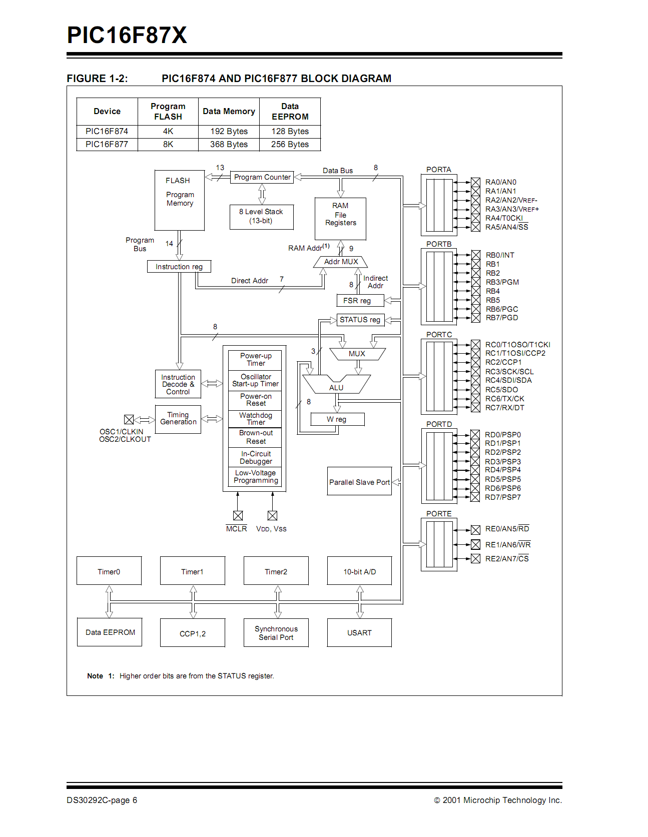

Slide 32
Summary

Slide 33
Thank you

