Slide 1
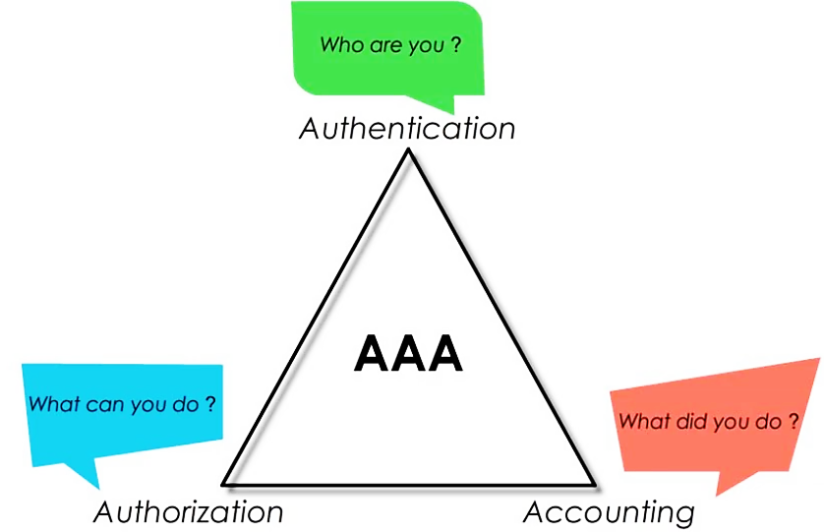
Computer & Network Security
AAA

Slide 2
Computer & Network Security
Prepared By: Misganaw A.
Email: mail@ethioptec.com/ethiomisgie@gmail.com
Website: project.ethioptec.com
Online material: academics.ethioptec.com
You Tube: youtube.com/@ethioptech

Slide 3

Fundamental security framework
AAA
AAA stands for Authentication, Authorization and Accounting.
It is the fundamental security framework.
controlling a user’s access to a network.
determining access level or privileges.
Keeping track of user activities based on policies and user identities.

Slide 4
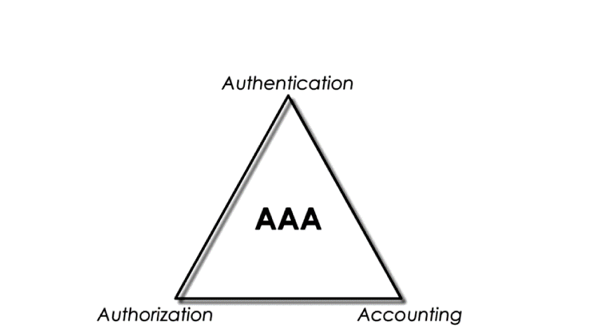
Fundamental security framework
Authentication
The 1st component of AAA is authentication. Asks who are you?.
In this stage we need some credentials such as username and password to verify our identity.

Slide 5
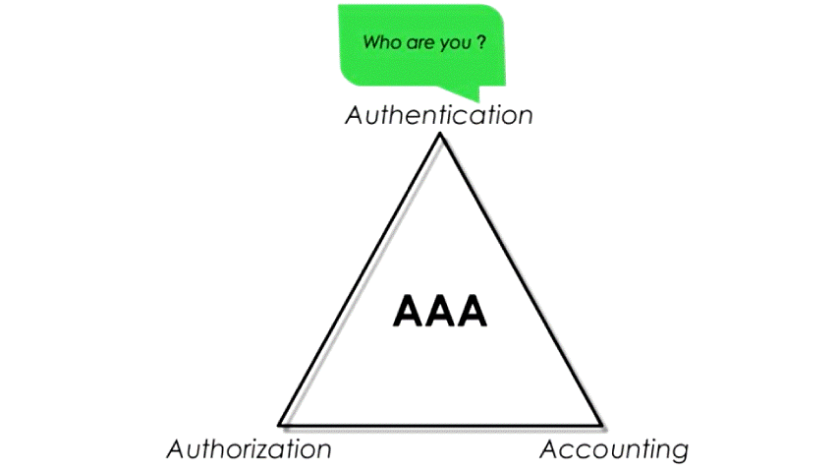
Fundamental security framework
Authorization
After our identity is verified, we will be granted with some privileges.
This is called authorization.
Authorization is about what do we can do?
The privilege includes what sources or services can we access.

Slide 6
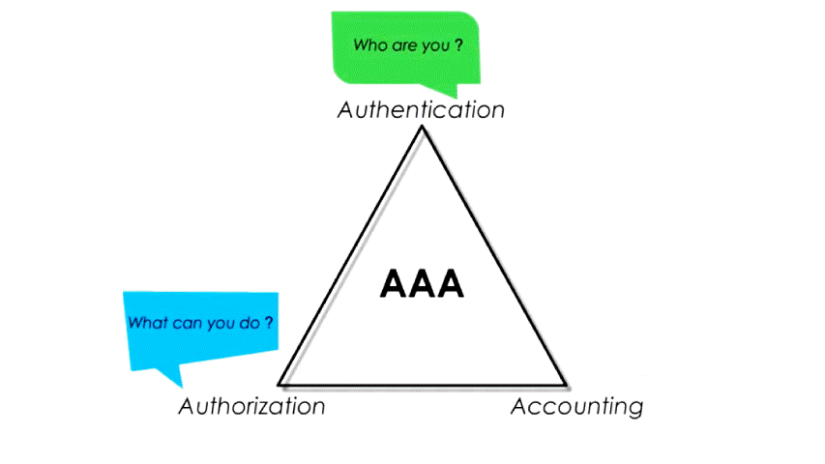
Fundamental security framework
Accounting
It keeps track of our log activities.
It may include
what resources we used.
how much we used and
how long we used.
Data collected at this stage could be used for
Controlling
monitoring
Billing
statistics and more

Slide 7
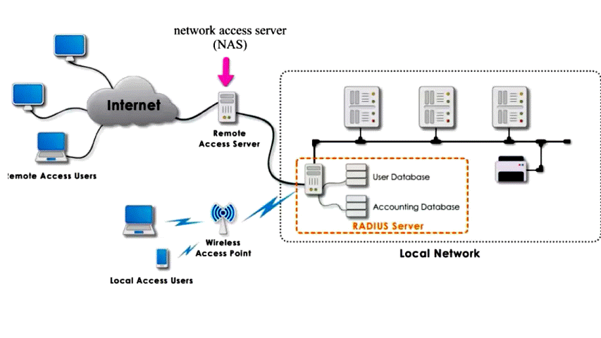
Fundamental security framework
RADIUS- remote authentication dial-in user service.
It use AAA framework.
It is client/server protocol and system.
It enable NAS (network access server) to communicate with a central server to
authenticate dial-in users.
Authorize access to the network and
keep track of their activities.
In RADIUS NAS is connecting point b/n user and AAA servers

Slide 8
Fundamental security framework
RADIUS- remote authentication dial-in user service.
NAS can be remote access server for remote user or WAP (wireless access point) for local wireless user.
RADIUS is not just for remote users as its name suggests. But I can be used for local users.
For local user through wireless or wired connection.

Slide 9
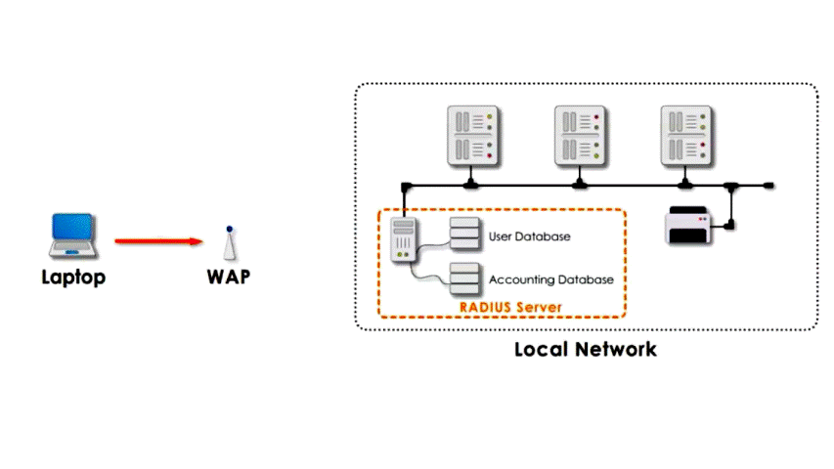
Fundamental security framework
Suppose a user want to access local network.
In RADIUS user device is called as supplicant.
WAP is called RADIUS client.
A middleman b/n user and AAA servers.

Slide 10
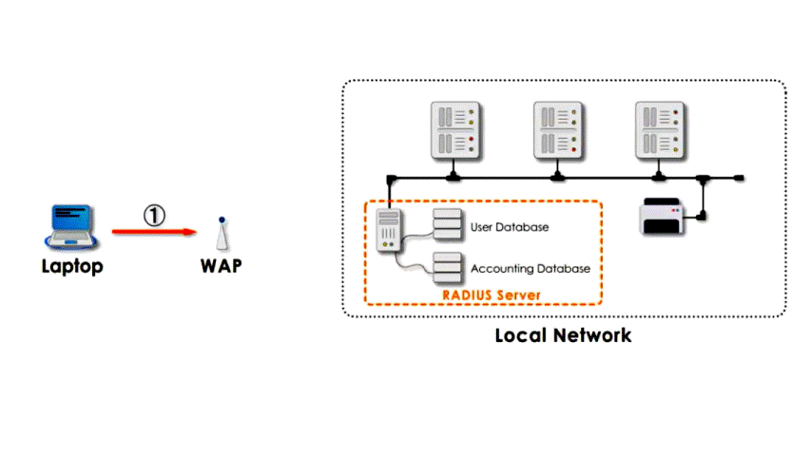
Fundamental security framework
Step1: Request WAP for authentication
The user contacts WAP and request permission to access the network using his/her user ID and password.
Step 2: WAP request Authentication to RADIUS server.
WAP contact the RADIUS server to see if a user exist in RADIUS server’s database as a valid user.

Slide 11
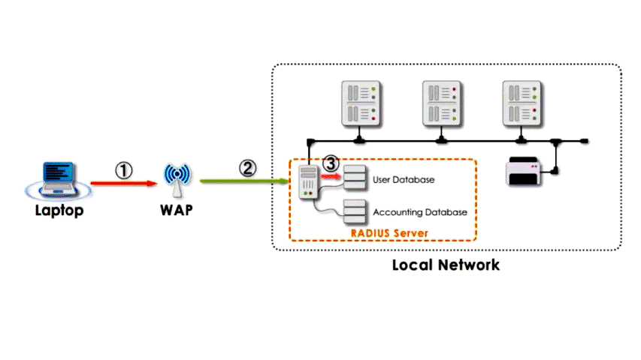
Fundamental security framework
Step 3: RADIUS compare requested ID and password with the database.
The RADIUS checks the database against client credentials.
Step 4: authentication acknowledgment.
Once a user verified, the RADIUS server sends a packet to the WAP with access permission, session and certain privileges.

Slide 12
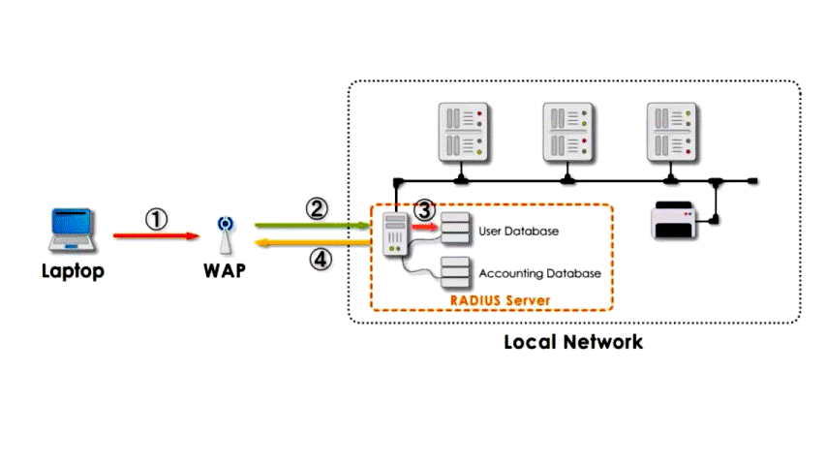
Fundamental security framework
Step 5: recodes in accounting database.
It is accounting component of AAA server.
The accounting database creates a record of the user and keep track of all client activities during active session.

Slide 13
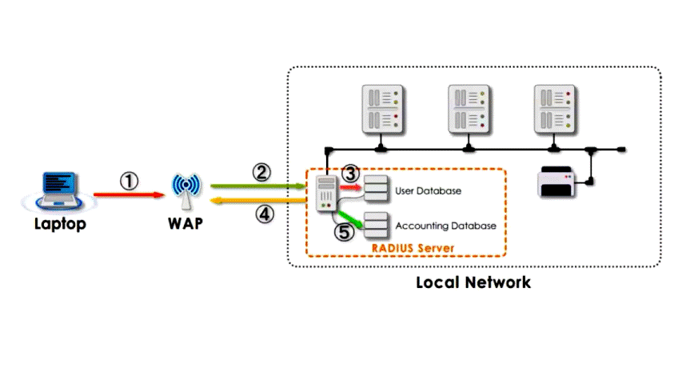
Fundamental security framework
Step 6: Approval to client.
The WAP forward the packets to the client.
Now client can access and use the network resources until he/she logout of active session is expired.
Generally, RADIUS is designed to provide centralized access to a network.

Slide 14
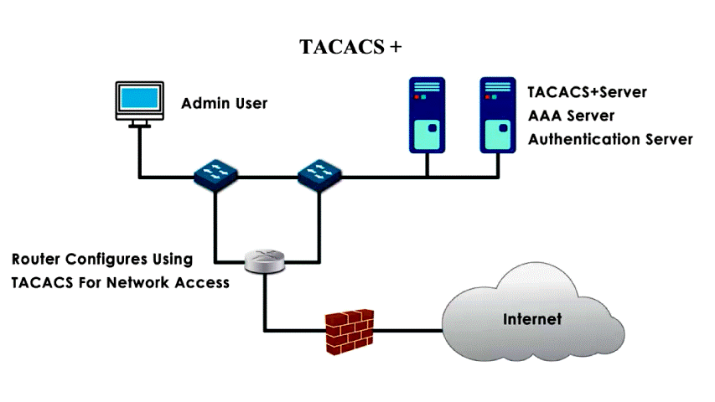
Fundamental security framework
TACACS- Terminal access control access control system
like RADIUS TACACS used AAA framework.
RADIUS designed to authenticate and log remote network users.
While TACACS+ is designed for administrative access to network devices like routers and switches.
TACACS+ should be deployed in a fully trusted integral network.
No direct access allowed form untrusted or semi-trusted networks.

Slide 15
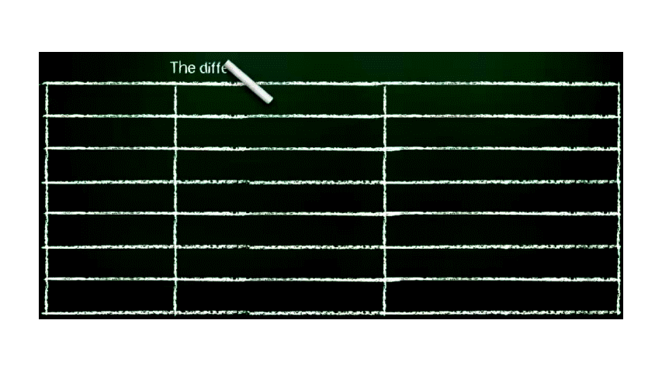
Fundamental security framework

Slide 16
Exercises on Fundamental security framework
If your university allows you to use username and password to access SIMS to see your cumulative grade, what type of AAA security framework is applied in university SIMS?
If you are ICT office director having full privilege to access different network devices deployed in a very secured area, what type of AAA framework type is you have?
Suppose you are telecom technician in customer service department. The customer services are fully operated online through internet. Your admin control and monitor what activity are you doing. What type of AAA framework is your admin used?
Explain the main difference b/n RADIUS and TACACS+

