Slide 1
Compiler design
Target batch 5th year Computer engineering students
ECE, GIT, DTU
By Misganaw Aguate
MSc. In Computer Engineering
ethiomisgie@gmail.com
https://www.project.ethioptec.com
YouTube channel: ethioptech
ethiomisgie@gmail.com | Project.ethioptec.com | YouTube: ethioptech

Slide 2
Compiler design
Contents
Common terminologies of compiler design
Introduction
Syntax and Semantics
Lexical and syntax analysis
ethiomisgie@gmail.com | Project.ethioptec.com | YouTube: ethioptech

Slide 3
Introduction to compiler
Prerequisites
This tutorial requires no prior knowledge of compiler design but requires
basic understanding of at least one programming language such as
C
Java
Javascript
Python etc.
It would be an additional advantage if you have had prior exposure to Assembly Programming.
ethiomisgie@gmail.com | Project.ethioptec.com | YouTube: ethioptech

Slide 4
Common terminologies in Compiler
1. Grammar
<assignment> ::= <identifier> = <expression>;
<expression> ::= <identifier> | <number> | <expression> + <expression>
<identifier> ::= [a-zA-Z][a-zA-Z0-9]*
<number> ::= [0-9]+
Grammars define the rules of syntax for a programming language.
A grammar specifies how tokens are combined to form valid statements or expressions in the language. Grammars are often expressed using Backus-Naur Form (BNF) or Context-Free Grammar (CFG).
Example: A simple grammar for an assignment statement:
This grammar specifies:
An assignment statement consists of an identifier, followed by =, followed by an expression, and ends with ;.
An expression can be an identifier, a number, or a combination of expressions with +.
ethiomisgie@gmail.com | Project.ethioptec.com | YouTube: ethioptech

Slide 5
Common terminologies in Compiler
2. token
Tokens are the smallest meaningful units of a program, derived during the lexical analysis phase of a compiler or interpreter.
Tokens represent a categorized group of characters in source code, such as keywords, identifiers, literals, operators, and symbols.
Examples: For the code snippet:
x = 10 + y;
The tokens are:
x (identifier)
= (assignment operator)
10 (numeric literal)
+ (arithmetic operator)
y (identifier)
; (symbol
ethiomisgie@gmail.com | Project.ethioptec.com | YouTube: ethioptech

Slide 6
Common terminologies in Compiler
Examples of Lexemes:
For the following C++ code:
int x = 10 + y;
3. Lexeme
A lexeme is a sequence of characters in source code that matches the pattern for a token.
It is the actual text or string from the source code that gets classified as a specific token during the lexical analysis phase of compilation.
int is a lexeme for the token type Keyword.
x is a lexeme for the token type Identifier.
10 is a lexeme for the token type Numeric Literal.
+ is a lexeme for the token type Operator.
ethiomisgie@gmail.com | Project.ethioptec.com | YouTube: ethioptech

Slide 7
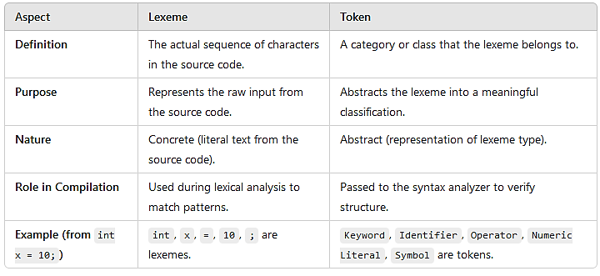
Common terminologies in Compiler
The difference between Lexeme and token
ethiomisgie@gmail.com | Project.ethioptec.com | YouTube: ethioptech

Slide 8
Common terminologies in Compiler
Illustrative example
consider the following code
print(5 + 3)
Lexemes:
print
(
5
+
3
)
Tokens:
Keyword for print
Left Parenthesis for (
Numeric Literal for 5
Operator for +
Numeric Literal for 3
Right Parenthesis for )
Lexeme is the raw data from the source code (actual text).
Token is the processed, classified representation of that data used for further analysis.
ethiomisgie@gmail.com | Project.ethioptec.com | YouTube: ethioptech

Slide 9
Common terminologies in Compiler
Semantics
Semantics refer to the meaning of a program or code.
While syntax specifies structure, semantics ensure that the program is meaningful and behaves as expected.
Types of Semantics:
Static Semantics: Rules checked at compile-time (e.g., type-checking, variable declarations).
Dynamic Semantics: Behaviour during runtime (e.g., division by zero).
Example: For the code:
x = "10" + 20;
Syntactically valid: It follows the rules for assignment and expression formation.
Semantically invalid: Concatenation of a string with an integer may not be meaningful, depending on the language
ethiomisgie@gmail.com | Project.ethioptec.com | YouTube: ethioptech

Slide 10
Common terminologies in Compiler
Lexical Analyzer
The lexical analyzer, or lexer, is the first phase of the compiler.
It scans the source code and breaks it into tokens.
It also removes whitespace and comments.
Example: Input code:
int x = 100;
Lexical analysis breaks it into tokens:
int → Keyword
x → Identifier
= → Assignment operator
100 → Integer literal
; → Symbol
The lexical analyzer ensures that tokens are valid but does not check if they make sense together (that's the parser's job).
ethiomisgie@gmail.com | Project.ethioptec.com | YouTube: ethioptech

Slide 11
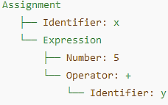
Common terminologies in Compiler
Syntax Analizer
A syntax analyzer or parser checks if the input tokens form a valid syntax as per the grammar of the programming language. It constructs a parse tree or abstract syntax tree (AST).
Example: Input code:
x = 5 + y;
If an invalid statement like x + = y; is encountered, the syntax analyzer will report an error.
Tokens: x, =, 5, +, y, ;
The syntax analyzer will produce a parse tree:
ethiomisgie@gmail.com | Project.ethioptec.com | YouTube: ethioptech

Slide 12
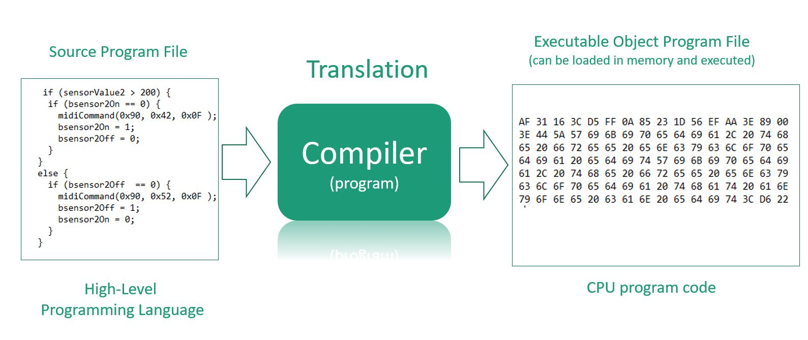
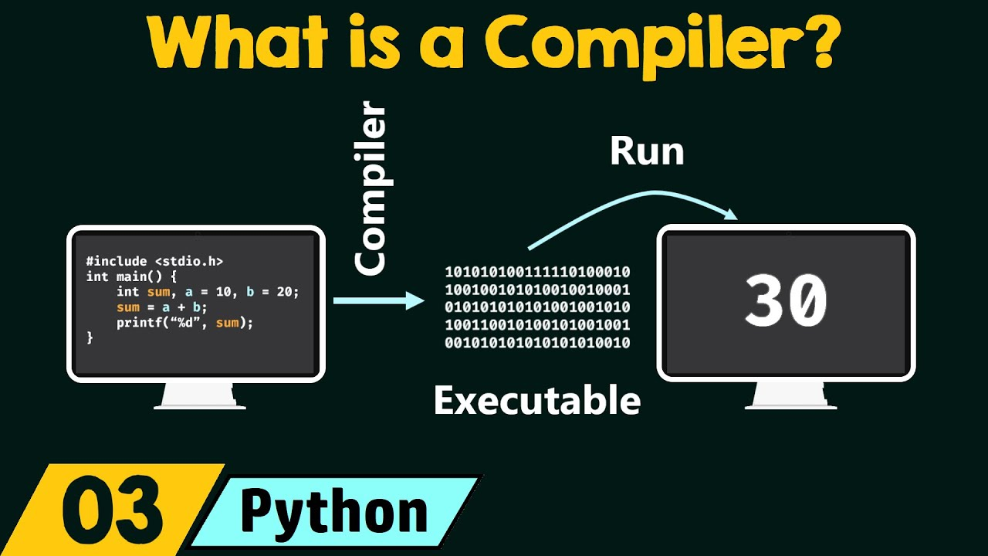
Introduction to compiler
A compiler translates the code written in one language to some other language without changing the meaning of the program.
It is also expected that a compiler should make the target code efficient and optimized in terms of time and space.
Compiler design principles provide an in-depth view of translation and optimization process.
Compiler design covers basic translation mechanism and error detection & recovery.
It includes lexical, syntax, and semantic analysis as front end, and code generation and optimization as back-end.
ethiomisgie@gmail.com | Project.ethioptec.com | YouTube: ethioptech

Slide 13
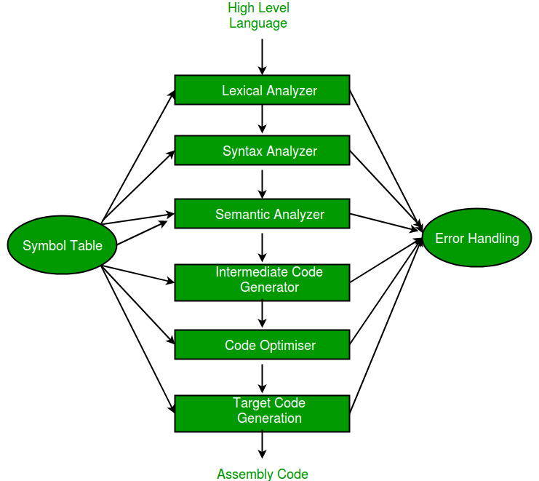
Introduction to compiler
Why to Learn Compiler design?
Computers are a balanced mix of software and hardware.
Hardware is just a piece of mechanical device and its functions are being controlled by a compatible software.
Hardware understands instructions in the form of electronic charge, which is the counterpart of binary language in software programming.
Binary language has only two alphabets, 0 and 1.
To instruct, the hardware codes must be written in binary format, which is simply a series of 1s and 0s.
It would be a difficult and cumbersome task for computer programmers to write such codes, which is why we have compilers to write such codes.
ethiomisgie@gmail.com | Project.ethioptec.com | YouTube: ethioptech

Slide 14
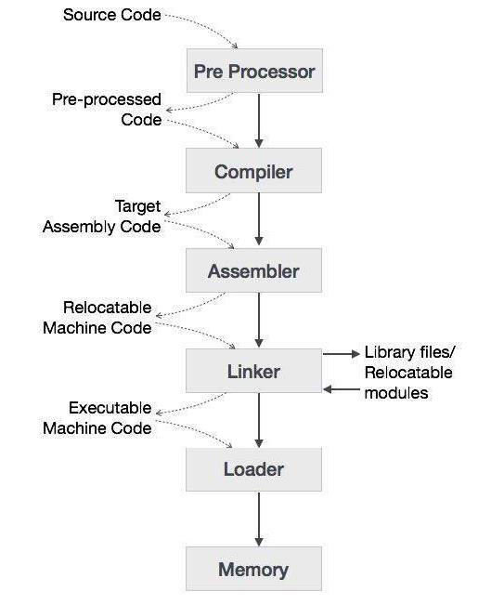
Introduction to compiler
Language Processing System
We have learnt that any computer system is made of hardware and software.
The hardware understands a language, which humans cannot understand.
So we write programs in high-level language, which is easier for us to understand and remember.
These programs are then fed into a series of tools and OS components to get the desired code that can be used by the machine.
This is known as Language Processing System.
ethiomisgie@gmail.com | Project.ethioptec.com | YouTube: ethioptech

Slide 15
Introduction to compiler
A compiler is a program that converts high-level language to assembly language.
Similarly, an assembler is a program that converts the assembly language to machine-level language.
Let us first understand how a program, using C compiler, is executed on a host machine.
User writes a program in C language (high-level language).
The C compiler, compiles the program and translates it to assembly program (low-level language).
An assembler then translates the assembly program into machine code (object).
A linker tool is used to link all the parts of the program together for execution (executable machine code).
A loader loads all of them into memory and then the program is executed.
ethiomisgie@gmail.com | Project.ethioptec.com | YouTube: ethioptech

Slide 16
Introduction to compiler
A few other tools that work closely with compilers.
Preprocessor
Is a tool that produces input for compilers.
It deals with macro-processing, augmentation, file inclusion, language extension, etc.
Interpreter
A compiler reads the whole source code at once, creates tokens, checks semantics, generates intermediate code, executes the whole program and may involve many passes.
In contrast, an interpreter reads a statement from the input, converts it to an intermediate code, executes it, then takes the next statement in sequence.
If an error occurs, an interpreter stops execution and reports it.
whereas a compiler reads the whole program even if it encounters several errors.
ethiomisgie@gmail.com | Project.ethioptec.com | YouTube: ethioptech

Slide 17
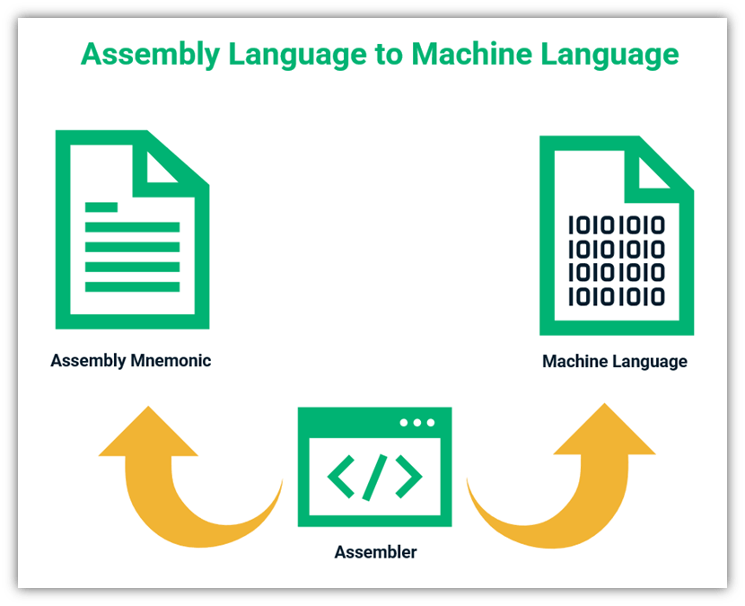
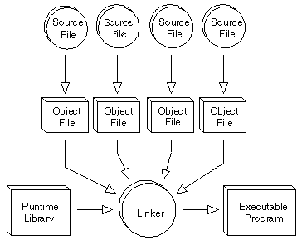
Introduction to compiler
A few other tools that work closely with compilers.
Assembler
It translates assembly language programs into machine code.
The output of an assembler is called an object file, which contains a combination of machine instructions as well as the data required to place these instructions in memory.
Linker
Linker is a computer program that links and merges various object files together in order to make an executable file.
All these files might have been compiled by separate assemblers.
The major task of a linker is to search and locate referenced module/routines in a program and to determine the memory location where these codes will be loaded, making the program instruction to have absolute references.
ethiomisgie@gmail.com | Project.ethioptec.com | YouTube: ethioptech

Slide 18
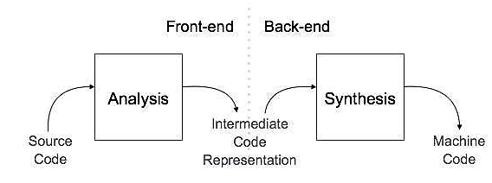
Introduction to compiler
Compiler architecture
A compiler can broadly be divided into two phases based on the way they compile.
1. Analysis Phase
Known as the front-end of the compiler,
The analysis phase of the compiler reads the source program, divides it into core parts and then checks for lexical, grammar and syntax errors.
The analysis phase generates an intermediate representation of the source program and symbol table, which should be fed to the Synthesis phase as input.
ethiomisgie@gmail.com | Project.ethioptec.com | YouTube: ethioptech

Slide 19
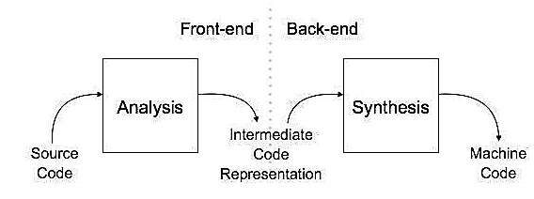
Introduction to compiler
2. Synthesis Phase
Known as the back-end of the compiler
The synthesis phase generates the target program with the help of intermediate source code representation and symbol table.
A compiler can have many phases and passes.
Pass : A pass refers to the traversal of a compiler through the entire program.
Phase : A phase of a compiler is a distinguishable stage, which takes input from the previous stage, processes and yields output that can be used as input for the next stage. A pass can have more than one phase.
ethiomisgie@gmail.com | Project.ethioptec.com | YouTube: ethioptech

Slide 20
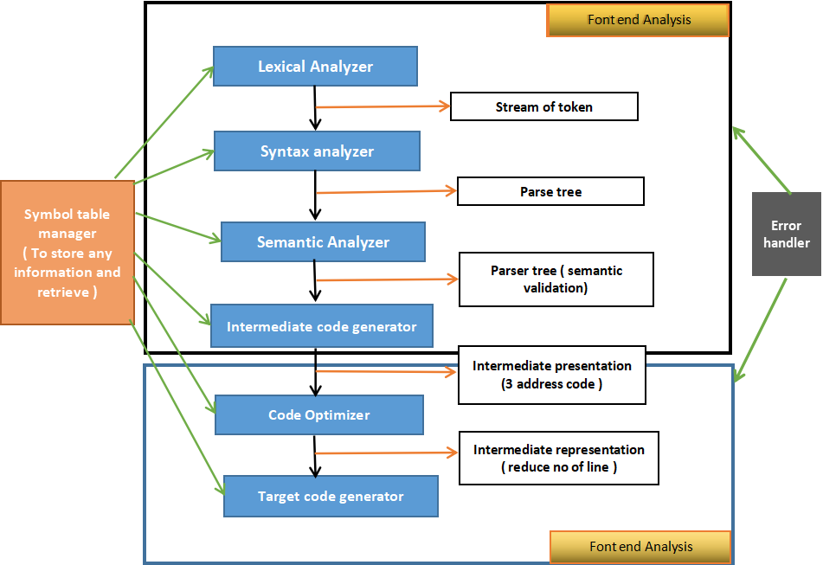
Introduction to compiler
Phases of compiler
The compilation process is a sequence of various phases.
Each phase takes input from its previous stage, has its own representation of source program, and feeds its output to the next phase of the compiler.
ethiomisgie@gmail.com | Project.ethioptec.com | YouTube: ethioptech

Slide 21
Introduction to compiler
Review questions
What is Compiler Design?
Why do we use compiler?
What are four type of compiler
How does compiler work?
Is that compiler a system or application software?
What is token and lexeme in compiler design?
ethiomisgie@gmail.com | Project.ethioptec.com | YouTube: ethioptech

Slide 22
Syntax and Semantics
Syntax
The syntax of a programming language is the form of its expressions, statements, and program units.
Its semantics is the meaning of those expressions, statements, and program units. For example, the syntax of a Java while statement is
while (boolean_expr) statement
A language, whether natural (such as English) or artificial (such as Java), is a set of strings of characters from some alphabet.
The strings of a language are called sentences or statements.
Lexemes
Lexemes are a sequence of characters (alphanumeric) in a token.
ethiomisgie@gmail.com | Project.ethioptec.com | YouTube: ethioptech

Slide 23
Syntax and Semantics
Lexemes are partitioned into groups.
For example, the names of variables, methods, classes, and so forth.
In a programming language form a group called identifiers.
Each lexeme group is represented by a name, or token.
So, a token of a language is a category of its lexemes. For example, an identifier is a token that can have lexemes, or instances, such as sum and total.
In some cases, a token has only a single possible lexeme. For example, the token for the arithmetic operator symbol + has just one possible lexeme. Consider the following Java statement:
index = 2 * count + 17;
ethiomisgie@gmail.com | Project.ethioptec.com | YouTube: ethioptech

Slide 24
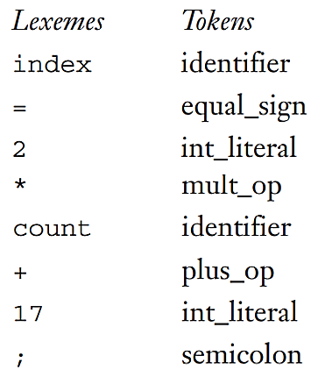
Syntax and Semantics
ethiomisgie@gmail.com | Project.ethioptec.com | YouTube: ethioptech

Slide 25
Syntax and Semantics
Language recognizer
In general, languages can be formally defined in two distinct ways:
by recognition and
by generation.
The syntax analysis part of a compiler is a recognizer for the language that the compiler translates.
In this role, the recognizer need not test all possible strings of characters from some set to determine whether each is in the language.
Rather, it need only determine whether given programs are in the language. In effect then, the syntax analyzer determines whether the given programs are syntactically correct.
ethiomisgie@gmail.com | Project.ethioptec.com | YouTube: ethioptech

Slide 26
Syntax and Semantics
Language generator
A language generator is a device that can be used to generate the sentences of a language. Formal method of describing syntax
Backus-Naur Form (BNF)
BNF uses abstractions for syntactic structures.
A simple Java assignment statement, for example, might be represented by the abstraction <assign> .
The actual definition of <assign> can be given by
<assign> → <var> = <expression>
ethiomisgie@gmail.com | Project.ethioptec.com | YouTube: ethioptech

Slide 27
Syntax and Semantics
The text on the left side of the arrow, which is aptly called the left-hand side (LHS), is the abstraction being defined.
The text to the right of the arrow is the definition of the LHS. It is called the right-hand side (RHS) and consists of some mixture of tokens, lexemes, and references to other abstractions. Altogether, the definition is called a rule, or production.
In the example rule just given, the abstractions <var> and <expression> obviously must be defined for the <assign> definition to be useful.
Fore example
total = subtotal1 + subtotal2
ethiomisgie@gmail.com | Project.ethioptec.com | YouTube: ethioptech

Slide 28
Syntax and Semantics
The abstractions in a BNF description, or grammar, are often called nonterminal symbols, or simply nonterminals
The lexemes and tokens of the rules are called terminal symbols, or simply terminals.
A BNF description, or grammar, is a collection of rules.
Nonterminal symbols can have two or more distinct definitions, representing two or more possible syntactic forms in the language.
Multiple definitions can be written as a single rule, with the different definitions separated by the symbol|, meaning logical OR.
For example, a Java if statement can be described with the rules
ethiomisgie@gmail.com | Project.ethioptec.com | YouTube: ethioptech

Slide 29
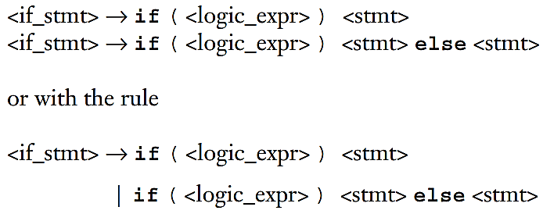
Syntax and Semantics
In these rules, <stmt> represents either a single statement or a compound statement
ethiomisgie@gmail.com | Project.ethioptec.com | YouTube: ethioptech

Slide 30
Syntax and Semantics
Describing Lists
For BNF, the alternative method required for describing lists of syntactic elements in programming languages is recursion.
A rule is recursive if its LHS appears in its RHS.
The following rules illustrate how recursion is used to describe lists:
<ident_list> → identifier | identifier, <ident_list>
This defines <ident_list> as either a single token (identifier) or an identifier followed by a comma and another instance of <ident_list>. Recursion is used to describe lists in many of the example grammars.
ethiomisgie@gmail.com | Project.ethioptec.com | YouTube: ethioptech

Slide 31
Syntax and Semantics
Grammar and derivation
A grammar is a generative device for defining languages.
The sentences of the language are generated through a sequence of applications of the rules, beginning with a special nonterminal of the grammar called the start symbol.
This sequence of rule applications is called a derivation.
In a grammar for a complete programming language, the start symbol represents a complete program and is often named <program>.
The simple grammar shown in following Example 3.1 is used to illustrate derivations
ethiomisgie@gmail.com | Project.ethioptec.com | YouTube: ethioptech

Slide 32
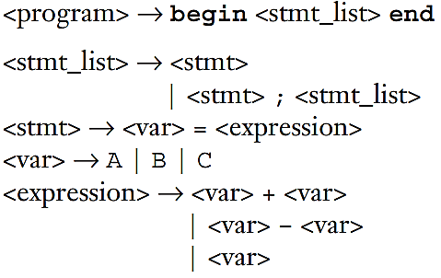
Syntax and Semantics
A program consists of the special word begin, followed by a list of statements separated by semicolons, followed by the special word end.
An expression is either a single variable or two variables separated by either a + or - operator.
The only variable names in this language are A, B, and C.
A derivation of a program in this language follows in the next slide:
ethiomisgie@gmail.com | Project.ethioptec.com | YouTube: ethioptech

Slide 33
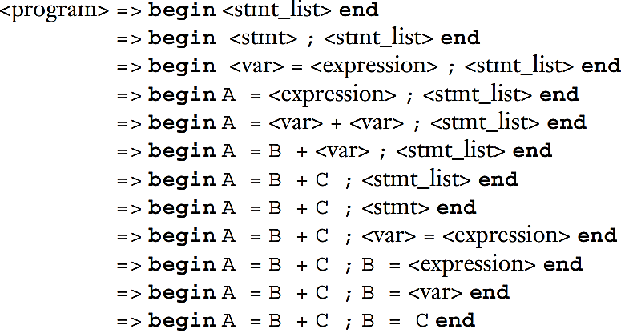
Syntax and Semantics
The symbol => is read “derives.”
ethiomisgie@gmail.com | Project.ethioptec.com | YouTube: ethioptech

Slide 34
Syntax and Semantics
In this derivation, the replaced nonterminal is always the leftmost nonterminal in the previous sentential form.
Derivations that use this order of replacement are called leftmost derivations.
The derivation continues until the sentential form contains no non terminals.
That sentential form, consisting of only terminals, or lexemes, is the generated sentence.
In addition to leftmost, a derivation may be rightmost.
Derivation order has no effect on the language generated by a grammar.
ethiomisgie@gmail.com | Project.ethioptec.com | YouTube: ethioptech

Slide 35
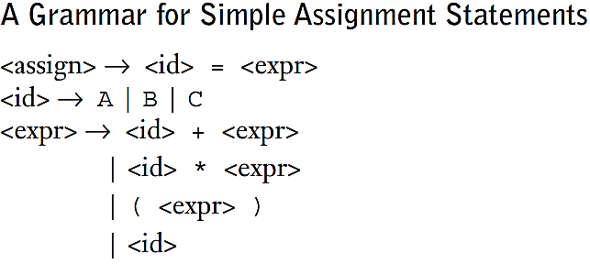
Syntax and Semantics
Example 3.2 is another example of a grammar for part of a typical programming language.
The grammar of the Example describes assignment statements whose right sides are arithmetic expressions with multiplication and addition operators and parentheses.
For example, the statement
A = B * ( A + C )
is generated by the leftmost derivation:
ethiomisgie@gmail.com | Project.ethioptec.com | YouTube: ethioptech

Slide 36
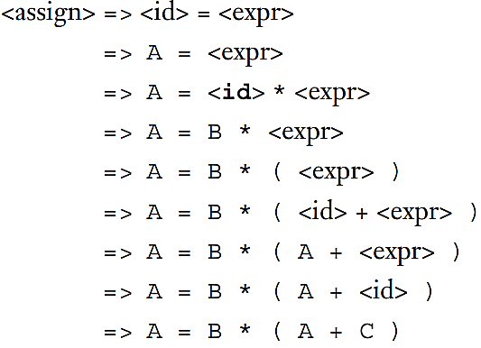
Syntax and Semantics
ethiomisgie@gmail.com | Project.ethioptec.com | YouTube: ethioptech

Slide 37
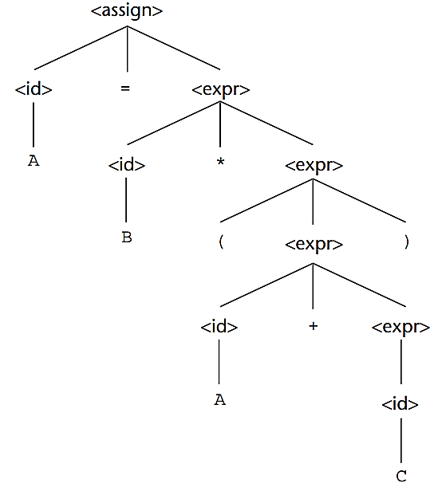
Syntax and Semantics
Pars tree
Figure 3.1
One of the most attractive features of grammars is that they naturally describe the hierarchical syntactic structure of the sentences of the languages they define.
These hierarchical structures are called parse trees.
For example, the parse tree in Figure 3.1 shows the structure of the assignment statement derived previously.
Every internal node of a parse tree is labeled with a nonterminal symbol. every leaf is labeled with a terminal symbol.
Every subtree of a parse tree describes one instance of an abstraction in the sentence.
ethiomisgie@gmail.com | Project.ethioptec.com | YouTube: ethioptech

Slide 38
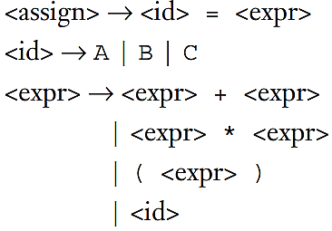
Syntax and Semantics
Ambiguity
A grammar that generates a sentential form for which there are two or more distinct parse trees is said to be ambiguous.
Consider the grammar shown in the Example 3.3, which is a minor variation of the grammar shown in Example 3.2.
Source of Ambiguity
Lack of determination of operator precedence
Lack of determination of operator associatively
ethiomisgie@gmail.com | Project.ethioptec.com | YouTube: ethioptech

Slide 39
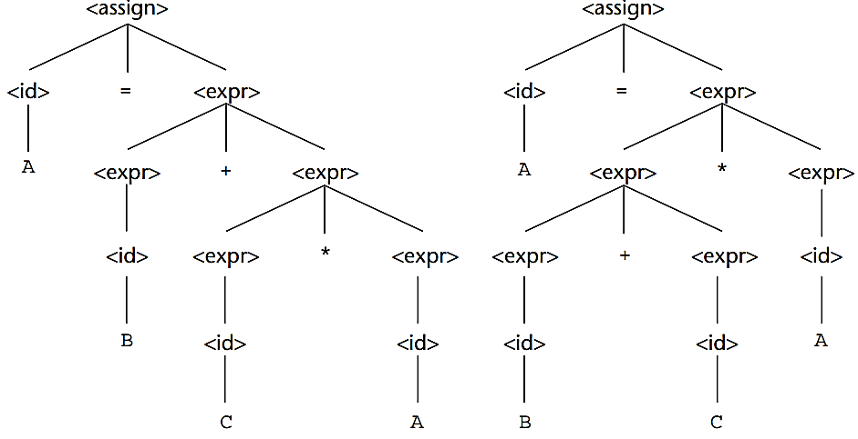
Syntax and Semantics
The grammar of Example 3.3 is ambiguous because the sentence
A = B + C * A
has two distinct parse trees, as shown in Figure 3.2.
The ambiguity occurs because the grammar specifies slightly less syntactic structure than does the grammar of Example 3.2.
Rather than allowing the parse tree of an expression to grow only on the right, this grammar allows growth on both the left and the right.
Figure 3.2.
ethiomisgie@gmail.com | Project.ethioptec.com | YouTube: ethioptech

Slide 40
Syntax and Semantics
Syntactic ambiguity of language structures is a problem because compilers often base the semantics of those structures on their syntactic form.
Specifically, the compiler chooses the code to be generated for a statement by examining its parse tree.
If a language structure has more than one parse tree, then the meaning of the structure cannot be determined uniquely.
We can avoid Syntactic ambiguity using operator precedence and associativity of operator
ethiomisgie@gmail.com | Project.ethioptec.com | YouTube: ethioptech

Slide 41
Syntax and Semantics
Operator precedence
When an expression includes two different operators, for example, x + y * z, one obvious semantic issue is the order of evaluation of the two operators .
This semantic question can be answered by assigning different precedence levels to operators. For example, if * has been assigned higher precedence than +, multiplication will be done first, regardless of the order of appearance of the two operators in the expression.
ethiomisgie@gmail.com | Project.ethioptec.com | YouTube: ethioptech

Slide 42
Syntax and Semantics
In the first parse tree of Figure 3.2, the multiplication operator is generated lower in the tree, which could indicate that it has precedence over the addition operator in the expression.
The second parse tree, however, indicates just the opposite.
It appears, that the two parse trees indicate conflicting precedence information.
Notice that although the grammar of Example 3.2 is not ambiguous, the precedence order of its operators is not the usual one.
A grammar can be written for the simple expressions.
we have been discussing that is both unambiguous and specifies a consistent precedence of the + and * operators, regardless of the order in which the operators appear in an expression.
ethiomisgie@gmail.com | Project.ethioptec.com | YouTube: ethioptech

Slide 43
Syntax and Semantics
The correct ordering is specified by using separate nonterminal symbols to represent the operands of the operators that have different precedence.
This requires additional nonterminals and some new rules.
Instead of using <expr> for both operands of both + and *, we could use three nonterminals to represent operands, which allows the grammar to force different operators to different levels in the parse tree.
If <expr> is the root symbol for expressions, + can be forced to the top of the parse tree by having <expr> directly generate only + operators Using the new nonterminal, <term>, as the right operand of +.
ethiomisgie@gmail.com | Project.ethioptec.com | YouTube: ethioptech

Slide 44
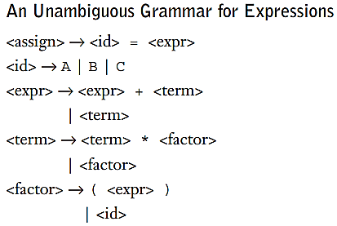
Syntax and Semantics
Next, we can define <term> to generate * operators. using <term> as the left operand and a new nonterminal, <factor>, as its right operand.
Now, * will always be lower in the parse tree, simply because it is farther from the start symbol than + in every derivation.
The grammar of Example 3.4 is such a grammar.
ethiomisgie@gmail.com | Project.ethioptec.com | YouTube: ethioptech

Slide 45
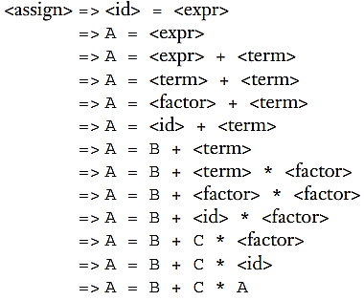
Syntax and Semantics
The grammar in Example 3.4 generates the same language as the grammars of Examples 3.2 and 3.3, but it is unambiguous and it specifies the usual precedence order of multiplication and addition operators.
The following derivation of the sentence A = B + C * A uses the grammar of Example 3.4:
ethiomisgie@gmail.com | Project.ethioptec.com | YouTube: ethioptech

Slide 46
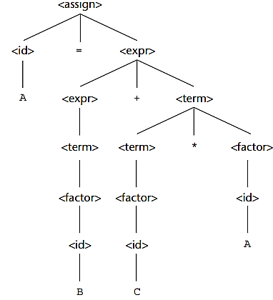
Syntax and Semantics
The unique parse tree for this sentence, using the grammar of Example 3.4, is shown in Figure 3.3.
Every derivation with an unambiguous grammar has a unique parse tree, although that tree can be represented by different derivations.
For example, the following derivation of the sentence A = B + C * A is different from the derivation of the same sentence given previously. This is a rightmost derivation, whereas the previous one is leftmost. Both of these derivations, however, are represented by the same parse tree.
Figure 3.3
ethiomisgie@gmail.com | Project.ethioptec.com | YouTube: ethioptech

Slide 47
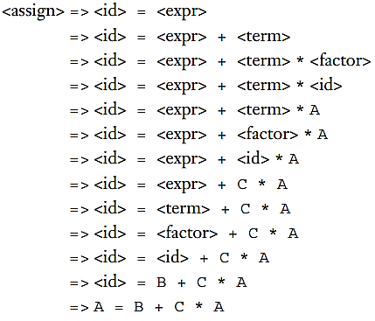
Syntax and Semantics
Right most derivation of A=B+C*A
ethiomisgie@gmail.com | Project.ethioptec.com | YouTube: ethioptech

Slide 48
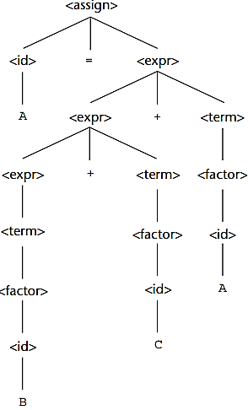
Syntax and Semantics
Associativity of Operators
When an expression includes two operators that have the same precedence, a semantic rule is required to specify which should have precedence.
for example, A / B * C.
This rule is named associativity.
Consider the following example of an assignment statement:
A = B + C + A
The parse tree for this sentence, as defined with the grammar of Example 3.4, is shown in Figure 3.4.
Figure 3.4
ethiomisgie@gmail.com | Project.ethioptec.com | YouTube: ethioptech

Slide 49
Syntax and Semantics
Associativity of Operators
When an expression includes two operators that have the same precedence, a semantic rule is required to specify which should have precedence.
for example, A / B * C.
This rule is named associativity.
Consider the following example of an assignment statement:
A = B + C + A
The parse tree for this sentence, as defined with the grammar of Example 3.4, is shown in Figure 3.4.
Figure 3.4
ethiomisgie@gmail.com | Project.ethioptec.com | YouTube: ethioptech

Slide 50
Syntax and Semantics
The parse tree of Figure 3.4 shows the left addition operator lower than the right addition operator.
This is the correct order if addition is meant to be left associative, which is typical.
In most cases, the associativity of addition in a computer is irrelevant.
In mathematics, addition is associative, which means that left and right associative orders of evaluation mean the same thing. That is, (A + B) + C = A + (B + C).
ethiomisgie@gmail.com | Project.ethioptec.com | YouTube: ethioptech

Slide 51
Syntax and Semantics
When a grammar rule has its LHS also appearing at the beginning of its RHS, the rule is said to be left recursive.
This left recursion specifies left associativity.
For example, the left recursion of the rules of the grammar of Example 3.4 causes it to make both addition and multiplication left associative.
Unfortunately, left recursion disallows the use of some important syntax analysis algorithms.
When such algorithms are to be used, the grammar must be modified to remove the left recursion.
This, in turn, disallows the grammar from precisely specifying that certain operators are left associative.
Fortunately, left associativity can be enforced by the compiler, even though the grammar does not dictate it.
ethiomisgie@gmail.com | Project.ethioptec.com | YouTube: ethioptech

Slide 52
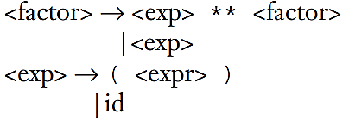
Syntax and Semantics
In most languages that provide it, the exponentiation operator is right associative.
To indicate right associativity, right recursion can be used.
A grammar rule is right recursive if the LHS appears at the right end of the RHS. Rules such as
could be used to describe exponentiation as a right-associative operator.
ethiomisgie@gmail.com | Project.ethioptec.com | YouTube: ethioptech

Slide 53
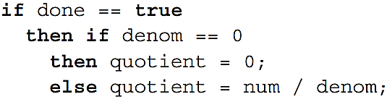
Syntax and Semantics
An Unambiguous Grammar for if-then-else
The BNF rules for an Ada if-then-else statement are as follows:
<if_stmt> → if <logic_expr> then <stmt>
if <logic_expr> then <stmt> else <stmt>
If we also have <stmt> → <if_stmt>, this grammar is ambiguous.
The simplest sentential form that illustrates this ambiguity is
if <logic_expr> then if <logic_expr> then <stmt> else <stmt>
The two parse trees in Figure 3.5 show the ambiguity of this sentential form. Consider the following example of this construct:
ethiomisgie@gmail.com | Project.ethioptec.com | YouTube: ethioptech

Slide 54
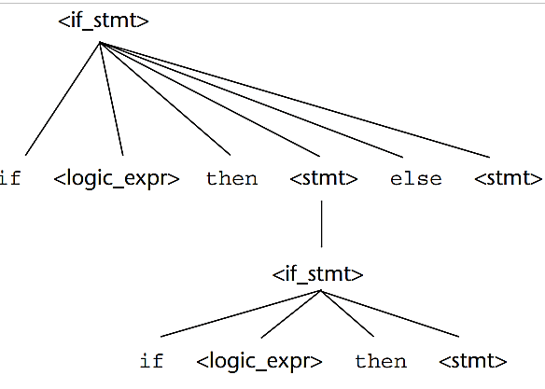
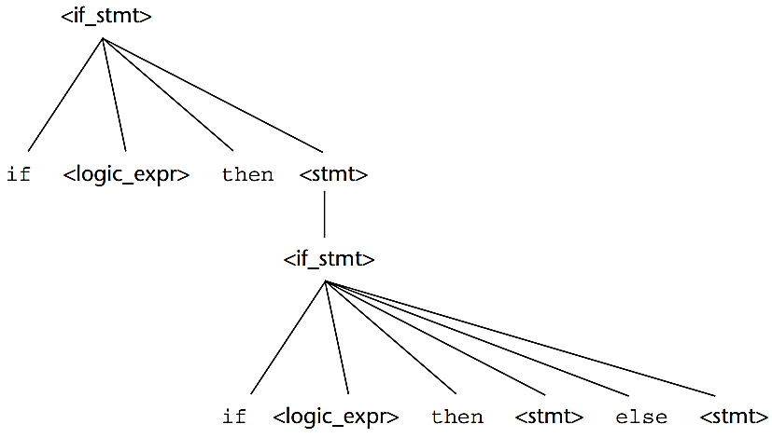
Syntax and Semantics
Figure 3.5
ethiomisgie@gmail.com | Project.ethioptec.com | YouTube: ethioptech

Slide 55
Syntax and Semantics
The problem is that if the upper parse tree in Figure 3.5 is used as the basis for translation, the else clause would be executed when done is not true.
That is probably is not what was intended by the author of the construct.
We will now develop an unambiguous grammar that describes this if statement.
The rule for if constructs in many languages is that an else clause, when present, is matched with the nearest previous unmatched then.
Therefore, there cannot be an if statement without an else between a then and its matching else.
So, for this situation, statements must be distinguished between those that are matched and those that are unmatched, where unmatched statements are matched.
ethiomisgie@gmail.com | Project.ethioptec.com | YouTube: ethioptech

Slide 56
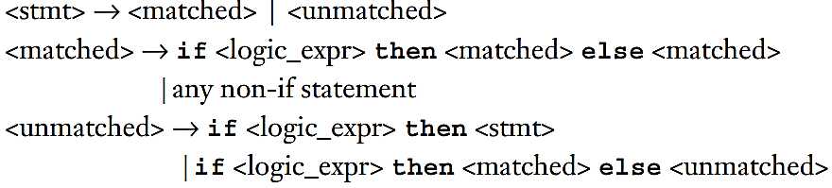
Syntax and Semantics
The problem with the earlier grammar is that it treats all statements as if they had equal syntactic significance.
To reflect the different categories of statements, different abstractions, or nonterminals, must be used.
The unambiguous grammar based on these ideas follows:
There is just one possible parse tree, using this grammar, for the following sentential form:
if <logic_expr> then if <logic_expr> then <stmt> else <stmt>
ethiomisgie@gmail.com | Project.ethioptec.com | YouTube: ethioptech

Slide 57
Syntax and Semantics
Extended BNF
The extended versions of BNF is Extended BNF, or simply EBNF.
The extensions do not enhance the descriptive power of BNF
Instead they only increase its readability and writability.
Three extensions are commonly included in the various versions of EBNF.
The first of these denotes an optional part of an RHS, which is delimited by brackets.
<if_stmt> → if (<expression>) <statement> [else <statement>]
Without the use of the brackets, the syntactic description of this statement would require the following two rules
<if_stmt> → if (<expression>) <statement>
| if (<expression>) <statement> else <statement>
ethiomisgie@gmail.com | Project.ethioptec.com | YouTube: ethioptech

Slide 58
Syntax and Semantics
The second extension is the use of braces in an RHS to indicate that the enclosed part can be repeated indefinitely or left out altogether.
This extension allows lists to be built with a single rule, instead of using recursion and two rules.
For example, lists of identifiers separated by commas can be described by the following rule:
<ident_list> → <identifier> {, <identifier>}
This is a replacement of the recursion by a form of implied iteration
The part enclosed within braces can be iterated any number of times.
The third common extension deals with multiple-choice options.
ethiomisgie@gmail.com | Project.ethioptec.com | YouTube: ethioptech

Slide 59
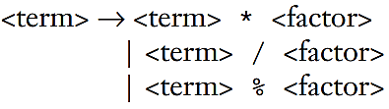
Syntax and Semantics
When a single element must be chosen from a group, the options are placed in parentheses and separated by the OR operator.For example,
<term> → <term> (* | / | %) <factor>
In BNF, a description of this <term> would require the following three rules:
The brackets, braces, and parentheses in the EBNF extensions are meta symbols.
which means they are notational tools and not terminal symbols in the syntactic entities they help describe.
In cases where these meta symbols are also terminal symbols in the language being described, the instances that are terminal symbols can be underlined or quoted.
Example 3.5 illustrates the use of braces and multiple choices in an EBNF grammar.
ethiomisgie@gmail.com | Project.ethioptec.com | YouTube: ethioptech

Slide 60
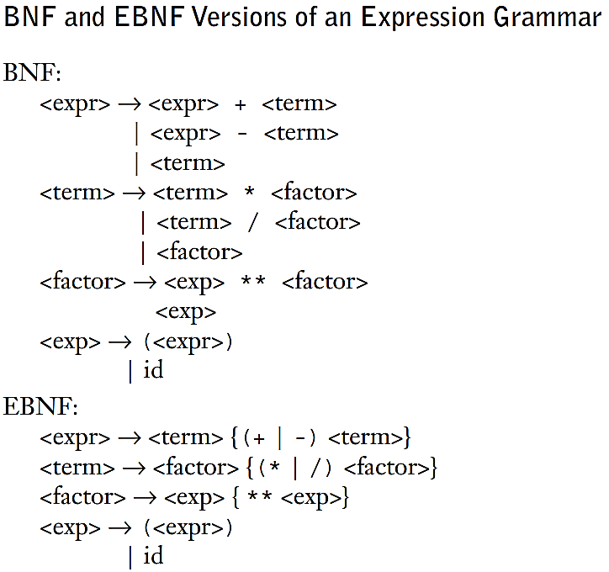
Syntax and Semantics
ethiomisgie@gmail.com | Project.ethioptec.com | YouTube: ethioptech

Slide 61
Syntax and Semantics
Review questions
Describe the operation of a general language generator.
Describe the operation of a general language recognizer.
What is the difference between a sentence and a sentential form.
Define a left-recursive grammar rule
Using the grammar in Example 3.2, show a parse tree and a leftmost derivation for each of the following statements:
A = A * (B + (C * A))
B = C * (A * C + B)
A = A * (B + (C))
6. Using the grammar in Example 3.4, show a parse tree and a leftmost derivation for each of the following statements:
A = ( A + B ) * C
A = B + C + A
ethiomisgie@gmail.com | Project.ethioptec.com | YouTube: ethioptech

Slide 62


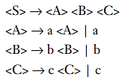
Syntax and Semantics
7. Prove that the following grammar is ambiguous:
9. Consider the following grammar
Which of the following sentences are in the language generated by this grammar? a. baab b. bbbab c. bbaaaaa d. bbaab
8. Describe, in English, the language defined by the following grammar:
ethiomisgie@gmail.com | Project.ethioptec.com | YouTube: ethioptech

Slide 63

Syntax and Semantics
10. Consider the following grammar:
Which of the following sentences are in the language generated by this grammar? a. abcd b. acccbd c. acccbcc d. acd e. accc
ethiomisgie@gmail.com | Project.ethioptec.com | YouTube: ethioptech

Slide 64
Lexical and Syntax analysis
Introduction
All compilers separate the task of analysing syntax into two distinct parts named
lexical analysis and
syntax analysis
The lexical analyser deals with small-scale language constructs, such as names and numeric literals.
The syntax analyser deals with the large-scale constructs, such as expressions, statements, and program units.
There are three reasons why lexical analysis is separated from syntax analysis
ethiomisgie@gmail.com | Project.ethioptec.com | YouTube: ethioptech

Slide 65
Lexical and Syntax analysis
Simplicity: Techniques for lexical analysis are less complex than those required for syntax analysis, so the lexical-analysis process can be simpler if it is separate.
Efficiency: Although it pays to optimize the lexical analyser, because lexical analysis requires a significant portion of total compilation time, it is not fruitful to optimize the syntax analyser.
Portability: Because the lexical analyser reads input program files and often includes buffering of that input, it is somewhat platform dependent. However, the syntax analyser can be platform independent. It is always good to isolate machine dependent parts of any software system.
ethiomisgie@gmail.com | Project.ethioptec.com | YouTube: ethioptech

Slide 66
Lexical and Syntax analysis
Lexical analyser
A lexical analyser serves as the front end of a syntax analyser.
Technically, lexical analysis is a part of syntax analysis.
A lexical analyser performs syntax analysis at the lowest level of program structure.
An input program appears to a compiler as a single string of characters.
The lexical analyser collects characters into logical groupings and assigns internal codes to the groupings according to their structure. constants.
ethiomisgie@gmail.com | Project.ethioptec.com | YouTube: ethioptech

Slide 67
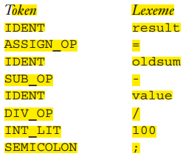
Lexical and Syntax analysis
In the previous section, these logical groupings are named lexemes, and the internal codes for categories of these groupings are named tokens.
Lexemes are recognized by matching the input character string against character string patterns.
Although tokens are usually represented as integer values, for the sake of readability of lexical and syntax analysers, they are often referenced through named constants.
result = oldsum – value / 100;
Following are the tokens and lexemes of this statement:
ethiomisgie@gmail.com | Project.ethioptec.com | YouTube: ethioptech

Slide 68
Lexical and Syntax analysis
Lexical analysers extract lexemes from a given input string and produce the corresponding tokens.
The only view of the input program seen by the syntax analyser is the output of the lexical analyser, one token at a time.
The lexical-analysis process includes skipping comments and white space outside lexemes, as they are not relevant to the meaning of the program.
Also, the lexical analyser inserts lexemes for user-defined names into the symbol table, which is used by later phases of the compiler.
ethiomisgie@gmail.com | Project.ethioptec.com | YouTube: ethioptech

Slide 69
Lexical and Syntax analysis
There are three approaches to building a lexical analyser:
Write a formal description of the token patterns of the language using a descriptive language related to regular expressions.1 These descriptions are used as input to a software tool that automatically generates a lexical analyser.
Design a state transition diagram that describes the token patterns of the language and write a program that implements the diagram.
Design a state transition diagram that describes the token patterns of the language and hand-construct a table-driven implementation of the state diagram.
ethiomisgie@gmail.com | Project.ethioptec.com | YouTube: ethioptech

Slide 70
Lexical and Syntax analysis
Parsing problem
The part of the process of analysing syntax that is referred to as syntax analysis is often called parsing.
the two main categories of parsing algorithms are top-down and bottom-up.
Parsers for programming languages construct parse trees for given programs.
Both parse trees and derivations include all of the syntactic information needed by a language processor.
There are two distinct goals of syntax analysis:
First, the syntax analyser must check the input program to determine whether it is syntactically correct.
Second, produce a complete parse tree, or at least trace the structure of the complete parse tree, for syntactically correct input.
ethiomisgie@gmail.com | Project.ethioptec.com | YouTube: ethioptech

Slide 71
Lexical and Syntax analysis
Top-down parser; the tree is built from the root downward to the leaves, and
Bottom-up parser: the parse tree is built from the leaves upward to the root.
Set of notational conventions for grammar symbols and strings.
Terminal symbols: lowercase letters at the beginning of the alphabet (a, b, . . .)
Nonterminal symbols: uppercase letters at the beginning of the alphabet (A, B, . . .)
Terminals or non terminals: uppercase letters at the end of the alphabet (W, X, Y, Z)
Strings of terminals: lowercase letters at the end of the alphabet (w, x, y, z)
Mixed strings (terminals and/or non terminals): lowercase Greek letters
ethiomisgie@gmail.com | Project.ethioptec.com | YouTube: ethioptech

Slide 72
Lexical and Syntax analysis
For programming languages, terminal symbols are the small-scale syntactic constructs of the language, what we have referred to as lexemes.
The nonterminal symbols of programming languages are usually connotative names or abbreviations, surrounded by pointed brackets. For example, <while_statement>, <expr>, and <function_def>.
The sentences of a language (programs, in the case of a programming language) are strings of terminals.
Mixed strings describe right-hand sides (RHSs) of grammar rules and are used in parsing algorithms.
ethiomisgie@gmail.com | Project.ethioptec.com | YouTube: ethioptech

Slide 73
Lexical and Syntax analysis
Top –Down Parsing
A top-down parser traces or builds a parse tree in preorder.
A preorder traversal of a parse tree begins with the root.
Each node is visited before its branches are followed.
Branches from a particular node are followed in left-to-right order.
This corresponds to a leftmost derivation.
The general form of a left sentential form is
xαA
whereby our notational conventions x is a string of terminal symbols, A is a nonterminal, and α is a mixed string.
ethiomisgie@gmail.com | Project.ethioptec.com | YouTube: ethioptech

Slide 74
Lexical and Syntax analysis
Because x contains only terminals, A is the leftmost nonterminal in the sentential form. So, it is the one that must be expanded to get the next sentential form in a leftmost derivation.
Determining the next sentential form is a matter of choosing the correct grammar rule that has A as its LHS. For example, if the current sentential form is
xαA
and the A-rules are A -> bBα, A -> cBbα, and A -> aα, a top-down parser must choose among these three rules to get the next sentential form, which could be xbBα, xcBbα , or xaα.
This is the parsing decision problem for top-down parsers. Different top-down parsing algorithms use different information to make parsing decisions.
ethiomisgie@gmail.com | Project.ethioptec.com | YouTube: ethioptech

Slide 75
Lexical and Syntax analysis
The most common top-down parsers choose the correct RHS for the leftmost nonterminal in the current sentential form by comparing the next token of input with the first symbols that can be generated by the RHSs of those rules.
Whichever RHS has that token at the left end of the string it generates is the correct one.
So, in the sentential form xAα, the parser would use whatever token would be the first generated by A to determine which A-rule should be used to get the next sentential form.
In the example above, the three RHSs of the A-rules all begin with different terminal symbols.
ethiomisgie@gmail.com | Project.ethioptec.com | YouTube: ethioptech

Slide 76
Lexical and Syntax analysis
The parser can easily choose the correct RHS based on the next token of input, which must be a, b, or c in this example.
In general, choosing the correct RHS is not so straightforward, because some of the RHSs of the leftmost nonterminal in the current sentential form may begin with a nonterminal.
ethiomisgie@gmail.com | Project.ethioptec.com | YouTube: ethioptech

Slide 77
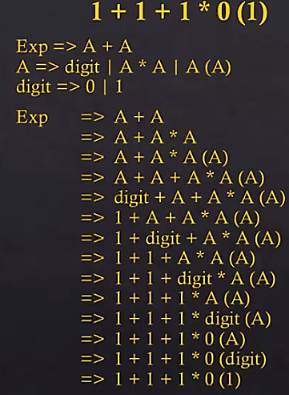
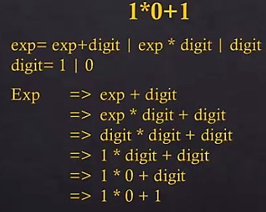
Lexical and Syntax analysis
Top down parsing- example 1 Example 2
ethiomisgie@gmail.com | Project.ethioptec.com | YouTube: ethioptech

Slide 78
Lexical and Syntax analysis
Recursive descent parsing process
A recursive-descent parser is so named because it consists of a collection of subprograms
Many of which are recursive and it produces a parse tree in top-down order.
This recursion is a reflection of the nature of programming languages, which include several different kinds of nested structures.
For example, statements are often nested in other statements.
Also, parentheses in expressions must be properly nested.
The syntax of these structures is naturally described with recursive grammar rules.
EBNF is ideally suited for recursive-descent parsers.
ethiomisgie@gmail.com | Project.ethioptec.com | YouTube: ethioptech

Slide 79
Lexical and Syntax analysis
LL grammar class
One simple grammar characteristic that causes a catastrophic problem for LL parsers is left recursion.
For example, consider the following rule:
A → A + B
A recursive-descent parser subprogram for A immediately calls itself to parse the first symbol in its RHS. That activation of the A parser subprogram then immediately calls itself again, and again, and so forth.
The left recursion in the rule A → A + B is called direct left recursion, because it occurs in one rule.
Direct left recursion can be eliminated from a grammar by the following process:
For each nonterminal, A,
ethiomisgie@gmail.com | Project.ethioptec.com | YouTube: ethioptech

Slide 80
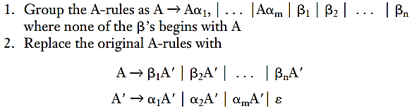

Lexical and Syntax analysis
Note that ε specifies the empty string. A rule that has as its RHS is called an erasure rule, because its use in a derivation effectively erases its LHS from the sentential form.
Consider the following example grammar and the application of the above process
ethiomisgie@gmail.com | Project.ethioptec.com | YouTube: ethioptech

Slide 81
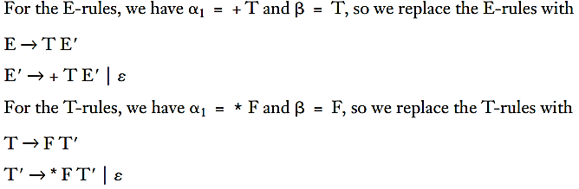
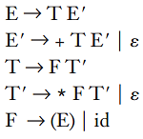
Lexical and Syntax analysis
Because there is no left recursion in the F-rules, they remain the same, so the complete replacement grammar is
This grammar generates the same language as the original grammar but is not left recursive.
ethiomisgie@gmail.com | Project.ethioptec.com | YouTube: ethioptech

Slide 82
Lexical and Syntax analysis
Indirect left recursion poses the same problem as direct left recursion. For example, suppose we have A → B a A
B → A b
A recursive-descent parser for these rules would have the A subprogram
‘A’ immediately call the subprogram for B
‘B’ immediately calls the ‘A’ subprogram.
So, the problem is the same as for direct left recursion.
The problem of left recursion is not confined to building top-down parsers.
It is a problem for all top-down parsing algorithms.
Fortunately, left recursion is not a problem for bottom-up parsing algorithms
ethiomisgie@gmail.com | Project.ethioptec.com | YouTube: ethioptech

Slide 83
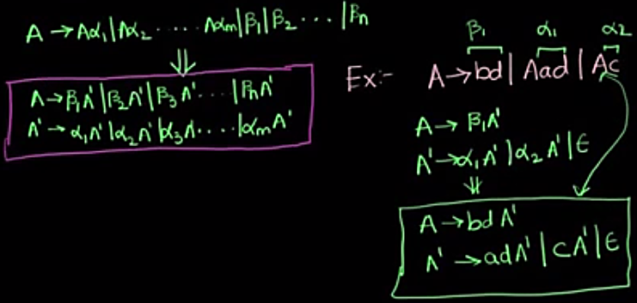
Lexical and Syntax analysis
Avoiding left recursion
ethiomisgie@gmail.com | Project.ethioptec.com | YouTube: ethioptech

Slide 84
Lexical and Syntax analysis
Bottom-Up parser
A bottom-up parser constructs a parse tree by beginning at the leaves and progressing toward the root.
This parse order corresponds to the reverse of a rightmost derivation.
That is, the sentential forms of the derivation are produced in order of last to first.
In terms of the derivation, a bottom-up parser can be described as follows:
Given a right sentential form α, the parser must determine what substring of α is the RHS of the rule in the grammar that must be reduced to its LHS to produce the previous sentential form in the rightmost derivation.
ethiomisgie@gmail.com | Project.ethioptec.com | YouTube: ethioptech

Slide 85

Lexical and Syntax analysis
For example, the first step for a bottom-up parser is to determine which substring of the initial given sentence is the RHS to be reduced to its corresponding LHS to get the second last sentential form in the derivation.
The process of finding the correct RHS to reduce is complicated by the fact that a given right sentential form may include more than one RHS from the grammar of the language being parsed.
The correct RHS is called the handle.
Consider the following grammar and derivation:
ethiomisgie@gmail.com | Project.ethioptec.com | YouTube: ethioptech

Slide 86
Lexical and Syntax analysis
A bottom-up parser of this sentence, aabc, starts with the sentence and must find the handle in it.
In this example, this is an easy task, for the string contains only one RHS, b.
When the parser replaces b with its LHS, A, it gets the second to last sentential form in the derivation, aaAc.
In the general case, as stated previously, finding the handle is much more difficult, because a sentential form may include several different RHSs.
A bottom-up parser finds the handle of a given right sentential form by examining the symbols on one or both sides of a possible handle.
Symbols to the right of the possible handle are usually tokens in the input that have not yet been analysed.
ethiomisgie@gmail.com | Project.ethioptec.com | YouTube: ethioptech

Slide 87
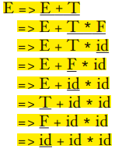
Lexical and Syntax analysis
Consider the following grammar for arithmetic expressions:
This grammar is left recursive, which is acceptable to bottom-up parsers.
Also note that grammars for bottom-up parsers normally do not include meta symbols such as those used to specify extensions to BNF.
The following rightmost derivation illustrates this grammar
ethiomisgie@gmail.com | Project.ethioptec.com | YouTube: ethioptech

Slide 88
Lexical and Syntax analysis
The underlined part of each sentential form in this derivation is the RHS that is rewritten as its corresponding LHS to get the previous sentential form.
The process of bottom-up parsing produces the reverse of a rightmost derivation.
So, in the example derivation, a bottom-up parser starts with the last sentential form (the input sentence) and produces the sequence of sentential forms from there until all that remains is the start symbol, which in this grammar is E.
In each step, the task of the bottom-up parser is to find the specific RHS.
That is the handle, in the sentential form that must be rewritten to get the next (previous) sentential form.
ethiomisgie@gmail.com | Project.ethioptec.com | YouTube: ethioptech

Slide 89
Lexical and Syntax analysis
As mentioned earlier, a right sentential form may include more than one RHS. For example, the right sentential for. E + T * id
includes three RHSs, E + T, T, and id. Only one of these is the handle.
For example, if the RHS, E + T were chosen to be rewritten in this sentential form, the resulting sentential form would be E * id
but E * id is not a legal right sentential form for the given grammar.
ethiomisgie@gmail.com | Project.ethioptec.com | YouTube: ethioptech

Slide 90
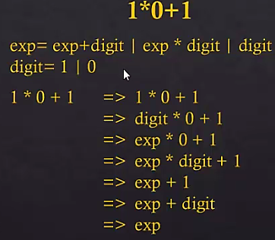
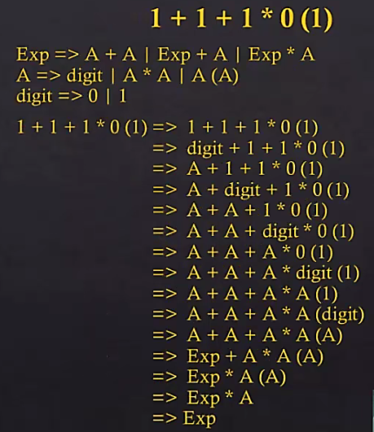
Lexical and Syntax analysis
Bottom-up parsing – example 1 Example 2
ethiomisgie@gmail.com | Project.ethioptec.com | YouTube: ethioptech

Slide 91
Lexical and Syntax analysis
The complexity of parsing
Parsing algorithms that work for any unambiguous grammar are complicated and inefficient.
In fact, the complexity of such algorithms is O(n3), which means the amount of time they take is on the order of the cube of the length of the string to be parsed.
This relatively large amount of time is required because these algorithms frequently must back up and reparse part of the sentence being analysed.
Reparsing is required when the parser has made a mistake in the parsing process.
All algorithms used for the syntax analysers of commercial compilers have complexity O(n), which means the time they take is linearly related to the length of the string to be parsed.
ethiomisgie@gmail.com | Project.ethioptec.com | YouTube: ethioptech

Slide 92
Lexical and Syntax analysis
Big O Notation
Big O notation is used in programming to describe the performance or complexity of an algorithm.
Big O specifically describes the worst-case scenario, and can be used to describe the execution time required or the space used (e.g. in memory or on disk) by an algorithm.
void printFirstElementOfArray(int arr[])
{
printf("First element of array = %d",arr[0]);
}
This function runs in O(1) time (or "constant time") relative to its input.
The input array could be 1 item or 1,000 items, but this function would still just require one step.
ethiomisgie@gmail.com | Project.ethioptec.com | YouTube: ethioptech

Slide 93
Lexical and Syntax analysis
void printAllElementOfArray(int arr[], int size)
{
for (int i = 0; i < size; i++)
{
printf("%d\n", arr[i]);
}
}
This function runs in O(n) time (or "linear time"), where n is the number of items in the array.
If the array has 10 items, we have to print 10 times.
If it has 1000 items, we have to print 1000 times.
ethiomisgie@gmail.com | Project.ethioptec.com | YouTube: ethioptech

Slide 94
Lexical and Syntax analysis
void printAllPossibleOrderedPairs(int arr[], int size)
{
for (int i = 0; i < size; i++)
{
for (int j = 0; j < size; j++)
{
printf("%d = %d\n", arr[i], arr[j]);
}
}
}
Here we're nesting two loops.
If our array has n items, our outer loop runs n times and our inner loop runs n times for each iteration of the outer loop, giving us n² total prints.
Thus this function runs in O(n²) time (or "quadratic time").
If the array has 10 items, we have to print 100 times.
If it has 1000 items, we have to print 1000000 times.
ethiomisgie@gmail.com | Project.ethioptec.com | YouTube: ethioptech

Slide 95
Lexical and Syntax analysis
int fibonacci(int num)
{
if (num <= 1) return num;
return fibonacci(num - 2) + fibonacci(num - 1);
}
An example of an O(2^{n}) function is the recursive calculation of Fibonacci numbers.
O(2^{n}) denotes an algorithm whose growth doubles with each addition to the input data set.
The growth curve of an O(2^{n}) function is exponential - starting off very shallow, then rising meteorically.
ethiomisgie@gmail.com | Project.ethioptec.com | YouTube: ethioptech

Slide 96
Lexical and Syntax analysis
void printAllNumbersThenAllPairSums(int arr[], int size)
{
for (int i = 0; i < size; i++)
{
printf("%d\n", arr[i]);
}
for (int i = 0; i < size; i++)
{
for (int j = 0; j < size; j++)
{
printf("%d\n", arr[i] + arr[j]);
}
}
}
Here our runtime is O(n + n²), which we just call O(n²).
ethiomisgie@gmail.com | Project.ethioptec.com | YouTube: ethioptech

Slide 97
Lexical and Syntax analysis
Review questions
What are three reasons why syntax analysers are based on grammars?
Explain the three reasons why lexical analysis is separated from syntax analysis?
Define lexeme and token?
What are the primary tasks of a lexical analyser?
Describe the differences between top-down and bottom-up parsers?
Describe the parsing problem for a top-down parser?
Describe the parsing problem for a bottom-up parser?
Show a trace of the recursive descent parser for the string a + b * c.
ethiomisgie@gmail.com | Project.ethioptec.com | YouTube: ethioptech

Slide 98
Lexical and Syntax analysis
9. Derivate the following grammar using leftmost and right most derivation? For the A=B+C+(C*D)
<prog> = exp
Exp=exp + exp| (exp) | exp*id | id
Id=A | B |C | D
Draw the parsing tree.
ethiomisgie@gmail.com | Project.ethioptec.com | YouTube: ethioptech

Slide 99
Lexical and Syntax analysis
10. Derivate the following grammar using leftmost and right most derivation? For the A=(B+C)+C*D
<prog> = exp
Exp=(exp) | exp + term | term
Term=term*id | id
Id=A | B |C | D
Draw the parsing tree.
ethiomisgie@gmail.com | Project.ethioptec.com | YouTube: ethioptech

Slide 100
Lexical and Syntax analysis
11. Derivate the following grammar using leftmost and right most derivation? For the A=B-C+C+D
<prog> = exp
Exp=exp-fact | exp*fact | fact
Fact=fact + id | id
Id=A | B |C | D
Draw the parsing tree.
ethiomisgie@gmail.com | Project.ethioptec.com | YouTube: ethioptech

Slide 101
Lexical and Syntax analysis
12. Derivate the following grammar using leftmost and right most derivation? For the A=B-(C/D)+D
Exp=exp-term | exp*term | (exp) | term
term=(term) | term/id | id
Id=A | B |C | D
Draw the parsing tree.
ethiomisgie@gmail.com | Project.ethioptec.com | YouTube: ethioptech

Slide 102
Lexical and Syntax analysis
12. What is the big O notation of the following program?
bool arrayContainsElement(int arr[], int size, int element)
{
for (int i = 0; i < size; i++)
{
if (arr[i] == element) return true;
}
return false;
}
ethiomisgie@gmail.com | Project.ethioptec.com | YouTube: ethioptech

Slide 103
Lexical and Syntax analysis
12. What is the big O notation of the following program?
#include<stdio.h>
void print_values(int end)
{
for (int i = 0; i < end; i++)
{
printf("%d\n", i);
}
}
int main()
{
print_values(10000);
return 0;
}
ethiomisgie@gmail.com | Project.ethioptec.com | YouTube: ethioptech

Slide 104
Lexical and Syntax analysis
13. Eliminate the following left recursive Grammer.
X -> XSb | Sa | b
S -> Sb | Sa | a
14. Eliminate the left recursion from the following grammar
S -> AB
A -> Aa | b
B -> C
ethiomisgie@gmail.com | Project.ethioptec.com | YouTube: ethioptech

