Slide 1
Design and Analysis of Algorithm
Introduction to Algorithm
Prepared by: Misganaw A.(MSC.)
Email: mail@ethioptec.com/ethiomisgie@gmail.com
Website : https://ethioptec.com or https://info.ethioptec.com/
Telegram: https://t.me/ethiop_computing

Slide 2
Introduction to algorithm
An algorithm is a set of steps of operations to solve a problem performing calculation, data processing, and automated reasoning tasks.
An algorithm is the best way to represent the solution of a particular problem in a very simple and efficient way.
If we have an algorithm for a specific problem, then we can implement it in any programming language, meaning that the algorithm is independent from any programming languages.

Slide 3
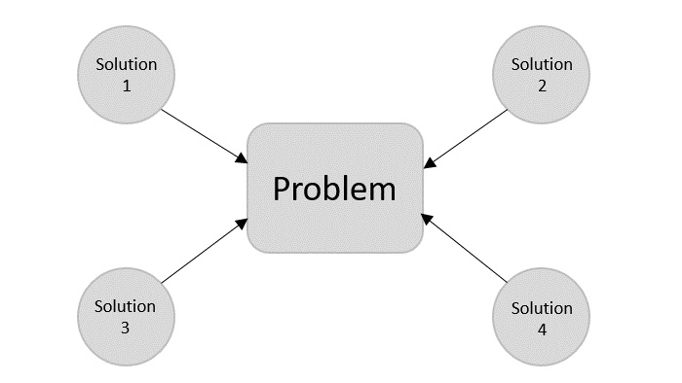
Algorithm design
To solve a problem, different approaches can be followed.
Some of them can be efficient with respect to time consumption, whereas other approaches may be memory efficient.
Both time consumption and memory usage cannot be optimized simultaneously.
If we require an algorithm to run in lesser time, we have to invest in more memory and
if we require an algorithm to run with lesser memory, we need to have more time.

Slide 4
Problem development steps
The following steps are involved in solving computational problems.
Problem definition
Development of a model
Specification of an Algorithm
Designing an Algorithm
Checking the correctness of an Algorithm
Analysis of an Algorithm
Implementation of an Algorithm
Program testing
Documentation

Slide 5
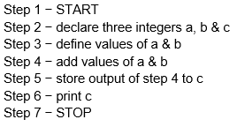

Example
Let's try to learn algorithm-writing by using an example.
Problem − Design an algorithm to add two numbers and display the result.
Algorithms tell the programmers how to code the program. Alternatively, the algorithm can be written as −
In design and analysis of algorithms, usually the second method is used to describe an algorithm.

Slide 6
Characteristics of algorithm
An algorithm should have the following characteristics
Unambiguous − Algorithm should be clear and unambiguous.
Input − An algorithm should have 0 or more well-defined inputs.
Output − An algorithm should have 1 or more well-defined outputs, and should match the desired output.
Finiteness − Algorithms must terminate after a finite number of steps.
Feasibility − Should be feasible with the available resources.
Independent − An algorithm should have step-by-step directions, which should be independent of any programming code.

Slide 7
Performance of Algorithm
The performance of a program is the amount of computer memory and time needed to run a program. We use two approaches to determine the performance of a program.
One is analytical, and
The other experimental.
In performance analysis we use analytical methods, while in performance measurement we conduct experiments.
Pseudocode
Pseudocode gives a high-level description of an algorithm without the ambiguity associated with plain text but also without the need to know the syntax of a particular programming language.

Slide 8
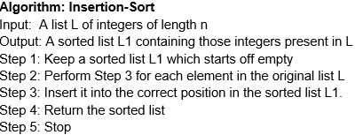
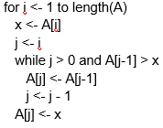
For example, following is an algorithm for Insertion Sort.
Here is a pseudocode which describes how the high-level abstract process mentioned above in the algorithm Insertion-Sort could be described in a more realistic way.

Slide 9

Example
Following are the implementations of the above approach in python programming languages –
Python program
def insertion_sort(arr): for i in range(1, len(arr)): key = arr[i] j = i - 1 # Move elements of arr[0..i-1] that are greater than key, # to one position ahead of their current position. while j >= 0 and arr[j] > key: arr[j + 1] = arr[j] j -= 1 arr[j + 1] = key # Insert the current element (key) in the correct position. arr = [64, 34, 25, 12, 22, 11, 90] insertion_sort(arr) print("Sorted array:", arr)

Slide 10
Exercise
Write C ++ and Java program for the above python code?

