Slide 1
Design and Analysis of Algorithm
Algorithm for Fundamental graphs
Prepared by: Misganaw A.(MSC.)
Email: mail@ethioptec.com/ethiomisgie@gmail.com
Website : https://ethioptec.com or https://info.ethioptec.com
Telegram: https://t.me/ethiop_computing

Slide 2
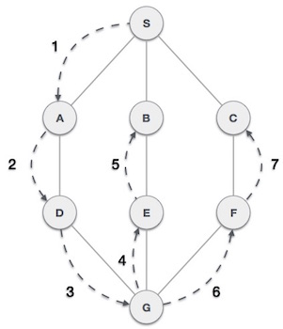
Algorithm for Fundamental graphs
Depth first search
Depth First Search (DFS) algorithm traverses a graph in a depth ward motion and uses a stack to remember to get the next vertex to start a search, when a dead end occurs in any iteration.
As in the example given, DFS algorithm traverses from S to A to D to G to E to B first, then to F and lastly to C. It employs the following rules.
Rule 1 − Visit the adjacent unvisited vertex. Mark it as visited. Display it. Push it in a stack.
Rule 2 − If no adjacent vertex is found, pop up a vertex from the stack. (It will pop up all the vertices from the stack, which do not have adjacent vertices.)
Rule 3 − Repeat Rule 1 and Rule 2 until the stack is empty.

Slide 3
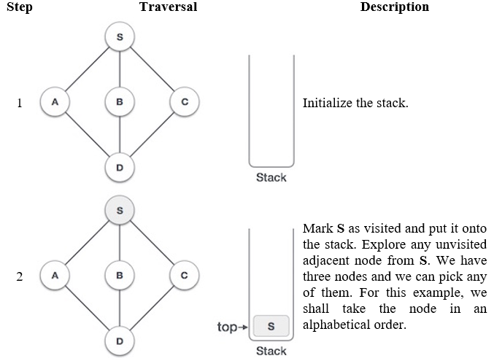
Algorithm for Fundamental graphs

Slide 4
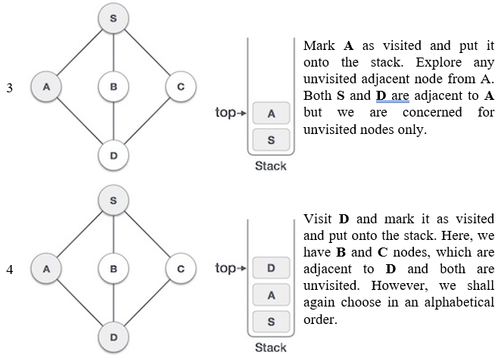
Algorithm for Fundamental graphs

Slide 5
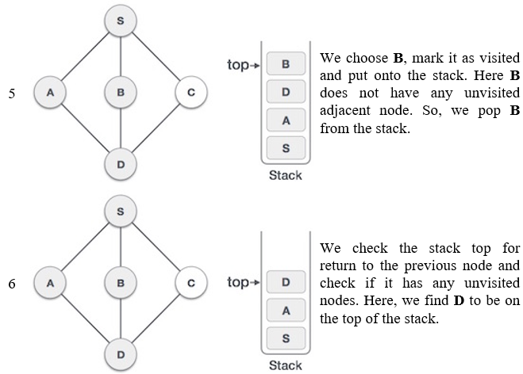
Algorithm for Fundamental graphs

Slide 6
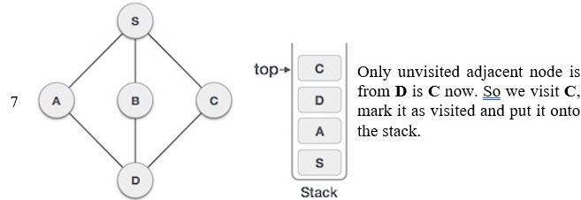
Algorithm for Fundamental graphs
As C does not have any unvisited adjacent node so we keep popping the stack until we find a node that has an unvisited adjacent node.
In this case, there's none and we keep popping until the stack is empty.

Slide 7
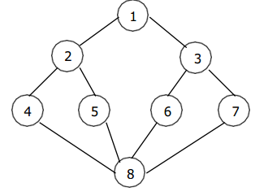
Algorithm for Fundamental graphs
Let us observe the following graph. The we will perform DFS based on this graph.
Depth first search of undirected graph proceeds as follows.
The start vertex V is visited. Next an unvisited vertex 'W' adjacent to 'V' is selected and a depth first search from 'W' is initiated.
When a vertex 'u' is reached such that all its adjacent vertices have been visited, we back up to the last vertex visited, which has an unvisited vertex 'W' adjacent to it and initiate a depth first search from W.
The search terminates when no unvisited vertex can be reached from any of the visited ones.

Slide 8
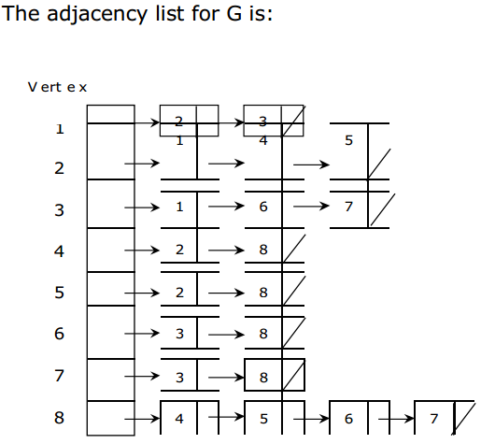
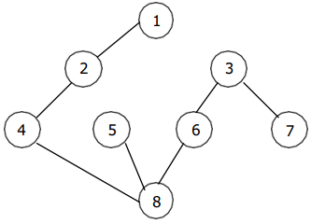
Algorithm for Fundamental graphs
If the depth first is initiated from vertex 1, then the vertices of G are visited in the order: 1, 2, 4, 8, 5, 6, 3, 7. The depth first spanning tree is as follows:

Slide 9
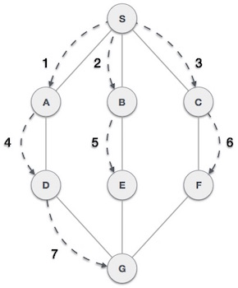
Algorithm for Fundamental graphs
Breadth First Search
Breadth First Search (BFS) algorithm traverses a graph in a breadth ward motion and uses a queue to remember to get the next vertex to start a search, when a dead end occurs in any iteration.
As in the example given, BFS algorithm traverses from A to B to C first then to D and E lastly to G. It employs the following rules.
Rule 1: Visit the adjacent unvisited vertex. Mark it as visited. Display it. Insert it in a queue.
Rule 2: If no adjacent vertex is found, remove the first vertex from the queue.
Rule 3 : Repeat Rule 1 and Rule 2 until the queue is empty.

Slide 10
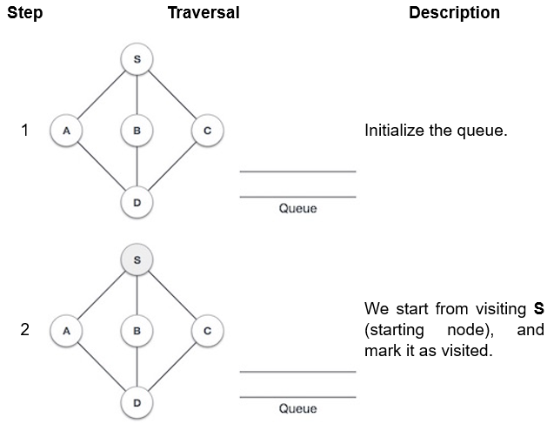
Algorithm for Fundamental graphs

Slide 11
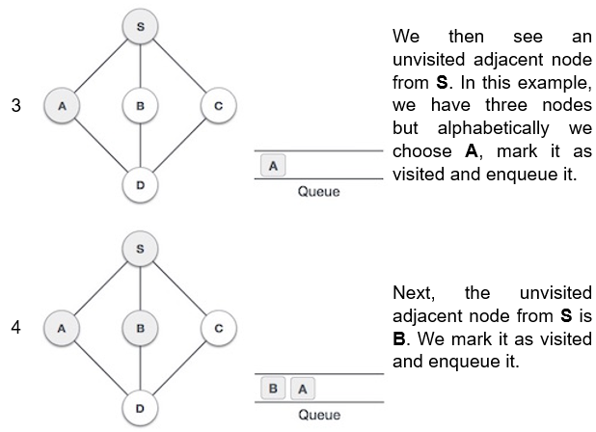
Algorithm for Fundamental graphs

Slide 12
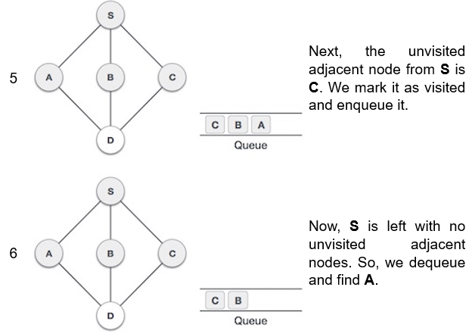
Algorithm for Fundamental graphs

Slide 13
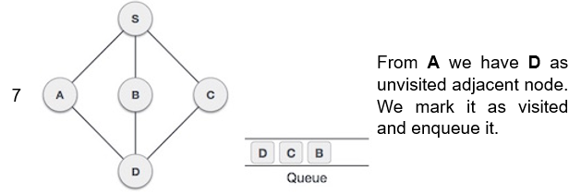
Algorithm for Fundamental graphs
At this stage, we are left with no unmarked (unvisited) nodes. But as per the algorithm we keep on dequeuing in order to get all unvisited nodes. When the queue gets emptied, the program is over.

Slide 14
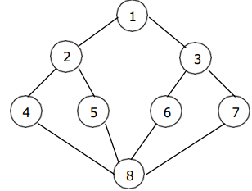
Algorithm for Fundamental graphs
Let us observe the following graph. The we will perform BFS based on this graph.s
Starting at vertex 'V' and marking it as visited, BFS differs from DFS in that all unvisited vertices adjacent to V are visited next.
Then unvisited vertices adjacent to there vertices are visited and so on.
A breadth first search beginning at vertex 1 of the graph would first visit 1 and then 2 and 3.
Next vertices 4, 5, 6 and 7 will be visited and finally 8.
The spanning trees obtained using BFS are called Breadth first spanning trees.

Slide 15
Algorithm for Fundamental graphs
Tree Traversal
Traversal is a process to visit all the nodes of a tree and may print their values too.
We always start from the root (head) node.
That is, we cannot randomly access a node in a tree.
There are three ways which we use to traverse a tree
In-order Traversal L… Root …. R
Pre-order Traversal Root …. L… R
Post-order Traversal L… R … Root
Generally, we traverse a tree to search or locate a given item or key in the tree or to print all the values it contains.

Slide 16
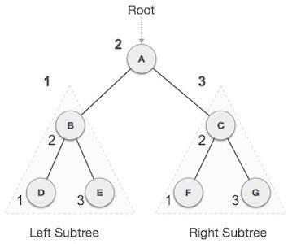
Algorithm for Fundamental graphs
In order travers
In this traversal method, the left subtree is visited first, then the root and later the right sub-tree. We should always remember that every node may represent a subtree itself.
If a binary tree is traversed in-order, the output will produce sorted key values in an ascending order.
We start from A, and following in-order traversal, we move to its left subtree B.B is also traversed in-order. The process goes on until all the nodes are visited. The output of in-order traversal of this tree will be −
D → B → E → A → F → C → G

Slide 17
Algorithm for Fundamental graphs
class Node: def __init__(self, key): self.leftChild = None self.rightChild = None self.data = key # Create a function to perform inorder tree traversal def InorderTraversal(root): if root: InorderTraversal(root.leftChild) print(root.data) InorderTraversal(root.rightChild)
# Main class if __name__ == "__main__": root = Node(3) root.leftChild = Node(26) root.rightChild = Node(42) root.leftChild.leftChild = Node(54) root.leftChild.rightChild = Node(65) root.rightChild.leftChild = Node(12) # Function call print("Inorder traversal of binary tree is") InorderTraversal(root)(root

Slide 18
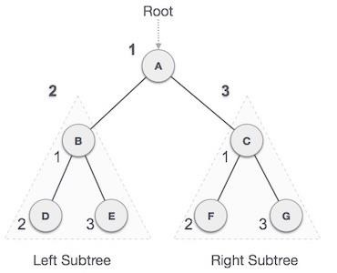
Algorithm for Fundamental graphs
Pre order travers
In this traversal method, the root node is visited first, then the left subtree and finally the right subtree.
We start from A, and following pre-order traversal, we first visit A itself and then move to its left subtree B. B is also traversed pre-order. The process goes on until all the nodes are visited. The output of pre-order traversal of this tree will be −
A → B → D → E → C → F → G

Slide 19
Algorithm for Fundamental graphs
# Main class if __name__ == "__main__": root = Node(3) root.leftChild = Node(26) root.rightChild = Node(42) root.leftChild.leftChild = Node(54) root.leftChild.rightChild = Node(65) root.rightChild.leftChild = Node(12) print("Preorder traversal of binary tree is") PreorderTraversal(root)
class Node: def __init__(self, key): self.leftChild = None self.rightChild = None self.data = key # Create a function to perform postorder tree traversal def PreorderTraversal(root): if root: print(root.data) PreorderTraversal(root.leftChild) PreorderTraversal(root.rightChild)

Slide 20
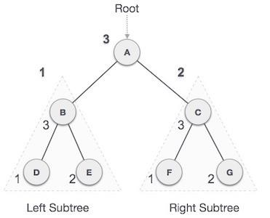
Algorithm for Fundamental graphs
Post order traves
In this traversal method, the root node is visited last, hence the name. First, we traverse the left subtree, then the right subtree and finally the root node.
We start from A, and following pre-order traversal, we first visit the left subtree B. B is also traversed post-order. The process goes on until all the nodes are visited. The output of post-order traversal of this tree will be −
D → E → B → F → G → C → A

Slide 21
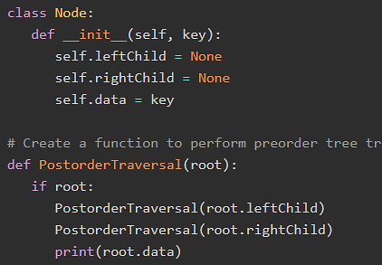
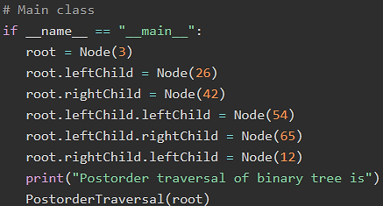
Algorithm for Fundamental graphs

Slide 22
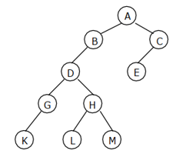
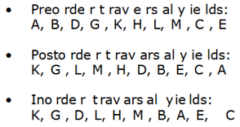
Algorithm for Fundamental graphs
Example
Traverse the following binary tree in pre, post and in order using non-recursive traversing algorithm.

Slide 23
Algorithm for Fundamental graphs
Binary search tree
A Binary Search Tree (BST) is a tree in which all the nodes follow the below-mentioned properties −
The left sub-tree of a node has a key less than or equal to its parent node's key.
The right sub-tree of a node has a key greater than or equal to its parent node's key.
Thus, BST divides all its sub-trees into two segments; the left sub-tree and the right sub-tree and can be defined as
left_subtree (keys) ≤ node (key) ≤ right_subtree (keys)

Slide 24
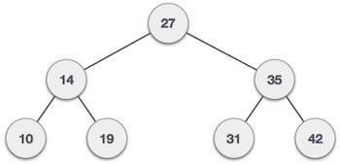
Algorithm for Fundamental graphs
Binary tree representation
BST is a collection of nodes arranged in a way where they maintain BST properties.
Each node has a key and an associated value.
While searching, the desired key is compared to the keys in BST and if found, the associated value is retrieved.
Following is a pictorial representation of BST.
We observe that the root node key (27) has all less-valued keys on the left sub-tree and the higher valued keys on the right sub-tree.

Slide 25
Algorithm for Fundamental graphs
Basic operation in binary search tree
Following are the basic operations of a Binary Search Tree −
Search − Searches an element in a tree.
Insert − Inserts an element in a tree.
Pre-order Traversal − Traverses a tree in a pre-order manner.
In-order Traversal − Traverses a tree in an in-order manner.
Post-order Traversal − Traverses a tree in a post-order manner.

Slide 26
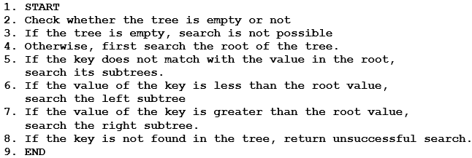
Algorithm for Fundamental graphs
Algorithm

Slide 27
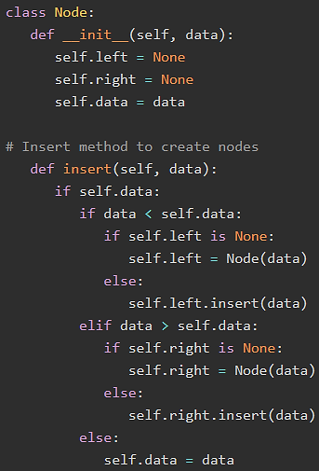
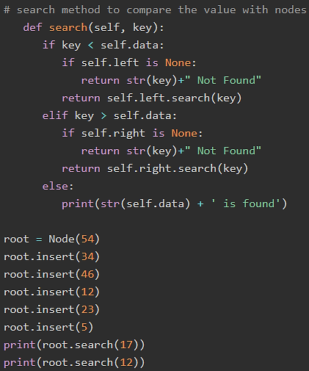
Algorithm for Fundamental graphs

Slide 28
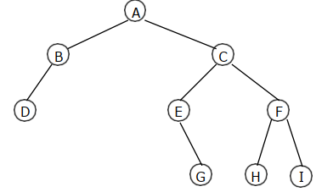
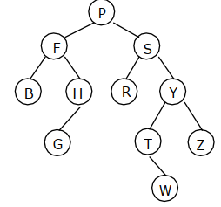
Algorithm for Fundamental graphs
Exercises on tree traversal
Travers the following tree in pre order, in order and post order? Write a python code for it?
2. Travers the following tree in pre order, in order and post order? Write a python code for it?

Slide 29
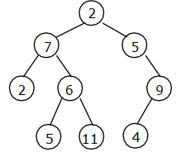
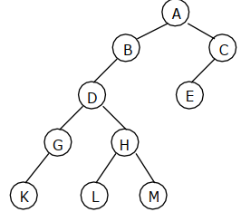
Algorithm for Fundamental graphs
Exercises
3. Travers the following tree in pre order, in order and post order? Write a python code for it?
4. Travers the following tree in pre order, in order and post order? Write a python code for it?

