Slide 1

Chapter 3: Relational Data Model
Database system for 4th Year ECE (Computer Engineering) students
Prepared by M.A
Debre Tabor University, Ethiopia
2010 E.C

Slide 2
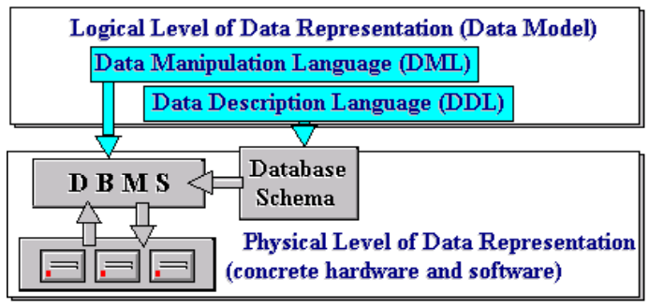
Chapter 3: Relational Data Model
DDL: which define the structure of entities and their relationships.
DML: which specify manipulation of database contents were also established
Data model = DDL + DML.
There is no single method for organizing data in a database

Slide 3
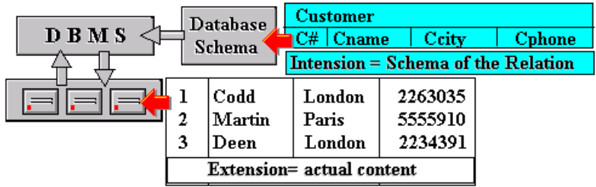
Chapter 3: Relational Data Model
More formally, a Data Model is a combination of at least three components:
A collection of data structure types
A collection of operators or rules of inference, which can be applied to any valid instance of data types
A collection of general integrity rules, which implicitly or explicitly define the set of consistent database states or change of state or both

Slide 4
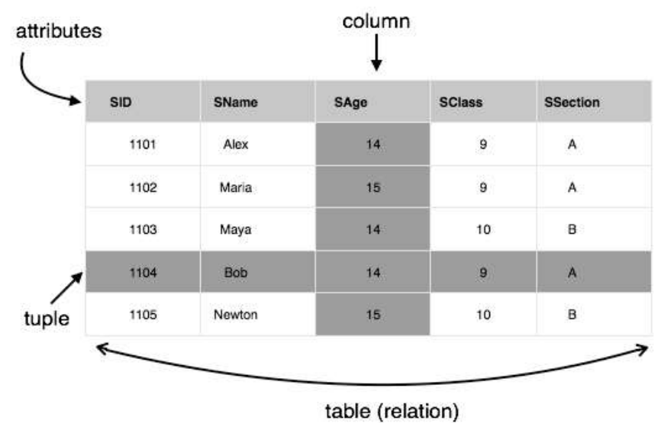
Chapter 3: Relational Data Model

Slide 5
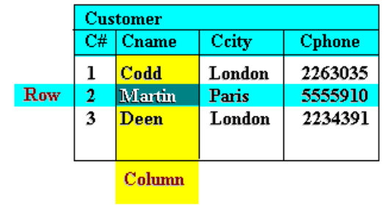
Chapter 3: Relational Data Model
Relations
The term relation in data model refers to a two-dimensional table of data. In other words, according to the model, information is arranged in columns and rows.
Relation consists of a relation schema and a relation instance. The relation instance is a table, and the relation schema describes the column heads for the table.
The schema specifies the relation’s name, the name of each field (or column, or attribute), and the domain of each field.
An instance of a relation is a set of tuples, also called records, in which each tuple has the same number of fields as the relation schema.

Slide 6
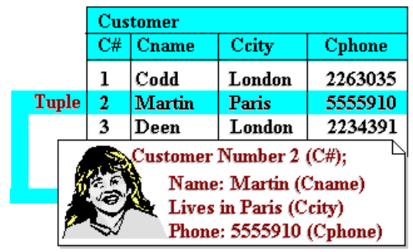
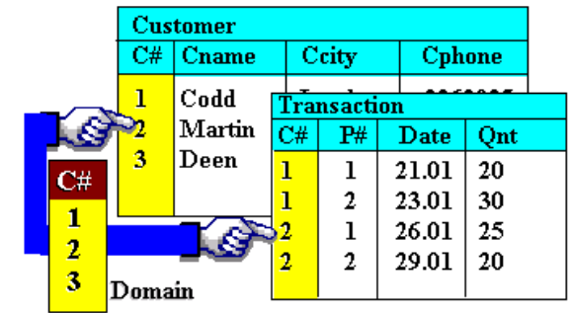
Chapter 3: Relational Data Model
A relation has a unique name and represents a particular entity. Each row of a relation, referred to as a tuple, is a collection of facts (values) about a particular individual of that entity. In other words, a tuple represents an instance of the entity represented by the relation.

Slide 7
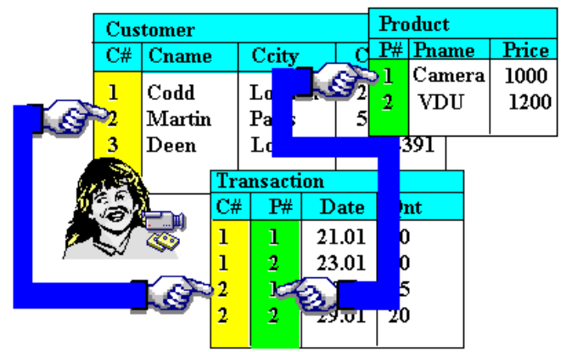
Chapter 3: Relational Data Model
When two relations share a domain, identical domain values act as a link between tuples that contain them (because such values mean the same thing). As an example, consider a database comprising three relations as shown in following Figure.
It highlights a Transaction tuple and a Customer tuple linked through the C# domain value ‘2’, and the same Transaction tuple and a Product tuple linked through the P# domain value ‘1’.
The Transaction tuple is a record of a purchase by customer number ‘2’ of product number ‘1’.
Through such links, we are able to retrieve the name of the customer and the product,
ie. we are able to state that the customer ‘Martin’ bought a ‘Camera’. They help to avoid redundancy in recording data.

Slide 8
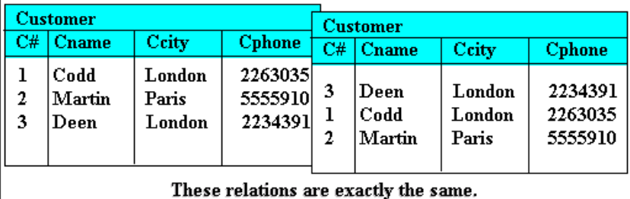
Chapter 3: Relational Data Model
Properties of relational model
The characteristic properties of a relation are as follows:
All entries in a given column are of the same kind or type
The ordering of columns is immaterial. This is illustrated in the following Figure where the two tables shown are identical in every respect except for the ordering of their columns.

Slide 9
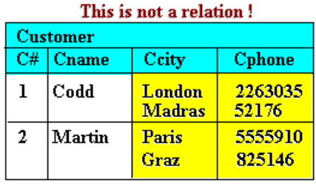
Chapter 3: Relational Data Model
No two tuples are exactly the same. A relation is a set of tuples. Thus a table that contains duplicate tuples is not a relation and cannot be stored in a relational database.
There is only one value for each attribute of a tuple. Thus a table such as in the following Figure is not allowed in the relational model.
The ordering of tuples is immaterial. This follows directly from defining a relation as a set of tuples, rather than a sequence or list.

Slide 10
Chapter 3: Relational Data Model
Keys of relation (integrity key)
Primary key: Uniquely identifies each row/record in a database table.
Foreign key: Uniquely identifies a row/record in any another database table
Unique key: Ensures that all the values in a column are different.
Super key: A super key is a set of one or more attributes that, taken collectively, allow us to identify uniquely an entity in the entity set. The set {sid, name} is an example of a superkey, which is a set of fields that contains a key.
Candidate key: A set of fields that uniquely identifies a tuple according to a key constraint is called a candidate key for the relation.

Slide 11

Chapter 3: Relational Data Model
Functional dependency and Normalization
Functional dependency
Consider R(A,B,C) Let the following
functional dependencies hold:
We can show that f1 and f2 together logically imply that the following functional dependency also holds:
Database normalization is the process of efficiently organizing data in a database. There are two reasons of this normalization process:
Eliminating redundant data. For example, storing the same data in more than one table.
Ensuring data dependencies make sense.

Slide 12
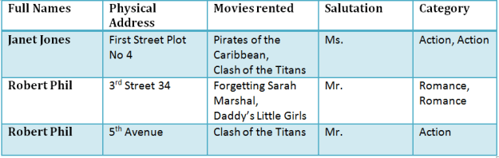
Chapter 3: Relational Data Model
Assume a video library maintains a database of movies rented out.
Without any normalization, all information is stored in one table as shown above
The aim of normal forms is to organize the database structure, so that it complies with the rules of
first normal form, then
second normal form and finally
The third normal form.

Slide 13
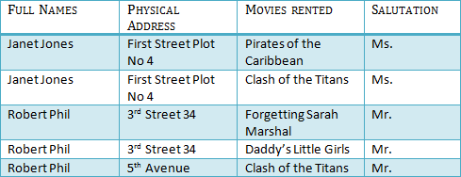
Chapter 3: Relational Data Model
1NF (first Normal Form) Rules
First Normal Form is defined in the definition of relations tables itself.
Each table cell should contain a single value.
Each record needs to be unique.
2NF (Second Normal Form) Rules
Rule 1- Be in 1NF
Rule 2- Single Column Primary Key
It is clear that we can't move forward to make our simple database in 2nd Normalization form unless we partition the table above.

Slide 14

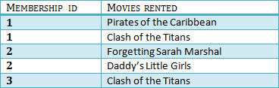
Chapter 3: Relational Data Model
We have divided our 1NF table into two tables viz. Table 1 and Table2. Table 1 contains member information. Table 2 contains information on movies rented.
We have introduced a new column called Membership_id which is the primary key for table 1. Records can be uniquely identified in Table 1 using membership id

Slide 15
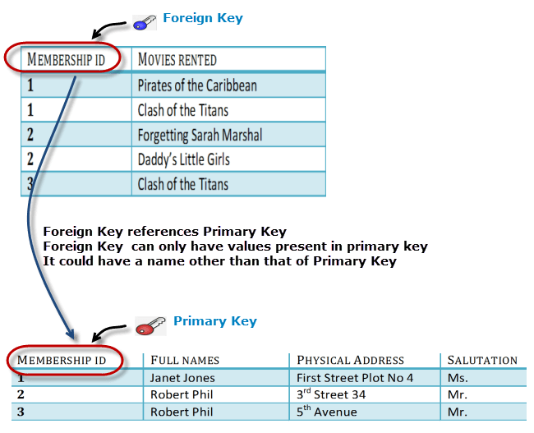
Chapter 3: Relational Data Model

Slide 16
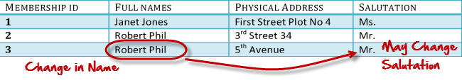

Chapter 3: Relational Data Model
3NF (Third Normal Form) Rules
Rule 1- Be in 2NF
Rule 2- Has no transitive functional dependencies
Third normal form

Slide 17
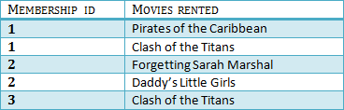

Chapter 3: Relational Data Model
We have again divided our tables and created a new table which stores Salutations. There are no transitive functional dependencies, and hence our table is in 3NF. In Table 3 Salutation ID is primary key, and in Table 1 Salutation ID is foreign to primary key in Table 3

