Slide 1

Chapter 4: Relational Algebra
Database system for 4th Year ECE (Computer Engineering) students
Prepared by M.A
Debre Tabor University, Ethiopia
2010 E.C

Slide 2
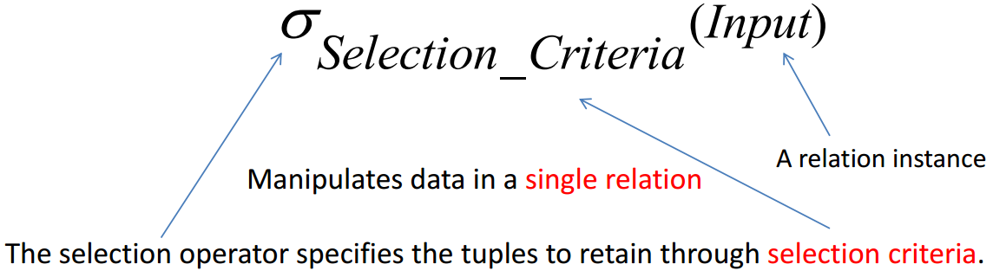
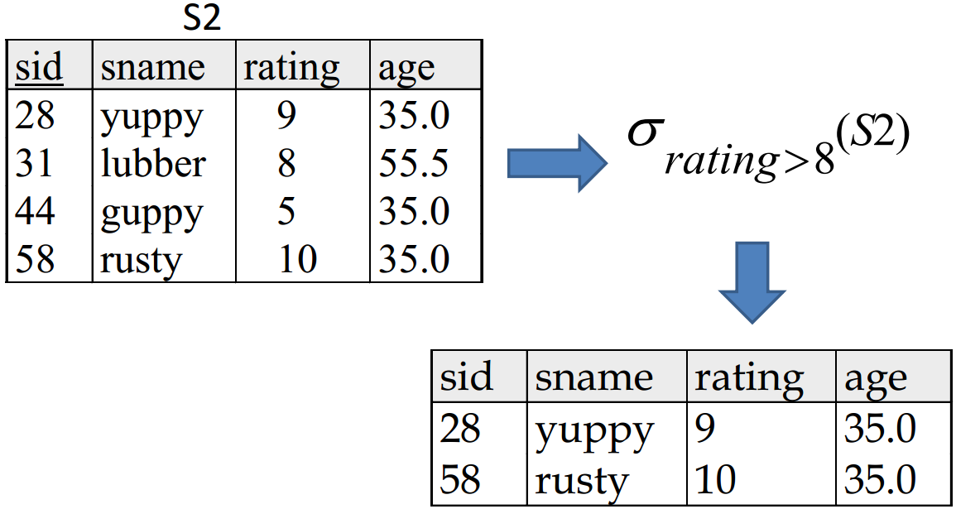
Chapter 4: Relational Algebra
Basic operations
Five basic operators
Selection
Projection
Union
Interception
Cross-product
Difference
Selection operator

Slide 3
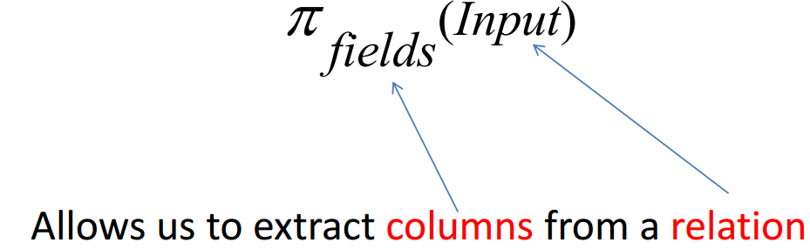
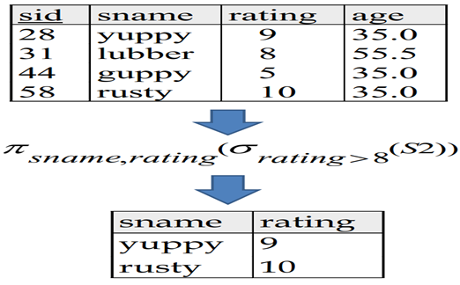
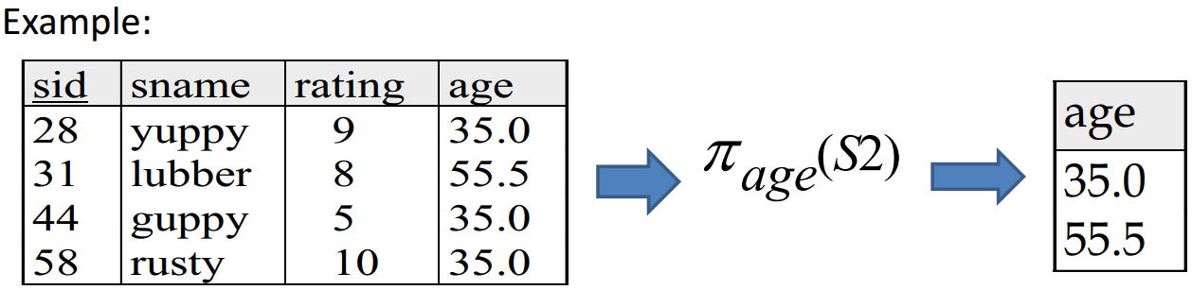
Chapter 4: Relational Algebra
Projection operation

Slide 4
Chapter 4: Relational Algebra
Set operation
Takes as input two relation instances
Four standard operations
Union
Intersection
Set-difference
Cross-product
Union, intersection, and difference require the two input set to be union compatible
They have the same number of fields
corresponding fields, taken in order from left to right, have the same domains

Slide 5
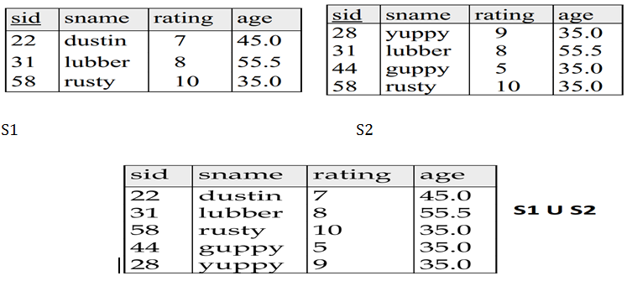
Chapter 4: Relational Algebra
Union
R U S returns relation instance containing all tuples that occur in either relation instance R or S, or both.
R and S must be union compatible.
Schema of the result is defined to be that of R.

Slide 6
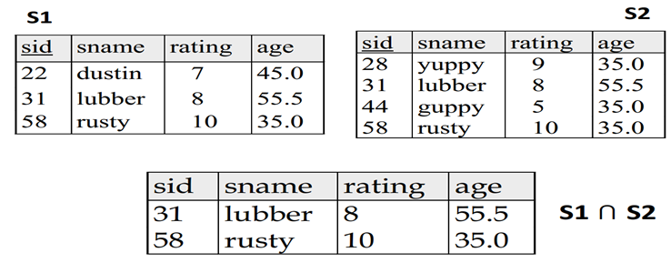
Chapter 4: Relational Algebra
Interception operator
R ⋂ S: returns a relation instance containing all tuples that occur in both R and S.
R and S must be union compatible.
Schema of the rsult is the schema of R

Slide 7
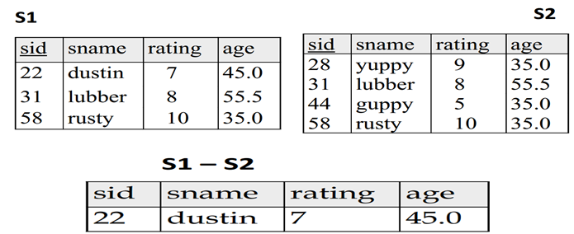
Chapter 4: Relational Algebra
Set difference operator
R – S: returns a relation instance containing all tuples that occur in R but not in S.
R and S must be union-compatible.
Scheme of the result is the schema of R.

Slide 8
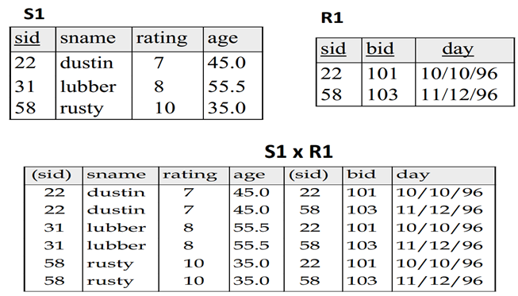
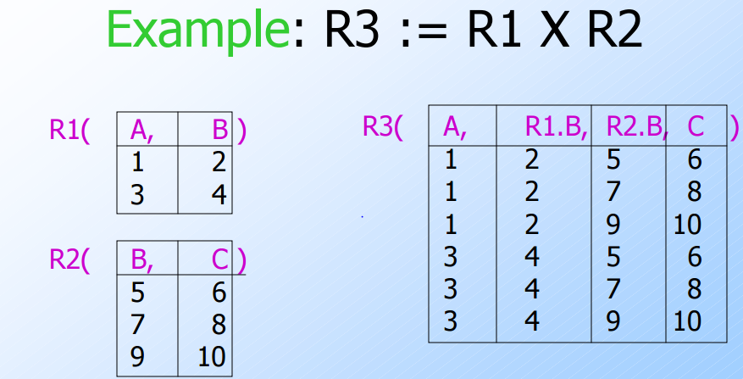
Chapter 4: Relational Algebra
Cross-product
R x S: Returns a relation instance whose scheme contains:
All the fields of R (in the same order as they appear in R)
All the fields of S (in the same order as they appear in S)
The result contains one tuple <r,s> for each pair with r ⋳ R and s ⋳ S
Basically, it is the Cartesian product.
Fields of the same name are unnamed.

