Slide 1

Chapter 5: SQL
Database system for 4th Year ECE (Computer Engineering) students
Prepared by M.A
Debre Tabor University, Ethiopia
2010 E.C

Slide 2
Chapter 5: SQL
Introduction
SQL is Structured Query Language, which is a computer language for storing, manipulating and retrieving data stored in a relational database.
SQL is the standard language for Relational Database System.
All the Relational Database Management Systems (RDMS) like MySQL, MS Access, Oracle,
Sybase, Informix, Postgres and SQL Server use SQL as their standard database language

Slide 3
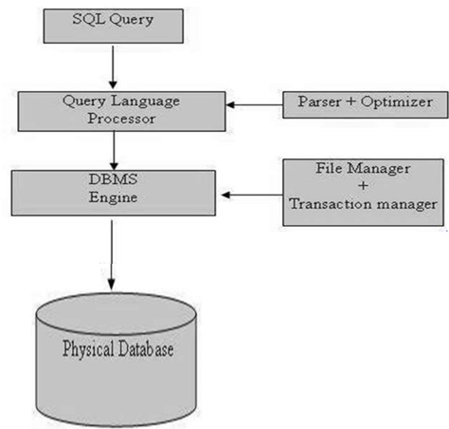
SQL Process and Architecture
Some of the components that include in this process are:
Query Dispatcher
Optimization Engines
Classic Query Engine
SQL Query Engine, etc
Following is a simple diagram showing the SQL Architecture:

Slide 4
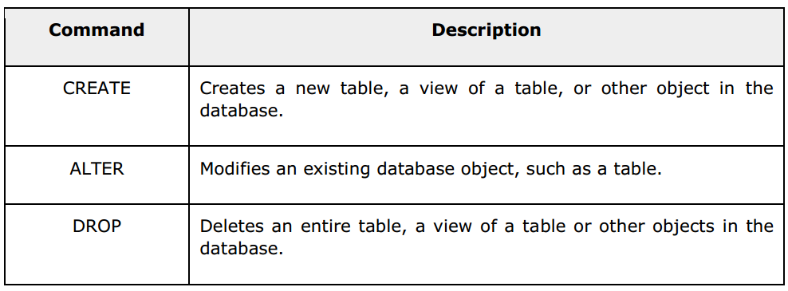
Basic SQL Commands
The standard SQL commands to interact with relational databases are CREATE, SELECT, INSERT, UPDATE, DELETE and DROP.
Types of SQL commands
These commands can be classified into the following groups based on their nature:
DDL - Data Definition Language

Slide 5
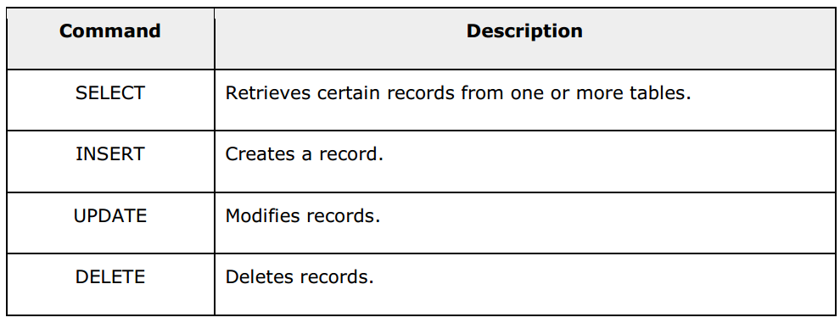
DML - Data Manipulation Language

Slide 6
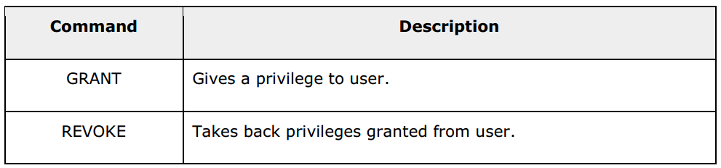
DCL - Data Control Language

Slide 7
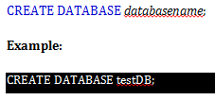

Creating a database
Drop a database
DROP DATABASE databasename;
Example : DROP DATABASE testDB;
Creating a table
In our SQL server there may be multiple database to use one specified database we will use the use key word to manipulate a table inside that database
CREATE TABLE table_name (
column1 datatype,
column2 datatype,
column3 datatype,
....
....
);

Slide 8
Example :
CREATE TABLE Persons (
PersonID int,
LastName varchar(255),
FirstName varchar(255),
Address varchar(255),
City varchar(255) );
SQL truncate table
The TRUNCATE TABLE statement is used to delete the data inside a table, but not the table itself.
TRUNCATE TABLE table_name;
Example :
TRUNCATE TABLE person;
Drop tables
DROP TABLE table_name;
Example : DROP TABLE person;
SQL alter table Statement
The ALTER TABLE statement is used to add, delete, or modify columns in an existing table.

Slide 9
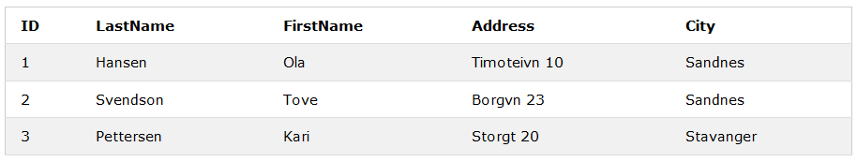
Alter table - add column
To add a column in a table, use the following syntax:
ALTER TABLE table_name
ADD column_name datatype;
Example
Look at the "Persons" table:

Slide 10
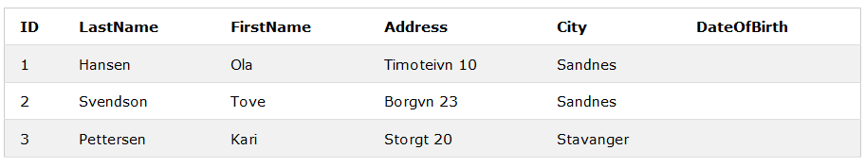
ALTER TABLE Persons
ADD DateOfBirth date;
Alter table - drop column
To delete a column in a table, use the following syntax (notice that some database systems don't allow deleting a column):
ALTER TABLE table_name
DROP COLUMN column_name;
Example Next, we want to delete the column named "DateOfBirth" in the "Persons" table. We use the following SQL statement:
ALTER TABLE Persons
DROP COLUMN DateOfBirth;

Slide 11
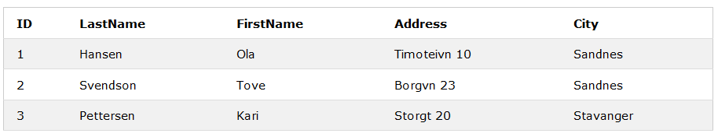
The "Persons" table will now look like this:
Alter table - alter/modify column
ALTER TABLE table_name
ALTER COLUMN column_name datatype;
Example:
ALTER TABLE persons
ALTER COLUMN PersonId varchar(12);
Constraints can be specified when the table is created with the CREATE TABLE statement, or after the table is created with the ALTER TABLE statement.
SQL Constraints
SQL constraints are used to specify rules for data in a table.

Slide 12
Basic syntax
CREATE TABLE table_name (
column1 datatype constraint,
column2 datatype constraint,
column3 datatype constraint,
....
);
Example:
CREATE TABLE Persons (
ID int NOT NULL,
LastName varchar(255) NOT NULL,
FirstName varchar(255) NOT NULL,
Age int);
SQL unique constraint
The UNIQUE constraint ensures that all values in a column are different.
SQL not null constraint
By default, a column can hold NULL values.
The NOT NULL constraint enforces a column to NOT accept NULL values.
However, you can have many UNIQUE constraints per table, but only one PRIMARY KEY constraint per table

Slide 13
SQL primary key constraint
The PRIMARY KEY constraint uniquely identifies each record in a database table.
Primary keys must contain UNIQUE values, and cannot contain NULL values.
A table can have only one primary key, which may consist of single or multiple fields.
Example:
CREATE TABLE Persons (ID int NOT NULL, LastName varchar(255) NOT NULL,
FirstName varchar(255), Age int, PRIMARY KEY (ID));
CREATE TABLE Persons (
ID int NOT NULL,
LastName varchar(255) NOT NULL,
FirstName varchar(255),
Age int,
UNIQUE (ID));
SQL unique constraint on alter table
To create a UNIQUE constraint on the "ID" column when the table is already created, use the following SQL:
ALTER TABLE Persons
ADD UNIQUE (ID);
Drop a unique constraint
To drop a UNIQUE constraint, use the following SQL:
ALTER TABLE Persons
DROP INDEX UC_Person;

Slide 14
SQL foreign key constraint
A FOREIGN KEY is a key used to link two tables together.
A FOREIGN KEY is a field (or collection of fields) in one table that refers to the PRIMARY KEY in another table.
The table containing the foreign key is called the child table, and the table containing the candidate key is called the referenced or parent table.
SQL primary key on alter table
To create a PRIMARY KEY constraint on the "ID" column when the table is already created, use the following SQL:
ALTER TABLE Persons
ADD PRIMARY KEY (ID);
Drop a primary key constraint
To drop a PRIMARY KEY constraint, use the following SQL:
ALTER TABLE Persons
DROP PRIMARY KEY;

Slide 15
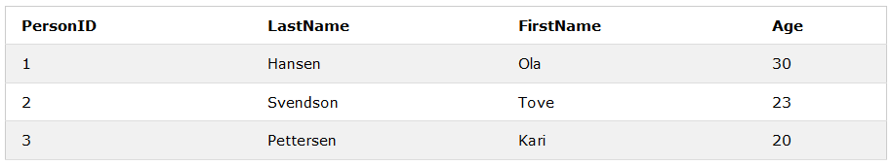
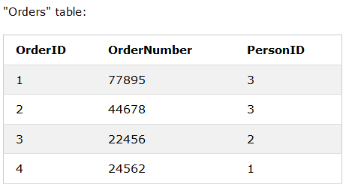
Look at the following two tables: "Persons" table:

Slide 16
Notice that the "PersonID" column in the "Orders" table points to the "PersonID" column in the "Persons" table.
The "PersonID" column in the "Persons" table is the PRIMARY KEY in the "Persons" table.
The "PersonID" column in the "Orders" table is a FOREIGN KEY in the "Orders" table
SQL foreign key on alter table
To create a FOREIGN KEY constraint on the "PersonID" column when the "Orders" table is already created, use the following SQL:
ALTER TABLE Orders
ADD FOREIGN KEY (PersonID) REFERENCES Persons(PersonID);
Drop a foreign key constraint
To drop a FOREIGN KEY constraint, use the following SQL:
ALTER TABLE Orders
DROP FOREIGN KEY FK_PersonOrder;
Example:
CREATE TABLE Orders (OrderID int NOT NULL, OrderNumber int NOT NULL, PersonID int,
PRIMARY KEY (OrderID),
FOREIGN KEY (PersonID) REFERENCES Persons(PersonID));

Slide 17
INSERT INTO Syntax
It is possible to write the INSERT INTO statement in two ways.
The first way specifies both the column names and the values to be inserted:
INSERT INTO table_name (column1, column2, column3, ...)
VALUES (value1, value2, value3, ...);
The second way specifies only the values to be inserted:
INSERT INTO table_name
VALUES (value1, value2, value3, ...)
Example:
Below is a selection from the "Customers" table in the sample database
SQL check constraint
The CHECK constraint is used to limit the value range that can be placed in a column.
If you define a CHECK constraint on a single column it allows only certain values for this column.
If you define a CHECK constraint on a table it can limit the values in certain columns based on values in other columns in the row.
Example:
CREATE TABLE Persons (ID int NOT NULL, LastName varchar(255) NOT NULL, FirstName varchar(255), Age int,
CHECK (Age>=18));

Slide 18

NSERT INTO Customers (CustomerName, ContactName, Address, City, PostalCode, Country)
VALUES ('Cardinal', 'Tom B. Erichsen', 'Skagen 21', 'Stavanger', '4006', 'Norway');

