Slide 1

Chapter 6:DB security and integrity
Database system for 4th Year ECE (Computer Engineering) students
Prepared by M.A
Debre Tabor University, Ethiopia
2010 E.C

Slide 2
Chapter 6:DB security and integrity
DBMS can provide some security
Each user has an account, username and password
These are used to identify a user and control their access to information
DBMS verifies password and checks a user’s permissions when they try to
Retrieve data
Modify data
Modify the database structure
Permissions and Privilege
SQL uses privileges to control access to tables and other database objects
SELECT privilege
INSERT privilege
UPDATE privilege
DELETE privilege
The owner (creator) of a database has all privileges on all objects in the database, and can grant these to others
The owner (creator) of an object has all privileges on that object and can pass them on to others

Slide 3
Chapter 6:DB security and integrity
Privileges in SQL
GRANT <privileges>
ON <object>
TO <users>
[WITH GRANT OPTION]
Removing Privileges
If you want to remove a privilege you have granted you use
REVOKE <privileges>
ON <object>
FROM <users>
If a user has the same privilege from other users then they keep it
All privileges dependent on the revoked one are also revoked
Privileges Examples
GRANT ALL ON Employee
TO Manager
WITH GRANT OPTION
GRANT SELECT,
UPDATE (Salary) ON
Employee TO Finance

Slide 4
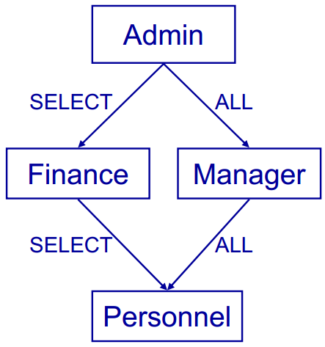
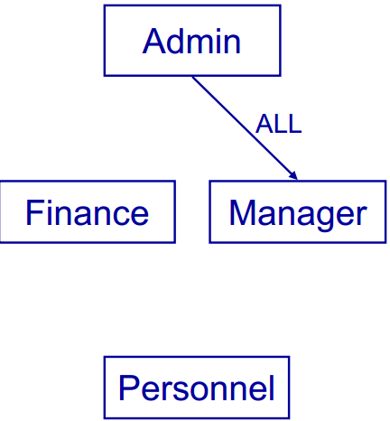
Chapter 6:DB security and integrity
Granting privilege revoking privilege
Views
Privileges work at the level of tables
You can restrict access by column
You cannot restrict access by row
Views, along with privileges, allow for customized access
Views provide ‘derived’ tables
A view is the result of a SELECT statement which is treated like a table
You can SELECT from (and sometimes UPDATE etc) views just like tables

Slide 5
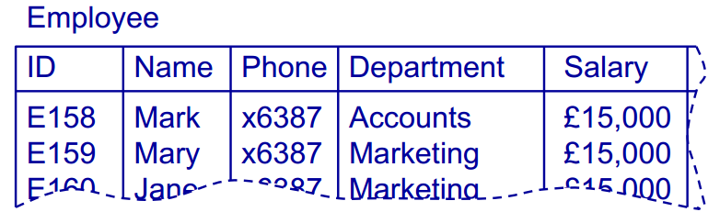
Chapter 6:DB security and integrity
Example
CREATE VIEW <name>
AS <select stmt>
CREATE VIEW OwnDept AS
SELECT Name, Phone FROM Employee
WHERE Department = (SELECT Department FROM Employee WHERE name = USER)
GRANT SELECT ON OwnDept TO PUBLIC
Using Views and Privileges
Views and privileges are used together to control access
A view is made which contains the information needed
Privileges are granted to that view, rather than the underlying tables

Slide 6
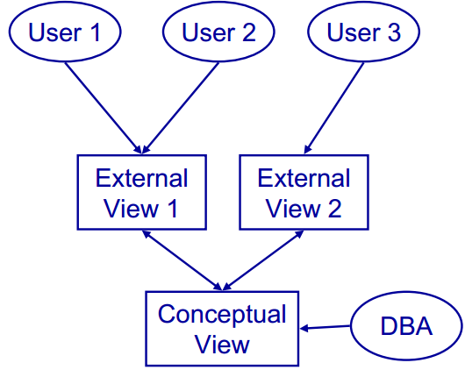
Chapter 6:DB security and integrity

Slide 7
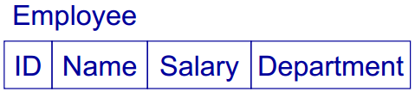
Chapter 6:DB security and integrity
To restrict someone's access to a table
Create a view of that table that shows only the information they need to see
Grant them privileges on the view
Revoke any privileges they have on the original table
View Updating
Views are like virtual tables
Their value depends on the ‘base’ tables that they are defined from
You can select from views just like a tableWhat about update, insert, and delete?

Slide 8
Chapter 6:DB security and integrity
Set the privileges
GRANT SELECT,
UPDATE (Department) ON forJohn
TO John
REVOKE ALL ON Employee FROM John
Create a view
CREATE VIEW forJohn
AS SELECT Name, Department FROM Employee
Database Integrity
Security
Integrity
Database security makes sure that the user is authorized to access information
Database integrity makes sure that (authorized) users use that information correctly

Slide 9
Chapter 6:DB security and integrity
Domains and Attributes
Domains constraints are data types
CREATE DOMAIN Colour VARCHAR(15) CONSTRAINT checkCol
CHECK (VALUE IN (‘RED’,‘Blue’…))
Attributes are constrained by their domains
CREATE TABLE Rainbow ( Rorder Int, Rcolour Colour)
Integrity constraints
This can be classified as:
Domain constraint
Relation constraint
Database constraint
Assertions
Provide a way to give relation and database constraints
Give a Boolean condition that must always be true
No action is permitted that would make the condition false
CREATE ASSERTION <name>
CHECK (<condition> )
The condition can refer to one or several tables
Often use EXISTS or NOT EXISTS

Slide 10

Chapter 6:DB security and integrity
Database Constraints
Database constraints are similar but refer to several tables
Example: Given tables student and enrolment, make sure no CS student takes more than 12 modules
Relation Constraints
To create a relation constraint
We simply make an assertion that checks the constraint
Example: in an Employee table, no employee’s bonus should be more than 15% of their salary CREATE ASSERTION
checkSalaryBonus
CHECK ( NOT EXISTS ( SELECT * FROM EMPLOYEE
WHERE (Bonus > 0.15*Salary) ))
CREATE ASSERTION CSEnrolment CHECK
(NOT EXISTS (SELECT * FROM Student AS S
WHERE S.Department = ‘CS’ AND ((SELECT COUNT (*) FROM Enrolment AS E
WHERE S.ID = E.ID) > 12)))

