Slide 1
Design and Analysis of Algorithm
Method of algorithm analysis
Prepared by: Misganaw A.(MSC.)
Email: mail@ethioptec.com/ethiomisgie@gmail.com
Website : https://ethioptec.com or https://info.ethioptec.com
Telegram: https://t.me/ethiop_computing

Slide 2
Method of algorithm analysis
Asymptotic Analysis
Asymptotic analysis of an algorithm refers to defining the mathematical foundation/framing of its run-time performance.
Using asymptotic analysis, we can very well conclude the best case, average case, and worst case scenario of an algorithm.
Asymptotic analysis is input bound i.e., if there's no input to the algorithm, it is concluded to work in a constant time.
Asymptotic analysis refers to computing the running time of any operation in mathematical units of computation.

Slide 3
Method of algorithm analysis
For example
The running time of one operation is computed as f(n) and may be for another operation it is computed as g(n²).
This means the first operation running time will increase linearly with the increase in n and the running time of the second operation will increase exponentially when n increases.
Similarly, the running time of both operations will be nearly the same if n is significantly small.
Usually, the time required by an algorithm falls under three types
Best Case − Minimum time required for program execution.
Average Case − Average time required for program execution.
Worst Case − Maximum time required for program execution.

Slide 4
Method of algorithm analysis
The asymptotic behavior of a function f(n) refers to the growth of f(n) as n gets large.
The asymptotic behavior of a function f(n) refers to the growth of f(n) as n gets large.
We typically ignore small values of n, since we are usually interested in estimating how slow the program will be on large inputs.
A good rule of thumb is that the slower the asymptotic growth rate, the better the algorithm. Though it’s not always true.
For example, a linear algorithm f(n)=d∗n+k is always asymptotically better than a quadratic one, f(n)=c *n²+q.
Where c, d and k are constants

Slide 5
Method of algorithm analysis
Asymptotic Notations
Execution time of an algorithm depends on
the instruction set
processor speed
disk I/O speed, etc.
Hence, we estimate the efficiency of an algorithm asymptotically.
Time function of an algorithm is represented by T(n), where n is the input size.
Following asymptotic notations are used to calculate the running time complexity of an algorithm.

Slide 6
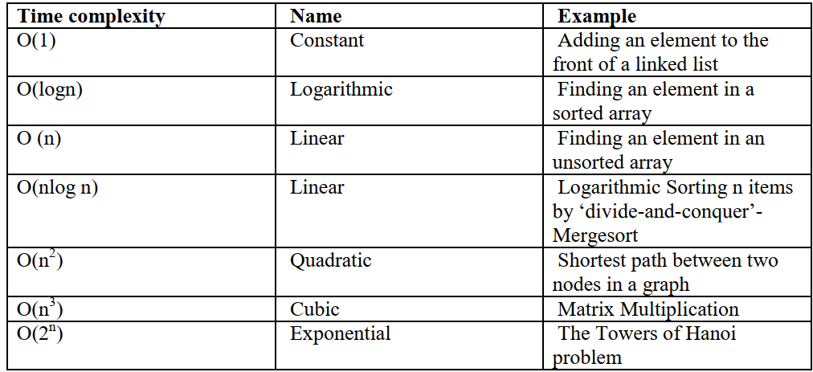
Method of algorithm analysis
O − Big Oh
Ω − Big omega
θ − Big theta
o − Little Oh
ω − Little omega

Slide 7
Method of algorithm analysis
O: Asymptotic Upper Bound
'O' (Big Oh) is the most commonly used notation. A function f(n) can be represented is the order of g(n) that is O(g(n)), if there exists a value of positive integer n as n₀ and a positive constant c such that
f(n)⩽c.g(n) for n>n0 in all case
Hence, function g(n) is an upper bound for function f(n), as g(n) grows faster than f(n).
For example, if f(n) = n⁴ + 100n² + 10n + 50 is the given algorithm, then n4 is g(n). That means g(n) gives the maximum rate of growth for f(n) at larger values of n
f(n) = O(g(n)), (pronounced order of or big oh), says that the growth rate of f(n) is less than or equal (<) that of g(n).

Slide 8
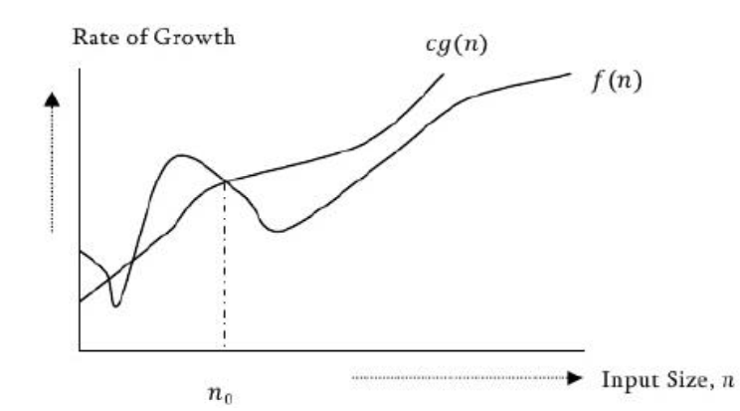
Method of algorithm analysis
Example
Let us consider a given function, f(n)=4.n³+10.n²+5.n+1
Considering g(n)=n³, f(n)⩽5.g(n) for all the values of n>2
Hence, the complexity of f(n) can be represented as O(g(n)), i.e. O(n³)
In general, we do not consider lower values of n. That means the rate of growth at lower values of n is not important. In the below figure, no is the point from which we consider the rate of growths for a given algorithm. Below no the rate of growths may be different

Slide 9
Method of algorithm analysis
Ω: Asymptotic Lower Bound
Similar to above discussion, this notation gives the tighter lower bound of the given algorithm and we represent it as f(n) = Ω (g(n)).
That means, at larger values of n, the tighter lower bound of f(n) is g.
For example, if f(n) = 100n² + 10n + 50, g(n) is Ω (n²). The . Ω. notation as be defined as Ω (g (n)) = {f(n): there exist positive constants c and no such that 0 <= cg (n) <= f(n) for all n >= no}. g(n) is an asymptotic lower bound for f(n).
Ω (g (n)) is the set of functions with smaller or same order of growth as f(n).

Slide 10
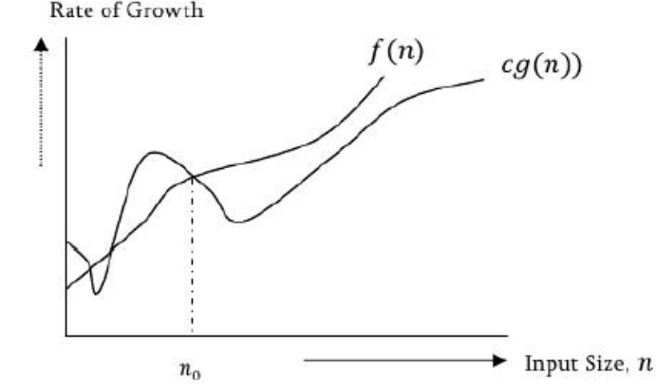
Method of algorithm analysis
Example
Let us consider a given function, f(n)=4. n³+10.n²+5.n+1.
Considering g(n)=n³, f(n)⩾4. g(n) for all the values of n>0.
Hence, the complexity of f(n) can be represented as Ω(g(n)), i.e. Ω(n³)

Slide 11
Method of algorithm analysis
θ: Asymptotic Tight Bound
This notation decides whether the upper and lower bounds of a given function are same or not. The average running time of algorithm is always between lower bound and upper bound.
If the upper bound (O) and lower bound (Ω) gives the same result then Θ notation will also have the same rate of growth.
As an example, let us assume that f(n) = 10n + n is the expression. Then, its tight upper bound g(n) is O(n). The rate of growth in best case is g (n) =O(n). In this case, rate of growths in best case and worst are same. As a result, the average case will also be same.

Slide 12
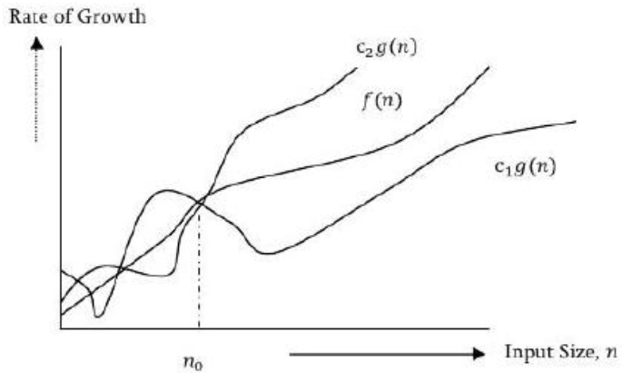
Method of algorithm analysis
Note: For a given function (algorithm), if the rate of growths (bounds) for O and Ω are not same then the rate of growth Θ case may not be same.
We say that f(n)=θ(g(n))
when there exist constants c₁ and c₂ that c1.g(n)⩽f(n)⩽c2.g(n) for all sufficiently large value of n. Here n is a positive integer.
This means function g is a tight bound for function f.

Slide 13
Method of algorithm analysis
Example
Let us consider a given function, f(n)=4. n³+10.n²+5.n+1
Considering g(n)=n³, 4.g(n)⩽f(n)⩽5. g(n) for all the large values of n.
Hence, the complexity of f(n) can be represented as θ(g(n)), i.e. θ(n³)
Analyzing Algorithm
Suppose “M‟ is an algorithm, and suppose “n‟ is the size of the input data.
Clearly the complexity f(n) of M increases as n increases.
It is usually the rate of increase of f(n) we want to examine.
This is usually done by comparing f(n) with some standard functions.
The most common computing times are: O(1), O(log₂^{n}), O(n), O(n. log₂^{n}), O(n²), O(n³), O(2^{n}).

Slide 14
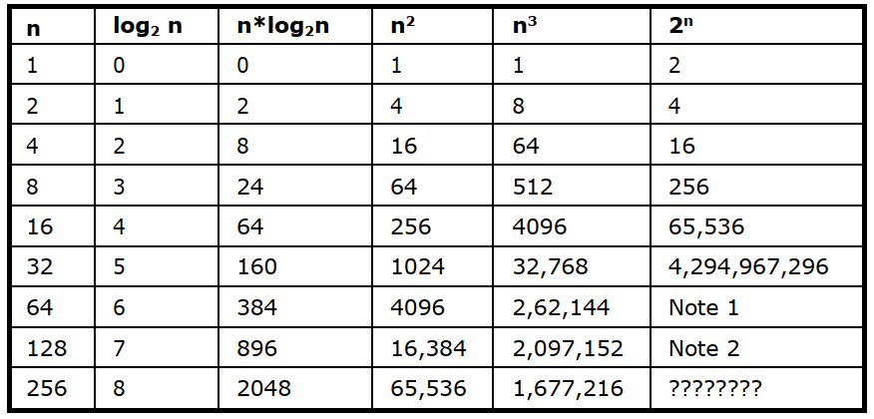
Method of algorithm analysis
Numerical Comparison of Different Algorithms
The execution time for six of the typical functions is given below:

Slide 15
Method of algorithm analysis
The rule of sums
Suppose that T1(n) and T2(n) are the running times of two programs fragments P1 and P2, and that T1(n) is O(f(n)) and T2(n) is O(g(n)). Then T1(n) + T2(n), the running time of P1 followed by P2 is O (max f(n), g(n))
this is called as rule of sums.
For example, suppose that we have three steps whose running times are respectively O(n²), O(n³) and O (n. log n). Then the running time of the first two steps executed sequentially is O (max (n², n³)) which is O(n³). The running time of all three together is O (max (n³, n. log n)) which is O(n³)

Slide 16
Method of algorithm analysis
The Running time of a program
When solving a problem, we are faced with a choice among algorithms. The basis for this can be any one of the following:
We would like an algorithm that is easy to understand, code and debug.
We would like an algorithm that makes efficient use of the computer’s resources, especially, one that runs as fast as possible.
Measuring the running time of a program
The running time of a program depends on factors such as:
The input to the program.
The quality of code generated by the compiler used to create the object program.
The nature and speed of the instructions on the machine used to execute the program, and
The time complexity of the algorithm underlying the program.

Slide 17
Method of algorithm analysis
Rules for using big-O:
big-O gives an upper bound only.
If an algorithm is O(n²), it doesn’t have to take n² steps (or a constant multiple of n²). But it can’t take more than n².
So any algorithm that is O(n), is also an O(n²) algorithm.
If this seems confusing, think of big-O as being like "<". Any number that is < n is also < n².
Ignoring constant factors: O(c f(n)) = O(f(n)), where c is a constant; e.g. O(20 n³) = O(n³)
Ignoring smaller terms: If a<b then O(a+b) = O(b), for example O(n²+n) = O(n²)
Upper bound only: If a<b then an O(a) algorithm is also an O(b) algorithm. For example, an O(n) algorithm is also an O(n²) algorithm (but not vice versa).

Slide 18

Method of algorithm analysis
n and log n are "bigger" than any constant, from an asymptotic view (that means for large enough n). So if k is a constant, an O(n + k) algorithm is also O(n), by ignoring smaller terms.
Similarly, an O(log n + k) algorithm is also O(log n).
Another consequence of the last item is that an O(n log n + n) algorithm, which is O(n(log n + 1)), can be simplified to O(n logn).
Calculating the running time of a program
Let us now look into how big-O bounds can be computed for some common algorithms.
Example 1:
Let’s consider a short piece of source code:

Slide 19
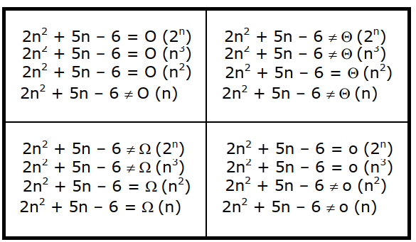
Method of algorithm analysis
If y, z are scalars, this piece of code takes a constant amount of time, which we write as O(1).
In terms of actual computer instructions or clock ticks, it’s difficult to say exactly how long it takes. But whatever it is, it should be the same whenever this piece of code is executed.
O(1) means some constant, it might be 5, or 1 or 1000.

Slide 20

Method of algorithm analysis
Example 4:
Analysis of simple for loop
Now let’s consider a simple for loop:
This loop will run exactly n times, because the inside of the loop takes constant time
The total running time is proportional to n. We write it as O(n).
The actual number of instructions might be 50n, while the running time might be 17n microseconds.
It might even be 17n+3 microseconds because the loop needs some time to start up. The big-O notation allows a multiplication factor (like 17) as well as an additive factor (like 3).
As long as it’s a linear function which is proportional to n, the correct notation is O(n) and the code is said to have linear running time.

Slide 21
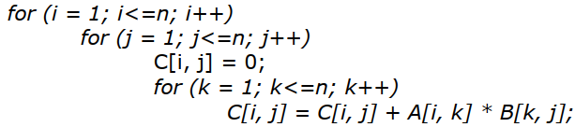
Method of algorithm analysis
Example 6:
Analysis of matrix multiply
Let’s start with an easy case. Multiplying two n × n matrices. The code to compute the matrix product C = A * B is given below.
There are 3 nested for loops, each of which runs n times.
The innermost loop therefore executes n*n*n = n³ times.
The innermost statement, which contains a scalar sum and product takes constant O(1) time.
So the algorithm overall takes O(n³) time.

Slide 22
Method of algorithm analysis
Solving recurrence solution
A recurrence is an equation or inequality that describes a function in terms of its value on smaller inputs. Recurrences are generally used in divide-and-conquer paradigm.
A recurrence relation can be solved using the following methods −
Substitution Method − In this method, we guess a bound and using mathematical induction we prove that our assumption was correct.
Recursion Tree Method − In this method, a recurrence tree is formed where each node represents the cost.
Master’s Theorem − This is another important technique to find the complexity of a recurrence relation.

Slide 23
Method of algorithm analysis
Exercises on methods of algorithm analysis 1. Find the time complexity for the following program? for(i=1;i<n;i=i+2) { stmt; } 2. Find the time complexity for the following program? p=0; for(i=1;p<n;i++) { p=p+i; }
3. Find the time complexity for the following program? for(i=1;p<n;i=i*2) { stmt; } 4. Find the time complexity for the following program? a=1; while(a<b) { stmt; a=a*2; }

Slide 24
Method of algorithm analysis

