Slide 1
Design and Analysis of Algorithm
Sorting and Searching algorithm
Prepared by: Misganaw A.(MSC.)
Email: mail@ethioptec.com/ethiomisgie@gmail.com
Website : https://ethioptec.com or https://info.ethioptec.com
Telegram: https://t.me/ethiop_computing

Slide 2
Sorting and Searching algorithm
Sorting algorithm
The main idea behind performing sorting is to arrange the data in an orderly way, making it easier to search for any element within the sorted data.
Bubble Sort Algorithm
It is comparison-based algorithm in which each pair of adjacent elements is compared and the elements are swapped if they are not in order.
This algorithm is not suitable for large data sets as its average and worst case complexity are of O(n²) where n is the number of items.
We assume list is an array of n elements. We further assume that swap function swaps the values of the given array elements.

Slide 3
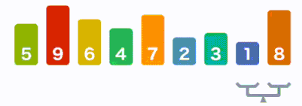
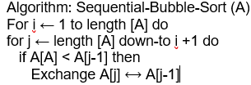
Sorting and Searching algorithm
Step 1 − Check if the first element in the input array is greater than the next element in the array.
Step 2 − If it is greater, swap the two elements; otherwise move the pointer forward in the array.
Step 3 − Repeat Step 2 until we reach the end of the array.
Step 4 − Check if the elements are sorted; if not, repeat the same process (Step 1 to Step 3) from the last element of the array to the first.
Step 5 − The final output achieved is the sorted array.

Slide 4
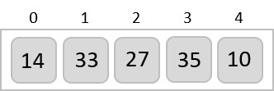
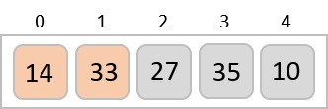
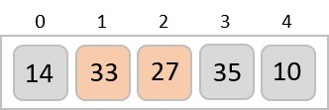
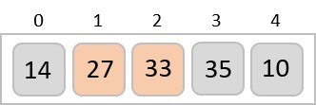
Sorting and Searching algorithm
Let us take an unsorted array for our example.
Bubble sort starts with very first two elements, comparing them to check which one is greater
In this case, value 33 is greater than 14, so it is already in sorted locations. Next, we compare 33 with 27
We find that 27 is smaller than 33 and these two values must be swapped.

Slide 5
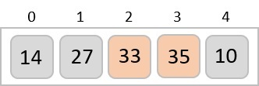
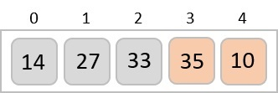
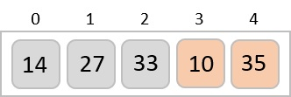
Sorting and Searching algorithm
Next we compare 33 and 35. We find that both are in already sorted positions
Then we move to the next two values, 35 and 10.
We know then that 10 is smaller 35. Hence they are not sorted. We swap these values. We find that we have reached the end of the array. After one iteration, the array should look like this −

Slide 6

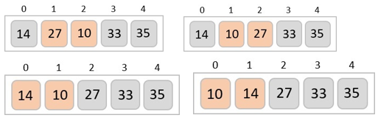

Sorting and Searching algorithm
To be precise, we are now showing how an array should look like after each iteration. After the second iteration, it should look like this
Notice that after each iteration, at least one value moves at the end.
And when there's no swap required, bubble sort learns that an array is completely sorted.

Slide 7
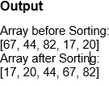
Sorting and Searching algorithm
def bubble_sort(array, size):
for i in range(size):
swaps = 0;
for j in range(0, size-i-1):
if(arr[j] > arr[j+1]):
temp = arr[j];
arr[j] = arr[j+1];
arr[j+1] = temp;
swaps = 1;
if(swaps == 0):
break;
arr = [67, 44, 82, 17, 20]
n = len(arr)
print("Array before Sorting: ")
print(arr)
bubble_sort(arr, n);
print("Array after Sorting: ")
print(arr)

Slide 8
Sorting and Searching algorithm
Insertion Sort Algorithm
Insertion sort is a very simple method to sort numbers in an ascending or descending order.
It follows the incremental method.
It can be compared with the technique how cards are sorted at the time of playing a game.
This is an in-place comparison-based sorting algorithm.
Here, a sub-list is maintained which is always sorted.
For example, the lower part of an array is maintained to be sorted. An element which is to be 'inserted' in this sorted sub-list, has to find its appropriate place and then it has to be inserted there. Hence the name, insertion sort

Slide 9
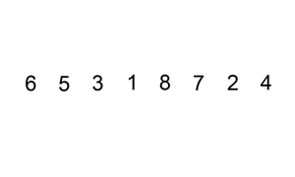
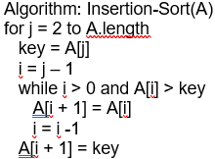
Sorting and Searching algorithm
Now we have a bigger picture of how this sorting technique works, so we can derive simple steps by which we can achieve insertion sort.
Step 1 − If it is the first element, it is already sorted. return 1;
Step 2 − Pick next element.
Step 3 − Compare with all elements in the sorted sub-list.
Step 4 − Shift all the elements in the sorted sub-list that is greater than the value to be sorted.
Step 5 − Insert the value.
Step 6 − Repeat until list is sorted.

Slide 10
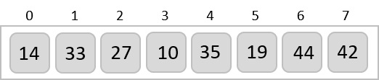
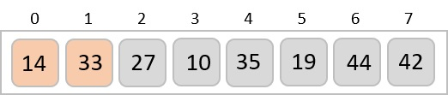
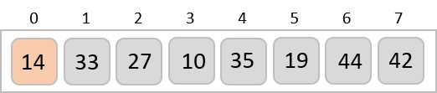
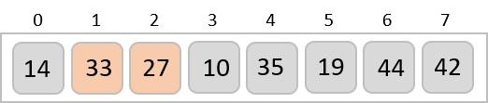
Sorting and Searching algorithm
Let us take an unsorted array for our example.
Insertion sort compares the first two elements.
It finds that both 14 and 33 are already in ascending order. For now, 14 is in sorted sub-list.
Insertion sort moves ahead and compares 33 with 27.

Slide 11
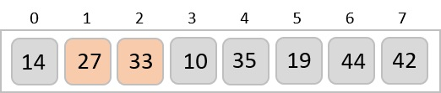
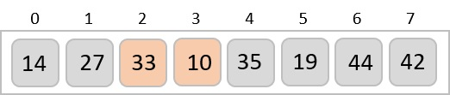

Sorting and Searching algorithm
And finds that 33 is not in the correct position. It swaps 33 with 27. It also checks with all the elements of sorted sub-list. Here we see that the sorted sub-list has only one element 14, and 27 is greater than 14. Hence, the sorted sub-list remains sorted after swapping.
By now we have 14 and 27 in the sorted sub-list. Next, it compares 33 with 10. These values are not in a sorted order.
So they are swapped.

Slide 12

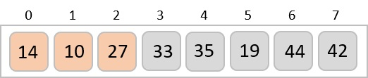
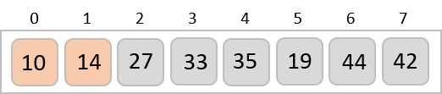
Sorting and Searching algorithm
However, swapping makes 27 and 10 unsorted.
Hence, we swap them too.
Again we find 14 and 10 in an unsorted order.
By the end of third iteration, we have a sorted sub-list of 4 items.
This process goes on until all the unsorted values are covered in a sorted sub-list.

Slide 13
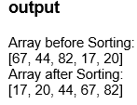
Sorting and Searching algorithm
Python code
def insertion_sort(array, size):
for i in range(1, size):
key = array[i]
j = i
while (j > 0) and (array[j-1] > key):
array[j] = array[j-1]
j = j-1
array[j] = key
arr = [67, 44, 82, 17, 20]
n = len(arr)
print("Array before Sorting: ")
print(arr)
insertion_sort(arr, n);
print("Array after Sorting: ")
print(arr)

Slide 14
Sorting and Searching algorithm
Selection Sort Algorithm
This sorting algorithm is like insertion sort,
It is an in-place comparison-based algorithm in which the list is divided into two parts, the sorted part at the left end and the unsorted part at the right end. Initially, the sorted part is empty and the unsorted part is the entire list.
The smallest element is selected from the unsorted array and swapped with the leftmost element, and that element becomes a part of the sorted array. This process continues moving unsorted array boundaries by one element to the right.
This algorithm is not suitable for large data sets as its average and worst case complexities are of O(n²), where n is the number of items.

Slide 15
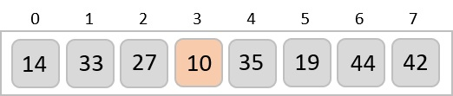
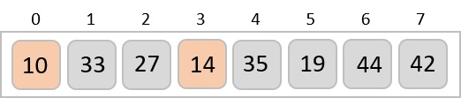
Sorting and Searching algorithm
Consider the following depicted array as an example.
For the first position in the sorted list, the whole list is scanned sequentially. The first position where 14 is stored presently, we search the whole list and find that 10 is the lowest value.
So we replace 14 with 10. After one iteration 10, which happens to be the minimum value in the list, appears in the first position of the sorted list.

Slide 16
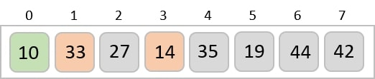
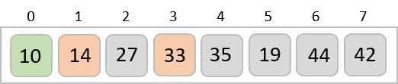
Sorting and Searching algorithm
For the second position, where 33 is residing, we start scanning the rest of the list in a linear manner.
We find that 14 is the second lowest value in the list and it should appear at the second place. We swap these values.
After two iterations, two least values are positioned at the beginning in a sorted manner

Slide 17
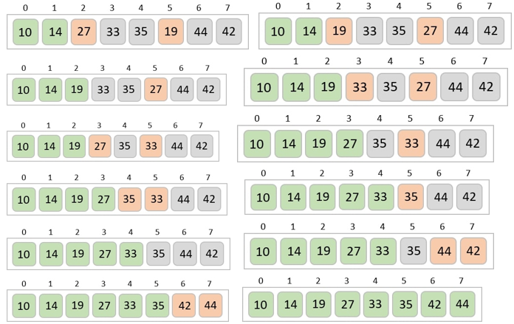
Sorting and Searching algorithm
The same process is applied to the rest of the items in the array −

Slide 18
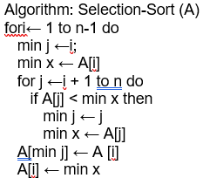
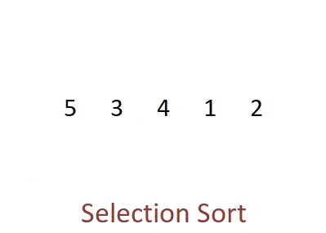
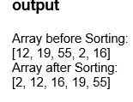
Sorting and Searching algorithm
Algorithm
def insertion_sort(array, size):
for i in range(size):
imin = i
for j in range(i+1, size):
if arr[j] < arr[imin]:
imin = j
temp = array[i];
array[i] = array[imin];
array[imin] = temp;
arr = [12, 19, 55, 2, 16]
n = len(arr)
print("Array before Sorting: ")
print(arr)
insertion_sort(arr, n);
print("Array after Sorting: ")
print(arr)

Slide 19

Sorting and Searching algorithm
Shell Sort Algorithm
Shell sort is a highly efficient sorting algorithm
Shell sort is based on insertion sort algorithm.
This algorithm avoids large shifts as in case of insertion sort, if the smaller value is to the far right and has to be moved to the far left.
This algorithm uses insertion sort on a widely spread elements, first to sort them and then sorts the less widely spaced elements.
This spacing is termed as interval. This interval is calculated based on Knuth's formula as

Slide 20

Sorting and Searching algorithm
This algorithm is quite efficient for medium-sized data sets as its average and worst-case complexity are of O(n), where n is the number of items.
Following is the algorithm for shell sort.

Slide 21
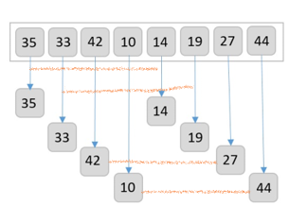
Sorting and Searching algorithm
Let us consider the following example to have an idea of how shell sort works.
For our example and ease of understanding, we take the interval of 4.
Make a virtual sub-list of all values located at the interval of 4 positions. Here these values are {35, 14}, {33, 19}, {42, 27} and {10, 44}

Slide 22
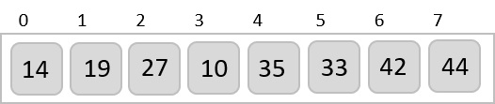
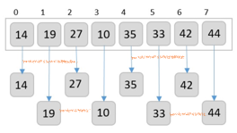
Sorting and Searching algorithm
We compare values in each sub-list and swap them (if necessary) in the original array. After this step, the new array should look like this
Then, we take interval of 2 and this gap generates two sub-lists - {14, 27, 35, 42}, {19, 10, 33, 44}
We compare and swap the values, if required, in the original array. After this step, the array should look like this

Slide 23
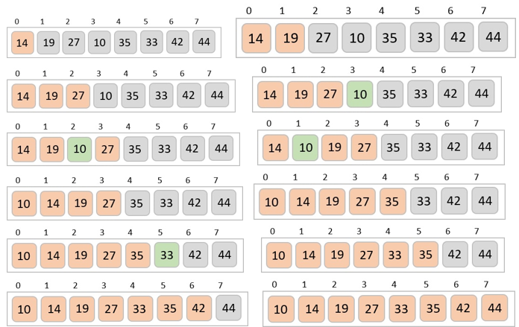
Sorting and Searching algorithm
Finally, we sort the rest of the array using interval of value 1. Shell sort uses insertion sort to sort the array.
Following is the step-by-step depiction

Slide 24
Sorting and Searching algorithm
Exercises on sorting algorithm
Implement bubble sort using C++ & Java code.?
Implement insertion sort using C++ & Java code.?
Implement selection sort using C++ & Java code.?
Implement shell sort using C++ & Java code.?

Slide 25
Sorting and Searching algorithm
Searching algorithm
Searching is a process of finding a particular record, which can be a
single element
a small chunk, within a huge amount of data.
The data can be in various forms:
Arrays
linked lists
trees, heaps, and
graphs etc.

Slide 26
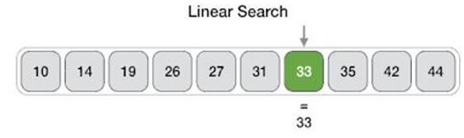
Sorting and Searching algorithm
Linear Search Algorithm
Linear search is a type of sequential searching algorithm.
Every element within the input array is traversed and compared with the key element to be found. If a match is found in the array the search is said to be successful
if there is no match found the search is said to be unsuccessful and gives the worst-case time complexity.
For instance, in the given diagram, we are searching for an element 33. Therefore, the linear search method searches for it sequentially from the very first element until it finds a match. This returns a successful search.

Slide 27
Sorting and Searching algorithm
The algorithm for linear search is relatively simple. The procedure starts at the very first index of the input array to be searched.
Step 1 − Start from the 0th index of the input array, compare the key value with the value present in the 0th index.
Step 2 − If the value matches with the key, return the position at which the value was found.
Step 3 − If the value does not match with the key, compare the next element in the array.
Step 4 − Repeat Step 3 until there is a match found. Return the position at which the match was found.
Step 5 − If it is an unsuccessful search, print that the element is not present in the array and exit the program.

Slide 28
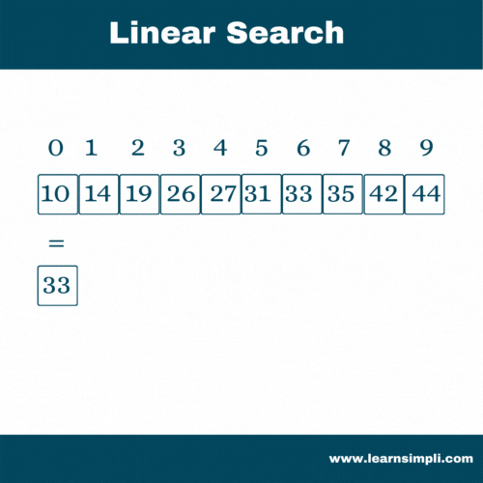
Sorting and Searching algorithm
The algorithm for linear search is relatively simple. The procedure starts at the very first index of the input array to be searched.

Slide 29
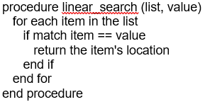
Sorting and Searching algorithm
Linear search traverses through every element sequentially
Therefore, the best case is when the element is found in the very first iteration.
The best-case time complexity would be O(1).
However, the worst case of the linear search method would be an unsuccessful search that does not find the key value in the array, it performs n iterations.
Therefore, the worst-case time complexity of the linear search algorithm would be O(n).

Slide 30
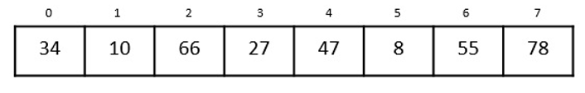
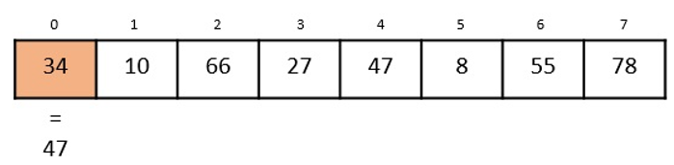
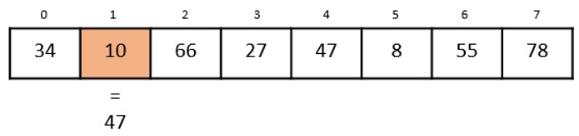
Sorting and Searching algorithm
Let us look at the step-by-step searching of the key element (say 47) in an array using the linear search method.
Step 1
The linear search starts from the 0th index. Compare the key element with the value in the 0th index, 34.
However, 47 ≠ 34. So, it moves to the next element.
Step 2
Now, the key is compared with value in the 1st index of the array.

Slide 31
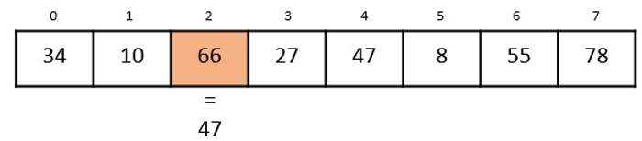
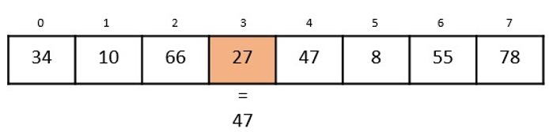
Sorting and Searching algorithm
Still, 47 ≠ 10, making the algorithm move for another iteration.
Step 3
The next element 66 is compared with 47. They are both not a match so the algorithm compares the further elements.
Step 4
Now the element in 3rd index, 27, is compared with the key value, 47. They are not equal so the algorithm is pushed forward to check the next element.

Slide 32
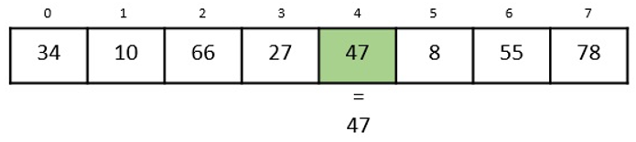
Sorting and Searching algorithm
Step 5
Comparing the element in the 4th index of the array, 47, to the key 47. It is figured that both the elements match. Now, the position in which 47 is present, i.e., 4 is returned.
The output achieved is “Element found at 4th index”.

Slide 33

Sorting and Searching algorithm
Python code Implementation
def linear_search(a, n, key):
count = 0
for i in range(n):
if(a[i] == key):
print("The element is found at position", (i+1))
count = count + 1
if(count == 0):
print("The element is not present in the array")
a = [14, 56, 77, 32, 84, 9, 10]
n = len(a)
key = 32
linear_search(a, n, key)
key = 3
linear_search(a, n, key)

Slide 34
Sorting and Searching algorithm
Binary Search Algorithm
Binary search is a fast search algorithm with run-time complexity of Ο(log n).
This search algorithm works on the principle of divide and conquer, since it divides the array into half before searching.
For this algorithm to work properly, the data collection should be in the sorted form.
Binary search looks for a particular key value by comparing the middle most item of the collection.
If a match occurs, then the index of item is returned.
But if the middle item has a value less than the key value, the right sub-array of the middle item is searched.
Otherwise, the left sub-array is searched. This process continues recursively until the size of a subarray reduces to zero.

Slide 35
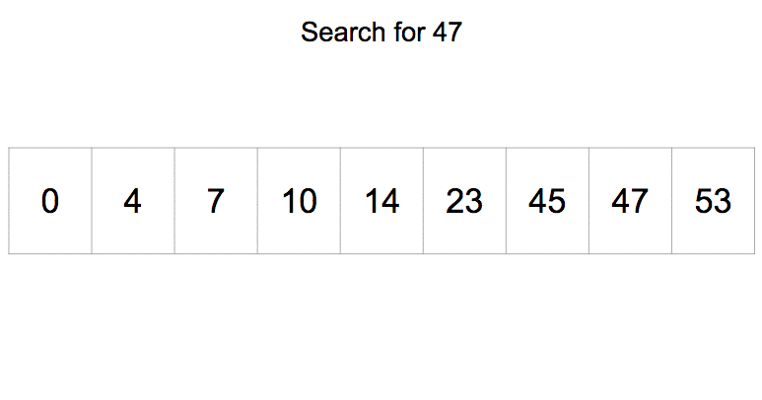
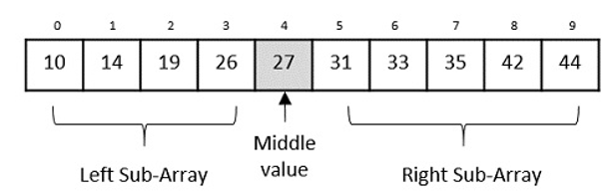
Sorting and Searching algorithm
Binary Search algorithm is an interval searching method that performs the searching in intervals only.
The input taken by the binary search algorithm must always be in a sorted array since it divides the array into subarrays based on the greater or lower values.
The algorithm follows the procedure below

Slide 36
Sorting and Searching algorithm
Step 1 − Select the middle item in the array and compare it with the key value to be searched. If it is matched, return the position of the median.
Step 2 − If it does not match the key value, check if the key value is either greater than or less than the median value.
Step 3 − If the key is greater, perform the search in the right sub-array; but if the key is lower than the median value, perform the search in the left sub-array.
Step 4 − Repeat Steps 1, 2 and 3 iteratively, until the size of sub-array becomes 1.
Step 5 − If the key value does not exist in the array, then the algorithm returns an unsuccessful search.

Slide 37
Sorting and Searching algorithm
The input array is searched iteratively by dividing into multiple sub-arrays after every unsuccessful iteration. Therefore, the recurrence relation formed would be of a dividing function.
To explain it in simpler terms,
During the first iteration, the element is searched in the entire array. Therefore, length of the array = n.
In the second iteration, only half of the original array is searched. Hence, length of the array = n/2.
In the third iteration, half of the previous sub-array is searched. Here, length of the array will be = n/4.
Similarly, in the i^{th} iteration, the length of the array will become n/2^{i}
To achieve a successful search, after the last iteration the length of array must be 1. Hence,

Slide 38
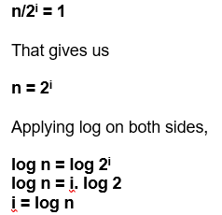
Sorting and Searching algorithm
Hence,
The time complexity of the binary search algorithm is O(log n)
For a binary search to work, it is mandatory for the target array to be sorted.
The following is our sorted array and let us assume that we need to search the location of value 31 using binary search.

Slide 39

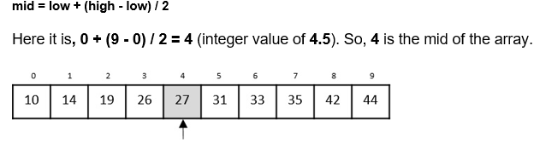
Sorting and Searching algorithm
First, we shall determine half of the array by using this formula
Now we compare the value stored at location 4, with the value being searched, i.e. 31.
We find that the value at location 4 is 27, which is not a match.
As the value is greater than 27, the target value must be in the upper portion of the array.

Slide 40


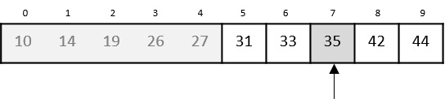
Sorting and Searching algorithm
We change our low to mid + 1 and find the new mid value again
Our new mid is 7 now. We compare the value stored at location 7 with our target value 31.
The value stored at location 7 is not a match, rather it is less than what we are looking for. So, the value must be in the lower part from this location.

Slide 41

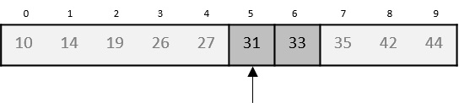

Sorting and Searching algorithm
Hence, we calculate the mid again. This time it is 5.
We compare the value stored at location 5 with our target value. We find that it is a match.

Slide 42

Sorting and Searching algorithm
Python code implementation
def binary_search(a, low, high, key):
mid = (low + high) // 2
if (low <= high):
if(a[mid] == key):
print("The element is present at index:", mid)
elif(key < a[mid]):
binary_search(a, low, mid-1, key)
elif (a[mid] < key):
binary_search(a, mid+1, high, key)
if(low > high):
print("Unsuccessful Search")
a = [6, 12, 14, 18, 22, 39, 55, 182]
n = len(a)
low = 0
high = n-1
key = 22
binary_search(a, low, high, key)
key = 54
binary_search(a, low, high, key)

Slide 43
Sorting and Searching algorithm
Jump Search Algorithm
Jump Search algorithm is a slightly modified version of the linear search algorithm.
The main idea is to reduce the time complexity by comparing lesser elements than the linear search algorithm.
The input array is hence sorted and divided into blocks to perform searching while jumping through these blocks.
For example, let us look at the given example below. The sorted input array is searched in the blocks of 3 elements each. The desired key is found only after 2 comparisons rather than the 6 comparisons of the linear search.

Slide 44
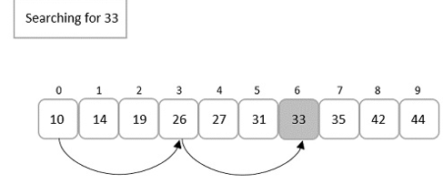
Sorting and Searching algorithm
Here, there arises a question about how to divide these blocks.
To answer that, if the input array is of size ‘n’, the blocks are divided in the intervals of √n.
First element of every block is compared with the key element until the key element’s value is less than the block element.
Linear search is performed only on that previous block since the input is sorted. If the element is found, it is a successful search; otherwise, an unsuccessful search is returned.

Slide 45
Sorting and Searching algorithm
The jump search algorithm takes a sorted array as an input which is divided into smaller blocks to make the search simpler. The algorithm is as follows
Step 1 − If the size of the input array is ‘n’, then the size of the block is √n. Set i = 0.
Step 2 − The key to be searched is compared with the ith element of the array. If it is a match, the position of the element is returned; otherwise i is incremented with the block size.
Step 3 − The Step 2 is repeated until the ith element is greater than the key element.
Step 4 − Now, the element is figured to be in the previous block, since the input array is sorted. Therefore, linear search is applied on that block to find the element.
Step 5 − If the element is found, the position is returned. If the element is not found, unsuccessful search is prompted.

Slide 46

Sorting and Searching algorithm
The time complexity of the jump search technique is O(√n) and space complexity is O(1).
Let us understand the jump search algorithm by searching for element 66 from the given sorted array, A, below
Step 1
Initialize i = 0, and size of the input array ‘n’ = 12
Suppose, block size is represented as ‘m’. Then, m = √n = √12 = 3
Step 2
Compare A[0] with the key element and check whether it matches,

Slide 47


Sorting and Searching algorithm
Therefore, i is incremented by the block size = 3. Now the element compared with the key element is A[3].
Step 3
Since it is not a match, i is again incremented by 3.
Step 4

Slide 48


Sorting and Searching algorithm
i is incremented by 3 again. A[9] is compared with the key element.
Step 5
However, 88 is greater than 66, therefore linear search is applied on the current block.
Step 6
After applying linear search, the pointer increments from 6th index to 7th. Therefore, A[7] is compared with the key element.

Slide 49


Sorting and Searching algorithm
We find that A[7] is the required element, hence the program returns 7th index as the output.
The jump search algorithm is an extended variant of linear search.
The algorithm divides the input array into multiple small blocks and performs the linear search on a single block that is assumed to contain the element.
If the element is not found in the assumed blocked, it returns an unsuccessful search.

Slide 50
Sorting and Searching algorithm
Python code implementation
import math
def jump_search(a, n, key):
i = 0
m = int(math.sqrt(n))
k = m
while(a[m] <= key and m < n):
i = m
m += k
if(m > n - 1):
return -1
for j in range(m):
if(arr[j] == key):
return j
return -1
arr = [0, 6, 12, 14, 19, 22, 48, 66, 79, 88, 104, 126]
n = len(arr);
print("Array elements are: ")
for i in range(n):
print(arr[i], end = " ")
key = 66
print("\nThe element to be searched: ", key)
index = jump_search(arr, n, key)
if(index >= 0):
print("The element is found at position: ", (index+1))
else:
print("\nUnsuccessful Search")

Slide 51

Sorting and Searching algorithm

Slide 52
Sorting and Searching algorithm
Exponential Search Algorithm
Exponential search algorithm targets a range of an input array in which it assumes that the required element must be present in and performs a binary search on that particular small range.
This algorithm is also known as doubling search or finger search.
It is similar to jump search in dividing the sorted input into multiple blocks and conducting a smaller scale search.
However, the difference occurs while performing computations to divide the blocks and the type of smaller scale search applied (jump search applies linear search and exponential search applies binary search).

Slide 53

Sorting and Searching algorithm
Hence, this algorithm jumps exponentially in the powers of 2.
In simpler words, the search is performed on the blocks divided using pow(2, k) where k is an integer greater than or equal to 0.
Once the element at position pow(2, n) is greater than the key element, binary search is performed on the current block.

Slide 54
Sorting and Searching algorithm
Step 1 − Compare the first element in the array with the key, if a match is found return the 0th index.
Step 2 − Initialize i = 1 and compare the i^{th} element of the array with the key to be search. If it matches return the index.
Step 3 − If the element does not match, jump through the array exponentially in the powers of 2. Therefore, now the algorithm compares the element present in the incremental position.
Step 4 − If the match is found, the index is returned. Otherwise Step 2 is repeated iteratively until the element at the incremental position becomes greater than the key to be searched.
Step 5 − Since the next increment has the higher element than the key and the input is sorted, the algorithm applies binary search algorithm on the current block.
Step 6 − The index at which the key is present is returned if the match is found; otherwise it is determined as an unsuccessful search.

Slide 55
Sorting and Searching algorithm
Analysis
Even though it is called Exponential search, it does not perform searching in exponential time complexity.
But as we know, in this search algorithm, the basic search being performed is binary search. Therefore, the time complexity of the exponential search algorithm will be the same as the binary search algorithm’s, O(log n).

Slide 56

Sorting and Searching algorithm
To understand the exponential search algorithm better and in a simpler way, let us search for an element in an example input array using the exponential search algorithm
The sorted input array given to the search algorithm is
Let us search for the position of element 81 in the given array.
Step 1
Compare the first element of the array with the key element 81.
The first element of the array is 6, but the key element to be searched is 81; hence, the jump starts from the 1st index as there is no match found.

Slide 57

Sorting and Searching algorithm
Step 2
After initializing i = 1, the key element is compared with the element in the first index. Here, the element in the 1st index does not match with the key element. So it is again incremented exponentially in the powers of 2.
The index is incremented to 2^{m} = 2¹ = the element in 2nd index is compared with the key element.

Slide 58


Sorting and Searching algorithm
It is still not a match so it is once again incremented.
Step 3
The index is incremented in the powers of 2 again.
2² = 4 = the element in 4th index is compared with the key element and a match is not found yet.

Slide 59

Sorting and Searching algorithm
Step 4
The index is incremented exponentially once again. This time the element in the 8th index is compared with the key element and a match is not found.
However, the element in the 8th index is greater than the key element. Hence, the binary search algorithm is applied on the current block of elements.
Step 5
The current block of elements includes the elements in the indices [4, 5, 6, 7].

Slide 60


Sorting and Searching algorithm
Small scale binary search is applied on this block of elements, where the mid is calculated to be the 5th element.
Step 6
The match is not found at the mid element and figures that the desired element is greater than the mid element. Hence, the search takes place is the right half of the block.
The mid now is set as 6th element

Slide 61


Sorting and Searching algorithm
Step 7
The element is still not found at the 6th element so it now searches in the right half of the mid element.
The next mid is set as 7th element.
Here, the element is found at the 7th index

Slide 62

Sorting and Searching algorithm
Python code implementation
import math
def exponential_search(a, n, key):
i = 1
m = int(math.pow(2, i))
if(a[0] == key):
return 0
while(a[m] <= key and m < n):
i = i + 1
m = int(math.pow(2, i))
low = 0
high = n - 1
while (low <= high):
mid = (low + high) // 2
if(a[mid] == key):
return mid
elif(a[mid] < key):
low = mid + 1
else:
high = mid - 1
return -1
arr = [6, 11, 19, 24, 33, 54, 67, 81, 94, 99]
n = len(arr);
print("Array elements are: ")
for i in range(len(arr)):
print(arr[i], end = " ")
key = 67
print("\nThe element to be searched: ", key)
index = exponential_search(arr, n, key)
if(index >= 0):
print("The element is found at index: ", (index))
else:
print("\nUnsuccessful Search")

Slide 63
Sorting and Searching algorithm
Exercises on Searching algorithm
Read about Hash Table?
Implement linear search using C++ & Java code.?
Implement binary search using C++ & Java code.?
Implement jump search using C++ & Java code.?
Implement exponential search using C++ & Java code.?

