Slide 1
Design and Analysis of Algorithm
Algorithm Design Techniques
Prepared by: Misganaw A.(MSC.)
Email: mail@ethioptec.com/ethiomisgie@gmail.com
Website : https://ethioptec.com or https://info.ethioptec.com
Telegram: https://t.me/ethiop_computing

Slide 2
Algorithm Design Techniques
Divide & Conquer Algorithm
Using divide and conquer approach, the problem in hand, is divided into smaller sub-problems and then each problem is solved independently.
When we keep dividing the sub-problems into even smaller sub-problems, we may eventually reach a stage where no more division is possible.
Those smallest possible sub-problems are solved using original solution because it takes lesser time to compute.
The solution of all sub-problems is finally merged in order to obtain the solution of the original problem.

Slide 3
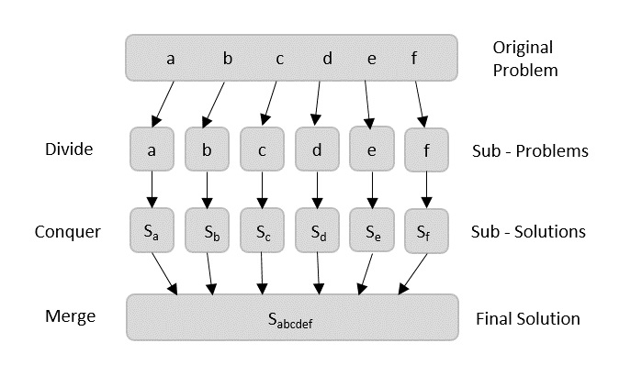
Algorithm Design Techniques

Slide 4
Algorithm Design Techniques
Broadly, we can understand divide-and-conquer approach in a three-step process.
Divide/Break
This step involves breaking the problem into smaller sub-problems.
Sub-problems should represent a part of the original problem.
This step generally takes a recursive approach to divide the problem until no sub-problem is further divisible. At this stage, sub-problems become atomic in size but still represent some part of the actual problem.
2. Conquer/Solve
This step receives a lot of smaller sub-problems to be solved.
Generally, at this level, the problems are considered 'solved' on their own.

Slide 5
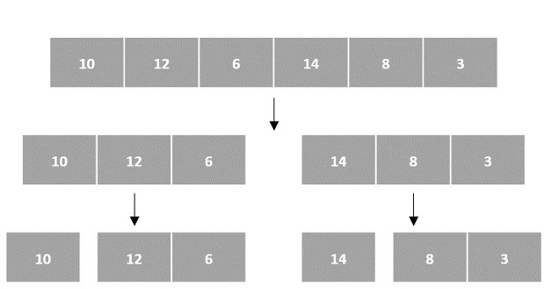
Algorithm Design Techniques
3. Merge/Combine
When the smaller sub-problems are solved, this stage recursively combines them until they formulate a solution of the original problem. This algorithmic approach works recursively and conquer & merge steps works so close that they appear as one.
Arrays as Input
In the input for a sorting algorithm below, the array input is divided into subproblems until they cannot be divided further

Slide 6
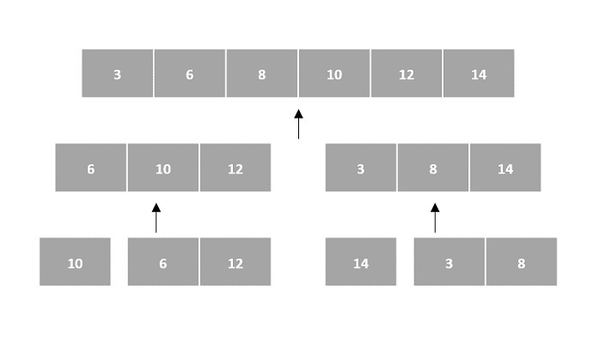
Algorithm Design Techniques
Then, the subproblems are sorted (the conquer step) and are merged to form the solution of the original array back (the combine step).
Since arrays are indexed and linear data structures, sorting algorithms most popularly use array data structures to receive input.

Slide 7
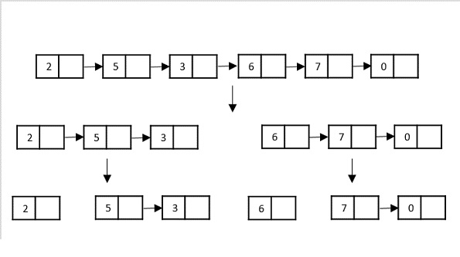
Algorithm Design Techniques
Linked Lists as Input
Another data structure that can be used to take input for divide and conquer algorithms is a linked list (for example, merge sort using linked lists). Like arrays, linked lists are also linear data structures that store data sequentially.
Consider the merge sort algorithm on linked list; following the very popular tortoise and hare algorithm, the list is divided until it cannot be divided further.

Slide 8
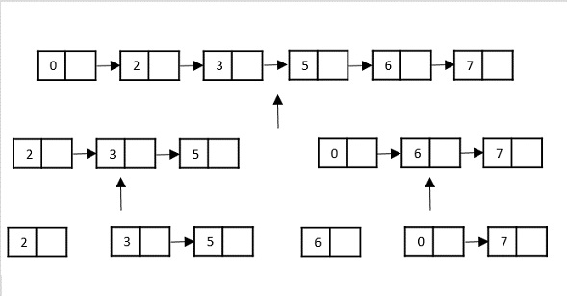
Algorithm Design Techniques
Then, the nodes in the list are sorted (conquered). These nodes are then combined (or merged) in recursively until the final solution is achieved.

Slide 9
Algorithm Design Techniques
Max-Min Problem
The Max-Min Problem in algorithm analysis is finding the maximum and minimum value in an array.
To find the maximum and minimum numbers in a given array numbers[] of size n, divide and conquer approach can be used.
Divide and Conquer Approach
The array is divided into two halves.
Then using recursive approach maximum and minimum numbers in each halves are found.
Later, return the maximum of two maxima of each half and the minimum of two minima of each half.

Slide 10

Algorithm Design Techniques
In this given problem, the number of elements in an array is y−x+1, where y is greater than or equal to x.
Max−Min(x,y)
will return the maximum and minimum values of an array numbers[x...y].
Python code implementation
def max_min_naive(arr): max_val = arr[0] min_val = arr[0] for i in range(1, len(arr)): if arr[i] > max_val:
# Update the maximum value if a larger element is found max_val = arr[i] if arr[i] < min_val:
# Update the minimum value if a smaller element is found min_val = arr[i] return max_val, min_val # Return the pair of maximum and minimum values
arr = [6, 4, 26, 14, 33, 64, 46] max_val, min_val = max_min_naive(arr) print("Maximum element is:", max_val) print("Minimum element is:", min_val)

Slide 11

Algorithm Design Techniques
Merge Sort Algorithm
Merge sort is a sorting technique based on divide and conquer technique. With worst-case time complexity being Ο(nlog n), it is one of the most used and approached algorithms.
Merge sort first divides the array into equal halves and then combines them in a sorted manner.
How Merge Sort Works?
To understand merge sort, we take an unsorted array as the following

Slide 12


Algorithm Design Techniques
We know that merge sort first divides the whole array iteratively into equal halves unless the atomic values are achieved. We see here that an array of 8 items is divided into two arrays of size 4.
This does not change the sequence of appearance of items in the original. Now we divide these two arrays into halves.
We further divide these arrays and we achieve atomic value which can no more be divided.
Now, we combine them in exactly the same manner as they were broken down. Please note the color codes given to these lists.

Slide 13


Algorithm Design Techniques
We first compare the element for each list and then combine them into another list in a sorted manner.
We see that 14 and 33 are in sorted positions.
We compare 27 and 10 and in the target list of 2 values we put 10 first, followed by 27.
We change the order of 19 and 35 whereas 42 and 44 are placed sequentially.
In the next iteration of the combining phase, we compare lists of two data values, and merge them into a list of found data values placing all in a sorted order.

Slide 14

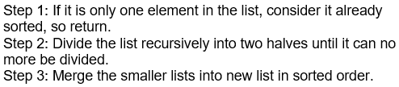
Algorithm Design Techniques
After the final merging, the list becomes sorted and is considered the final solution.
Merge sort keeps on dividing the list into equal halves until it can no more be divided.
By definition, if it is only one element in the list, it is considered sorted.
Then, merge sort combines the smaller sorted lists keeping the new list sorted too.

Slide 15
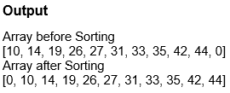
Algorithm Design Techniques
Python code implementation of merge sort
def merge_sort(a, n): if n > 1: m = n // 2 #divide the list in two sub lists l1 = a[:m] n1 = len(l1) l2 = a[m:] n2 = len(l2) #recursively calling the function for sub lists merge_sort(l1, n1) merge_sort(l2, n2) i = j = k = 0 while i < n1 and j < n2: if l1[i] <= l2[j]: a[k] = l1[i] i = i + 1 else: a[k] = l2[j] j = j + 1 k = k + 1
while i < n1: a[k] = l1[i] i = i + 1 k = k + 1 while j < n2: a[k]=l2[j] j = j + 1 k = k + 1 a = [10, 14, 19, 26, 27, 31, 33, 35, 42, 44, 0] n = len(a) print("Array before Sorting") print(a) merge_sort(a, n) print("Array after Sorting") print(a)

Slide 16
Algorithm Design Techniques
Greedy Algorithms
In this approach, the decision is taken on the basis of current available information without worrying about the effect of the current decision in future.
Greedy algorithms build a solution part by part. e.g. choosing the next part.
This approach never reconsiders the choices taken previously.
we can say that Greedy algorithm is an algorithmic paradigm based on heuristic that follows local optimal choice at each step with the hope of finding global optimal solution.

Slide 17
Algorithm Design Techniques
Components of greedy algorithm
Greedy algorithms have the following five components −
A candidate set − A solution is created from this set.
A selection function − Used to choose the best candidate to be added to the solution.
A feasibility function − Used to determine whether a candidate can be used to contribute to the solution.
An objective function − Used to assign a value to a solution or a partial solution.
A solution function − Used to indicate whether a complete solution has been reached.

Slide 18
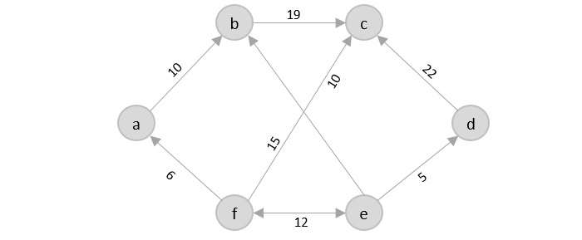
Algorithm Design Techniques
Travelling Salesman problem
The travelling salesman problem is a graph computational problem where the salesman needs to visit all cities (represented using nodes in a graph) in a list just once and
the distances (represented using edges in the graph) between all these cities are known.
The solution that is needed to be found for this problem is the shortest possible route in which the salesman visits all the cities and returns to the origin city.
If you look at the graph below, considering that the salesman starts from the vertex ‘a’, they need to travel through all the remaining vertices b, c, d, e, f and get back to ‘a’ while making sure that the cost taken is minimum.

Slide 19
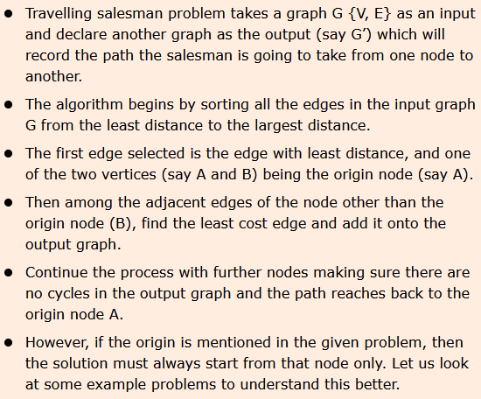
Algorithm Design Techniques
we need to find the best optimal solution locally to figure out the global optimal solution.
The inputs taken by the algorithm are the graph G {V, E}, where V is the set of vertices and E is the set of edges.
The shortest path of graph G starting from one vertex returning to the same vertex is obtained as the output.

Slide 20
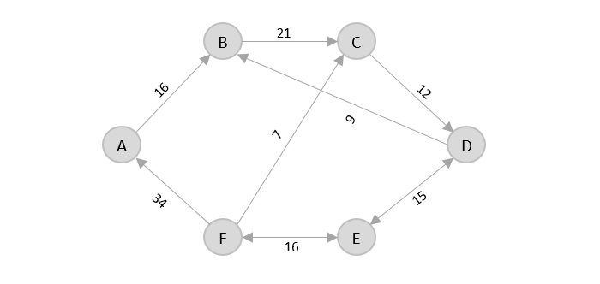
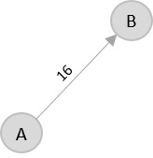
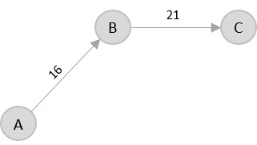
Algorithm Design Techniques
Consider the following graph with six cities and the distances between them −
From the given graph, since the origin is already mentioned, the solution must always start from that node. Among the edges leading from A, A → B has the shortest distance.
Then, B → C has the shortest and only edge between, therefore it is included in the output graph

Slide 21
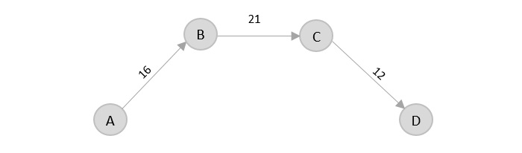
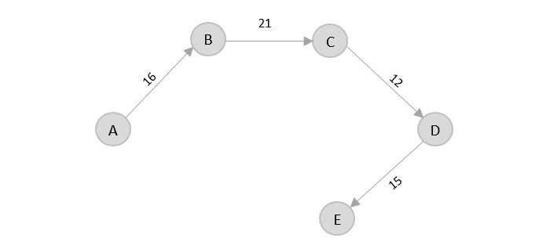
Algorithm Design Techniques
There’s only one edge between C → D, therefore it is added to the output graph.
There’s two outward edges from D. Even though, D → B has lower distance than D → E, B is already visited once and it would form a cycle if added to the output graph. Therefore, D → E is added into the output graph.
There’s only one edge from e, that is E → F. Therefore, it is added into the output graph.

Slide 22
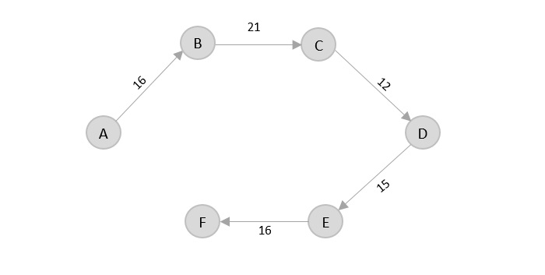
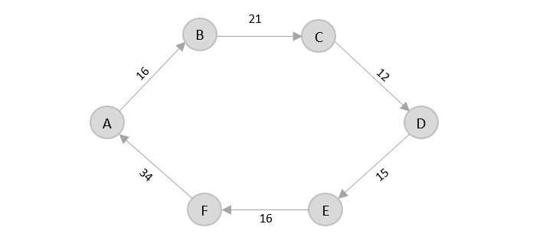
Algorithm Design Techniques
Again, even though F → C has lower distance than F → A, F → A is added into the output graph in order to avoid the cycle that would form and C is already visited once.
The shortest path that originates and ends at A is A → B → C → D → E → F → A
The cost of the path is: 16 + 21 + 12 + 15 + 16 + 34 = 114.
Even though, the cost of path could be decreased if it originates from other nodes but the question is not raised with respect to that.

Slide 23
Algorithm Design Techniques
Kruskal-s minimum spanning tree
Kruskal's minimal spanning tree algorithm is one of the efficient methods to find the minimum spanning tree of a graph.
A minimum spanning tree is a subgraph that connects all the vertices present in the main graph with the least possible edges and minimum cost (sum of the weights assigned to each edge).
The algorithm first starts from the forest – which is defined as a subgraph containing only vertices of the main graph – of the graph, adding the least cost edges later until the minimum spanning tree is created without forming cycles in the graph.

Slide 24
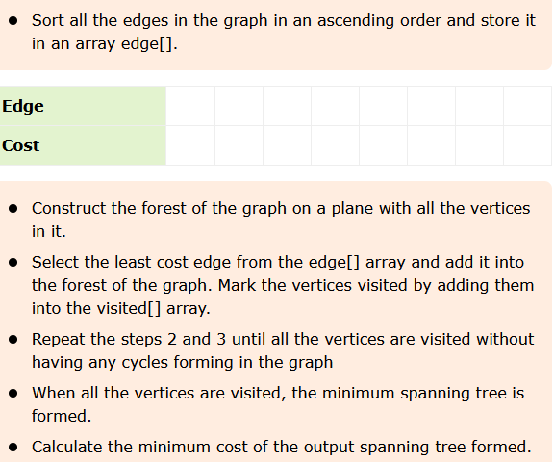
Algorithm Design Techniques

Slide 25
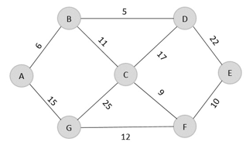
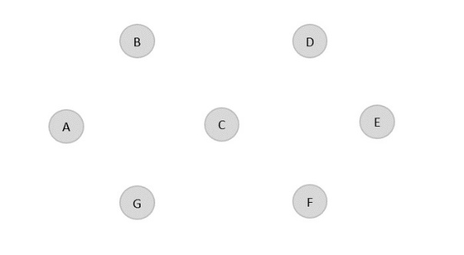
Algorithm Design Techniques
Construct a minimum spanning tree using kruskal’s algorithm for the graph given below
Solution
As the first step, sort all the edges in the given graph in an ascending order and store the values in an array.
Edge | B→D | A→B | C→F | F→E | B→C | G→F | A→G | C→D | D→E | C→G
Cost | 5 | 6 | 9 | 10 | 11 | 12 | 15 | 17 | 22 | 25
Then, construct a forest of the given graph on a single plane.

Slide 26
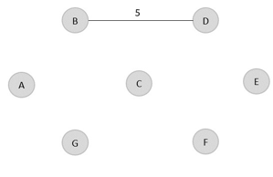
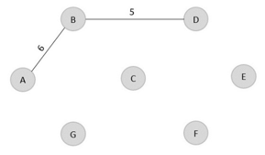
Algorithm Design Techniques
From the list of sorted edge costs, select the least cost edge and add it onto the forest in output graph.
B → D = 5
Minimum cost = 5
Visited array, v = {B, D}
Similarly, the next least cost edge is B → A = 6; so we add it onto the output graph.
Minimum cost = 5 + 6 = 11Visited array, v = {B, D, A}

Slide 27
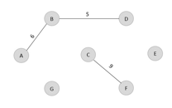
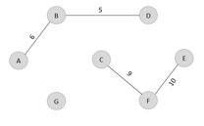
Algorithm Design Techniques
The next least cost edge is C → F = 9; add it onto the output graph.
Minimum Cost = 5 + 6 + 9 = 20
Visited array, v = {B, D, A, C, F}
The next edge to be added onto the output graph is F → E = 10.
Minimum Cost = 5 + 6 + 9 + 10 = 30
Visited array, v = {B, D, A, C, F, E}

Slide 28
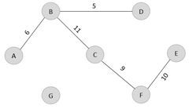
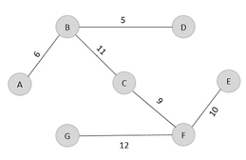
Algorithm Design Techniques
The next edge from the least cost array is B → C = 11, hence we add it in the output graph.
Minimum cost = 5 + 6 + 9 + 10 + 11 = 41
Visited array, v = {B, D, A, C, F, E}
The last edge from the least cost array to be added in the output graph is F → G = 12.
Minimum cost = 5 + 6 + 9 + 10 + 11 + 12 = 53
Visited array, v = {B, D, A, C, F, E, G}

Slide 29
Algorithm Design Techniques
Dijkstra Shortest path algorithm
designed to find the shortest path in the graph from one vertex to other remaining vertices in the graph.
Dijkstra’s algorithm can be performed on both directed and undirected graphs.
Since the shortest path can be calculated from single source vertex to all the other vertices in the graph, Dijkstra’s algorithm is also called single-source shortest path algorithm.
The output obtained is called shortest path spanning tree.
The dijkstra’s algorithm is designed to find the shortest path between two vertices of a graph.
These two vertices could either be adjacent or the farthest points in the graph.

Slide 30
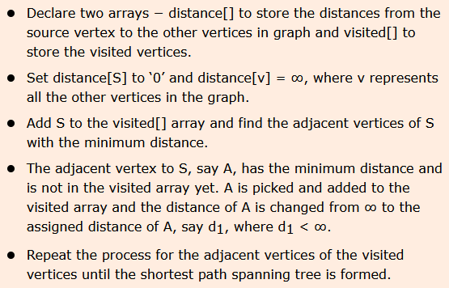
Algorithm Design Techniques

Slide 31
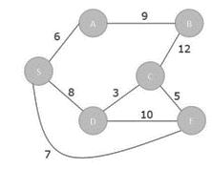

Algorithm Design Techniques
To understand the dijkstra’s concept better, let us analyze the algorithm with the help of an example graph
Step 1
Initialize the distances of all the vertices as ∞, except the source node S.

Slide 32

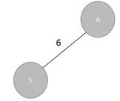
Algorithm Design Techniques
Now that the source vertex S is visited, add it into the visited array.
visited = {S}
Step 2
The vertex S has three adjacent vertices with various distances and the vertex with minimum distance among them all is A. Hence, A is visited and the dist[A] is changed from ∞ to 6.
S → A = 6
S → D = 8
S → E = 7
Visited = {S, A}

Slide 33
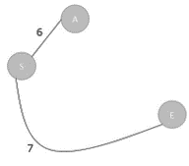

Algorithm Design Techniques
Step 3
There are two vertices visited in the visited array, therefore, the adjacent vertices must be checked for both the visited vertices.
Vertex S has two more adjacent vertices to be visited yet: D and E. Vertex A has one adjacent vertex B.
Calculate the distances from S to D, E, B and select the minimum distance
S → D = 8 and S → E = 7.
S → B = S → A + A → B = 6 + 9 = 15
Visited = {S, A, E}

Slide 34

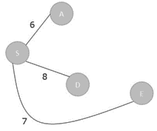
Algorithm Design Techniques
Step 4
Calculate the distances of the adjacent vertices – S, A, E – of all the visited arrays and select the vertex with minimum distance.
S → D = 8
S → B = 15
S → C = S → E + E → C = 7 + 5 = 12
Visited = {S, A, E, D}
Step 5
Recalculate the distances of unvisited vertices and if the distances minimum than existing distance is found, replace the value in the distance array.

Slide 35
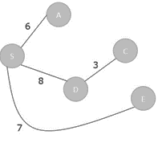

Algorithm Design Techniques
S → C = S → E + E → C = 7 + 5 = 12
S → C = S → D + D → C = 8 + 3 = 11
dist[C] = minimum (12, 11) = 11
S → B = S → A + A → B = 6 + 9 = 15
S → B = S → D + D → C + C → B = 8 + 3 + 12 = 23
dist[B] = minimum (15,23) = 15
Visited = { S, A, E, D, C}

Slide 36
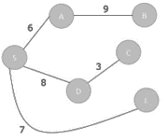
Algorithm Design Techniques
Step 6
The remaining unvisited vertex in the graph is B with the minimum distance 15, is added to the output spanning tree.
Visited = {S, A, E, D, C, B}

Slide 37
Algorithm Design Techniques
Map Coloring Algorithm
Map colouring problem states that given a graph G {V, E} where V and E are the set of vertices and edges of the graph, all vertices in V need to be coloured in such a way that no two adjacent vertices must have the same colour.
The real-world applications of this algorithm are – assigning mobile radio frequencies, making schedules, designing Sudoku, allocating registers etc.
With the map colouring algorithm, a graph G and the colours to be added to the graph are taken as an input and a coloured graph with no two adjacent vertices having the same colour is achieved.

Slide 38
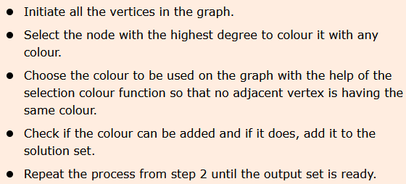
Algorithm Design Techniques
Algorithm

Slide 39
Algorithm Design Techniques
Step 1
Find degrees of all the vertices
A – 4
B – 2
C – 2
D – 3
E – 3
Step 2
Choose the vertex with the highest degree to colour first, i.e., A and choose a colour using selection colour function. Check if the colour can be added to the vertex and if yes, add it to the solution set.
Example

Slide 40
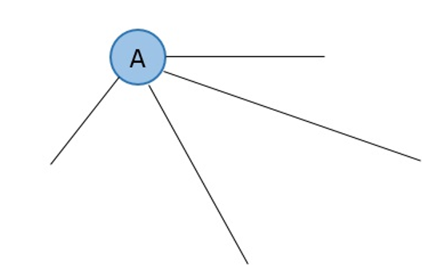
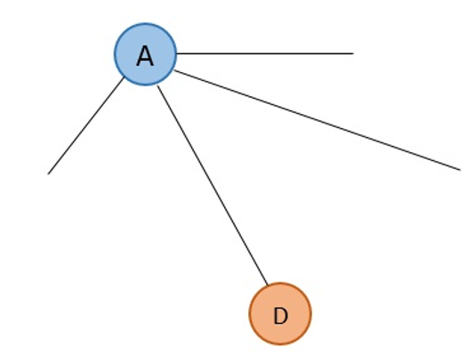
Algorithm Design Techniques
Step 3
Select any vertex with the next highest degree from the remaining vertices and colour it using selection colour function.
D and E both have the next highest degree 3, so choose any one between them, say D.
D is adjacent to A, therefore it cannot be coloured in the same colour as A. Hence, choose a different colour using selection colour function.

Slide 41
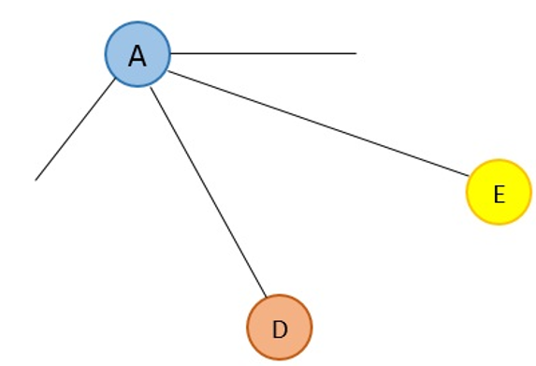
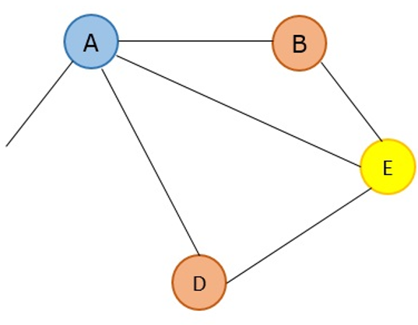
Algorithm Design Techniques
Step 4
The next highest degree vertex is E, hence choose E.
E is adjacent to both A and D, therefore it cannot be coloured in the same colours as A and D. Choose a different colour using selection colour function.
Step 5
The next highest degree vertices are B and C. Thus, choose any one randomly.
B is adjacent to both A and E, thus not allowing to be coloured in the colours of A and E but it is not adjacent to D, so it can be coloured with D’s colour.

Slide 42
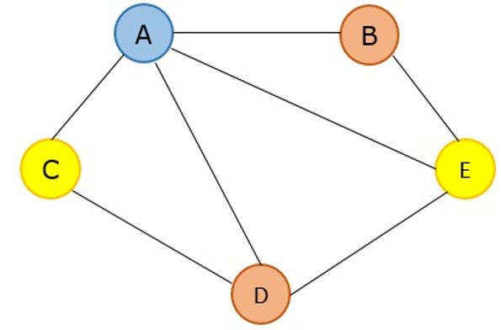
Algorithm Design Techniques
Step 6
The next and the last vertex remaining is C, which is adjacent to both A and D, not allowing it to be coloured using the colours of A and D. But it is not adjacent to E, so it can be coloured in E’s colour.

