Slide 1
Chapter Three
Signal Conditioning and Processing Elements
Signal conditioning element:
Receives the output/Signal from the sensing element then it converts into a more suitable signal for further processing, like a DC Voltage, DC Current or frequency signal.
Example:
Deflection bridge which converts an impedance change into voltage change
Amplifier which converts millivolts to volts
Oscillator which converts an impedance change into variable frequency voltage.

Slide 2
Filter
Reject useless noise within certain frequency range.
Prevent signal aliasing and distortion.
Consist at least one pass band, which is a band of frequencies that the output is approximately equal to input and attenuation band that the output is equal to zero.
Cut-off frequencies is the frequencies that separate the various pass and attenuation bands.
Two types of filter:
→ Passive Filters
→ Active Filters

Slide 3
Types of Filters
Passive filters only use passive circuit component such as resistors, capacitors and inductors.
Active filters use active elements like operational amplifiers in addition to passive elements like resistance, capacitance and inductance.
Both of passive and active filters can be classified as follows:
Low Pass Filter: deliver low frequencies and eliminate high frequencies
High Pass Filter: send on high frequencies and reject low frequencies
Band Pass Filter: pass some particular range of frequencies, discard other frequencies outside that band
Band Stop Filter: stop a range of frequencies and pass all other frequencies

Slide 4
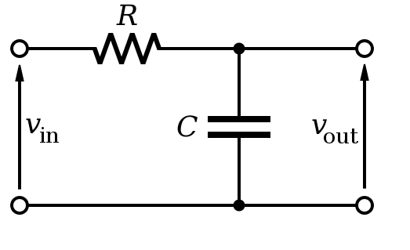
Passive Filter - Low Pass Filter
Blocks high frequencies and passes low frequencies.
Ideal LPF: signals above cut-off frequency, fc are simply rejected.
In terms of resistor and capacitor, cut-off frequency, fc is given by:
Gain is given by;
At low frequencies, the capacitive reactance is very high, therefore the capacitor circuit acts like an open circuit.
At very high frequencies, the capacitive reactance is very low therefore Vout is very small compared to Vin.

Slide 5
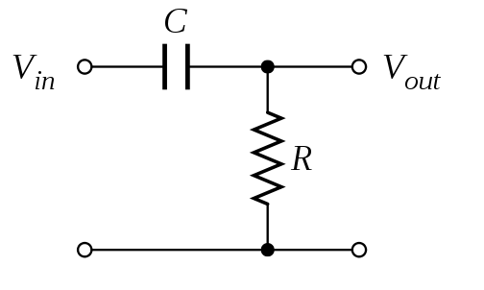
Passive Filter – High Pass Filter
Passes high frequencies and blocks/rejects low frequencies..
Ideal HPF: signals below cut-off frequency, fc are simply rejected.
In terms of resistor and capacitor, cut-off frequency, fc is given by:
Gain is given by;
At low frequencies, the gain is small, therefore Vout is small compared to Vin.
As the frequencies goes high the gain approaches unity.

Slide 6
Bridges
Bridge circuits are the instrument that widely used to measure resistance, inductance, capacitance and impedance.
Two types of bridge circuits are used in measurement:
  DC
  AC
DC Bridge
Wheatstone bridge
The Wheatstone bridge is an electrical bridge circuit used to measure resistance.
It consists of a voltage source and a galvanometer that connects two parallel branches, containing four resistors.

Slide 7
Cont.…
A null detector is the galvanometer which is connected between the parallel branches to detect the balance condition.
No current go through the galvanometer G, the bridge is in balance so,
Example:
Determine the value of unknown resistor, Rx in the circuit. Assuming a null exist ; current through the galvanometer is zero.

Slide 8
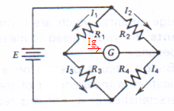
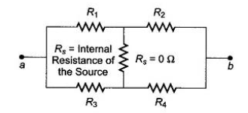
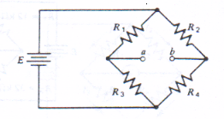
Unbalanced Wheatstone Bridge.
When the bridge is in unbalance condition, current flows through the galvanometer causing a deflection of its pointer.
The current flows through the galvanometer can determine by using Thevenin theorem.

Slide 9
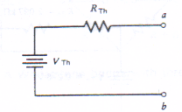
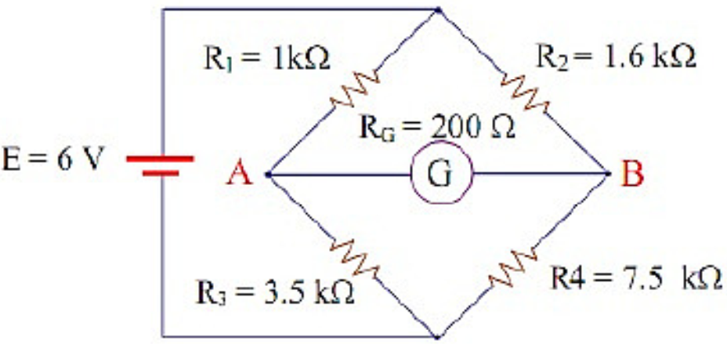
Cont…
The deflection current in the galvanometer is
Example: Calculate the current through the galvanometer in the circuit of below figure.

Slide 10
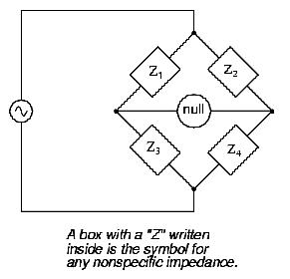
AC Bridge.
AC bridges are used to measure inductance and capacitance.
All the AC bridges are based on the Wheatstone bridge.
In the AC bridge the bridge circuit consists of four impedances and an ac voltage source.
The impedances can either be pure resistance or complex impedance.
Z1/Z3=Z2/Z4
Figure: General AC Bridge Circuit.

Slide 11
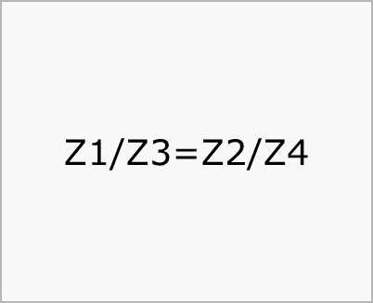
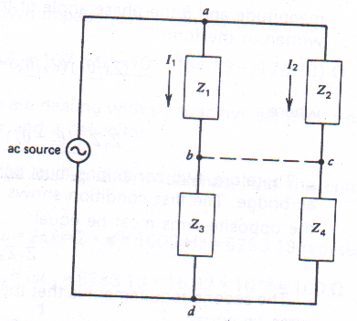
Cont’d…
Operation of AC Bridge:
When the specific circuit conditions apply, the detector current becomes zero, which is known as null or balance condition.
Since zero current, it means that there is no voltage difference across the detector, Figure below.
Voltage at point b and c are equal.
The same thing at point d.
From two above equation yield general bridge equation;
Figure: Equivalent of Balance (nulled) AC Bridge.

Slide 12
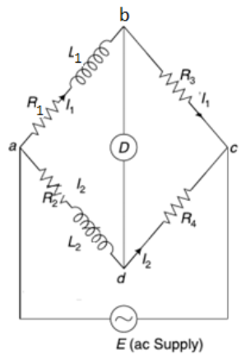
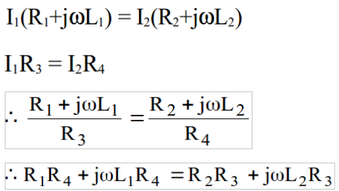
Maxwell Bridge
In this bridge arrangement the value of unknown inductance is measured by comparison with a variable standard self-inductance.

Slide 13
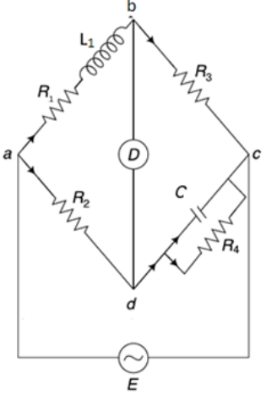
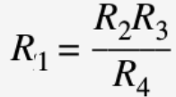

Maxwell-Wien Bridge
It is used to measure unknown inductances with capacitance standard.
Because the phase shifts of inductors and capacitors are exactly opposite each other, a capacitive impedance can balance out an inductive impedance if they are located in opposite legs of a bridge

Slide 14
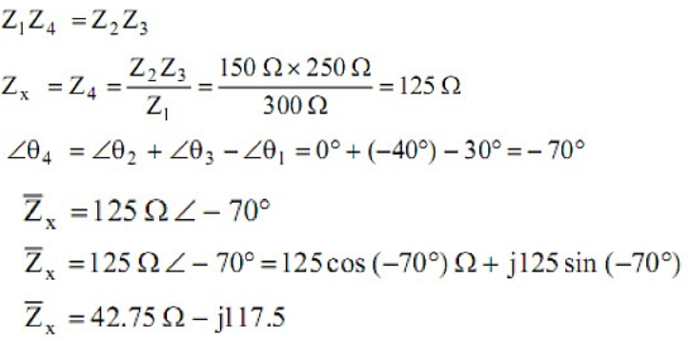
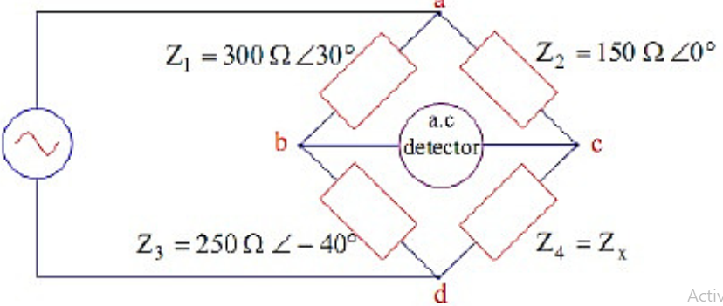

Example: AC Bridge.
The impedances of the AC bridge in Figure 7.4 are given as follows, $Z_{1}=300<{30}^{0}{, Z}_{2}=150<0^{0}$ $Z_{3}=250<{−40}^{0}$
$Z_{4}=u$nknown
Determine the constants of the unknown arm if the bridge is balanced.
Solution:

Slide 15
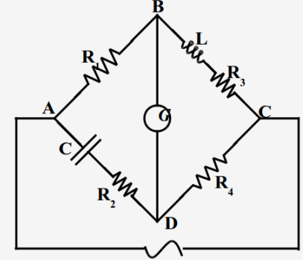
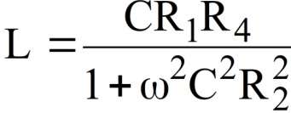

Hay’s bridge
It is also a modification of the Maxwell’s Wien Bridge and is particularly useful if the phase angle of the inductive impedance is large.
$R_{3}=\frac{{{ω^{2}C^{2}R}_{1}R_{2}R}_{4}}{1+ω^{2}C^{2}R_{}^{2}2}$

Slide 16
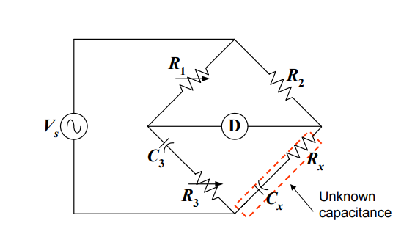
The bridge circuit shown in fig. below is balanced when Z1=5<0⁰KΩ, Z2=0.5<0⁰KΩ, Z3=Zs is a 10nF capacitor in series with an 0.8 KΩ resistor, and the frequency of the supply is 1kHz. Calculate Zx, Rx, and Cx.

Slide 17
Signal Processing Elements
These elements take the output of the conditioning element and convert it into a form more suitable for presentation.
  ADC which converts a voltage into a digital form for input to a computer
  Computer which calculates the measured value of the variable from the incoming digital data.
ADC:
The circuit has only one input with ‘n’ number of digital outputs.

Slide 18
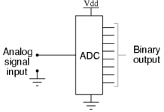
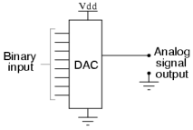
Cont..
The figure shown below shows this situation.
A DAC, on the other hand, inputs a binary number and outputs an analog voltage or current signal.

Slide 19
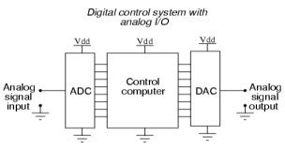
Cont..
Together, they are often used in digital systems to provide complete interface with analog sensors and output devices for control systems such as those used in automations.
We have a number of Analog to Digital Converters, The commonly used ones are :
  Flash ADC
  Digital Ramp ADC
  Successive Approximation AD

Slide 20
Chapter Four
Data Presentation Elements
The data presentation element is the final element in the measurement system,
Its function being to communicate the measured value of the variable to a human observer.
Next figure classifies data presentation elements in wide current use ,
It begins by classifying elements into displays and recorders/printers.
If no permanent record of measured variables is required, then displays can be used.

Slide 21
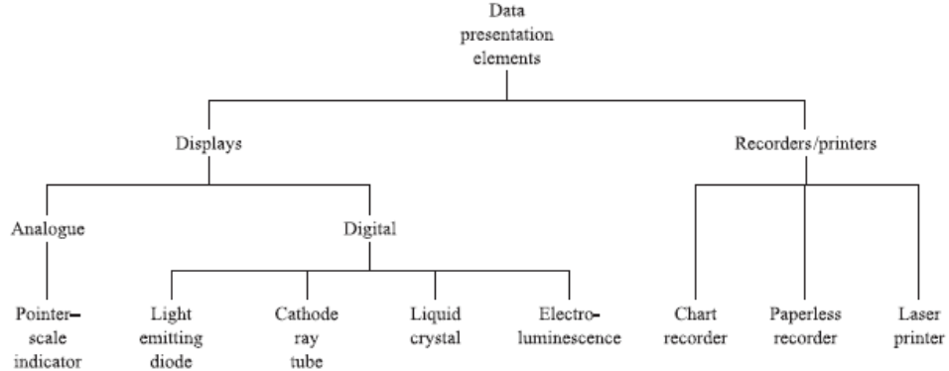
Cont..
A choice must first be made between analogue pointer–scale
indicators and digital displays.

Slide 22
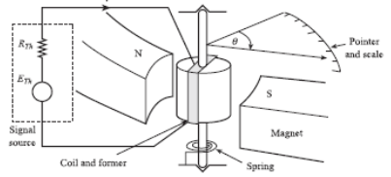
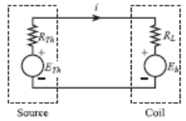
Pointer–scale indicators
These are analogue display devices.
The figure depicted below shows simplified diagrams and
an equivalent circuit for a moving coil indicator connected to a Thévenin signal source ETh, RTh.

Slide 23
Cont..
The coil is situated in a radial magnetic field of flux density B, so that a current i through the coil produces a deflecting torque.
This deflecting torque is opposed by the spring restoring torque .
The difference between this torques is the net torque responsible for the final deflection of the pointer.

Slide 24
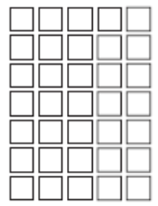
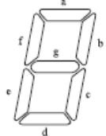
Digital display principles
Character displays:
These are used to display the numerals 0 to 9, the letters of the alphabet A to Z in either upper or lower case format, and a few other symbols such as punctuation marks.
Displays showing alphabetical and numerical information are often referred to as alphanumeric.
Figure below shows two character formats in widespread use: seven-segment and 7 by 5 dot matrix

Slide 25
Light Emitting Diode Displays
Light-emitting diodes have the special property that when forward biased they emit electromagnetic radiation over a certain band of wavelengths.
Two commonly used LED materials are:
  Gallium arsenide phosphide (GaAsP), which emits red light,
  Gallium phosphide (GaP), which emits green or yellow light
LEDs have high power consumption, which makes them only suitable for small-scale character displays;
They are not used in graphic displays.

Slide 26
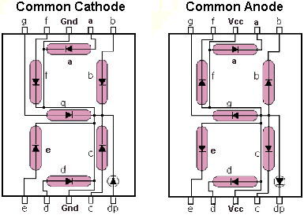
Segment Identification
A Seven-Segment Display (SSD) is simply a figure eight grouping of LEDs {some include a decimal point (DP)}.
Each Segment is labeled (a) thru (g).
SSDs are available in two configurations
  Common Cathode (all LED cathodes are connected)
  Common Anode (all LED anodes are connected)
a
f
g
b
e
c
d
dp
Notes:
The common cathode and common anode diagrams shown are typical pin layouts. They may or may not be the same as the device that the students will use to build their circuits.
http://www.thelearningpit.com/lp/doc/7seg/7seg.html

Slide 27
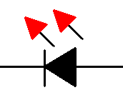
Basic LED Operations
To understand how a seven-segment display works, we must review how an LED works.
To Turn an LED ON . . .
The ANODE must be at a higher voltage potential (∼1.5v) than the CATHODE.
The amount of current flowing through the LED will determine the brightness of the LED.
The amount of current is controlled by a series resistor. (not shown)
CATHODE (‒)
(+) ANODE
← Current Flow

Slide 28
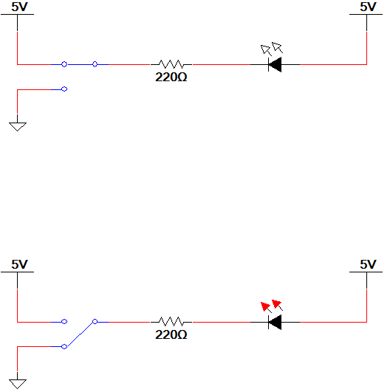
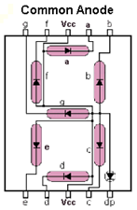
LED Configuration – Anode @ 5 Volts
Switch @ 5v
Top Circuit
LED Off
Switch @ 0v
Bottom Circuit
LED On
ANODE @ 5v
CATHODE @ 0v (nearly)
The 220 Ω resistor controls the current.
A larger resistor . . . less current . . . dimmer LED
A smaller resistor . . . more current . . . brighter LED
Common Anode
Configuration (5v=Off / 0v=On)
Notes:
In summary, common anode SSD have a common Vcc Connection and require a logic (0) to turn on a segment.

Slide 29
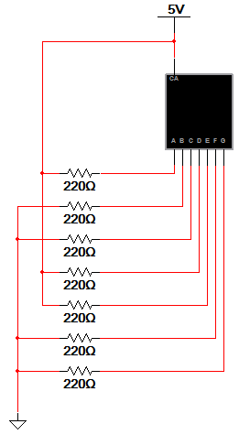
Example #1: Common Anode SSD
Example
What value would be displayed in the common anode seven-segment display shown?
Notes:
Pause the presentation and allow the students to work on the example. The solution is on the next slide.

Slide 30
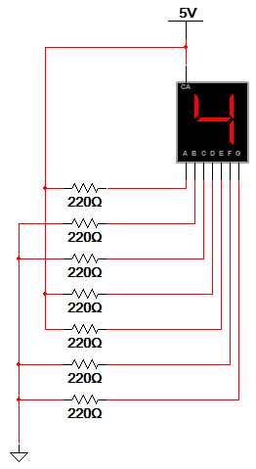
Example #1: Common Anode SSD
Example
  What value would be displayed in the common anode seven-segment display shown?
Solution
  Common Anode:
      0 volts = Segment On
        b, c, f, & g
      5 volts = Segment Off
        a, d, & e
a
f
g
b
e
c
d
Notes:
Here is the solution. If you print handouts, do not print this page.

Slide 31
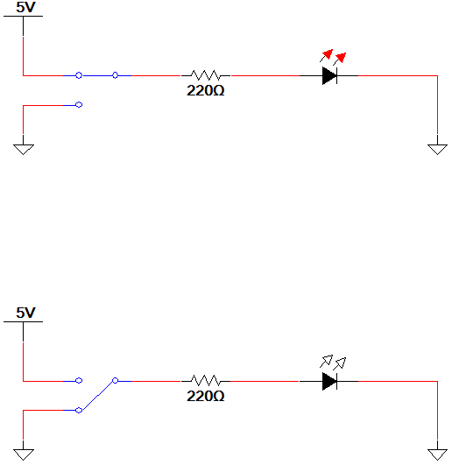
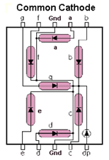
LED Configuration – Cathode @ Ground
Switch @ 5v
Top Circuit
LED On
ANODE @ 5v (nearly)
CATHODE @ 0v
The 220 Ω resistor controls the current.
A larger resistor . . . less current . . . dimmer LED
A smaller resistor . . . more current . . . brighter LED
Switch @ 0v
Bottom Circuit
LED Off
Common Cathode SSD Configuration (5v=On / 0v=Off)
Notes:
In summary, common cathode SSD have a common GND connection and require a logic (1) to turn on a segment.

Slide 32
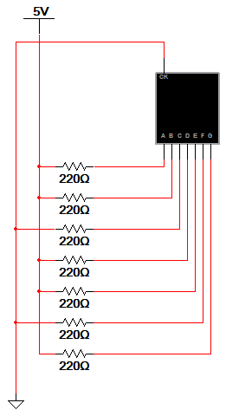
Example #2: Common Cathode SSD
Example
What value would be displayed in the common cathode seven-segment display shown?
Notes:
Pause the presentation and allow the students to work on the example. The solution is on the next slide.

Slide 33
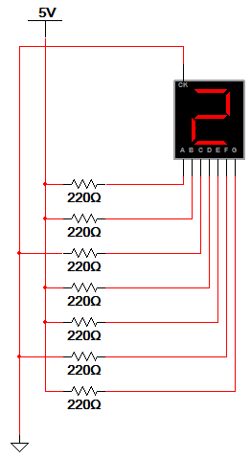
Example #2: Common Cathode SSD
Example
  What value would be displayed in the common cathode seven-segment display shown?
Solution
  Common Cathode:
      5 volts = Segment On
        a, b, d, e, & g
      0 volts = Segment Off
        c & f
a
f
g
b
e
c
d
Notes:
Here is the solution. If you print handouts, do not print this page.

Slide 34
Cont..
Reading assignment
Cathode ray tube (CRT) Displays
Liquid crystal displays (LCDs)
Recorders

Slide 35
THANK YOU!!!

