Slide 1
Chapter One
General Principles of Instrumentation
Introduction:
Measurement: is a comparison of a value obtained from the measuring instrument and an accepted standard.
Measuring instrument:It is a device for determining the value or magnitude of a quantity or variable.
Instrumentation: is a science of engineering of complete system designed to measure physical quantities (variables) so as to obtain data (information), which are transmitted to display record and control devices.

Slide 2
Cont..
Calibration: It is the process by which comparing the instrument with a standard to correct the accuracy.
Functions of Instruments and Measurement systems
  Indicating function
  Recording function
  Controlling function

Slide 3
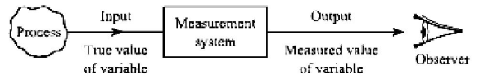
Cont..
  The main purpose of the measurement system is to link the observer to the information generating process.
We can now refer to the information variable as a measured variable
The input to the measurement system is the true value of the variable; the system output is the measured value of the variable.
In an ideal measurement system, the measured value would be equal to the true value

Slide 4
Structure of measurement systems
Sensing Element: This is in contact with the process and gives an output which depends in some way on the variable to be measured.
Examples are:
  Thermocouple where mill volt e.m.f. depends on temperature
  Strain gauge where resistance depends on mechanical strain
  Orifice plate where pressure drop depends on flow rate

Slide 5
Cont..
Signal conditioning element:
This takes the output of the sensing element and converts it into a form more suitable for further processing, usually a D.C. voltage, D.C. current or frequency signal.
Examples are:
Deflection Bridge which converts an impedance change into a voltage change
Amplifier which amplifies mill volts to volts
Oscillator which converts an impedance change into a variable frequency voltage

Slide 6
Cont..
Signal processing element :
This takes the output of the conditioning element and converts it into a form more suitable for presentation.
Examples are:
Analogue-to-digital converter (ADC) which converts a voltage into a digital form for input to a computer
Computer which calculates the measured value of the variable from the incoming digital data

Slide 7
Cont..
Data presentation element: This presents the measured value in a form which can be easily recognized by the observer.
Examples:
  Simple pointer–scale indicator
  Chart recorder
  Seven Segment Display
  Liquid Crystal Display
  Light Emitting Diode Display
  Visual display unit (VDU)

Slide 8

Performance Characteristics
The performance characteristic is the input and output relationship response (presentation) behaviour of each element in an instrumentation system.
Static characteristics: Those characteristics of an instrument which do not vary with time.
  Accuracy , Linearity Hysteresis
  Non-linearity , Sensitivity Precision
  Range, Span

Slide 9
Cont..
Accuracy:
  It is the degree of closeness with which the instrument reading approaches the true value of the quantity to be measured.
  It indicates the ability of instrument to indicate the true value of the quantity
Precision:
  It is the measure of consistency or repeatability of measurements
  It denotes the closeness with which individual measurements are departed or distributed about the average of number of measured values

Slide 10

Cont..
Sensitivity
  Denotes the smallest change in the measured variable to which the instrument responds.
  The ratio of the changes in the output of an instrument to a change in the value of the quantity to be measured.
        Ideal Straight Line:
        An element is said to be linear if corresponding values of I and O lie on a straight line.

Slide 11

Cont..
The ideal straight line connects the minimum point A (I_{MIN}, O_{MIN}) to maximum point B (I_{MAX}, O_{MAX}) and therefore has the equation.
…….1.1
        Non-linearity:
        In many cases the straight-line relationship defined by eqn. [1.1] is not obeyed and the element is said to be non-linear.
        Non-linearity can be defined Fig. below in terms of a function N(I) which is the difference between actual and ideal straight-line behavior,

Slide 12


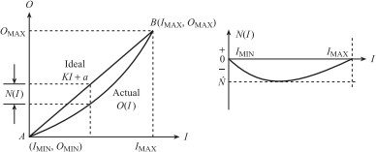
Cont..
i.e. Non-linearity is often quantified in terms of the maximum non-linearity; expressed as a percentage of full-scale deflection (f.s.d.), i.e. as a percentage of spans. Thus:

Slide 13
Cont..
Example: A non-linear temperature sensor has an input range of 0 to 400 °C and an output range of 0 to 20 mV. The output signal at 100 °C is 4.5 mV. Find the non-linearity at 100 °C in millivolts and as a percentage of span.
Hysteresis:
For a given value of I, the output O may be different depending on whether I is increasing or decreasing. Hysteresis is the difference between these two values of O. i.e.
Hysteresis H(I) =O(I)I↓−O(I)I↑

Slide 14
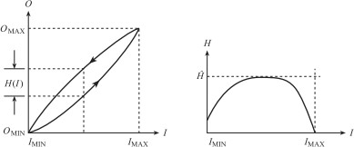
Cont..
Again hysteresis is usually quantified in terms of the maximum hysteresis à expressed as a percentage of f.s.d., i.e. span. Thus:
A simple gear system (Figure below) for converting linear movement into angular rotation provides a good example of hysteresis.
Figure: Hysteresis

Slide 15
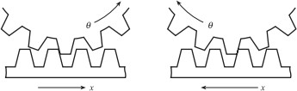
Cont..
Due to the ‘backlash’ or ‘play’ in the gears the angular rotation θ, for a given value of x, is different depending on the direction of the linear movement.
Figure 1.5: Backlash in gears
Example:
A level transducer has an output range of 0 to 10.2 V. For a 6 cm level, the output voltage for a falling level is 4.43 V and for a rising level 3.43 V. Find the hysteresis as a percentage of span.

Slide 16
Dynamic characteristics:
Which change within a period of time, and it is necessary to study the dynamic relations existing between input and output.
Respond Time:
It characterizes the instrument to a step change in the measurand (input).
It includes rise time, delay time and time constant.

Slide 17
Cont.
Dynamic Error:
It is the difference between the true value of the quantity under measurement changing with time and the measured value of the quantity.
Fidelity:
It is defined as the degree of the measurement system.
It indicates changes in the measurand without any dynamic error.
Measuring Lag:
It is the retardation or delay in the response of a measurement system to changes in the measurand.

Slide 18
Measurement Errors
There are three general categories of errors in any measurement process, namely Gross Errors, Systematic Errors and Random Errors.
Gross errors-
This are the error due to humans mistakes such as careless reading mistakes in recoding observation incorrect application of an instrument.
To avoid gross error, at least two, three or more readings of the measurand quantity should be taken by different observers.

Slide 19
Systematic Error
Systematic Errors:
Are equipment errors that result from mechanical weakness of an instrument
And makes a constant uniform deviation of an instrument
Types of systematic errors :
Instrumental error: These errors can be mainly due to the following three reasons:
a) Shortcomings of instruments, i.e.
    Friction in the bearings of various moving parts;
    Reductions in due to improper handling ,

Slide 20
Cont..
Ways to minimize this error
  Calibrating the measuring device or instrument against a standard
  Applying correction factor after determining the amount of
  Instrumental error
b) Misuse of instruments
  Poor initial adjustment
  Improper zero setting, using leads of high resistance etc.
  Loading effects due to improper way of using the instrument

Slide 21
Cont..
Ways to minimize this error:
  Thus the errors due to the loading effect can be avoided by using an instrument intelligently and correctly.
Environmental error: These errors are due to conditions external to the measuring device.
  These may be effects of temperature, pressure, humidity, dust or of external electrostatic or magnetic field.

Slide 22
Cont..
These errors can be eliminated or reduced by taking the following precautions:
  Use the measuring instrument in the same atmospheric conditions in which it was assembled and calibrated
  Automatic compensation, employing sophisticated devices for such deviations, is also possible

Slide 23
Cont..
Observational error
  The error on account of parallax is the observational
  error.
  Caused by habits of the observers like tilting his/her head too much while reading a “Needle – Scale Reading”.
  To eliminate such errors one should use the instruments with mirrors

Slide 24
Cont..
Random Errors:
  Are errors whose cause cannot be directly established because they appear to be accidental variations in the electrical parameters of the measuring system or the device under test.
  The effect of random errors is minimised by measuring the given quantity many times under the same conditions
  And calculating the arithmetical mean of the results obtained.

Slide 25
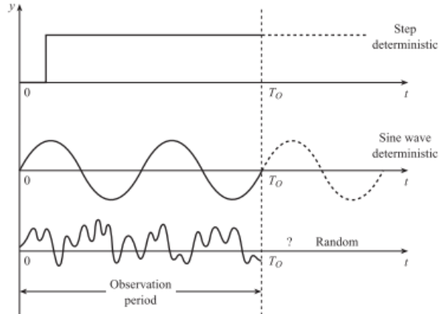
Signals and noise in measurement systems
A signal could be deterministic or random.
A deterministic signal is one whose value at any future time can be exactly predicted.
Thus if we record these signals for an observation period
TO, the future behaviour of the signal, once the observation period is over, is known exactly.

Slide 26
Cont..
In real measurement applications the input signal to the measurement system is not deterministic but random
If a random signal is recorded for an observation period TO the behaviour of the signal, once the observation period is over, is not known exactly.
These may be due to sources inside the measurement circuit or caused by coupling to sources outside the circuit.

Slide 27
Cont..
However, five statistical quantities – mean, standard deviation, probability density function, power spectral density and autocorrelation function are used to estimate the behaviour of random signals.
The unwanted signal then may be either random, e.g. signals caused by the random motion of electrons, or deterministic, e.g. sinusoidal signals at 50 Hz caused by power cables.

Slide 28
Noise sources
Internal noise sources:
The random, temperature-induced motion of electrons and other charge carriers in resistors and semiconductors gives rise to a corresponding random voltage which is called thermal or Johnson noise.
A similar type of noise is called shot noise; this occurs in transistors and is due to random fluctuations in the rate at
which carriers diffuse across a junction.

Slide 29
External noise and interference sources
The most common sources of external interference are near by AC power circuits which usually operate at 240 V, 50 Hz.
These can produce corresponding sinusoidal interference
signals in the measurement circuit
Power distribution lines and heavy rotating machines such as turbines and generators can cause serious interference.
DC power circuits are less likely to cause interference because DC voltages are not coupled capacitive and inductively to the measurement circuit

Slide 30
Cont..
Noise due to couplings
  Inductive coupling:
  Capacitive Coupling:
  Reading assignment

Slide 31
Methods of reducing effects of noise and interference
  Physical separation
  Electromagnetic shielding
  Use of differential amplifiers
  Filtering
  Modulation,
  Averaging
  Autocorrelation

Slide 32

Chapter Two
Sensing elements and their applications
Electrical and Electronic systems need to sense and react with the real world either by:
    Reading (sensing) an input quantity,
    Activating (actuating) some form of output devices.
A sensor is a device that measures/detects a signal or stimulus to acquire information from the real world.

Slide 33
Cont’d
An actuator is a device that generates a signal or stimulus to affect the state of the real world.
Transducer:
It is a collective word used for both sensors and actuators.
It is a device that converts a form of energy into a different form of energy.
Electrical Transducers:
Devices that are used to convert types of energy to/from electrical energy.

Slide 34
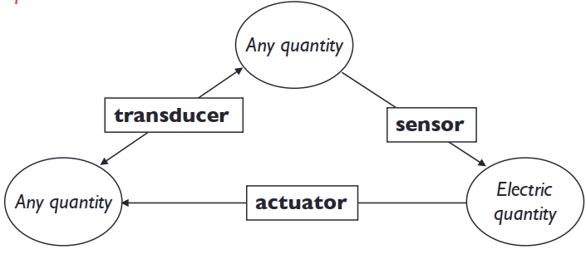
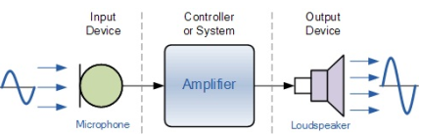
Cont’d
A microphone (input device) converts sound waves into electrical signals for the amplifier.
Also, a loudspeaker (output device) converts these electrical signals back into sound waves.

Slide 35
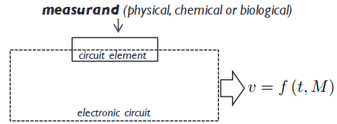
Cont’d
Sensor: device that converts a physical, a chemical or a biological quantity into an electric signal.
  Clinical thermometer: temperature to length= transducer
  Thermistor: temperature to electric resistance= sensor
Sensors are components of electronic circuits.
Due to sensors, the quantities of the circuit (current and voltage) become function of environmental quantities.

Slide 36
Selection of Sensors
The first step in the selection procedure of sensors is to clearly define the nature of quantity under measurement,
And know the range of magnitudes and frequency that the
measurand is expected to exhibit.
The next step will be to examine the available transducer principle for measurement of desired quantity.
The selected transducer type must be compatible with the type and range of the quantity to be measured and the output device.

Slide 37
Cont’d
The main points to be considered in selecting a sensor suitable for a specific measurement are:
Electrical output characteristics: Electrical characteristics (uniqueness) should be compatible (similar in temperament) with the output device.
Sensitivity: A small change in the measurand produces a relatively large change in the response (reaction) of the sensor.
Operating range: The range should be large enough to encompass all the expected magnitudes.
Physical environment: The application area and the surrounding condition where the sensor is used should be appropriate (correct).

Slide 38
Cont’d
Resolution: The resolution of a sensor measures its ability to detect a change in the perceived quantity, and is usually extracted in terms of the smallest change that can be detected.
Linearity: Equal changes in the measurand result in equal changes in the response (output) of the sensor.
Response time: In some applications a very small response (reply) time is required.
Stability: Its outcome does not change with age, mistreatment, or other effects of use.

Slide 39
Cont’d
Selectivity: It is affected by the measurand, but unaffected by other quantities.
  For example: A light sensor should be unaffected by changes of temperature.
Errors: They can be either static or dynamic and should be reduced as much as possible.

Slide 40
Classification of Sensors
Classification of sensors is conventionally (typically) by:
  The technology used whether the output signal they generate is Analogue or Digital signal.
  The conversion principle on the electrical phenomena employed by the transducers, the transduction element with a combination of appropriate sensing elements i.e. Passive and Active sensors (transducers).
      Passive Sensors: Resistive , Capacitive and Inductive
      Active Sensors: EMF generating elements
  The physical quantity being measured, such as temperature, pressure, flow, position, velocity, acceleration, displacement, force and so on.

Slide 41
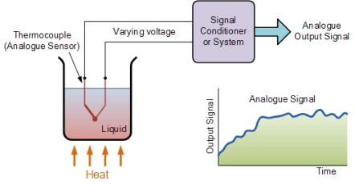
Classification of Sensors
Analog Sensors:
Analog sensors produce a continuous output signal or voltage which is generally proportional to the quantity being measured.
Physical quantities (such as Temperature, Speed, Pressure, Displacement, etc.) are all analog or continuous in nature.

Slide 42
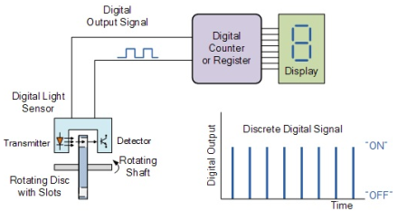
Cont’d
Digital Sensors:
Digital sensors produces Binary output signal in the form of logic "High" or logic "Low“.
For example, a shaft encoder is used to measure the speed of a shaft.

Slide 43

Active and Passive sensor
Active Sensor:
Generates electrical signal directly in response to physical parameter
Does not require external power for its operation.
Can generate electric current
Self generating device, operate under energy conversion principle
Example: piezo electric sensors, photo voltaic cells etc.

Slide 44
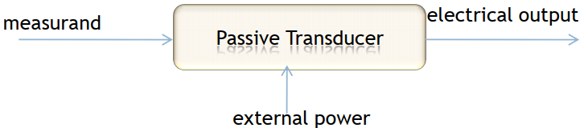
Active and Passive sensor
Passive Sensor:
Operate under energy controlling principle
Require external power source to operate
Can’t generate electric current
Depend upon change in electrical parameters (R,L and C)
Example : strain gauge, thermistors etc.

Slide 45
Temperature Sensors
Application of heat or its withdrawal from a body produces various primary effects on this body such as:
  Change in its physical or chemical state such as phase transition
  Change in its physical dimensions
  Variations in its electrical properties
  Generation of an emf at the junction of two dissimilar metals
  Change in the intensity of the emitted radiation
Any of these effects can be employed to measure the temperature of a body, though the first one is generally used for standardisation of temperature sensors rather than for direct measurement of temperature.

Slide 46
Cont’d
Temperature sensors give an output proportional to temperature.
Most temperature sensors have a positive temperature coefficient (desirable), which means that the sensor output goes up as the temperature goes up, but some sensors have a negative temperature coefficient, which means that the output goes down as the temperature goes up.
Many control systems require temperature sensors, if only to know how much to compensate other sensors that are temperature-dependent.

Slide 47
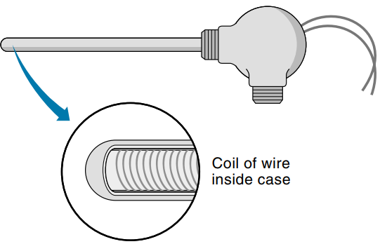
Resistive Temperature Detector (Sensor) (RTD)
A wire, such as platinum, is wrapped around a ceramic or glass rod (sometimes the wire coil is supported between two ceramic rods).
RTDs have the advantage of being very accurate and stable (characteristics do not change over time).
The disadvantages are low sensitivity (small change in resistance per degree), relatively slow response time to temperature changes, and high cost.

Slide 48
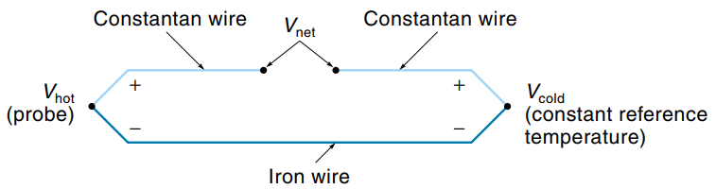
Thermocouples
The thermocouple is based on the Seebeck effect, a phenomenon whereby a voltage that is proportional to temperature can be produced from a circuit consisting of two dissimilar metal wires.
Figure above illustrates this situation, we can think of the junctions at each end of the dissimilar metal wires as producing a voltage, so the net voltage (Vnet) is actually the difference between the junction voltages.

Slide 49

Cont’d
One junction is on the probe and is called the hot junction.
The other junction is kept at some known reference temperature and is called the cold junction, or reference junction.
The output voltage from this system can be expressed as follows:
Thermocouples are simple and rugged but require extra electronics to deal with the inherent low-sensitivity and cold-junction problems.
However, because they are linear (over a limited range), reliable, and stable, they enjoy wide use in measuring high temperatures in furnaces and ovens.

Slide 50
Thermistors
Thermistors are made of oxide-based semiconductor materials and come in a variety of sizes and shapes.
Thermistors are nonlinear; therefore, they are not usually used to get an accurate temperature reading but to indicate temperature changes, for example, overheating.
Also, most thermistors have a negative temperature coefficient.
A very desirable feature of these devices is their high sensitivity.
A relatively small change in temperature can produce a large change in resistance.

Slide 51
Cont’d
Thermistors come in a wide range of resistances, from a few ohms to 1 MΩ, selection of which depends on the temperature range of interest.
Higher-resistance models are used for higher temperatures, to increase the sensitivity, and to keep the sensor from drawing too much current.

Slide 52
Applications of temperature sensors:
Temperature sensors are used just about everywhere.
There are in the homes we live in, the cars we drive, the schools we learn in.
They are even in planes, trains and boats.
You will also find them in all sorts of electrical appliances and electronic devices.
Refrigerators, stoves, hot water tanks as well as computers, GPS devices and battery chargers all have temperature sensors.
Today's digital medical thermometers, which are used in hospitals and millions of home every day, all have a temperature sensor in them.

Slide 53
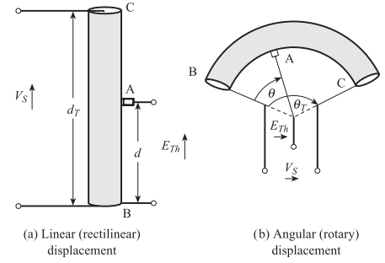
Displacement, Position and Proximity Sensors:
Potentiometer Sensors:
It converts linear or rotational displacement into a voltage signal.
This output voltage is measured by a voltmeter, which may be calibrated in terms of displacement.

Slide 54
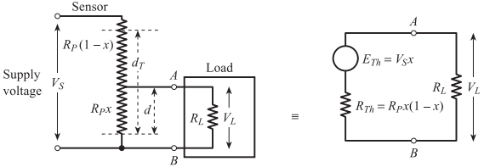
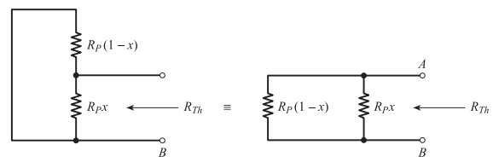

Cont..

Slide 55
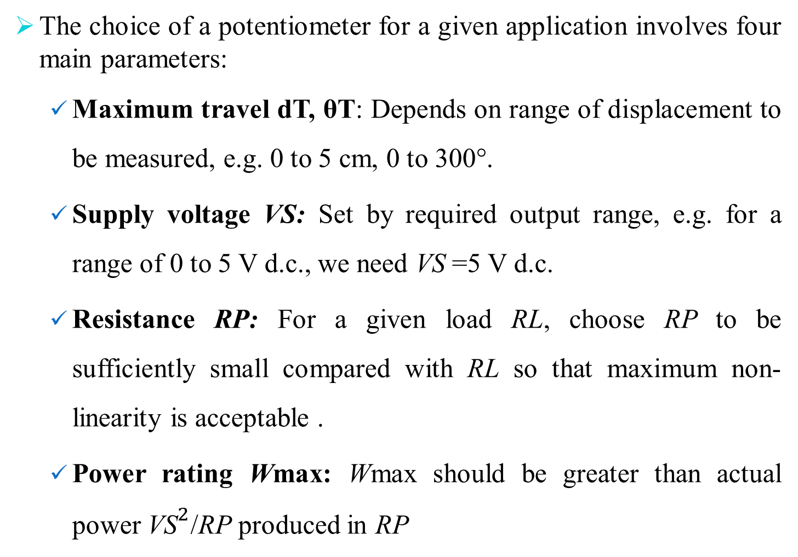
Cont..
The choice of a potentiometer for a given application involves four main parameters:
  Maximum travel dT, θT: Depends on range of displacement to be measured, e.g. 0 to 5 cm, 0 to 300°.
  Supply voltage VS: Set by required output range, e.g. for a range of 0 to 5 V d.c., we need VS =5 V d.c.
  Resistance RP: For a given load RL, choose RP to be sufficiently small compared with RL so that maximum non-linearity is acceptable .
  Power rating Wmax: Wmax should be greater than actual power ${\text{VS}}^{2}$/RP produced in RP

Slide 56
Applications of potentiometer
These are typically used on machine-tool controls, elevators, liquid-level, automobile throttle controls.
In manufacturing, these are used in control of injection molding machines, woodworking machinery, printing, spraying, robotics, etc.

Slide 57
Thermistors
It follow the principle of decrease in resistance with increasing temperature .
The material used in thermistor is generally a semiconductor material such as a sintered metal oxide (mixtures of metal oxides, chromium, cobalt, iron, manganese and nickel).
Thermistors are rugged and small in dimensions.
They exhibit nonlinear response characteristics.

Slide 58
Applications of Thermistors
To monitor the temperature of an incubator
To monitor the temperature of battery packs while charging
To monitor temperature of hot ends of 3D printers
To maintain correct temperature in the food handling and processing industry equipment's.

Slide 59
Resistance temperature detectors (RTDs)
RTDs work on the principle that the electric resistance of a metal changes due to change in its temperature.
On heating up metals, their resistance increases and follows a linear relationship.
Applications:
  Food Processing
  Stoves and grills
  Textile production
  Plastics processing

Slide 60
Light sensors
A light sensor is a device that is used to detect light.
Photo-resistor is also called as light dependent resistor (LDR).
It has a resistor whose resistance decreases with increasing incident light intensity.
It is made of a high resistance semiconductor material, cadmium sulphide (CdS).
The resistance of a CdS photo-resistor varies inversely to the amount of light incident upon it.

Slide 61
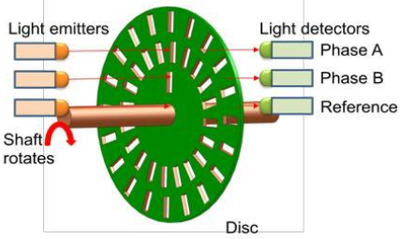
Optical encoders
Optical encoders provide digital output as a result of linear / angular displacement.
These are widely used in the Servo motors to measure the rotation of shafts.
It comprises of a disc with three concentric tracks of equally spaced holes.
Three light sensors are employed to detect the light passing through the holes.

Slide 62
Cont..
When the disc rotates in clockwise direction, the pulses in the outer track lead those in the inner.
In counter clockwise direction they lag behind.
The resolution can be determined by the number of holes on disc.
With 100 holes in one revolution, the resolution would be:
360⁰/100 = 3.6⁰.

Slide 63
Capacitive Sensors:
A capacitor is comprised of two parallel plates of conducting materials separated by an electrical insulating material called a dielectric.
Electrodes are attached to each capacitor plate for the purpose of making electrical connections.
Capacitive sensors basically consist of a capacitor with variable capacitance.
The principle of the sensor is based on causing changes in the non electrical variable

Slide 64
Cont..
These changes in capacitance can either be due to changes in the plate surface area, in the plate separation or in the relative
dielectric permittivity.
Applications:
  Control of liquid level in containers for various liquids,
  Detection of non-metallic items on a conveyor belt,
  Level control for waste reservoirs,
  Final inspection for packaging processes

Slide 65
Inductive Sensors:
Are basically used for detection of metallic objects.
An inductive proximity sensor has four components; the coil, oscillator, detection circuit and output circuit.
An alternating current is supplied to the coil which generates a
magnetic field.
When, a metal object comes closer to the end of the coil,
inductance of the coil changes. Applications:
Industrial automation: counting of products during production or transfer.
Security: detection of metal objects, arms, land mines

