Slide 1
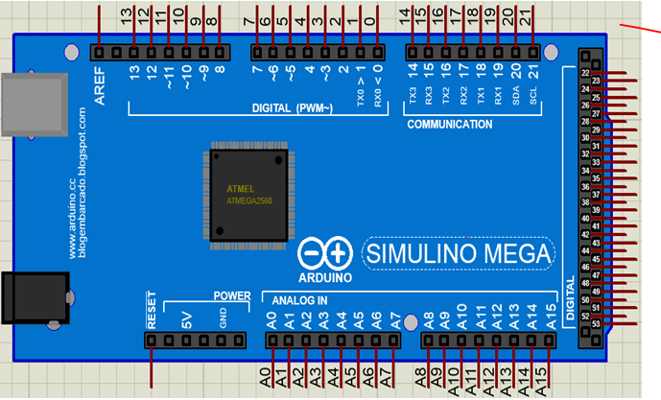
Outline

Slide 2
Outline
Introduction
Installation
Dive to blink
Inputs
Sensors
Outputs
Communication
Arduino Shields
Data types
Operators
Control structures

Slide 3
Embedded System Components ?
INPUT
PROCESSER
OUTPUT

Slide 4
Introduction
What is Arduino ?
  Microcontroller
Types of Arduino
  Arduino Uno
  Arduino Nano
  Arduino Mega
  Arduino Lilypad

Slide 5
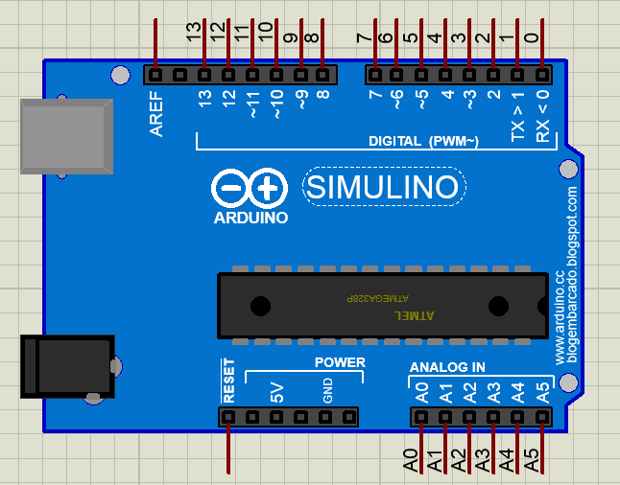
Arduino Uno

Slide 6
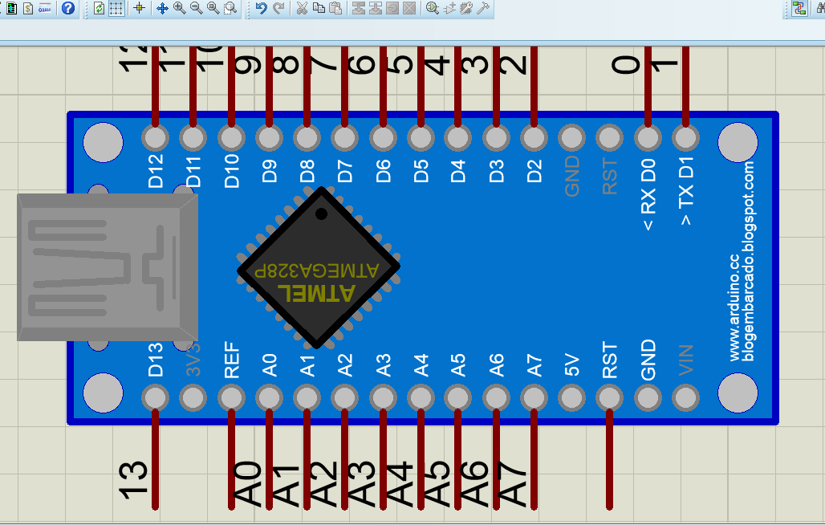
Arduino Nano

Slide 7
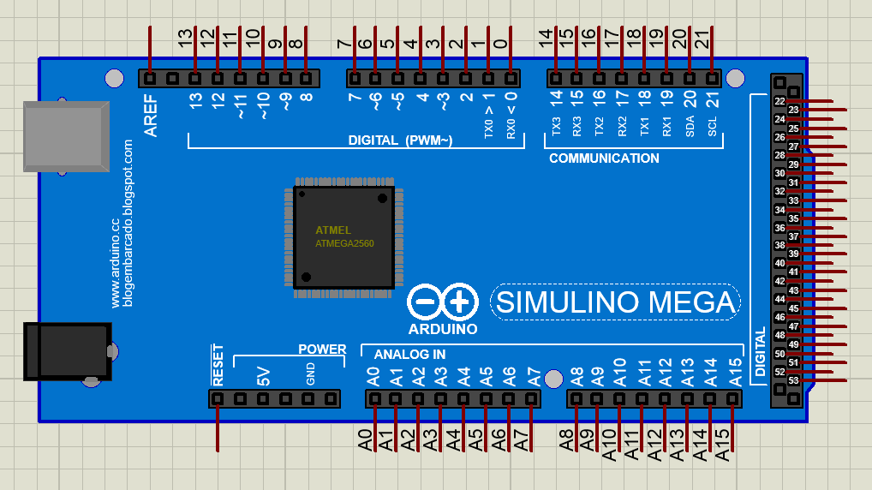
Arduino Mega

Slide 8
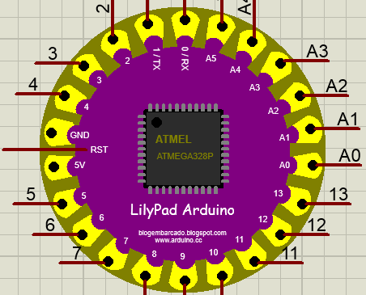
Arduino Lilypad

Slide 9
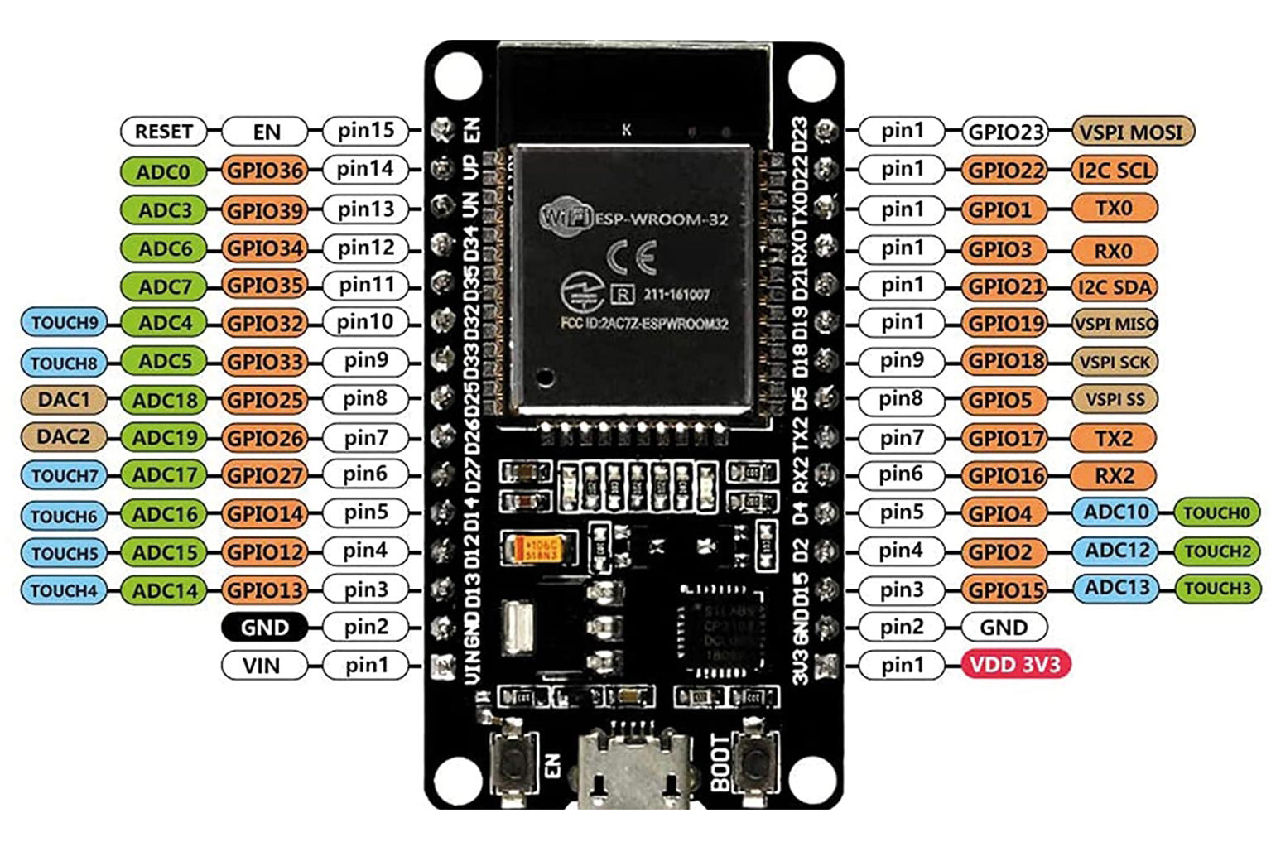
ESP32 microcontroller

Slide 10
What can we do with arduino?

Slide 11
Digital Write
Digital Read
Analog Write
Analog Read
Serial communication

Slide 12
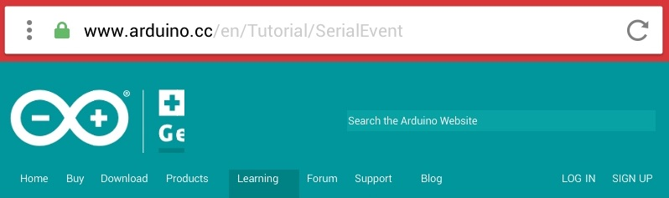
How to install Arduino IDE? https://www.arduino.cc/en/software/#ide

Slide 13
Adding New Libraries…

Slide 14
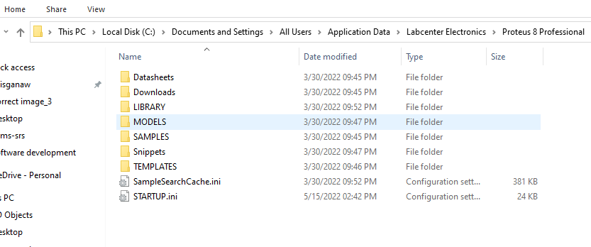
Copy the following file path at file exploler tab and press enter from key board
C:\Documents and Settings\All Users\Application Data\Labcenter Electronics\Proteus 8 Professional
The copy the Arduino sensor library and past inside Library.
Finally restart your proteus software

Slide 15
Comments
//
Single line comment
/*……*/
Multi-line comment

Slide 16


Let’s Dive to Blink

Slide 17
void setup()
{
pinMode(13,OUTPUT); // tell arduino pin 13 as output
}
Void loop()
{
digitalWrite(13,HIGH); // make pin 13 High (i.e. 5V)
delay(500); // do nothing for 500 m sec
digitalWrite(13,LOW); // make pin 13 Low (i.e. 0V)
delay(500); // do nothing for 500 m sec
}

Slide 18
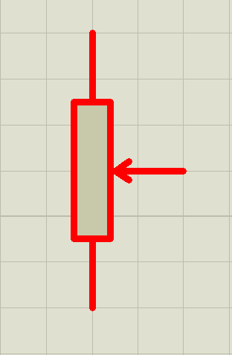
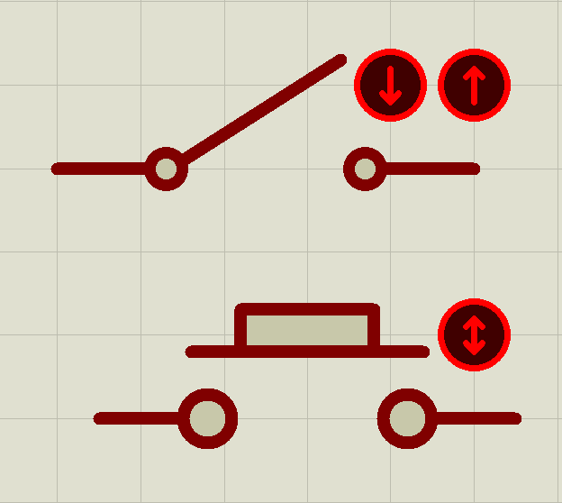
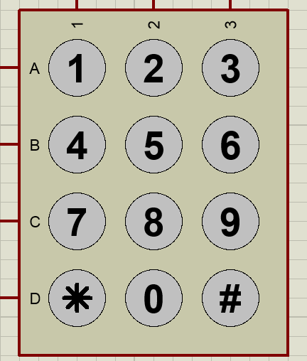
Inputs
Pushbuttons
switches
Potentiometers
Keypads
Sensors

Slide 19
Sensors
    LDR sensor
    IR sensor
    Ultrasonic
    Humidity sensor
    Temperature sensor
    Level sensor
    Distance sensor

Slide 20
Sensors
    Speed sensor
    Moisture sensor
    Gas sensor
    Alcohol sensor
    Vibration senor
    Magnetic field sensor

Slide 21
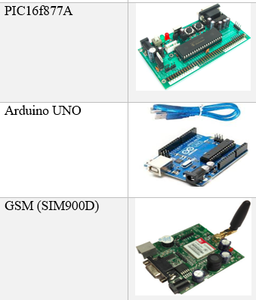
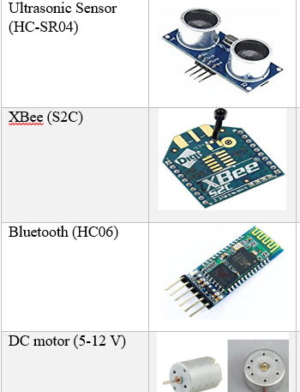
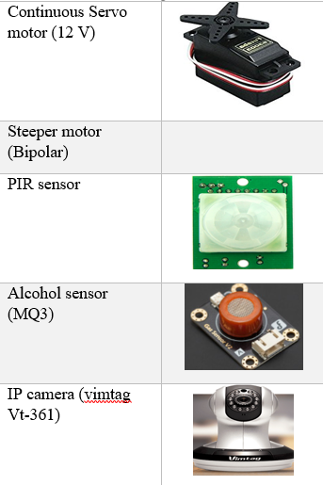
Sensors and embedded system electronics

Slide 22
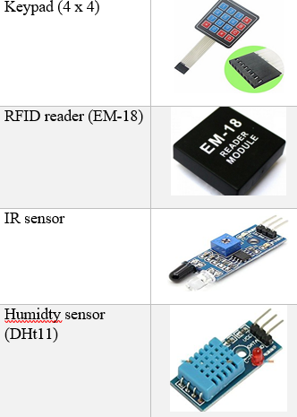
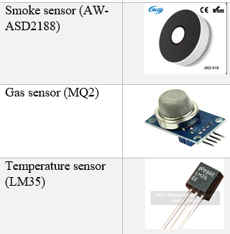
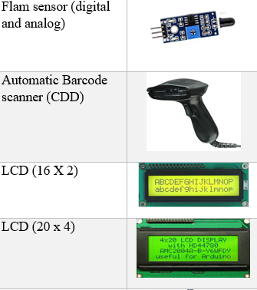
Sensors and embedded system electronics

Slide 23
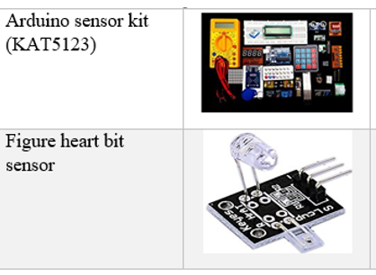
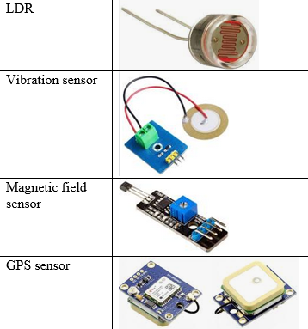
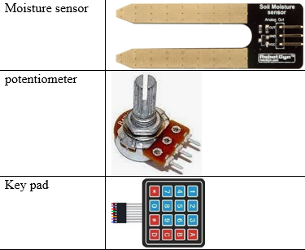
Sensors and embedded system electronics

Slide 24
Outputs
    LED
    Relays
    Transistor
    Motors
    Displays
    Other low current devises

Slide 25
Communication
    Serial.begin()
    Serial.end()
    Serial.available()
    Serial.read()
    Serial.print()
    Serial.println()
    Serial.Write()

Slide 26
Arduino Shields
    GSM Module
    Bluetooth
    XBee
    Wi-Fi
    GPS
    RFID
    Others

Slide 27
Data types
    int 16 bit num + or-32,768
    long 32 bit num + or -2147483648
    float 0.2 , 45.6 , 10.5
    double 8952.3 , 46975.9
    char a , b , c , d

Slide 28
Data types
    String “welcome”
    Array
    HIGH/LOW
    INPUT/OUTPUT
    True/false
23 | 5 | 10 | 9.4 | good | a

Slide 29
Operators
  Athematic operators
Comparison operators
Boolean operators
Math operators

Slide 30
  Arithematic operators
    =
    +
    -
    *
    /
    %

Slide 31
Comparison operators
  ==
  !=
  <
  >
  <=
  >=

Slide 32
Boolean operators
  && Boolean and
  || Boolean or
  ! Boolean not

Slide 33
Math operators
min()
max()
abs()
map()
pow(b,ex)
    sqrt()
    sin(rad)
    cos(r)
    tan(r)

Slide 34
Control structures
    If
    Else…if
    Else
    For
    while

Slide 35
Control structures
    switch case
    do….while
    break
    continue
    return

Slide 36
Summery
let us do it again

Slide 37
Help your self

