Slide 1
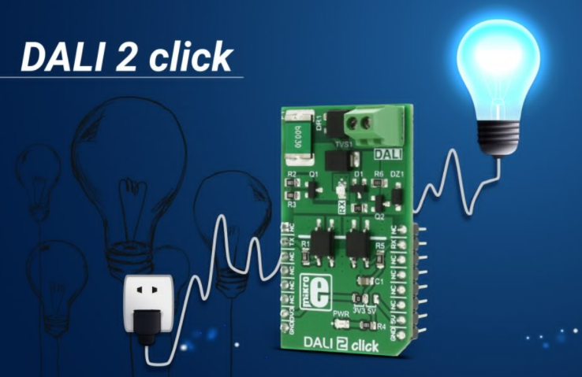
Introduction to Embedded system

Slide 2
Introduction to Embedded system
Contents
Introduction to embedded system
Examples of embedded system
Why to embed a computer
What makes embedded system differ
Attributes of embedded system
Types of embedded system
Types of Processor

Slide 3
Introduction to embedded system
Objectives of Embedded system
To understand
The role of Embedded system in the industry and human life
Component (hardware and software) of Embedded system
The concept of designing and development process of Embedded system

Slide 4
Introduction to embedded system
Chapter Objectives:
What is an embedded system?
Examples of embedded systems?
Why to embed a computer?
What is the similarities and difference b/n embedded systems and other computer systems?
What makes embedded system different
Classification of embedded system

Slide 5
Introduction to embedded system
Some interesting facts about embedded systems
The first microprocessors is used for embedded applications
About 98% of processors are shipped for embedded system application in 2009 G.C.
In USA there are 8 microcontroller based device for every person
The auto industry improve the efficiency of its engine system by 90% in the past 40 years

Slide 6
Introduction to embedded system
What is an embedded system? (intuitive)
Definitions
Embedded:
Putting something inside other thing
Hiding something inside other things
Putting something b/n other things
Systems:
Set of interacting component that work together to provide a given functions (meet objectives)
E.g. Watch, washing machines, cars etc

Slide 7
Introduction to embedded system
What are embedded system? (Definition)
“An embedded system is a system that has a customized programmable hardware which gives a functionality of control, user interface, interfacing to other system.
Key words are
Customized (application specific) hardware (computer)
Programmable
Provide functionalities

Slide 8
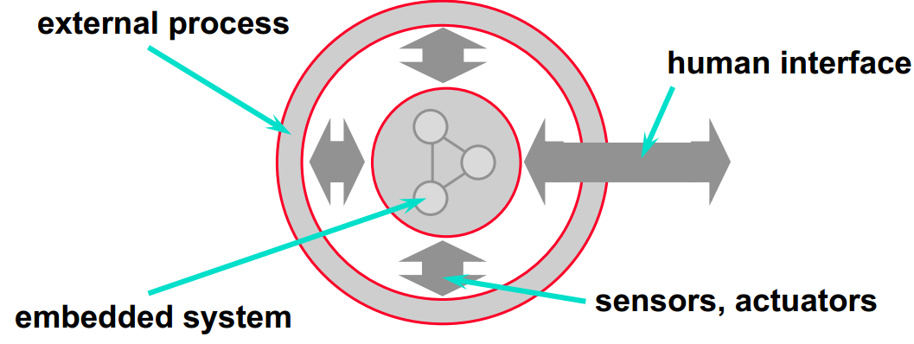
Introduction to embedded system

Slide 9
Introduction to embedded system
What are Some examples of embedded systems?
Anti-lock brakes
Auto-focus cameras
Automatic teller machines
Automatic toll systems
Automatic transmission
Avionic systems
Battery chargers
Camcorders
Cell phones
Cell-phone base stations
Cordless phones
Cruise control
Curbside check-in systems
Digital cameras
Disk drives
Electronic card readers
Electronic instruments
Electronic toys/games
Factory control
Fax machines
Fingerprint identifiers
Home security systems
Life-support systems
Medical testing systems
Modems
MPEG decoders
Network cards
Network switches/routers
On-board navigation
Pagers
Photocopiers
Point-of-sale systems
Portable video games
Printers
Satellite phones
Scanners
Smart ovens/dishwashers
Speech recognizers
Stereo systems
Teleconferencing systems
Televisions
Temperature controllers
Theft tracking systems
TV set-top boxes
VCR’s, DVD players
Video game consoles
Video phones
Washers and dryers

Slide 10
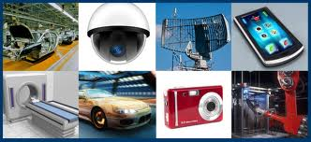
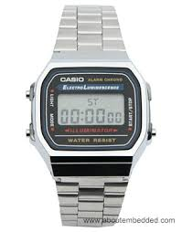
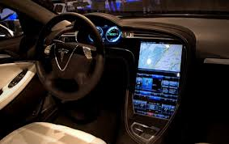
Introduction to embedded system
What are Some examples of embedded systems?

Slide 11
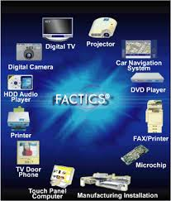
Introduction to embedded system

Slide 12
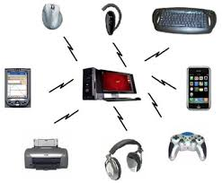
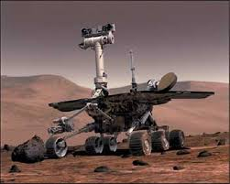
Introduction to embedded system

Slide 13
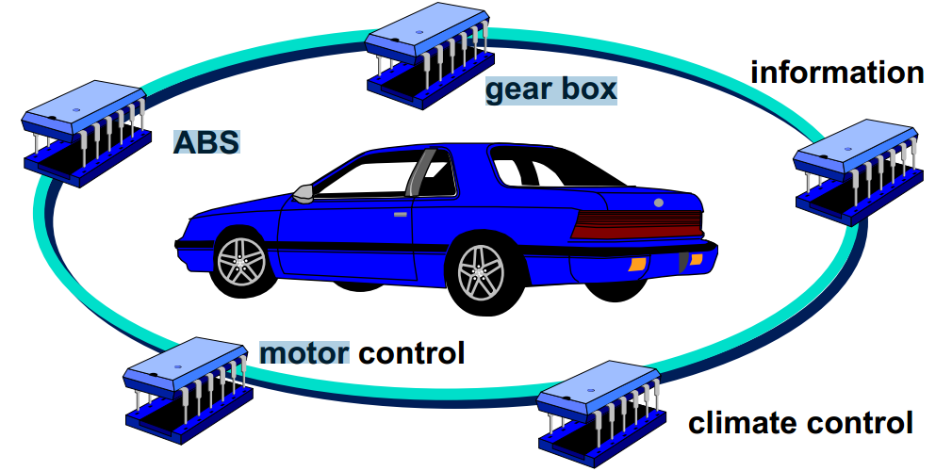
Introduction to embedded system

Slide 14
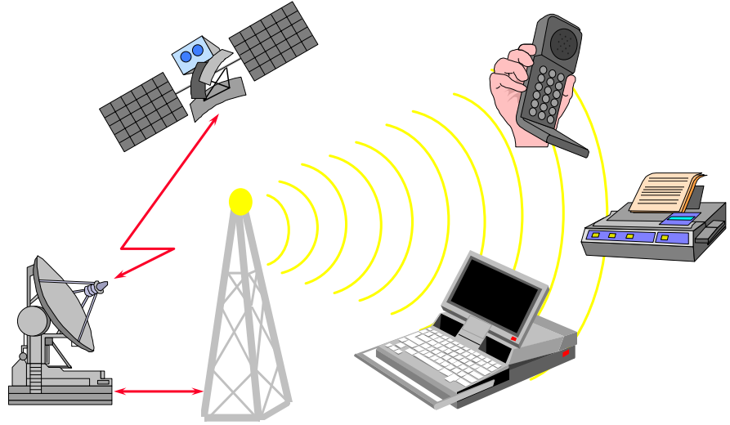
Introduction to embedded system

Slide 15
Introduction to embedded system
Different production system like, brewery, coca cola, paper, cloth, Electronics and other a lot of fabrics are operated by embedded system
Calculator, mobile, television, lift, equipment tracking system at laboratory, automatic door opening and closing which is available in our country Ethiopian around bole and so on… are example of embedded system
Different types of robot are the result of embedded system
Radar system, nuclear bomb, drone which is image and video capturing on space

Slide 16
Introduction to embedded system
Why to embed a computer?
Greater Performance and Efficiency
Lower Costs
Competition in the consumer market
Component cost (e.g. microcontroller cost = $0.25 average but processor cost $100 on average)
Manufacturing cost
Operating cost

Slide 17
Introduction to embedded system
More Features
Cruise control
Smart air bag
Headlight and interior light after some idle time
Better Dependability
By their variety nature embedded systems are designed reliable from the variety start
Diagnostics mechanism using the embedded system

Slide 18
Introduction to embedded system
What makes embedded system different
Real-time operation
Size
Cost
Time
Reliability
Safety
Energy
Security

Slide 19
Introduction to embedded system
Benefits ES
High flexibility
Only software update may be needed
low development cost
Small size and weight

Slide 20
Introduction to embedded system
What functionalities that Embedded System provide?
Control system
Cruise control system (by controlling the throttle size of the fuel)
Sequencing
Among multiple state (engine ignition system)
Signal processing
Filtering (eliminate noise), amplify signal component of interest
E.g. smart speaker phone avoiding road noise
Communication and networking
E.g. routers, hubs and so on

Slide 21
Introduction to embedded system
Attributes of Embedded Systems
Need to respond to events
E.g. sensor signal, push button, timing information
Respond to deadlines (Real-time system)
Late right answer is wrong answer
E.g. flight control, ignition of car engine
Fault tolerance
Unreliability is not an option
E.g. flight control
Operate independently for a long time

Slide 22
Introduction to embedded system
Constraints on Embedded Systems
Cost constraint
Competitive market (price is a major factors)
E.g. consumer electronics
Size and weight constraint
Portable products
Time constraint
Power constraint
Battery powered and solar cell operated products
Small size so less space for cooling in high power consumption
Harsh environment
vibration
electro-magnetic field interference
Reliability (high implication of failure)

Slide 23
Introduction to embedded system
Compression of embedded system with GPCS
Single/dedicated tasking
Power constrained
Memory constrained
(requires code size efficiency)
Real time response
(requires run time efficiency)
Design and development methodologies and tools
Standardization

Slide 24
Introduction to embedded sysetm
Light RTOS
Reliability and fault tolerant architecture
Operate for long period
No access for the user to update it
Simplified user interface (generally no GUI)
Less human interaction with human (infinite loop approach)
Very frequent interaction with the physical world

Slide 25
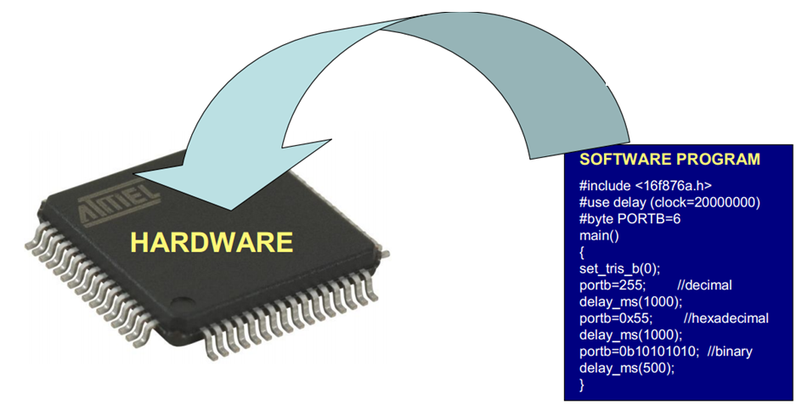
introduction to embedded system
Embedded systems

Slide 26
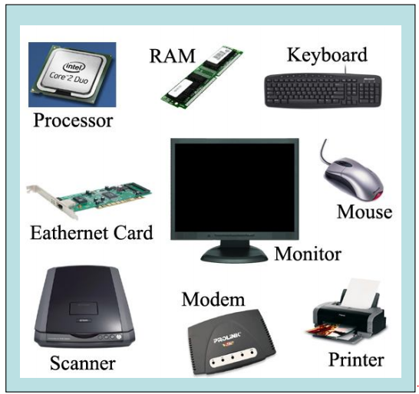
introduction to embedded system
General purpose computing

Slide 27
Introduction to embedded system
 | Embedded systems | General purpose computing
1 | Few applications that are known at design-time. | Broad class of applications.
2 | Not programmable by end user. | Programmable by end user.
3 | Fixed run-time requirements (additional computing power not useful). | Faster is better.

Slide 28
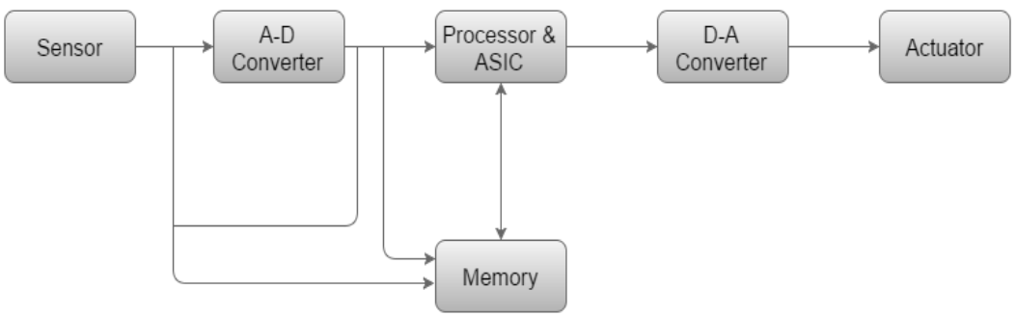
Introduction to embedded system
Basic structure of embedded system

Slide 29
Introduction to embedded system
Alternatives to embedded systems
Non programmable logic controller
555 timers
8253/54 timer counters
Electro-mechanical control
hydraulic control

Slide 30
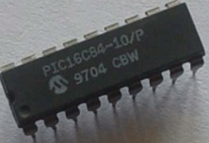
Introduction to embedded system
Classification of embedded system
1. Small Scale Embedded System
Single 8 bit or 16bit Microcontroller.
Little hardware and software complexity.
They May even be battery operated.
Usually “C” is used for developing this system.

Slide 31
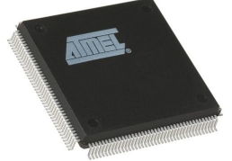
Introduction to embedded ststem
2. Medium scale embedded system
Single or few 16 or 32 bit microcontrollers or Digital Signal Processors (DSP) or Reduced Instructions Set Computers (RISC).
Both hardware and software complexity.

Slide 32
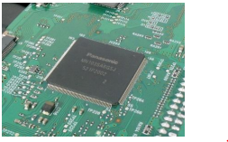
Introduction to embedded system
3. Sophisticated embedded system
Enormous hardware and software complexity
Which may need scalable processor or configurable processor and programming logic arrays?
Constrained by the processing speed available in their hardware units.

Slide 33
Introduction to embedded system
Types of processers
Processors can be of the following categories:
1. General Purpose Processor (GPP)
Microprocessor
Microcontroller
Embedded Processor
Digital Signal Processor
Media Processor
2. Application Specific System Processor (ASSP)
3. Application Specific Instruction Processors (ASIPs)
4. GPP core(s) or ASIP core(s) on either an Application Specific Integrated Circuit (ASIC) or a Very Large Scale Integration (VLSI) circuit

Slide 34
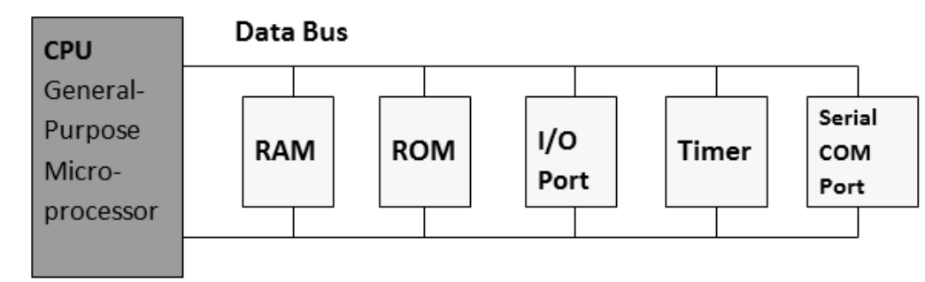
Introduction to embedded system
Microprocessor
A processor has two essential units:
Control Unit (CU)
Execution Unit (EU)

Slide 35
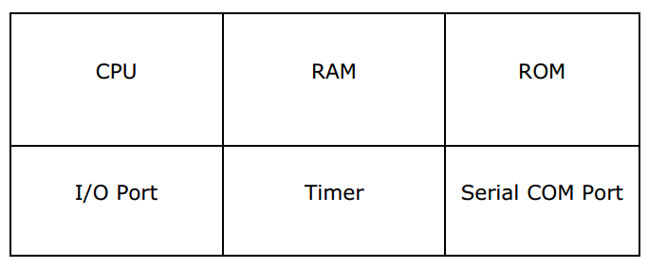
Introduction to embedded system
Microcontroller
A microcontroller is a functional computer system-on-a-chip. It contains a processor, memory, and programmable input/output peripherals.

Slide 36


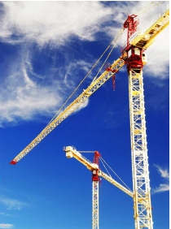
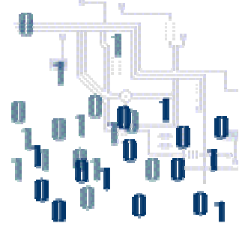
Benefits of microcontroller
Faster speed
Low cost
Easier and quicker development
Easy to code

Slide 37
Summary
We have seen
Definition of embedded system
Some application of embedded systems
Advantage of embedding a computer into a system
Attributes and functionality of embedded systems
The difference b/n embedded system and general computing system

