Slide 1
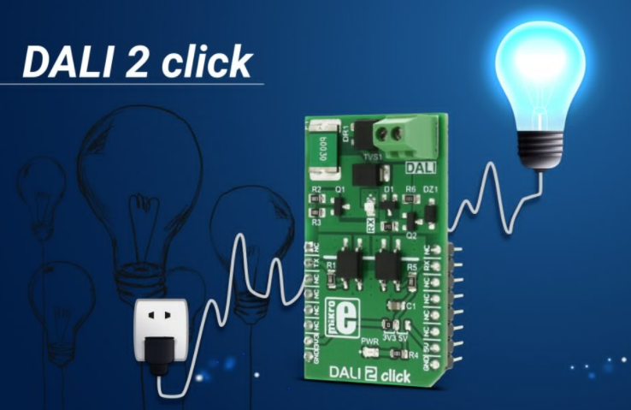
DESIGN PROCESS
Embedded system design

Slide 2
ES design
This chapter includes:
Embedded system design methodology
Embedded system design life cycle
Embedded system design requirement
Embedded system design phase
Embedded system design components and its function

Slide 3
ES design
Objective
Understand the embedded system design processes
If you don’t know where you are going, how do you know when you get there.
Understand the difference between embedded system design development process and standard computer software development process

Slide 4
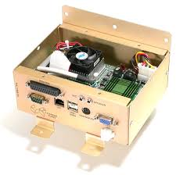
ES design
Computer on the box(PC)

Slide 5

ES design
Computer on the chip microcontrollers

Slide 6
ES design
Why methodology for designing embedded systems
Complexity of most embedded systems
For developing automating SW/HW tools
Interdisciplinary nature of embedded systems
Communication between different departments
Hardware
software
Team based embedded systems projects

Slide 7
ES design
Embedded system design methodology
There are different methods of designing and developing embedded systems
Most of them are inherited (similar to) from software development process

Slide 8
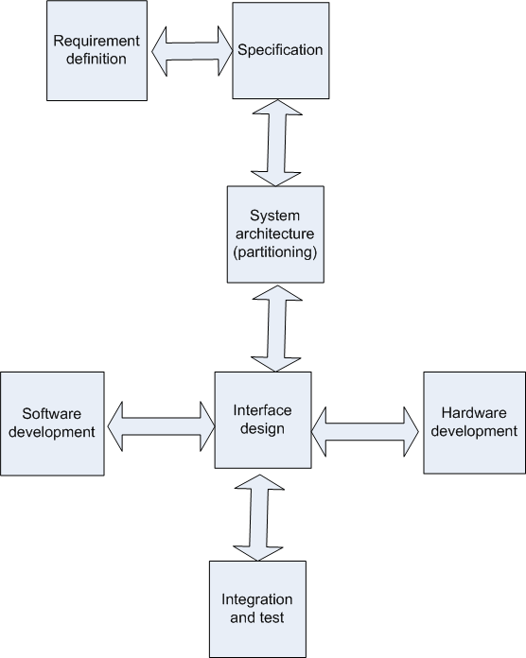
ES design
Embedded system design lifecycle

Slide 9
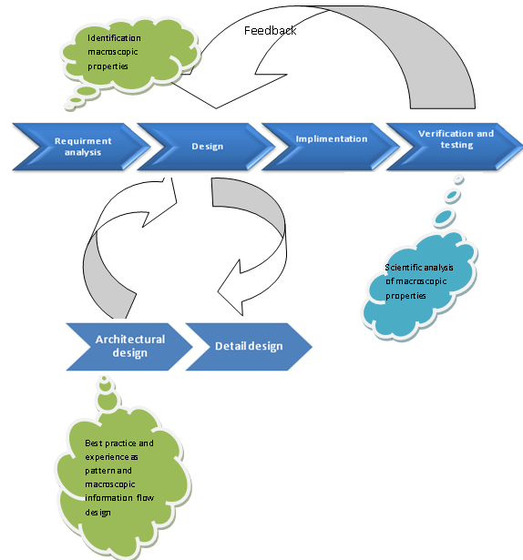
ES design

Slide 10
Embedded system design life cycle
Requirement
Specification
Architectural design
Detail design
Hardware design
Software design
Integration of subsystem
Testing, maintaining and upgrading

Slide 11
Embedded system design life cycle(phase view)

Slide 12
Embedded design requirements
We must know what we are going to design
The requirement stage capture this information in the language of the customer
The user and the designer usually speak different language

Slide 13
Embedded design requirements cont…
Variety of possible choices
More than 140 processor choice
More than 100 RTOS
Experience required to arrive at optimal design
Solution surface is smooth
Adequate solution not far off from the best solution
Constraints dictate the decision path

Slide 14
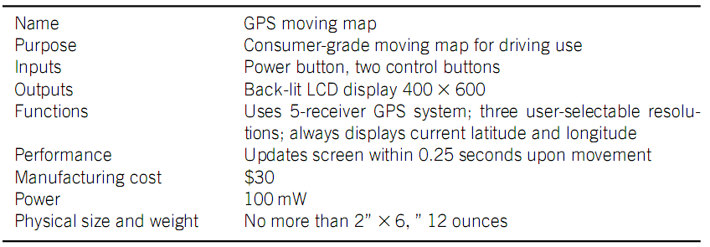
Example of requirement forms

Slide 15
Specification
While the requirement written with the language of the customer
The specification is written with the language of the designer
Both talk about “how” the final system should behave
Not “how” we are going to design the embedded system

Slide 16
Specification
The designer should massage the requirement so that they get actionable statements about the system to be designed
The specification
It is specified in the language of the designer
i.e. It is actionable
It serves as a contract between the customer and the designer
UML, a language for describing the specifications, is very helpful here

Slide 17
Design phase(Architecture design)
The specification does not say “how” the system does things, only “what” the system does.
Describing “how” the system implements those functions is the purpose of the architecture
Here block diagram is mostly employed to model it
It is here that we divided the design of the embedded system into hardware and software

Slide 18
Partitioning of S/w and H/w
Here functionality will tentatively assigned to software and hardware
Some requirements and constraint will dictate this partitioning
Performance, cost, past experience have a major role in this process

Slide 19
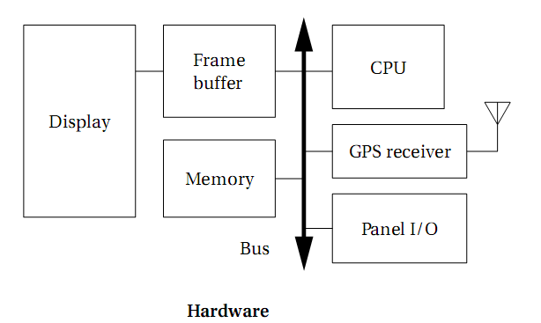
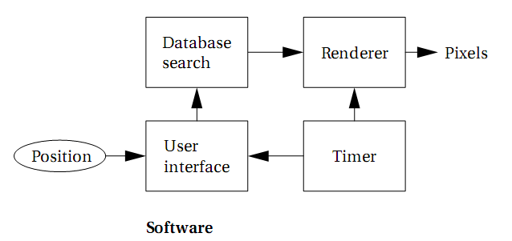
Architecture of The example

Slide 20
Iteration and implementation
Here Hardware and software paths begin to diverge
Design still very fluid
Major blocks partitioned
Boundary can still be moved
Iteration is common

Slide 21
Iterative implementation (conti…)
Major tasks in this steps includes
Architectural design
Selection of processor
Selection of toolset
Software tools and hardware tools
E.g. IDE, Simulator, Emulator, programmer etc.
Detail design
Iterative in nature
Incremental development

Slide 22
Iterative implementation (conti…)
Here both hardware and software can be done in parallel
The toolset used to the job make big difference
More tools means easy navigation on the design process

Slide 23
Hardware/software integration
Real-time nature of embedded systems leads to highly complex, non-deterministic behavior
Can only be analyzed as it occurs
Accurately modeling and simulating behavior may be very time consuming
But tools are getting better!
23
23
23

Slide 24
Product testing and release
Testing is important when performance is key
Testing and reliability more stringent
Is the system performing at close to its requirement and optimal capabilities?

Slide 25
Compliance testing
Embedded systems radiate a lot of radio frequency energy
“all electronic devices must be turned off…”
If embedded designer does not consider these things, compliance engineering (CE) will fail
Software must be running to pass this test
This is often overlooked

Slide 26
Maintaining and upgrading
Not many tools to support applications already in the field
60% of embedded engineers maintain systems
Original engineer long gone
Must rely on experience, any existing documentation, etc…
Tools might be handy…
“time to market” must become “time to reverse engineer” and “time to insight”

Slide 27
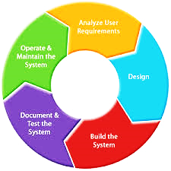
Summary

Slide 28
Review questions
Suppose you are going to design an embedded system which can do the following
Detect the motion of incoming person inside the room
While detecting the motion room light will automatically glow if the room is dark
List down the components to design this system
Identify which is input, process and output component
Write the function of each components for the system
Design the architecture of the system

