Slide 1
PIC Microcontroller, its Architecture and Assembly Language
Contents
PIC architecture
Assembly Language Directives
Assembling and linking
PIC Registers and Assembly Language
I/O programming Using Assembly and C language

Slide 2
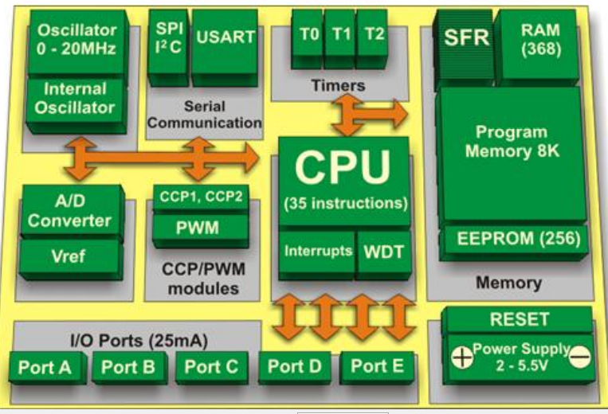
PIC microcontroller and its Architecture

Slide 3
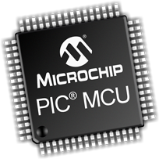
PIC and it Advantage
What is a Peripheral Interface Controller?
PIC (peripheral Interface Controller) is the world’s smallest microcontroller that can be programmed to carry out a vast range of tasks.
Advantages
low power consumption
high performance
supports hardware and software tools such as simulators, compilers, and debuggers.
2

Slide 4
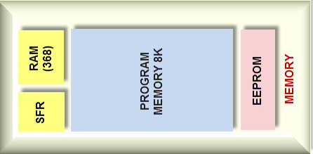
Individual definition
Central Processing Unit (CPU)
PIC microcontroller’s CPU is not different like other microcontroller CPU, which includes the ALU, controller unit, the memory unit, and accumulator.
Memory Organization
The memory module in the PIC microcontroller architecture consists of Random Access Memory, Read Only Memory and STACK.

Slide 5
Individual definition
RAM (Random Access Memory)
Categorized as:
GPR and
SPFR
Memory Organization
The memory organization of Peripheral Interface Controller includes the following
Read Only Memory (ROM)
Electrically Erasable Programmable Read Only Memory (EEPROM)
Flash Memory
Stack

Slide 6
Individual definition
I/O Ports
The PIC microcontroller consists of 5-ports, namely Port A, Port B, Port C, Port D and Port E.
BUS
transfer & receive the data from one peripheral to another.

Slide 7
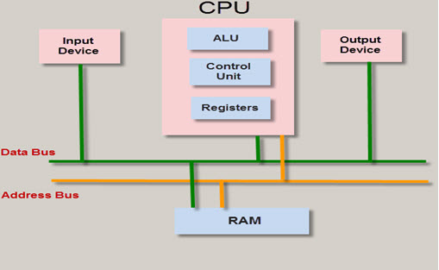
Bus

Slide 8
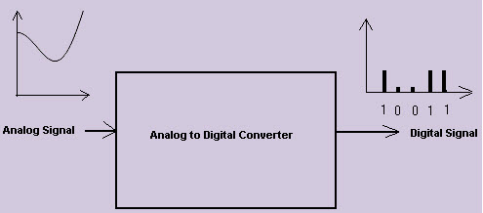
Individual definition
A/D Converters
A/D converter is used to convert analog voltage values to digital voltage values.

Slide 9
Individual definition
Timers/ Counters
PIC microcontroller has four-timer/counters wherein the one 8-bit timer and the remaining timers have the choice to select 8 or 16-bit mode.
Timers are used for generating accuracy actions, for example,
creating specific time delays between two operations.
Interrupts
PIC microcontroller consists of 20 internal & 3-external interrupt sources which are allied with different peripherals like
USART
ADC
Timers, and so on.

Slide 10
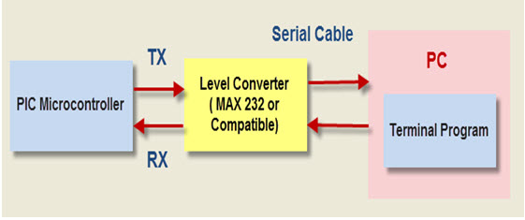
Individual definition
Serial Communication
Serial communication is the method for transferring one-bit data at a time sequentially over a communication channel.

Slide 11
Individual definition
USART
USART is used for transmitting & receiving the data bit by bit over a single wire with respect to CLK pulses.
The Peripheral Interface Controller consists of two pins TXD & RXD. These pins are used for transmitting & receiving the data serially.
SPI Protocol
used to send information between PIC microcontroller and other peripherals like
Sensors
SD cards, and shift registers.

Slide 12
Individual definition
I2C Protocol
it is a serial protocol, used to connect low-speed devices like
EEPROMS
A/D converters
microcontrollers, etc.
Oscillators
Oscillators are used for timing generation. This microcontroller comprises of external oscillators such as
crystal oscillators or
RC oscillators

Slide 13
Individual definition
CCP Module
it works in 3-modes such as compare mode, capture mode, and PWM mode.
Capture Mode
This mode captures the signal arrival time, or in other words, when the pin of this mode goes high, it captures the Timer1 value.
Compare Mode
Compare mode performances as an analog comparator. When the value of the timer1 reaches a certain reference value, then it produces an o/p.
PWM Mode
The PWM mode offers pulse width modulated o/p with a 10-bit resolution and programmable duty cycle.

Slide 14
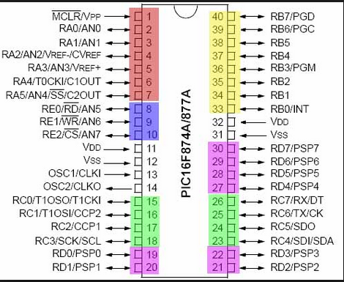
Pin diagram of PIC16

Slide 15
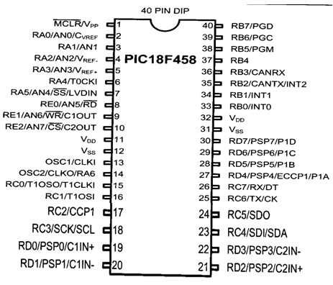
Pin Diagram of PIC18

Slide 16
Criteria for choosing microcontroller
Speed
Packaging
Power consumption
Amount of ROM
Number of I/O and timer
Cost per unit

Slide 17

PIC Register and Assembly Language
PIC have three Registers which are:
WREG
FR(GPR & SFR)
STATUS Registers
All register of PIC 18 have size of 8 bit
WREG
MOVLW instruction
MOVLW K ; move literal value K into WREG
MOVLW 25H
MOVLW 7F2H ; illegal 7F2H > 8 bits (FFH), become F2H

Slide 18
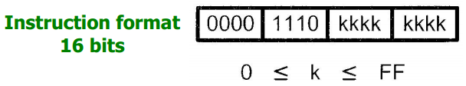
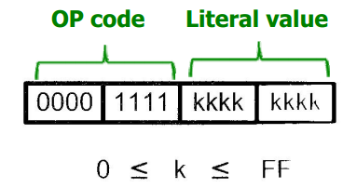
PIC Register and Assembly Language
ADDLW instruction
ADDLW K ; ADD literal value K to WREG
MOVLW 25H
ADDLW 34H

Slide 19
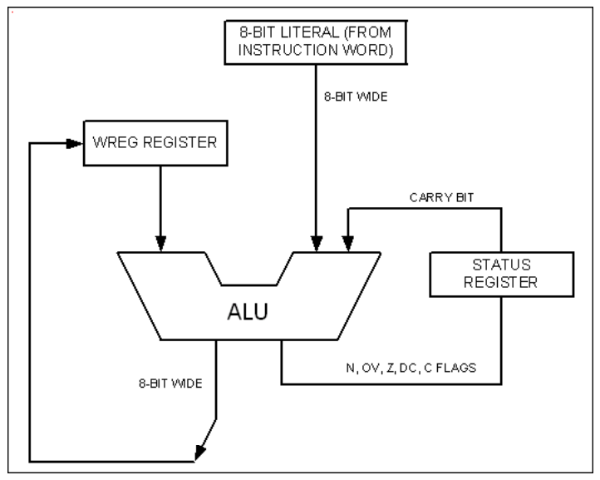
PIC Register and Assembly Language
WREG register and ALU using literal value

Slide 20
PIC Register and Assembly Language
File register (data RAM)
Can be categorized as:
Special functional registers (SFRs)
ALU status, timers
serial communication
I/O ports
ADC, etc
General-purpose registers (GPRs)
Data storage

Slide 21
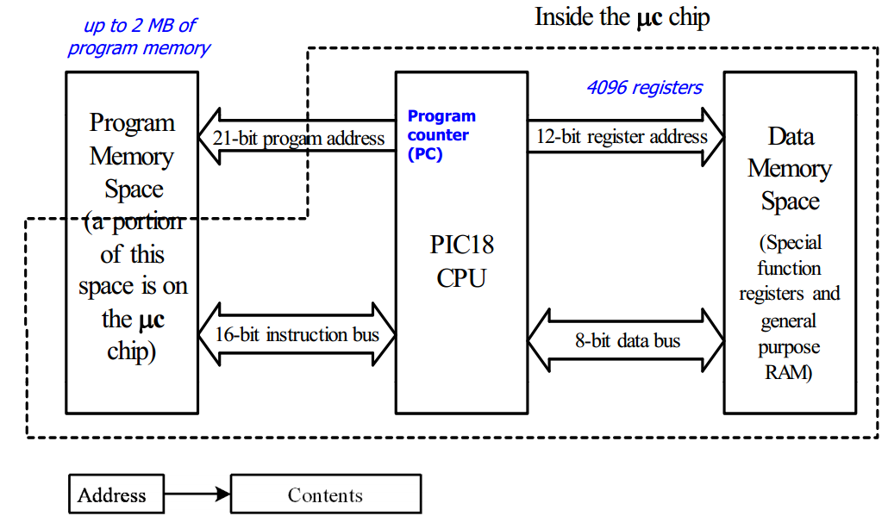
PIC Register and Assembly Language
PIC18 Memory Access

Slide 22
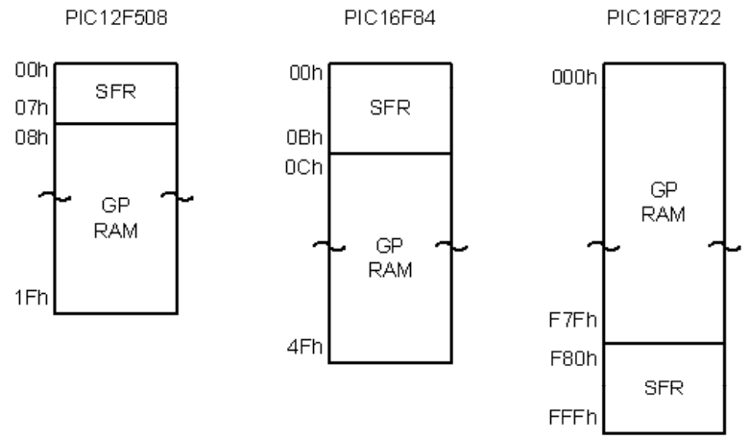
PIC Register and Assembly Language
File register (data RAM)
special functional registers (SFRs)
ALU status, timers, serial communication, I/O ports, ADC, etc
General-purpose registers (GPRs)
Data storage
File registers of PIC12, PIC16, and PIC18

Slide 23
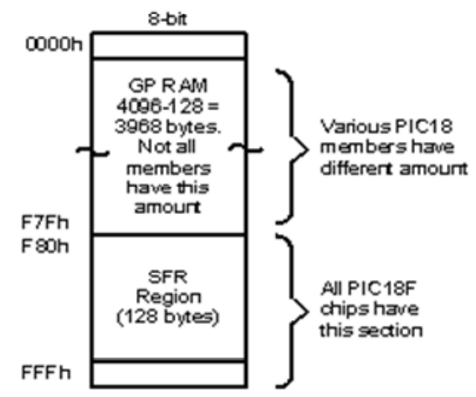
PIC Register and Assembly Language
File register allocation in PIC18

Slide 24
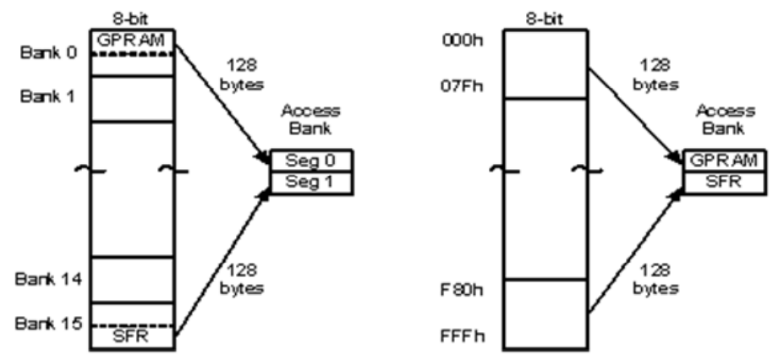
PIC Register and Assembly Language
PIC18 banks and access bank

Slide 25
PIC Register and Assembly Language
PIC18 banks
4096 registers are divided into 16 banks. Only one bank is active at a time.
Bank switching
When operating on a register in a different bank, bank switching is needed.
Access bank
is created to minimize the problems of bank switching.

Slide 26
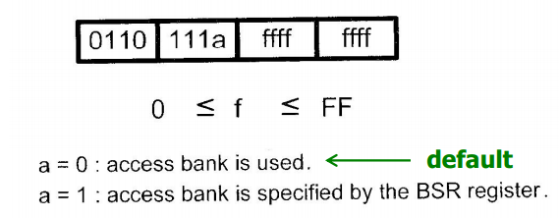
Instructions with default access bank
MOVWF instruction
F stands for a location in file register
Ex. 1
MOVLW 55H
MOVWF PORTB ; copy WREG contents to port B
Ex. 2
MOVLW 99H
MOVWF 12H ; copy WREG contents to location 12h

Slide 27
More instructions involving WREG and access bank
ADDWF fileReg, D
Add the contents of WREG and a file register
If D=0, p result is placed in WREG
If D=1, result is placed in file register
Ex1
MOVLW 28H
MOVWF 5H
MOVLW 56H
ADDWF 5H, 0 or ADDWF 5H, 1
(ADDWF 5H, W or ADDWF 5H, F)

Slide 28
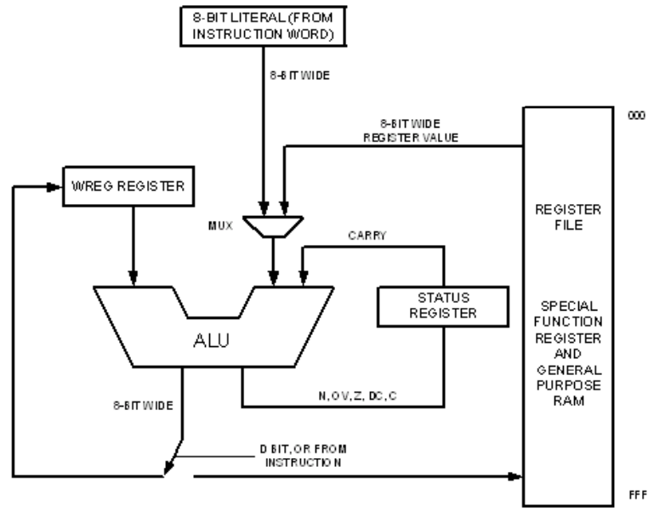
WREG, fileReg, and ALU in PIC18

Slide 29
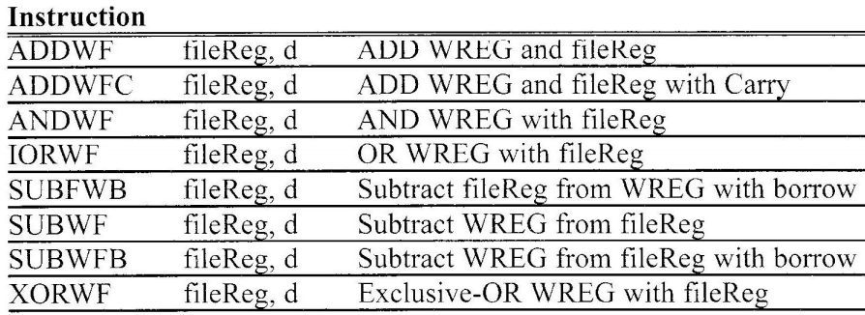
ALU instructions using WREG and file Reg

Slide 30
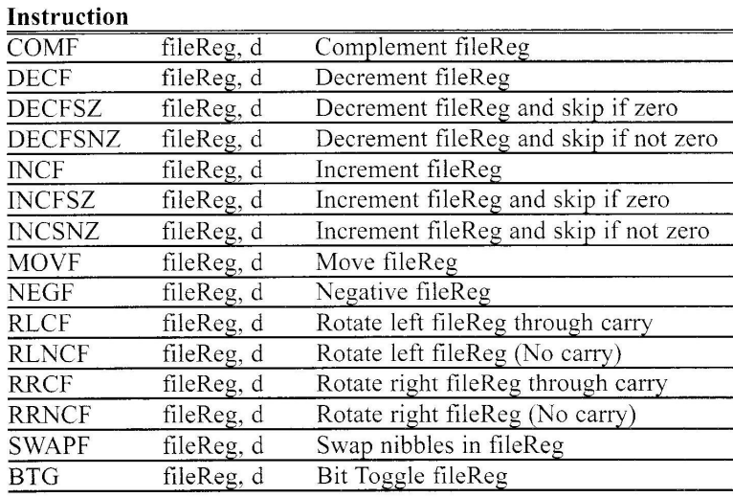
File register instructions

Slide 31
COMF instruction
Complements (inverts) the content of file register
Ex1
MOVLW 55H
MOVWF PORTB
COMF PORTB, F ; 55H (01010101) ……>AAH (10101010H)
Write a program to toggle PORTB continuously forever
Ans:
MOVLW 55H
MOVWF PORTB
B1 COMF PORTB
GOTO B1

Slide 32
DECF instruction
Subtract one from the content of file Reg
Ex1
MOVLW 3
MOVWF 20H
DECF 0x20, F ; loc 20H has 2
DECF 0x20, W ; loc 20H still has 2 but WREG = 1

Slide 33
MOVF instruction
MOVF filereg, D
Copy the content of file Reg to WREG or itself
Write a program to read data from PortB and send to
PORTC continuously
Ans:
AGAIN MOVF PORTB, W
MOVWF PORTC
GOTO AGAIN
MOVFF instruction
Move data directly among file Reg locations
32-bit instruction

Slide 34
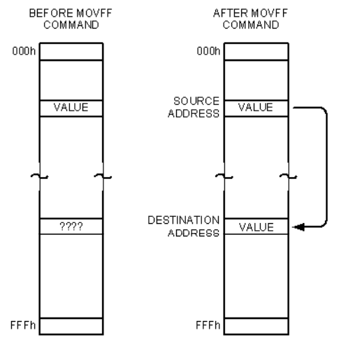

Slide 35
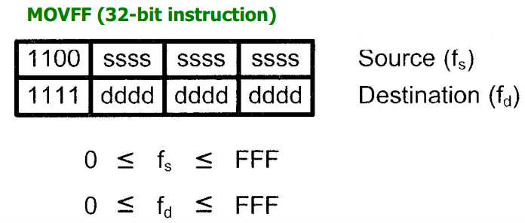
Write a program to read data from PortB and send to PORTC continuously
Ans:
AGAIN MOVFF PORTB, PORTC
GOTO AGAIN

Slide 36
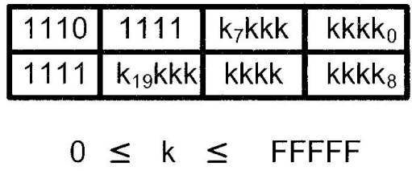
GOTO instruction
32-bit instruction

Slide 37
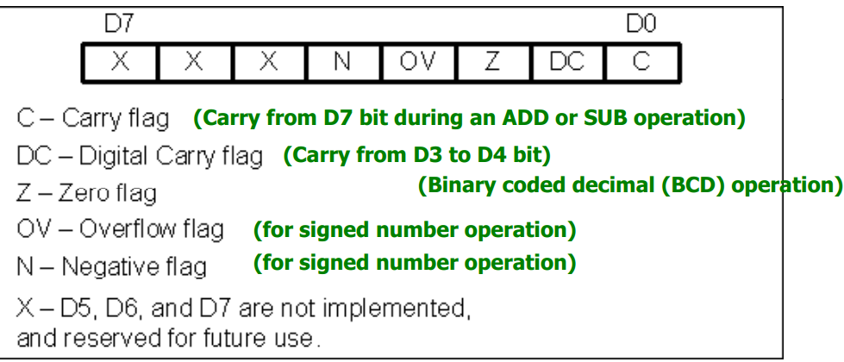
PIC18 status register

Slide 38
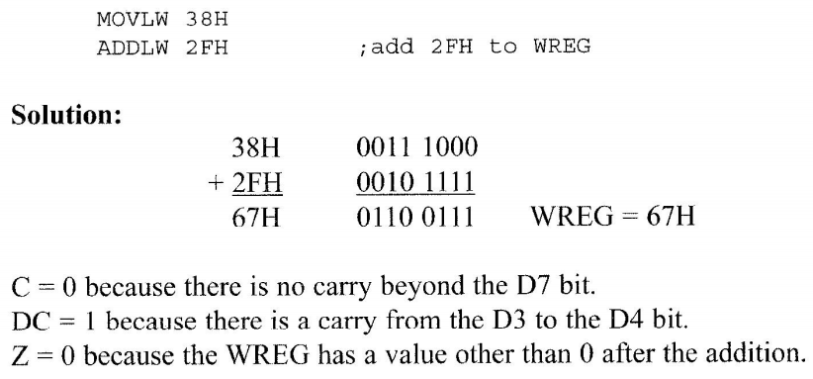
Status register example

Slide 39
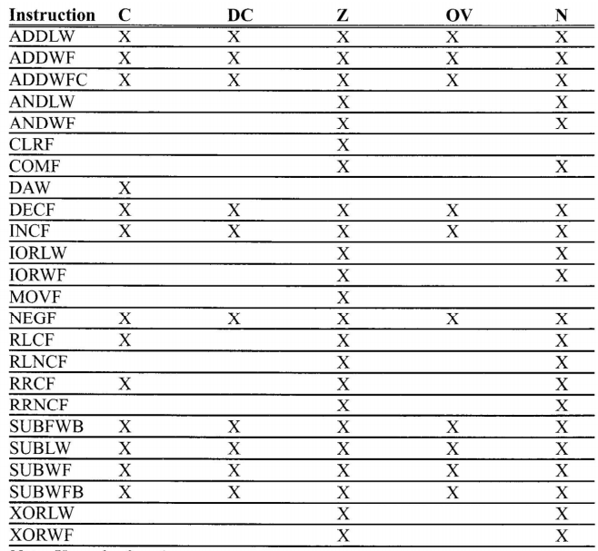
Instruction that affect flag bits

Slide 40
Assembling and linking
There are 4 steps to create, assemble, and run an assembly language
Write code assembly code on editor like MPLAB, MS-DOS
The ‘asm’ file which contains the source file written in step1 fed into microcontroller assembler
Linker integrate with assembler and change one or more object file to absolute file
Finally linker produce HEX file and loaded into microcontroller

Slide 41
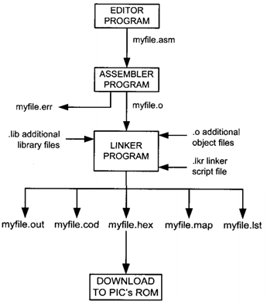
Assembling and linking

Slide 42
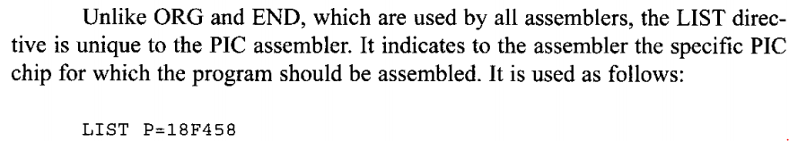
Assembly language directives
ORG (origin) – The origin directive is used to indicate the beginning of the address.
EQU (equate) – It is used to define a constant without occupying a memory location.
END directive – It indicates the end of the source (asm) file.
LIST directive

Slide 43
#include directive
_config directive: - tells the assembler the configuration bit for the the targeted PIC chip
Radix :- indicate weather the number system is hexadecimal or decimal

Slide 44
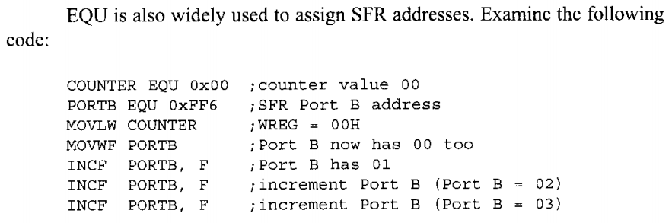
Example EQU

Slide 45
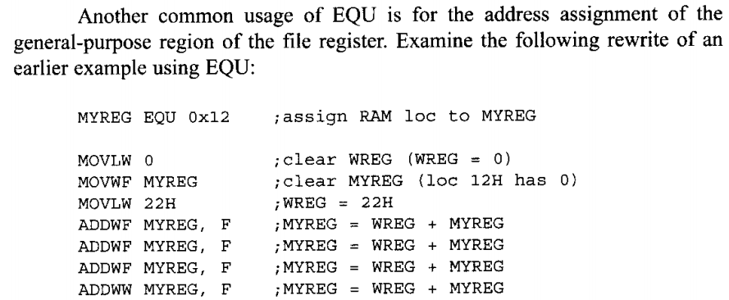
Example EQU

Slide 46
I/O programming in PIC18

Slide 47
As you know PIC 18 have 5 most I/O port which are, PORTA, PORTB, PORTC, PORTD & PORTE
Each port have three main SFR
PORTx
TRISx &
LATx

Slide 48
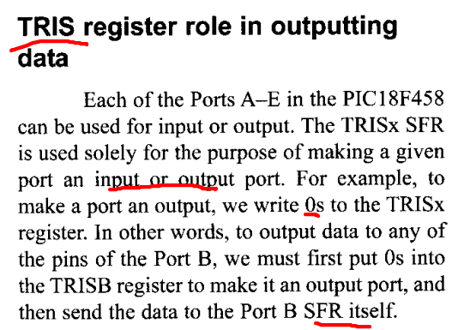

Slide 49
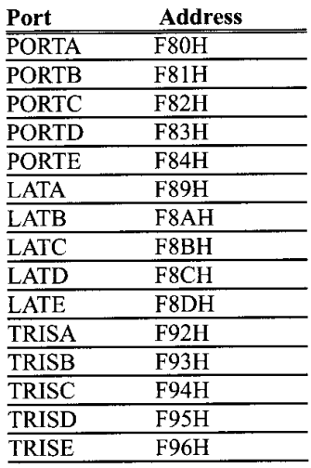

Slide 50
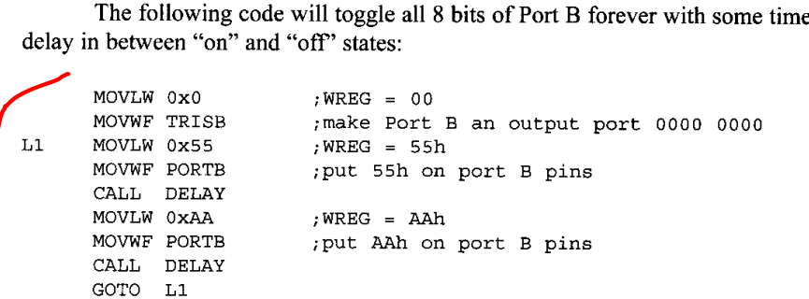

Slide 51
TRIS Register role in inputting data
If we set TRISx 1: we enable a port pin as input
If we set TRISx 0: we enable a port pin as ouput

Slide 52
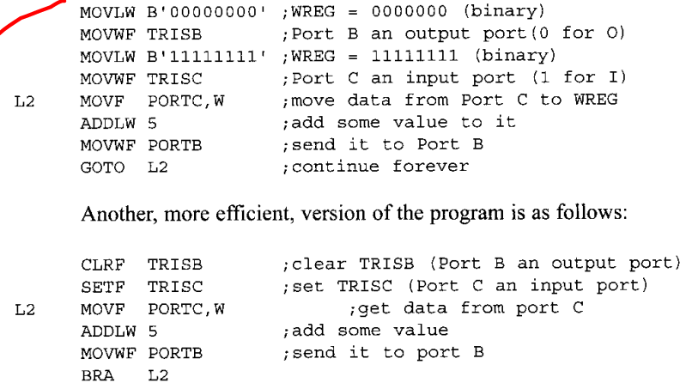

Slide 53
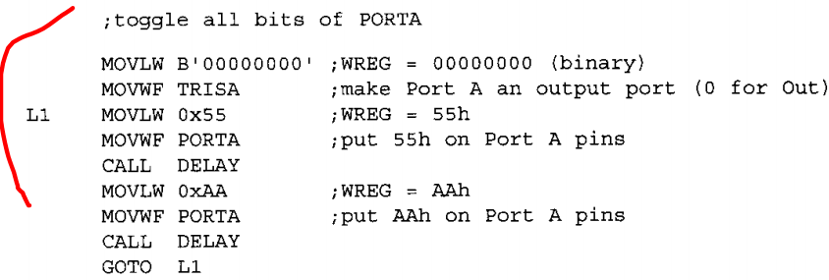
PORT A as OUTPUT

Slide 54
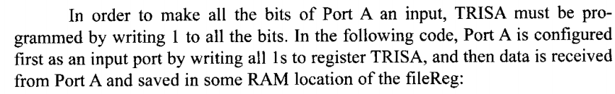
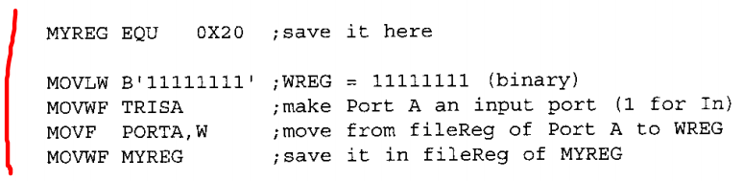
PORT A as INPUT

Slide 55
To make I/O For PORT B,
PORTC, PORTD & PORTE, the same scenario with PORTA

Slide 56
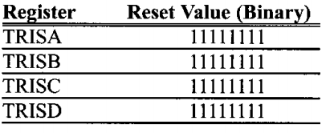
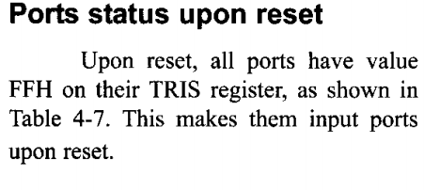

Slide 57
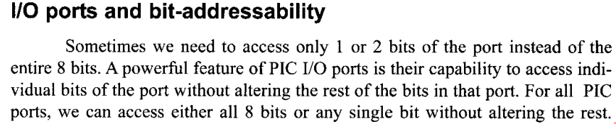
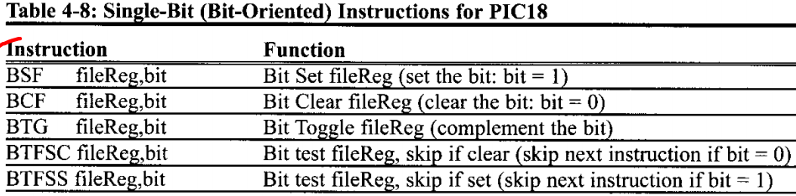
I/O bit manipulation programming

Slide 58
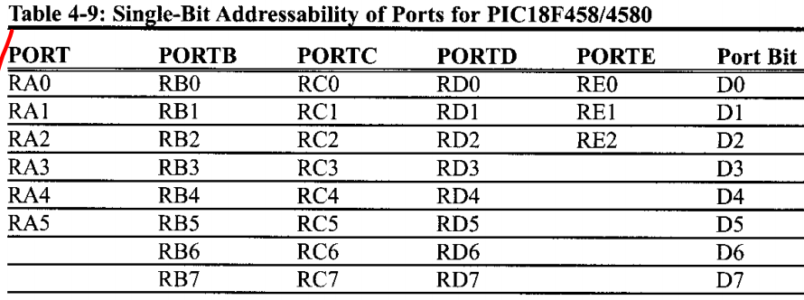
I/O bit manipulation programming

Slide 59
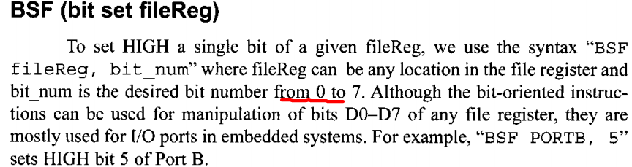
I/O bit manipulation programming

Slide 60
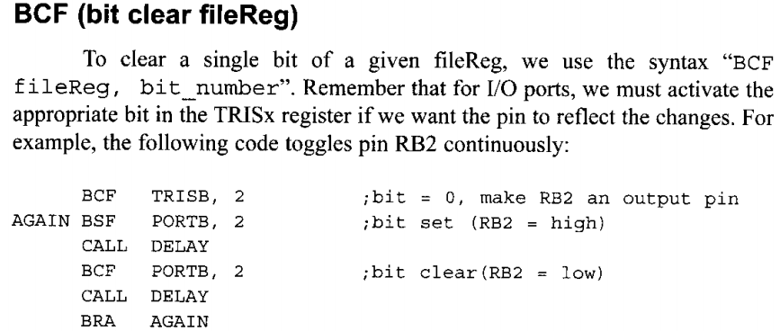
I/O bit manipulation programming

Slide 61
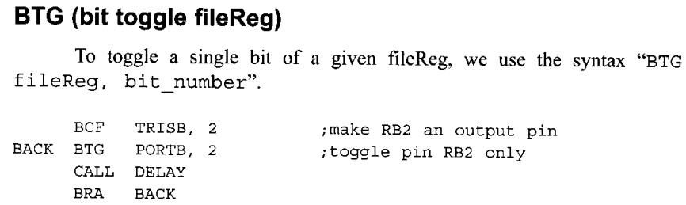
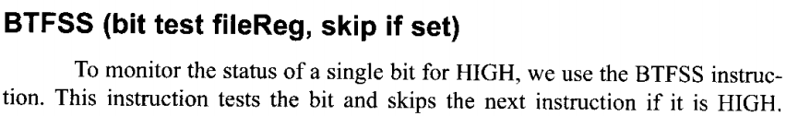
I/O bit manipulation programming

Slide 62
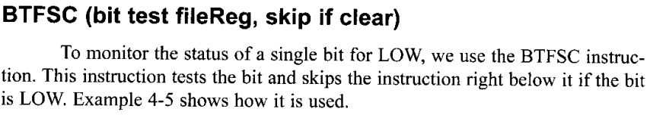
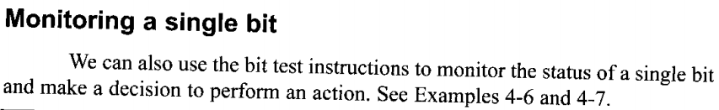
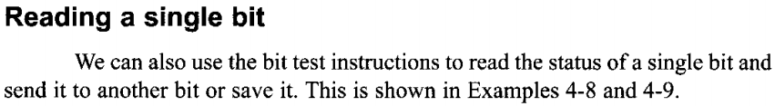
I/O bit manipulation programming

Slide 63
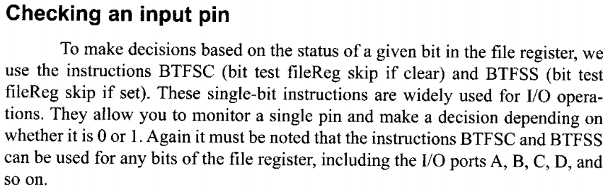
Summary on I/O bit manipulation programming

Slide 64
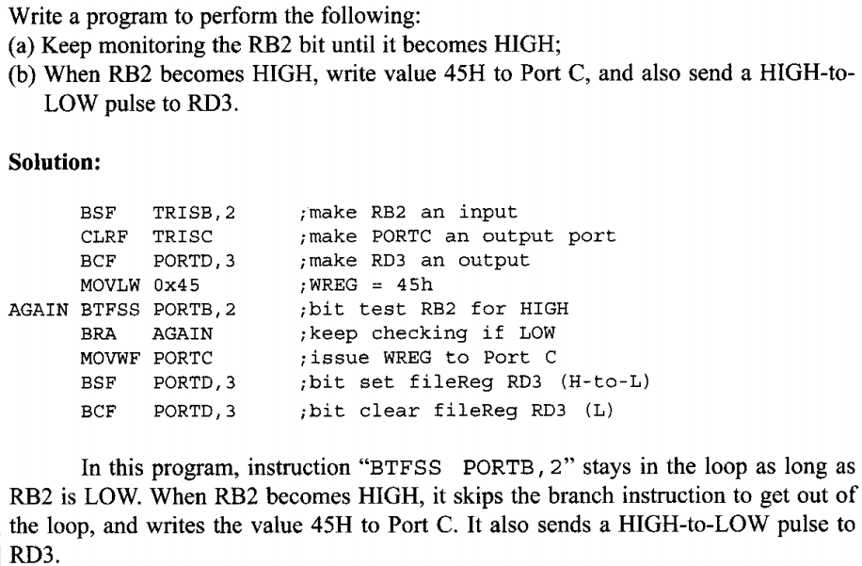

Slide 65

I/O bit manipulation programming

Slide 66

I/O bit manipulation programming

Slide 67


