Slide 1
PIC Interrupts
Contents
Interrupt Vs Polling
Source of Interrupt in PIC18
Interrupt control Registers
Interrupt source bit
Enabling and disabling interrupt
Steps in enabling an interrupt

Slide 2
Interrupt vs polling
A single microcontroller can serve several device
There are to main methods by which several device can receive service from microcontroller
Interrupt
Polling
Interrupt
An interrupt is a signal to the processor emitted by hardware or software indicating an event that needs immediate attention.
A special program to do interrupt is ISR
A place which holds address of ISR is IVT
When interrupt occur the microcontroller first run ISR

Slide 3
Interrupt vs polling
Interrupt may be
Hardware or
Software
Hardware Interrupt A hardware interrupt is an electronic alerting signal sent to the processor from an external device, like:
Keypad
Mouse
Button
Joystick
Switch
Sensors

Slide 4
Interrupt vs polling
Software Interrupt A software interrupt is caused either by an exceptional condition or a special instruction in the instruction set which causes an interrupt when it is executed by the processor. Like:
Processor try to divide a given number by zero
Polling
The state of continuous monitoring of interconnected device (peripherals)
Causes of time consumption

Slide 5
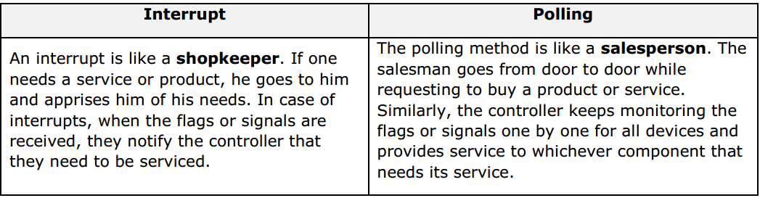
Interrupt vs polling

Slide 6
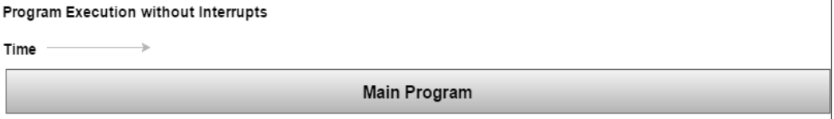
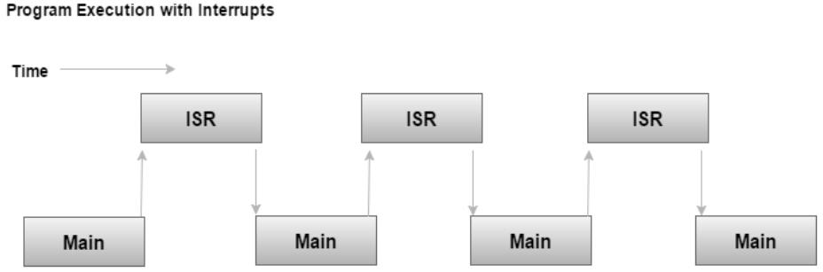
Interrupt vs polling

Slide 7
Interrupt vs polling
When an interrupt is invoked, the microcontroller runs the ISR
Interrupt vector table for PIC18 (ROM location) Power-on reset 0x0000 High priority interrupt 0x0008 Low priority interrupt 0x0018

Slide 8
Steps to execute interrupt
When an interrupt gets active, the microcontroller goes through the following steps:
Finishes executing the current instruction
Pushes the PC of next instruction in the stack
Jumps to the interrupt vector table to get the address of ISR and jumps to it
Begin executing the ISR instructions to the last instruction of ISR (RETFIE)
Executes RETFIE
Pops the PC from the stack
Starts to execute from the address of that PC

Slide 9
Source of interrupt
Timers 0, 1, 2, 3
Pins RB0, RB1, RB2 for external hardware interrupts INT0, INT1, INT2
PORTB-Change interrupt (any one of the upper four Port B pins)
Serial communication’s USART interrupts: receive and transmit, respectively
ADC
CCP

Slide 10
Interrupt control registers
The most common interrupt control register in PIC18 are:
INTCON
INTCON2
INTCON3
PIR1
PIR2
PIR3
PIE1
PIE2
IP1
IP2

Slide 11
Interrupt source bit
In general, interrupt sources have three bits to control their operation. They are:
Flag bit
to indicate that an interrupt event occurred
Enable bit
that allows program execution to branch to the interrupt vector address when the flag bit is set
Priority bit
to select high priority or low priority

Slide 12
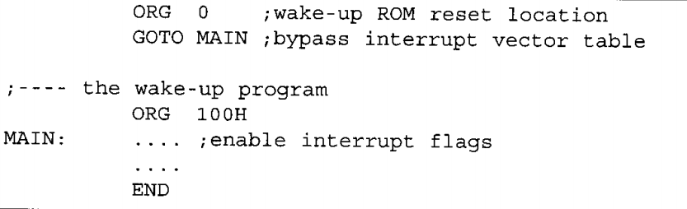

Slide 13
Step 1. Write the service routine ORG 0x08 … ; interrupt service for high priority interrupts RETFIE ORG 0x18 … ; interrupt service for low priority interrupts RETFIE Step p 2. Enable interrupts to be serviced Note: RETFIE perform clearing the GIE flag

Slide 14
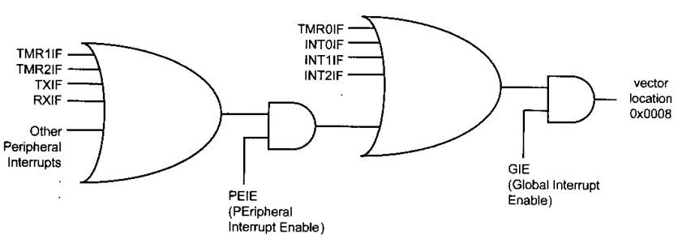
Enable and disable interrupt

Slide 15
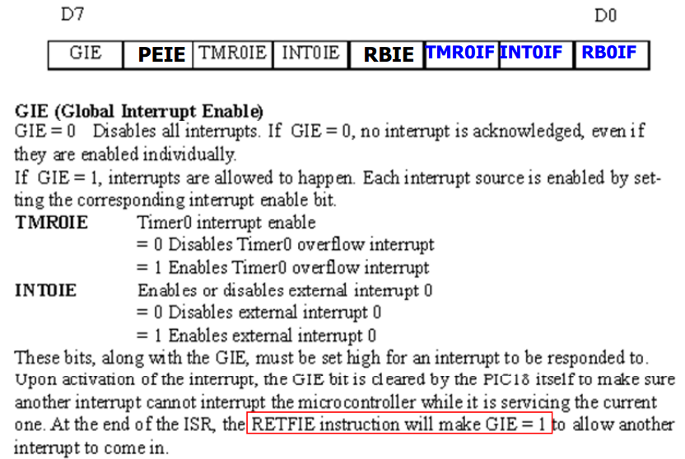
INTCON (interrupt control) Register

Slide 16
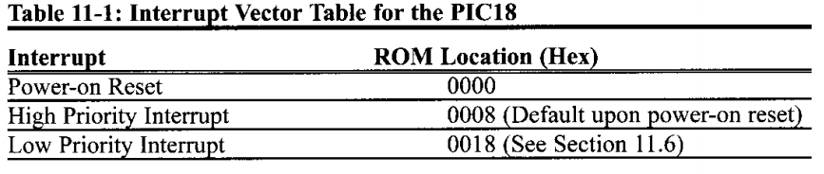
cont…
To enable interrupt we set the following instruction
BSF INTCON, GIE, which is GIE=1
To enable external hardware interrupt we set:
BSF INTCON, PEIE in addition to BSF INTCON, GIE
which is GIE=1 & PEIE=1
To disable interrupt we set the following instruction
BCF INTCON, GIE
To disable external hardware interrupt we set:
BCF INTCON, PEIE in addition to BCF INTCON, GIE

Slide 17
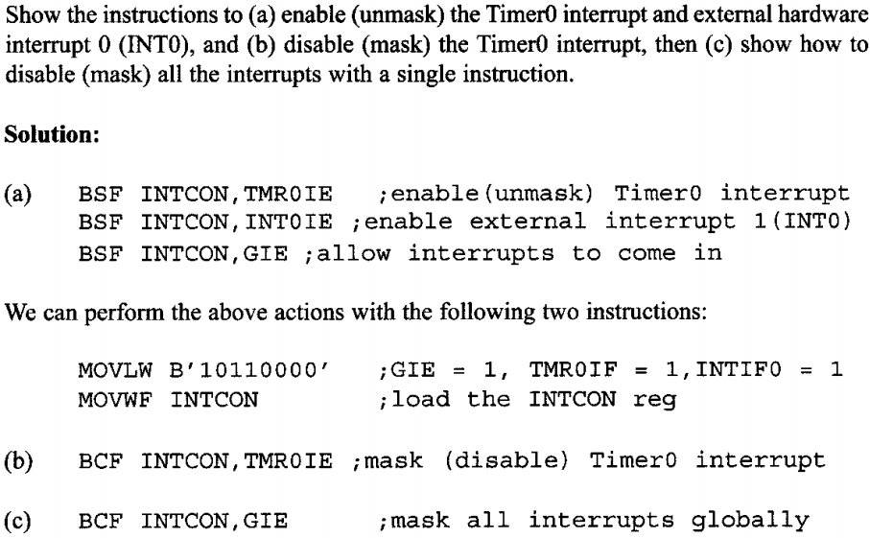
Cont…

Slide 18
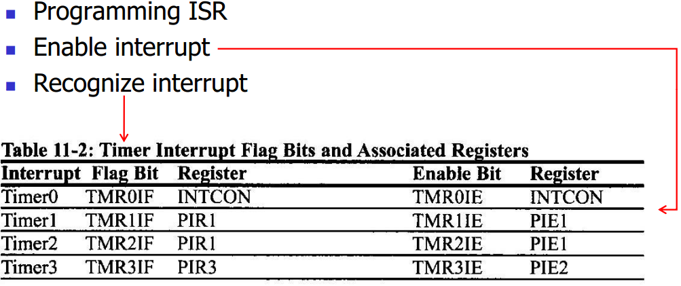
Timer interrupt

Slide 19
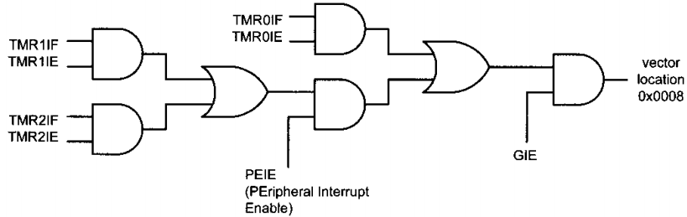
Cont…

Slide 20
Cont…
Check the status of interrupt
BTFSS INTCON, TMR0IF
RETFIE
Enable interrupt
BCF INTCON, TMR0IF ; clear Timer0 interrupt flag BSF T0CON, TMR0ON ; start Timer0 BSF INTCON, TMR0IE ; enable Timer0 interrupt BSF INTCON , GIE ; enable interrupt globally
The end of interrupt
BCF INTCON, TMR0IF ; clear Timer0 interrupt flag RETFIE ; return from interrupt

Slide 21
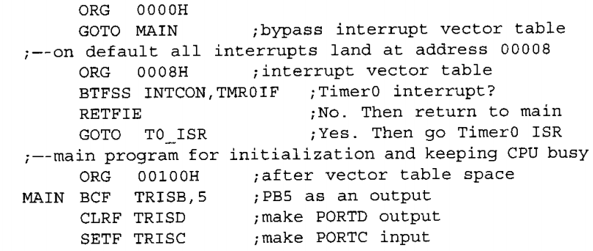
Cont…

Slide 22
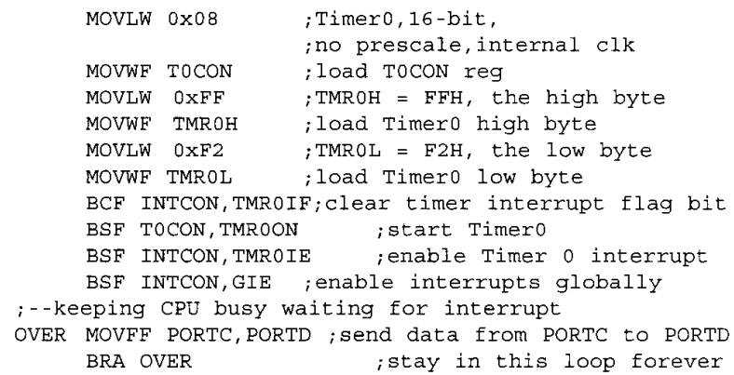
Cont…

Slide 23
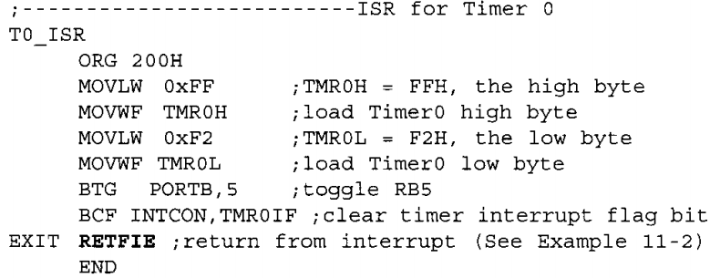
Cont…

Slide 24
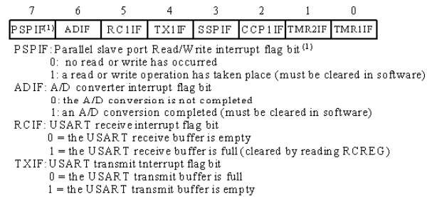
PIR1 (for peripheral interrupt)

Slide 25
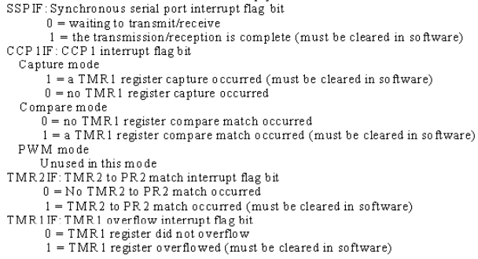
Cont…

Slide 26
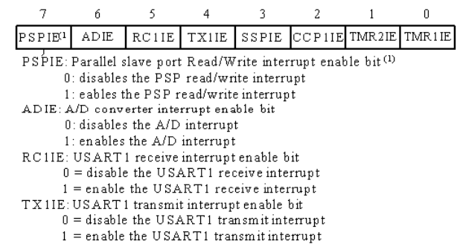
PIE1 (for peripheral interrupt)

Slide 27
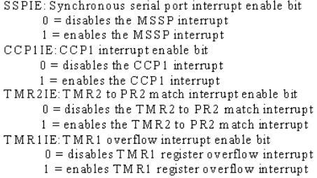
Cont…

Slide 28
Cont…
Example: check weather timer 0 or timer 1 is active
BTFSC INTCON, TMR0IF ; Timer0 interrupt ? BRA timer0 label BTFSC PIR1, TMR1IF ; Timer1 interrupt ? BRA timer1 label BSF INTCON, PEIE ; enable peripheral interrupts RETFIE
Enable interrupt
BSF T0CON, TMR0ON ; start Timer0 BSF T1CON, TMR1ON ; start Timer1 BSF INTCON, TMR0IE ; enable Timer0 interrupt BSF PIE1, TMR1IE ; enable Timer1 interrupt BSF INTCON, PEIE ; enable peripheral interrupts BSF INTCON, GIE ; enable interrupt globally
Quite interrupt
BCF INTCON, TMR0IF ; clear Timer0 interrupt flag
RETFIE BCF PIR1, TMR0IF ; clear Timer0 interrupt flag
RETFIE

Slide 29
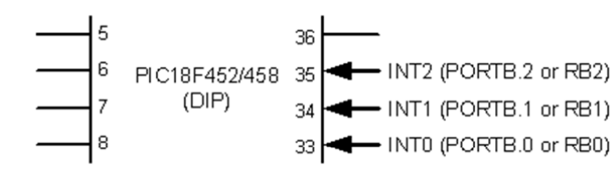
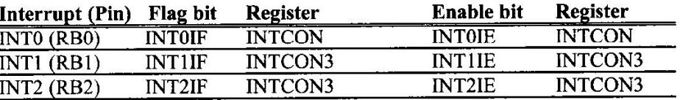
External hardware interrupt
Upon power-on reset, positive edge-triggered interrupts

Slide 30
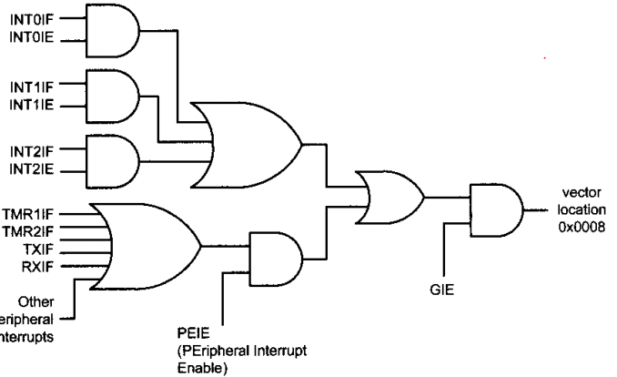
Cont….

Slide 31
Cont…
Check the status of interrupt flage
BTFSS INTCON, INT0IF ; INT0 interrupt ? RETFIE
Enable interrupt
BSF TRISB, INT0 ; INT0 as input pin BCF INTCON, INT0IF ; clear INT0 interrupt flag BSF INTCON, INT0IE ; enable INT0 interrupt BSF INTCON, GIE ; enable interrupt globally
Quit (end of interrupt) BCF INTCON, INT0IF ; clear INT0 interrupt flag
RETFIE

Slide 32
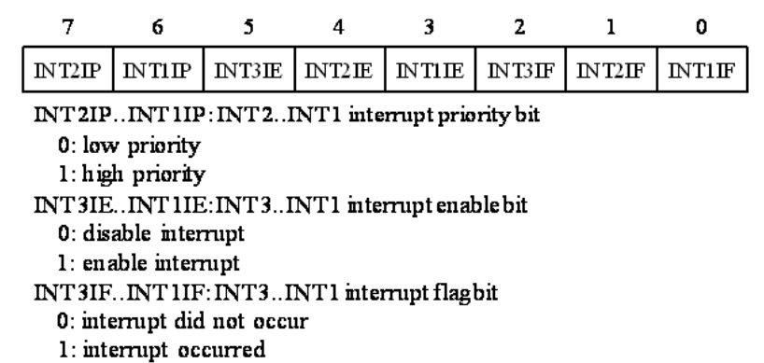
INTCON3

Slide 33
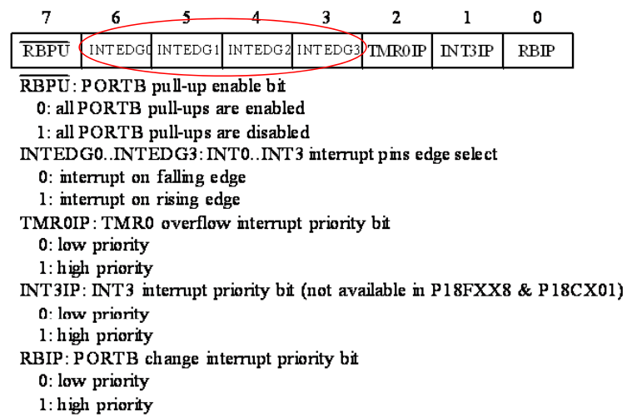
Negative edge interrupt
Configuring INTCON2

Slide 34
Cont…
Check the status of interrupt flage
BTFSS INTCON3, INT1IF ; INT1 interrupt ? RETFIE
Enable interrupt BSF TRISB, INT1 ; INT1 as input pin BCF INTCON3, INT1IF ; clear INT1 interrupt flag BSF INTCON3, INT1IE ; enable INT1 interrupt BCF INTCON2, INTEDG1 ; negative edge-triggered BSF INTCON, GIE ; enable interrupt globally Quit (end of interrupt) BCF INTCON3, INT1IF ; clear INT1 interrupt flag
RETFIE

Slide 35
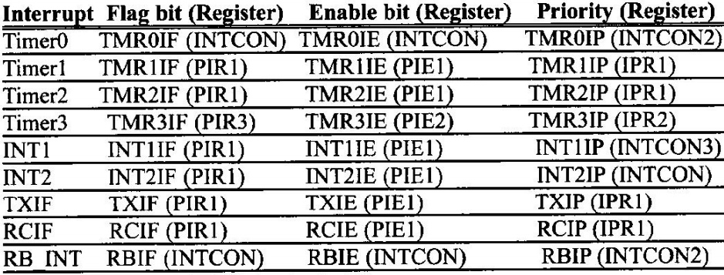

Slide 36

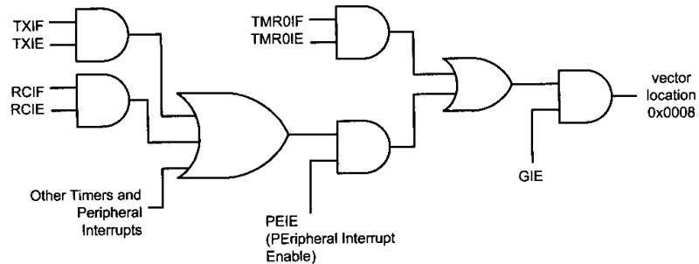
Serial communication interrupt

Slide 37
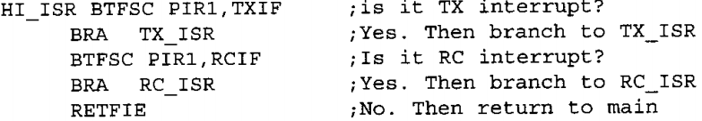
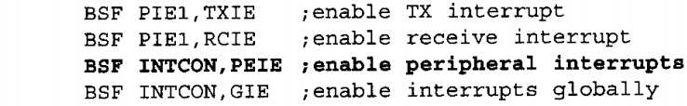
Cont…
Check interrupt status
Enable interrupt

Slide 38
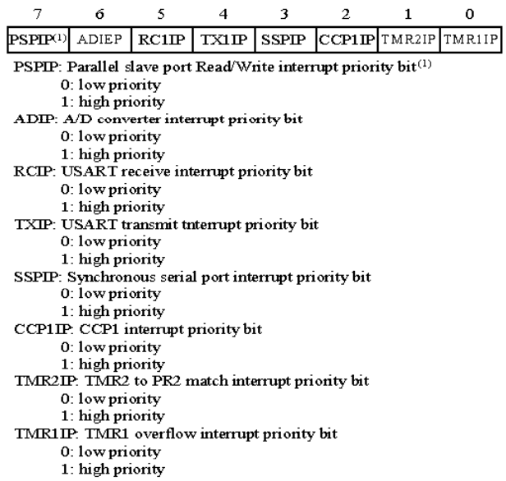
IPR1

Slide 39
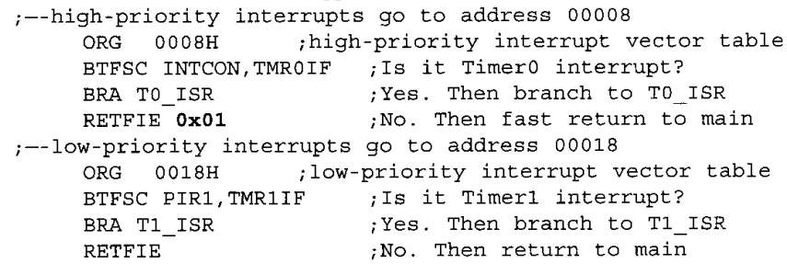
Check (recognize) the status of interrupt flage

Slide 40
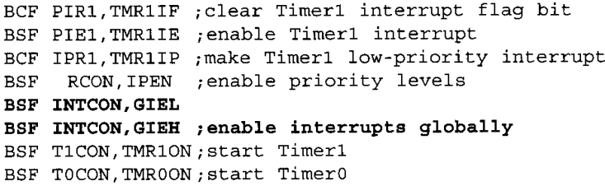
Enable interrupt
Quit interrupt

Slide 41
End

