Slide 1
High level design
You can view software development as a process that chops up the system into smaller and smaller pieces until the pieces are small enough to implement.
Using that viewpoint, high‐level design is the first step in the chopping up process.
High‐level design provides a view of the system at an abstract level. It shows how the major pieces of the finished application will fit together and interact with each other.
UML (Unified Modelling Language)
It defines several kinds of diagrams that you can use to represent different pieces of the system.

Slide 2
High level design
Some of UML are
There are many UML diagram. Some of this are
Structure diagram
Class Diagram Composite Structure Diagram Component Diagram Deployment Diagram Object Diagram Package Diagram Profile Diagram
Behaviour diagram
Activity Diagram Use Case Diagram State Machine Diagram Interaction Diagram
Interaction diagram
Sequence Diagram Communication Diagram Interaction Overview Diagram Timing Diagram

Slide 3
High level design
Structure diagram
A structure diagram describes things that will be in the system you are designing.
For example, the class diagram (one type of structure diagram) shows relationships among the classes that will represent objects in the system such as inventory items, vehicles, expense reports, and coffee requisition forms.
Interaction diagram
Interaction diagrams are a subset of activity diagrams.
They include sequence diagrams, communication diagrams, timing diagrams, and interaction overview diagrams.

Slide 4
High level design
ER (entity relationship) diagram
ER model, also called an entity-relationship (ER) diagram
it is a graphical representation of entities and their relationships to each other
typically used in computing in regard to the organization of data within databases or information systems.
An entity relationship diagram (ERD) shows the relationships of entity sets stored in a database.
An entity in this context is a component of data or concept about which data is stored.

Slide 5
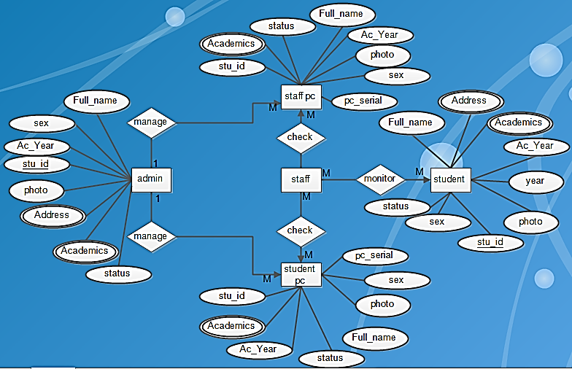
High level design
ER diagram for
Outgoing PC
Control system

Slide 6
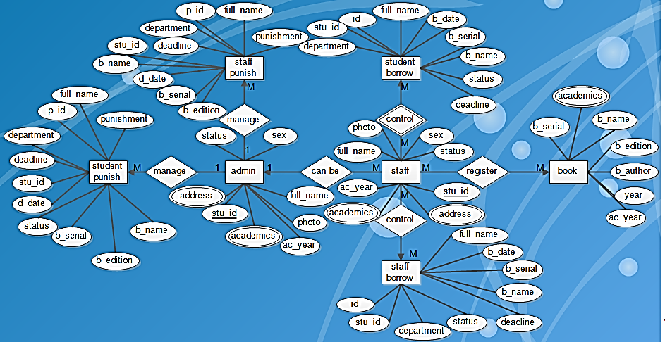
High level design
ER diagram for
Library book
Borrowing
system

Slide 7
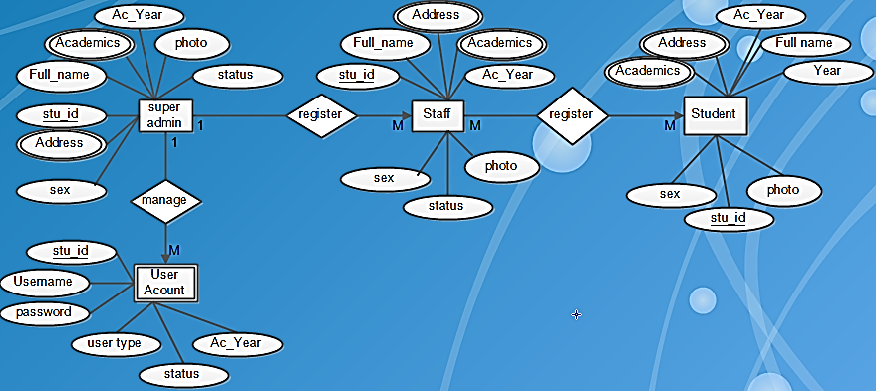
High level design
ER diagram for
User registration
ethiomisgie@gmail.com | Youtube: ethioptech | www.project.ethioptec.com

Slide 8
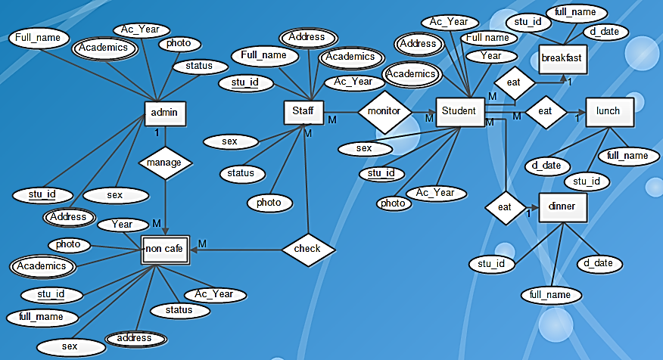
High level design
ER diagram for
Meal attendance
system
ethiomisgie@gmail.com | Youtube: ethioptech | www.project.ethioptec.com

Slide 9
High level design
ER diagram for
Outgoing PC
Control at the
Gateway of
Private or
Governmental
Organization.
ethiomisgie@gmail.com | Youtube: ethioptech | www.project.ethioptec.com

Slide 10
High level design
Use case diagram
A use case diagram represents a user’s interaction with the system.
Use case diagrams show stick figures representing actors (someone or something that performs a task) connected to tasks represented by ellipses.
To provide more detail, you can use arrows to join subtasks to tasks.
Use the annotation <<include>> to mean the task includes the subtask.
ethiomisgie@gmail.com | Youtube: ethioptech | www.project.ethioptec.com

Slide 11
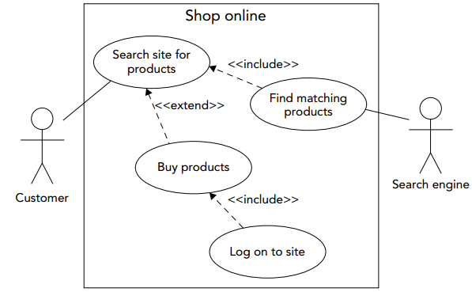
High level design
Use case diagram
If a subtask might occur only under some circumstances, connect it to the main task and add the annotation <<extend>>.
If you like, you can add a note indicating when the extension occurs. (Usually both <<include>> and <<extend>> arrows are dashed.)
ethiomisgie@gmail.com | Youtube: ethioptech | www.project.ethioptec.com

Slide 12
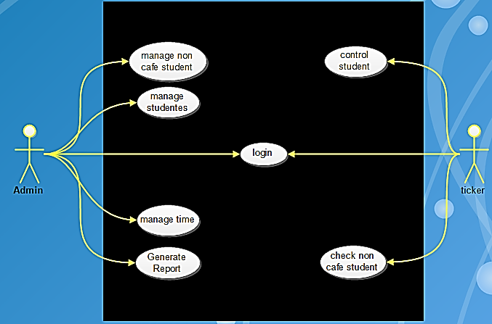
High level design
Use case diagram
Sample use case diagram
For meal attendance system
ethiomisgie@gmail.com | Youtube: ethioptech | www.project.ethioptec.com

Slide 13
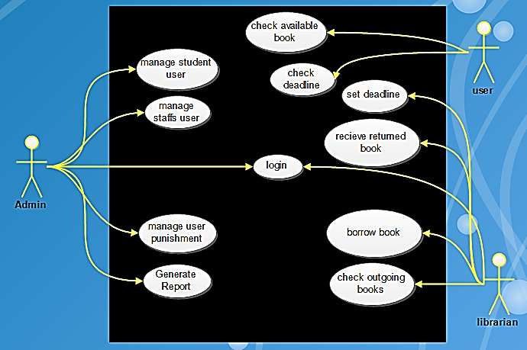
High level design
Use case diagram
Sample use case diagram
For book borrowing system
ethiomisgie@gmail.com | Youtube: ethioptech | www.project.ethioptec.com

Slide 14
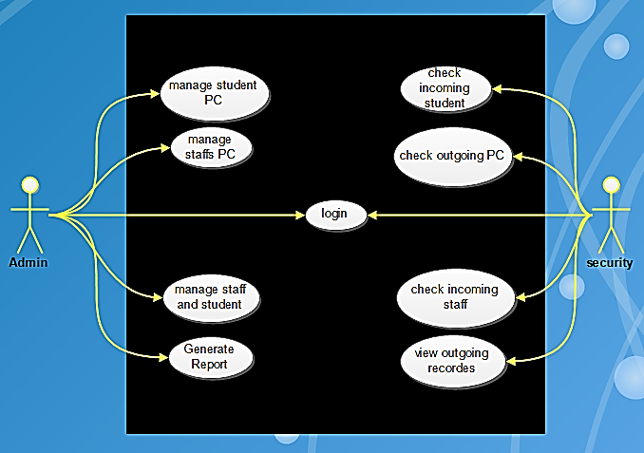
High level design
Use case diagram
Sample use case diagram
For outgoing
PC control system
At the gatway
ethiomisgie@gmail.com | Youtube: ethioptech | www.project.ethioptec.com

Slide 15
High level design
Sequence diagram
A sequence diagram shows how objects collaborate in a particular scenario.
It represents the collaboration as a sequence of messages.
Objects participating in the collaboration are represented as rectangles or sometimes as stick figures for actors. They are labelled with a name or class.
If the label includes both a name and class, they are separated by a colon.
Below each of the participants is a vertical dashed line called a lifeline. The lifeline basically represents the participant sitting there waiting for something to happen
ethiomisgie@gmail.com | Youtube: ethioptech | www.project.ethioptec.com

Slide 16
High level design
An execution specification (called an execution or informally an activation) represents a participant doing something.
In the diagram, these are represented as gray or white rectangles drawn on top of the lifeline.
You can draw overlapping rectangles to represent overlapping executions.
Labelled arrows with solid arrowheads represent synchronous messages.
Arrows with open arrowheads represent asynchronous messages.
Finally, dashed arrows with open arrowheads represent return messages sent in reply to a calling message.
ethiomisgie@gmail.com | Youtube: ethioptech | www.project.ethioptec.com

Slide 17
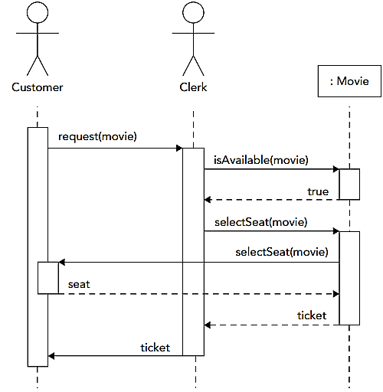
High level design
A customer, a clerk, and the Movie class interacting to print a ticket for a movie.
The customer walks up to the ticket window and requests the movie from the clerk.
The clerk uses a computer to ask the Movie class whether tickets are available for the desired show.
The Movie class responds.
ethiomisgie@gmail.com | Youtube: ethioptech | www.project.ethioptec.com

Slide 18
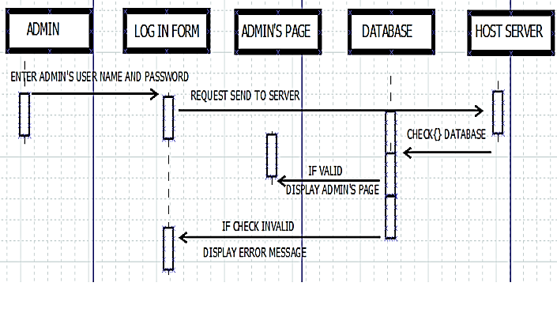
High level design
Sample Sequence diagram
for Login system
ethiomisgie@gmail.com | Youtube: ethioptech | www.project.ethioptec.com

Slide 19
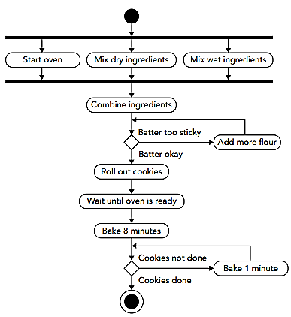
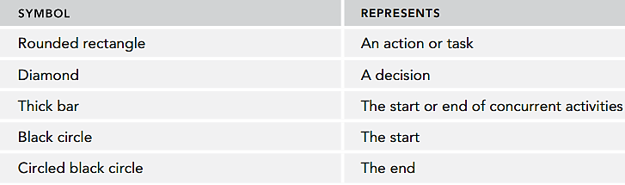
High level design
Activity diagram
An activity diagram represents work flows for activities. They include several kinds of symbols connected with arrows to show the direction of the work flow.
ethiomisgie@gmail.com | Youtube: ethioptech | www.project.ethioptec.com

Slide 20
Review exercises
5. Suppose you want to design student attendance system.
The system will have student registration page to register login detail in tbl_users and student and instructors detail information in tbl_student and tbl_instructors respectively.
The system will also have attendance page to take attendance that will be stored in tbl_attendance.
User ID is primary key in tbl_users and foreign key in tbl_student. User ID also primary key in tbl_users and foreign key in tbl_instructor.
The id in tbl_student and tbl_instructor is primary key in this table and foreign key in tbl_attendance and tbl_instructor.
Student can mark their attendance using take attendance page.
Instructor can view the absent, present and late student using view report page.
Instructor can also mark students’ attendance, update and delete students from attendance list.
The system enables Both student and instructor to login into the system. Both can change their login credentials.
ethiomisgie@gmail.com | Youtube: ethioptech | www.project.ethioptec.com

Slide 21
Review exercises
The system will allow students and instructors to access student and instructor page respectively if their username and password provided on login page are correct. If the login password and username are incorrect, the system will redirect the instructor or students to login page.
Draw the following high-level diagram for this system.
    Block diagram of the system (the project).
    ER diagram
    Use case diagram and
    sequence diagram.
ethiomisgie@gmail.com | Youtube: ethioptech | www.project.ethioptec.com

Slide 22
Review exercises
Hints for question 5
tbl_users will have user id, student and instructor first name, username and password
tbl_student will have ID as primary key, user id as foreign key, student, first, second and last name
tbl_instructor will have ID as primary key, user id as foreign key, instructor, first, second and last name
tbl_attendance will have ID as foreign key, student first name, second name and last name, absent, present and late, date of attendance columns.
Remember
ID is primary key in tbl_student and foreign key in tbl_attendance.
ethiomisgie@gmail.com | Youtube: ethioptech | www.project.ethioptec.com

Slide 23
Review exercises
6. Suppose you want to design illegal transport service reporting system.
The system will have the following GUI
passengers sign up page
Car, owner and driver detail registration
Traffic police registration
Login page
The system enables the admin login to the system and manipulate the following activities
Car, owner and driver registration, modification and deletion
Traffic police registration, registration, modification and deletion
Monitoring illegal service reports received from passengers or traffic polices
ethiomisgie@gmail.com | Youtube: ethioptech | www.project.ethioptec.com

Slide 24
Review exercises
The system enables the passengers to do the following activities
Sign up to the system
Login to the system
Access car and owner detail
Report if there occur incident (illegal service )
The system will enable the active traffic police to do the following tasks.
Login to the system
View the reported incident by the passengers
Track the care that the reported incidents are occurred
ethiomisgie@gmail.com | Youtube: ethioptech | www.project.ethioptec.com

Slide 25
Review exercises
The system will have the following tables in the database
Tbl_users
Tbl_passangers
Tbl_cars
Tbl_owners
Tbl_drivers
Tbl_trafficpolice
Tbl_incident
Tbl_admin
ethiomisgie@gmail.com | Youtube: ethioptech | www.project.ethioptec.com

Slide 26
Review exercises
Tbl_users table will have columns of user_id, username and password.
The user_id is the foreign key that relates
the tbl_passangers using passanger_id. passanger_id in tbl_passangers is the primary key. But in tbl_users, it is a foreign key found as user_id.
the tbl_drivers using driver_id. driver_id in tbl_drivers is the primary key. But in tbl_users, it is a foreign key found as user_id.
the tbl_owners using owner_id. owner_id in tbl_owners is the primary key. But in tbl_users, it is a foreign key found as user_id.
the tbl_trafficpolice using trafficpolice_id. trafficpolice_id in tbl_ trafficpolice is the primary key. But in tbl_users, it is a foreign key found as user_id.
ethiomisgie@gmail.com | Youtube: ethioptech | www.project.ethioptec.com

Slide 27
Review exercises
Tbl_passangers will have columns of passangers_id as primary key, full_name, mobile_number.
Tbl_care will have columns of car_id, owner_id, driver_id and type. Owner_id is foreign key to relate tbl_car with tbl_owner. Driver_id is also foreign key to relate tbl_car with tbl_driver.
Tbl_ownres will have columns of owner_id as primary key, full_name, mobile_number.
Tbl_driver will have columns of driver_id as primary key, full_name, mobile_number
Tbl_trafficpolice will have columns of trafficpolice_id, full_name, mobile_number
Tbl_admin will have colomuns of admin_id, full_name, mobile_number
Tbl_incident will have columns of incident_id as primary key, car_id as foreign key, incident_type, incident_description, incident_date, departure_city, arrival_city.
ethiomisgie@gmail.com | Youtube: ethioptech | www.project.ethioptec.com

Slide 28
Review exercises
Draw the following high-level diagram for this system.
    Block diagram of the system (the project).
    ER diagram
    Use case diagram and
    sequence diagram.
The system will allow passengers, admin, traffic and driver to access their respective page if their username and password provided on login page are correct. If the login password and username are incorrect, the system will redirect the passengers, drivers, owners, traffic polices or admins to login page.
ethiomisgie@gmail.com | Youtube: ethioptech | www.project.ethioptec.com

Slide 29
Review exercises
7. Suppose you want to design Library book borrowing system.
The system will have the following pages
Library admin page
Book registration and borrowing page
Student page
Lecturer page
Report viewing and preparation page
ethiomisgie@gmail.com | Youtube: ethioptech | www.project.ethioptec.com

Slide 30
Review exercises
Library admin can do the following activities
Login to the system
Register, update, and delete student data
Register, update, and delete lecturer data
Register, update, and delete book data
View and prepare reports
Make student and lecturers lend book
Student and lecturer can do the following tasks
View available books in the library, view deadline (the date that the book to be returned)
Reserve books and lend
ethiomisgie@gmail.com | Youtube: ethioptech | www.project.ethioptec.com

Slide 31
Review exercises
The system will have the following tables
Tbl_users
Tbl_students
Tbl_lecturer
Tbl_admin
Tbl_book
Tbl_borrow
Tbl_return
Tbl_users will have id as primary key, user_id, username and password. User_id is the foreign key that relates tbl_users with
Tbl_students that has colomns of student_id as primary key, full_name, department and phon_number. Student_id is user_id in tbl_users.
Tbl_lecturer that has colomns of leturer_id as primary key, full_name, department and phone_number. lecturer_id is user_id in tbl_users.
Tbl_admin that has colomns of admin_id as primary key, full_name and phone_number. admin_id is user_id in tbl_users.
ethiomisgie@gmail.com | Youtube: ethioptech | www.project.ethioptec.com

Slide 32
Review exercises
Tbl_book will have book_id, name, autor_name, edition, department, target_year. Book_id is primary key.
Tbl_borrow will have id as primary key, borrowing_id as foreign key, book_id as foreign key, borrowing_date, deadline. Borrowing_id used to relate tbl_borrow with tbl_student or tbl_lecturer. That means borrowing_id may be student_id or lecturer_id. Book_id used to relate tbl_borrow with tbl_book.
Tbl_return will have id as a primary key, borrowing_id as foreign key, book_id as foreign key. Borrowing_id used to relate tbl_return with tbl_student or tbl_lecturer. That means borrowing_id may be student_id or lecturer_id. Book_id used to relate tbl_borrow with tbl_book.
ethiomisgie@gmail.com | Youtube: ethioptech | www.project.ethioptec.com

Slide 33
Review exercises
Draw the following high-level diagram for this system.
    Block diagram of the system (the project).
    ER diagram
    Use case diagram and
    sequence diagram.
The system will allow students, lecturers and admin to access their respective page if their username and password provided on login page are correct. If the login password and username are incorrect, the system will redirect the instructor, students or admin to login page.
ethiomisgie@gmail.com | Youtube: ethioptech | www.project.ethioptec.com

Slide 34
Review exercises
8. Let you are going to develop e-commerce
The system will have the following pages
Product page to display the product.
Cart page to display the selected product to be purchased.
Payment page that makes the purchaser pay for the selected products available in the cart.
Confirmation page to check whether the payments of ordered products are completed or not.
Login page to enable customer and seller login to the system
ethiomisgie@gmail.com | Youtube: ethioptech | www.project.ethioptec.com

Slide 35
Review exercises
The system will have the following functionalities
It enable seller to post products on the system, update posts and delete posts
The system enable the customer to view products, add to cart, pay for the added product in cart and track the ordered products.
Thes system will have the following tables in the database
Tbl_users that has columns of id as primary key, user_id as foreign key, username and password. User_id used to relate tbl_seller and tbl_customer. Seller_id from tbl_sell and customer_id from tbl_customer will be taken as user_id in tbl_user
Tbl_seller that has columns of seller_id as primary key, full_name, email and phone_number, bank_account.
ethiomisgie@gmail.com | Youtube: ethioptech | www.project.ethioptec.com

Slide 36
Review exercises
Tbl_customer will have columns of customer_id as primary key, full_name, phone_number, bank_account.
Tbl_product will have columns of product_id as primary key, name, brand_name, product_category, price.
Tbl_cart will have columns of cart_id as primary key, product_id as foreign key, customer_id as foreign key, quanity, total_price. Product_id and customer_id are used to relate tbl_cart with tbl_product and tbl_customer respectively.
Tbl_payment will have columns of payment_id as primary key, cart_id as foreign key, paymet_status.
Cart_id will used to relate tbl_payment with tbl_cart.
This helps to know who purchased the product, what is the quaintly of purchased product and cross checke whether the payment is completed or not.
ethiomisgie@gmail.com | Youtube: ethioptech | www.project.ethioptec.com

Slide 37
Review exercises
Draw the following high-level diagram for this system.
    Block diagram of the system (the project).
    ER diagram
    Use case diagram and
    sequence diagram.
The system will allow seller and customer to access their respective page if their username and password provided on login page are correct. If the login password and username are incorrect, the system will redirect the seller or customer to login page.
ethiomisgie@gmail.com | Youtube: ethioptech | www.project.ethioptec.com

Slide 38
Review exercises
9. Let you want to design patient appointment and follow up system that will have the following pages and functionalities
Pages
Login page
Patients page
Admin page:
Doctors page
Recorder page and
Pharmacist page
ethiomisgie@gmail.com | Youtube: ethioptech | www.project.ethioptec.com

Slide 39
Review exercises
Users of the system
Patients
Patients can do the following activities
View their treatment history including type of disease they encountered and respective remedial drugs
View appointment date
Report symptoms if necessary
Doctors
Doctors can view the reported symptoms from the patients and give appointment for next follow up.
Register patient history and order appropriate laboratory test and medicine (drug)
ethiomisgie@gmail.com | Youtube: ethioptech | www.project.ethioptec.com

Slide 40
Review exercises
Recorder
Recorder can register patient information including record number
Pharmacist
Pharmacist can view the patient history settled by doctor
According to the history, the pharmacist will give drug for the patient
ethiomisgie@gmail.com | Youtube: ethioptech | www.project.ethioptec.com

Slide 41
Review exercises
the system will have the following tables
Tbl_users: has id, user_id, username and password columns
Tbl_patients: has p_id, full name, address, age and gender columns
Tbl_doctors: has d_id, full name and specialization columns
Tbl_pharmacist: has pha_id, full name and specialization columns
Tbl_recorder: has r_id, full name
Tbl_p_history: has id, patient_id, doctor_id, disease, ordered drug and utilization instruction columns
Tbl_appointment : has id, patient_id, doctor_id and date
ethiomisgie@gmail.com | Youtube: ethioptech | www.project.ethioptec.com

Slide 42
Review exercises
user_id in tbl_users area foreign key that relate this table with tbl_ptients, tbl_doctors,tbl_pharmacist and tbl_recordor. User_id in tbl_users are p_id, d_id,pha_id,r_id that are primary key of tbl_patients, tbl_doctors, tbl_pharmacist and tbl_recordors respectively.
Patient_id and doctor_id in tbl_history are foreign keys that relate this table with tbl_patient and tbl_doctor respectively. Patient_id and doctor_id are p_id and d_id that are primary keys in tbl_patients and tbl_doctors. This relation are required to know which patient history is recorded by whom doctor and which patient history is belongs to whom patients.
Patient_id and doctor_id in tbl_apoinment are foreign keys that relate this table with tbl_patient and tbl_doctor respectively. Patient_id and doctor_id are p_id and d_id that are primary keys in tbl_patients and tbl_doctors. This relation is required to know what patients are appointed by whom doctor.
ethiomisgie@gmail.com | Youtube: ethioptech | www.project.ethioptec.com

Slide 43
Review exercises
Draw the following high-level diagram for this system.
    Block diagram of the system (the project).
    ER diagram
    Use case diagram and
    sequence diagram.
The system will allow admin, doctors, recorders, pharmacist and patients to access their respective page if their username and password provided on login page are correct. If the login password and username are incorrect, the system will redirect to their respective login page.
ethiomisgie@gmail.com | Youtube: ethioptech | www.project.ethioptec.com

